Slide 1
Orchestration of multi-process applications
Notes:
This is big topic and we will be convering aspects that we thought are key or releveant. Given relative novelty, we will be going over these points from different angles (so hold your questions)

Slide 2
Problem setup
Batch-oriented solution for larger applications within GS (Procmon) is widely used
Procmon tenet is that data passing between processes is developers responsibility
Procmon jobs are triggered by process exit codes
Procmon team prides itself in beating Airflow
Many of our applications (current and future) can be thought of as multi-process entities…
… and we expect that exiting monolithic Slang scripts will be refactored into orchestrated multi-language processes exchanging data
We propose to make a clear distinction between top-level application-like entries and procmon, and application internal mechanics/orchestration.
Splitting a single procmon application into 30 procmon applications is not necessarily the only option.
There are 10+ orchestration solutions out there, we chose one of them primarily for illustration purposes.
Notes:
Interseting ly, there is an internal orchestration effort underway in Singapore, next to procmon team. They want to build orchestaration and data exchange on top procmon.

Slide 3
Takeaway from the demo (expected)
Desing of components does not need to be batch-oriented
Differentiate btween process interface and process artifacts
Failure/error handling/resilience provided by orchestrator
What the orchestrator is not
Replacement to procmon (it complements procomon)
Replacement to Kubernetes (it complements k8s)
The choice of temporal.io used in this demo is not random
10 years on development
Originally developed and used at Uber
Support for event-driven workflows
Praised for mid-scale projects
What the demo purpose is not
Sales pitch for temporal.ai specifically
However all aspects of the demo will need to be repeated for other candidates.

Slide 4
Multi-criterial choice
product | DAG creation | languages | trigggering
Procmon
K8S
Airflow
Prefect
Temporal (Uber)
Orcas (Netflix)

Slide 5
What do you get
Durable execution ™
Recovery from resource failure
“Checkpoints” of calculation for resets / reruns
Rerunning failed step
Rerunning whole workflow starting from the failed step
Transactional maintenance of the state of execution
Framework for remote function calls
Language independent inter-process data exchange emulating a function call
Smaller (~1MB) passed directly
Larger sets passed via storage
Defining dependency structure as code
Multi-language (Python, Java, Go, etc)
Monitoring via GUI
(not coverd today) no waiting for a sub-process to finish to launch the next
Heartbeats and signaling
Notes:
Durable aka reentrant

Slide 6
Prerequisites
Organize logic into
“workflow” – definition of the order and and dependency of subprocesses (‘activities’)
Workflows can be nested
“activities” – services handling “workflow” requests
Activities and workflows can be running on different machines and implemented in different languages
Workflow implemenetion must satisfy certain rules
Reproducibility of “workflow” jobs
No “random” (fixed seed)
No real time
Infrastructure running in the background
Temporal server(s)
Similar to kafka broker or procmon server
Workflow worker – process ready to run a workflow (your code)
Activity workers – processes ready to run an activity (your code)
Similar to kafka consumers/producers
Notes:
The notions will be come more clear from concrete examples
Activities can be time-dependent and return different results when run later.

Slide 7
Processes involved (simplified)
Launcher
1
6
Workflow1 worker
@workflow
activity1()
activity2()
2
5
3
4
Activity1 worker
Activity2 worker
Notes:
Lauchers can be as simple as a command like tool. Their only purpose is to send a message to temporal server. At least if it does not have to wait for return.

Slide 8
Processes involved
Launcher
1
“done”
Temporal Server
Workflow Queue
Activity Queue
2
3
5
Workflow1 worker
4
Activity1 worker
Activity2 worker
Notes:
Workers are not aware of each other. Workflow and Activity workers exchange messages with temporal server.
We will see that what looks like a function call in code is actually a message with instructions for worker (or results from worker)

Slide 9
Processes involved
Launcher1
(backtest)
Launcher2
(Factor Gen)
Temporal Server
Workflow Queue
Activity Queue
Workflow1
Worker
Workflow2
worker
Activity1 used by WF1
Activity2
used by WF2
Activity3
shared WF1|WF2
Notes:
Multiple activities (“remote functions”) per activitity workder. Same for WF workers.
Multiple workers can serve same activity for load balancing and throughpyt.
Same activity can be shared by mulltple workflows.

Slide 10
Orchestration demo
mockup of a backtester.
Load universe
Load pricing data
Compute returns
Load risk matrix
Run multiple flavors of backtests
Run attribution reports on multiple results.
Scenarios
Happy path
Broken activity ➔ fix activity
Broken workflow ➔ reset workflow

Slide 11
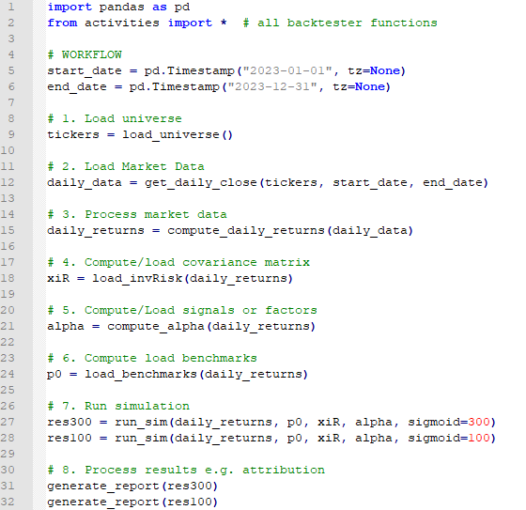
Original python script
Sequential activities
Potentially concurrent activities

Slide 12
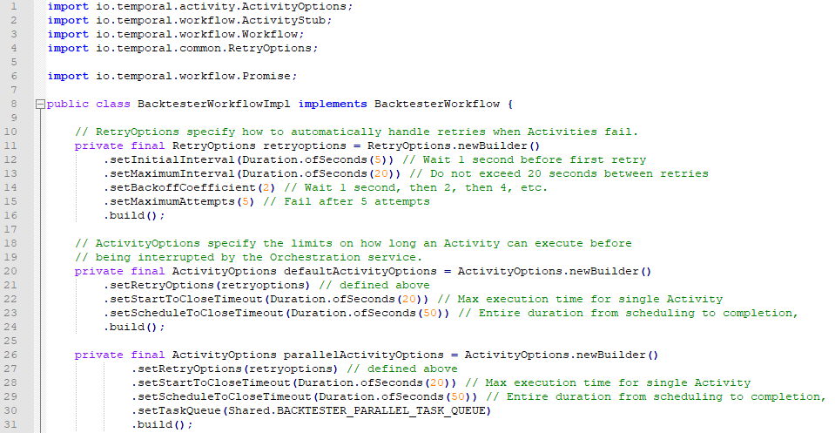
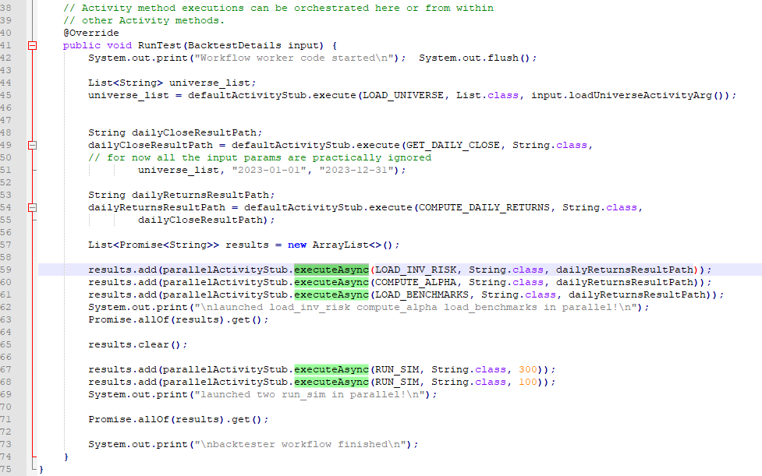
temporal.io decoration from end-user point of view
Workflow configuration: timeouts, retries, heartbeats
Sequential activities (execute)
concurrent activities (executeAsync)
Notes:
Don’t squint I’ll zoom in in a second. Just notice the standard header on top, and a code block I will be zooming into. Just to reiterate, these are NOT function calls, but messages to temporal passing workers to temporal to find activity workers and pass arguments to them.

Slide 13
Sequential activities (execute)
concurrent activities (executeAsync)
Notes:
Don’t squint I’ll zoom in in a second. Just notice the standard header on top, and a code block I will be zooming into. Just to reiterate, these are NOT function calls, but messages to temporal passing workers to temporal to find activity workers and pass arguments to them.

Slide 14
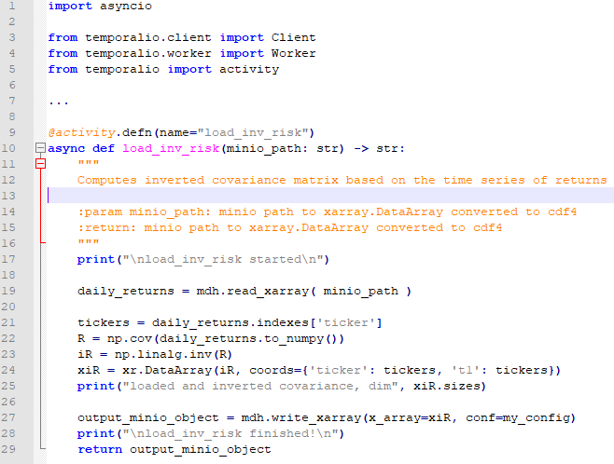
temporal.io decoration from end-user point of view
Transparently supported:
list, map, array
Notes:
One of the functions in activities. Note my python function did not change save imports and decorators.
MiniIO is an S3-compatible storage one can easily spin off.

Slide 15
Takeaway from the demo
Temporal.io is one example of orchestration we use for illustration
There are multiple well developed choices
Exploring any one of them would involve a similar excercise
Design of components does not need to be batch-oriented
Need to differentiate between process interface and process artifacts
Failure/error handling/resilience provided by orchestrator
Notes:
A lot of useful functionalities
Planning and architecture needs to be taken seriously. Avoiding tech debt (e.g. GRM), using good tools ➔ maintainalbility

Slide 16
Roles and players
Worklow.py
import temporal
@workflow
def LCx2(filename):
@activity

Slide 17
Use cases
Returns loader
Backtesting
Optmization-as-a-service

