Slide 1
Orchestration of multi-process applications

Slide 2
Problem setup
Batch-oriented solution for larger applications within GS (Procmon) is widely used
Procmon tenet is that data passing between processes is developers responsibility
Procmon jobs are triggered by process exit codes
Procmon team prides itself in beating Airflow
Many of our applications (current and future) can be thought of as multi-process entities…
… and we expect that exiting monolithic Slang scripts will be refactored into orchestrated multi-language processes exchanging data
We propose to make a clear distinction between top-level application-like entries and procmon, and application internal mechanics/orchestration.
Splitting a single procmon application into 30 procmon applications is not necessarily the only option.
There are 10+ orchestration solutions out there, we chose one of the primarily for illustration purposes.

Slide 3
What the orchestrator is not
Replacement to procmon (complements it)
Replacement to Kubernetes (complements it)
What the demo purpose is not
Sales pitch for temporal.ai specifically

Slide 4
What do you get
Durable execution ™
Recovery from resource failure
“Checkpoints” of calculation for fast reruns
Transactional maintenance of the state of execution
Inter-process data exchange (by value or “reference”)
Defining dependency structure as code
Framework for remote function calls
no waiting for a sub-process to finish to launch the next
Heartbeats and signaling (not covered today)
Multi-language (Python, Java, Go, etc)

Slide 5
Prerequisites
Organize logic into
“workflow” – definition of the order and and dependency of subprocesses (‘activities’)
Workflows can be nested
“activities” – services handling “workflow” requests
Activities and workflows can be running on different machines and implemented in different languages
Workflow implemenetion must satisfy certain rules
Reproducibility of “workflow” jobs
No “random” (fixed seed)
No real time
Infrastructure running in the background
Temporal server(s)
Similar to kafka broker or gitlab runner
Workflow worker – process ready to run a workflow (your code)
Activity workers – processes ready to run an activity (your code)
Similar to kafka consumers/producers

Slide 6
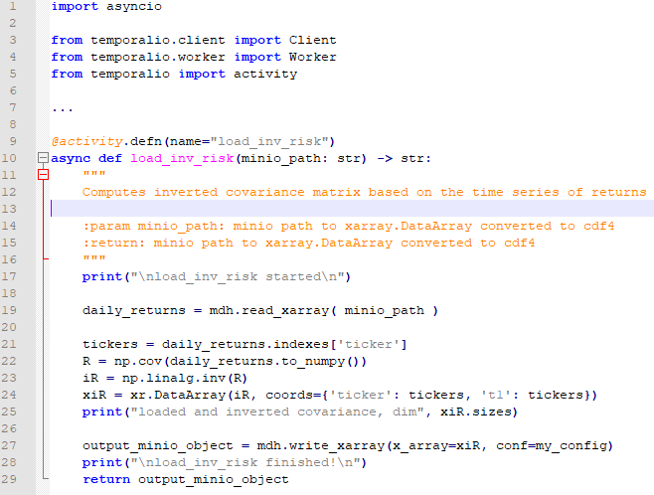

Slide 7
Processes involved [simplified]
Launcher1
(backtest)
1
6
Workflow1
(backtest) Worker
2
5
4
3
Activity1 (return)
Worker 1
Activity2
(universe) worker

Slide 8
Processes involved
Launcher1
(backtest)
1
“done”
Temporal Server
Workflow Queue
4
Activity Queue
2
3(A1)
6
Workflow1
(backtest) Worker
5
Activity1 (return)
worker 1
Activity2
(universe) worker

Slide 9
Processes involved
Launcher1
(backtest)
Launcher2
(Factor Gen)
Temporal Server
Workflow Queue
Activity Queue
Workflow1
(backtest) Worker
Workflow2
(Factor Gen)
worker
Activity1 (return)
Worker 1
Activity2
(universe) worker
Activity3
(Factor loadings) worker

Slide 10
Roles and players
Worklow.py
import temporal
@workflow
def LCx2(filename):
@activity

Slide 11
Our demo
mockup of backtester.
Load universe
Load pricing data
Compute returns
Load risk matrix
Run multiple flavors of backtests over multiple days
Run multiple attribution reports on results.
Anyone can probably think of his processes in similar terms.

Slide 12
Use cases
Returns loader
Backtesting
Optmization-as-a-service

