Slide 1
Best Practices For Web App Development
ZACH COTTER

Slide 2

About Me
Zach Cotter
Senior
Computer Science and Environmental Science
Graduating in May
Web Developer at America’s Test Kitchen (TV show, recipe creation, cookbooks, website)

Slide 3
What are Web Apps?
Software that runs in a web browser and is stored on the internet.
Inherently cross-platform
SaaS (Software as a Service)
Users licensed to access hosted software rather than installing it on their computer
Easy to make updates because software is stored in only one place

Slide 4
What are best practices?
Guidelines for making web apps more maintainable
Reduce the cost and time of development
Lead to higher quality software
Will be using Ruby on Rails for examples
Based on “The Twelve Factor App” and personal opinion

Slide 5
1) Codebase
Where to keep your code and what should be stored with it.

Slide 6
Codebase
All code should be stored in a single central location
Should use a version control system (Git)
All instances of the app (ie Production, your local development machine) should use the same codebase
But each might be running a different version of that codebase
Each change made to the app should be represented by a separate commit

Slide 7
Why use git?
Keeps track of changes to app
Easy to revert broken code to a stable version (in either Production or during Development)
Can use branches so multiple developers can work on multiple new features simultaneously
Accountability – can track who wrote what code and how much
Easy and fast to deploy code to a new environment

Slide 8
Git, branches, and deployments
A “deploy” refers to a version of the app running on a machine
Production, Development, Staging, Test, etc
The “master” branch should always have a one-to-one correlation with production
Each in progress feature should be stored in a “feature branch” so each developer can work on it
During development, deployed to each developers computer
During testing/QA deployed to Staging or Test environments
Merged with master before production deploy

Slide 9
What to store in git
The code needed to run your app
Scripts that might need to be run in production
Tests
Code to create the current database schema (migrations)
A list of dependencies your app needs

Slide 10
What NOT to keep in git
Usernames/passwords for attached resources like the database (security)
Any other configuration variables
Dependencies/executables (except for a script that installs them)
Data
Log files, or output from scripts or tests

Slide 11
2) Dependencies
How to manage the external code your app will need to use

Slide 12
What are dependencies?
Modules/Libraries that your app uses
JQuery
Bootstrap
Database adaptors
Authentication or E-Commerce modules (third-party or locally developed)

Slide 13
What to do about dependencies
Never keep them in version control
Never depend on them already being present on a system or at a specific location
Use a dependency packaging system (like Bundler for rails)
Explicitly declare them in a dependency manifest
Isolate them from any other programs that happen to be on the machine to avoid implicit dependencies

Slide 14
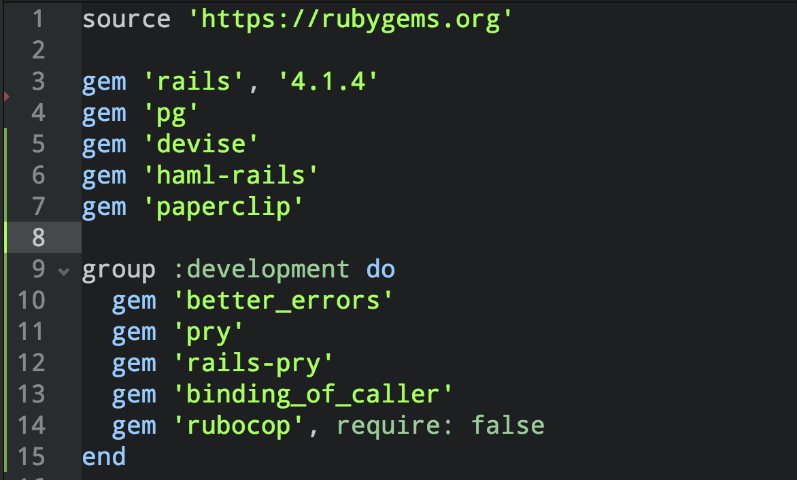
Gemfile – Dependency manifest for Rails
Explicitly declares dependencies to use
Can group by environment
Can specify version
Only dependencies specified here can be used

Slide 15
Isolate Dependencies
App should only be able to access dependencies declared in the manifest
Prevents accidental dependencies
Example: works on developer’s machine, but breaks in production
In rails, bundler does this for you
Ensures there are no version conflicts

Slide 16
Don’t depend on exact path to file
Bad
Good
Dependencies shouldn’t need to be in a specific location
Example: Program shells out to /usr/bin/curl during runtime
Instead, list it in the manifest and let the dependency manager take care of it – use a wrapper if necessary
Example: gem ‘curb’ listed in the Gemfile

Slide 17
Why use a dependency manager
Dependencies are neatly organized in one place
Can quickly set up a new developer machine or deployment using a single command
Code will never break because of dependency issues

Slide 18
3) Config
How to manage configuration variables and credentials

Slide 19
What is Config?
Config is anything that varies between deploys
Address of database, caching system, or other backing services
Credentials for those services
Auth Tokens for Third Party API’s
Hostname (staging.mysite.com vs www.mysite.com)
Should NEVER be in your code or stored in your version control system

Slide 20
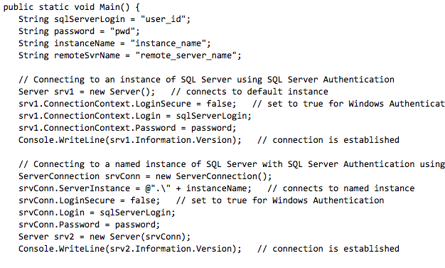

Actual Code From Microsoft’s C#/.NET Docs
Have to change code for administrative tasks like credential switches, new hostname
Developers have to manually change so they aren’t working with Prod database
Not secure
Doesn’t make any sense

Slide 21
A better solution
Environment variables
key/value pairs stored by each operating system
Most languages have an OS agnostic way to acesss them
Store config as environment variables
Configuration files checked into version control
Contain reference to an environment variable
Can change value of config variable without changing your code

Slide 22
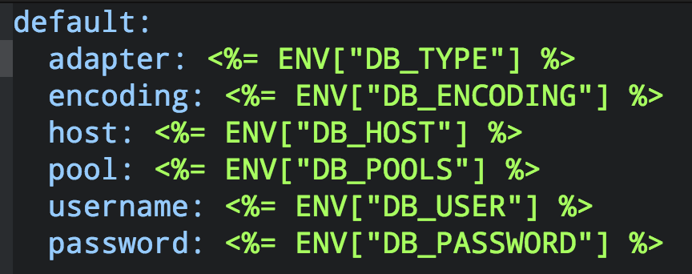
Config file that references environment variables
Each database connection variable references an environment variable
No code changes needed to change the way the database is set up
Can be safely added to open source version control
Never have to touch this file again

Slide 23
Why should code and config be separated?
Don’t want system administrators to make/request changes to code
Security – don’t want credentials in your code
Different environments require different configurations
Storing config in your code would violate the singular codebase principal

Slide 24
4) Backing Services
How to manage network services consumed by your app.

Slide 25
What is a backing service?
A service that the web app consumes over the network
Can be local
Databases
Messaging systems
Process managers (delayed_job)
Caching systems
Mail servers (SMTP)
Or remote
Metrics (New Relic)
Third-Party APIs (Twitter, Google Maps)

Slide 26
How to manage backing services
Don’t distinguish between local and remote services
Use a URL or other identifier to connect to the service
Local Service URL: http://localhost:6379
Remote Service: https://auth@thirdpartyservice.com
These values should be stored in config (not code)

Slide 27
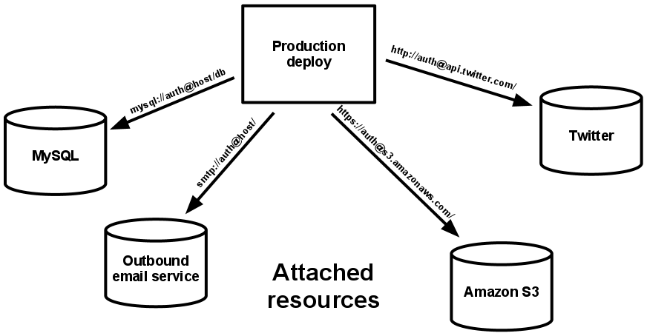
Backing services referenced by URL
Can seamlessly switch between local or remote hosted service without changing code or redeploying app
Each deploy can have a different instance of the backing service

Slide 28
5) Releasing the app
Build, Release, Run

Slide 29
What is a release?
A release happens when your codebase is turned into production deploy
Code is compiled
Dependencies are installed
Tests run
The apps processes are started on the production machine

Slide 30
Build
Code is compiled into binaries (unless using an interpreted language)
Each build matches a specific version of the app (commit in git)
Dependencies are fetched and installed on the production machine

Slide 31
Release and Run
Compiled code is combined with the app’s config
Shouldn’t be possible to make changes to code at this stage
The apps processes are started, usually with a singular command that starts the web server and other worker processes

Slide 32
Tests
Before code is run in production, tests should be run
Should be run in an environment that closely matches production
If tests fail, release should be postponed

Slide 33
What to do when a release fails
Sometimes tests pass but there are still bugs
Need to rollback to an earlier release
Each release should be tagged with a unique identifier that doesn’t change
Git commit works great
Should be easy to rollback to a previous release

Slide 34
6 & 7) Processes and Port Binding
Web apps are stateless

Slide 35
Processes
App should consist of a single master web process that handles incoming requests
Runs for the entirety of the apps lifetime
Worker processes are started to handle long running tasks
Worker processes terminated when no longer necessary
Stops main web process from getting blocked

Slide 36
Stateless Processes
Never assume requests from the same user will be handled by the same process
Don’t store data in process memory
Instead use stateful backing service like a database
Makes app more robust against process failure or restart
Prevents data loss

Slide 37
Port Binding
Bind internal services to a port
This includes the web server itself
At runtime, the app can connect to itself with a URL like http://localhost:4500
This URL should be stored in config

Slide 38
8 & 9) Disposability + Admin Tasks
Web apps should be robust and scalable

Slide 39
Disposability
Apps can be started or stopped with little notice
Helps with scaling
Can quickly create and destroy instances of the app to handle demand
Apps should have a fast startup time
Apps should have an automated release system to install dependencies, start the app with a single command

Slide 40
Admin Tasks
Sometimes jobs need to be run in production
Fix data that was broken by a bug
Run one-time tasks to handle business needs
These can be long-running and resource intensive
Shouldn’t interfere with people using the app
Create a separate process to run the script
Process should end when the job is done

Slide 41
10) Dev/Prod Parity
Ensure consistency between environments

Slide 42
Dev/Prod Parity
Important to minimize differences between developers environment and production
Helps prevent bugs
Reduces incompatibilities
A number of problems are caused by this

Slide 43
The Time Gap
Problem
Solution
It takes time to write and test code
Code becomes susceptible to code-rot, or changes to other parts of the app that prevent it from working
Code should be tested and deployed as soon as it is ready
Avoid scheduled weekly/monthly releases

Slide 44
The Personnel Gap
The Problem
The Solution
Code written by developers is often deployed by another engineer who is unfamiliar with it
If it breaks, they don’t know what to do
Code should be deployed by it’s developer
Responsible for making sure it works in production

Slide 45
The Tools Gap
The Problem
The Solution
Developers use different stacks (OS, database, etc) than on production
Might prefer “lightweight” services for speed
Causes compatibility issues
Use the same stack as in production
Time cost of compatibility problems is far outweighed by time saved using lightweight services

Slide 46
11) Log files
Tracking your app’s behavior

Slide 47
Logs
Time ordered list of events run by the app
Show errors, exceptions, and normal behavior
Important for identifying bugs
App should write logs to standard output, not a specific file
In production, the run command for the app can pipe this to a file, or send it to a analysis system like Splunk

Slide 48
Using Logs
Writing to standard output instead of a file allows greater flexibility and robustness
Analysis systems provide a number of additional services
Searching for past events
Graphing events and finding trends
Alerting developers to certain errors or error frequencies

Slide 49
More Information
Loosely based on www.12factor.net
Document written by the creators of Heroku, a popular scalable web app hosting service
github.com/zcotter
www.zachcotter.com – Projects in Ruby on Rails and other languages

Slide 50
Questions?

