Slide 1
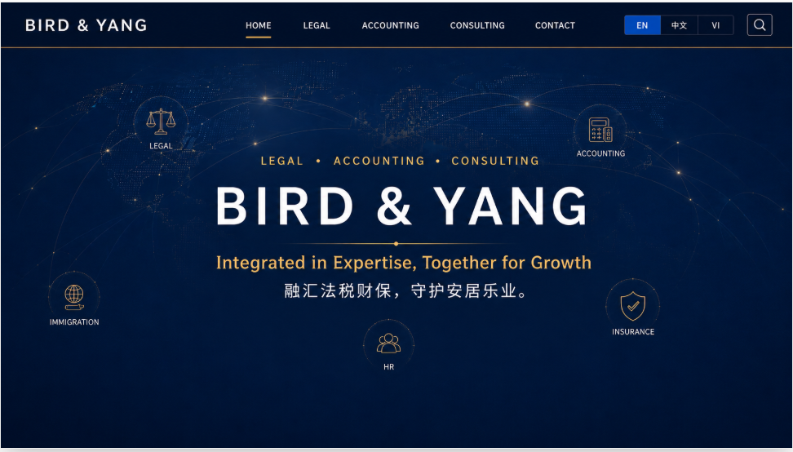




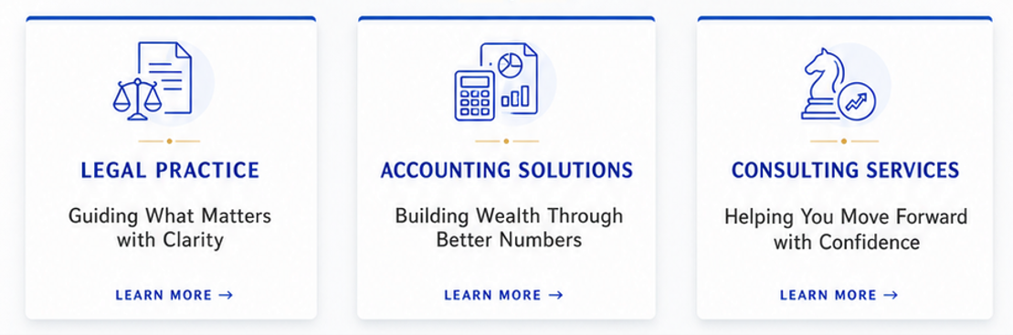
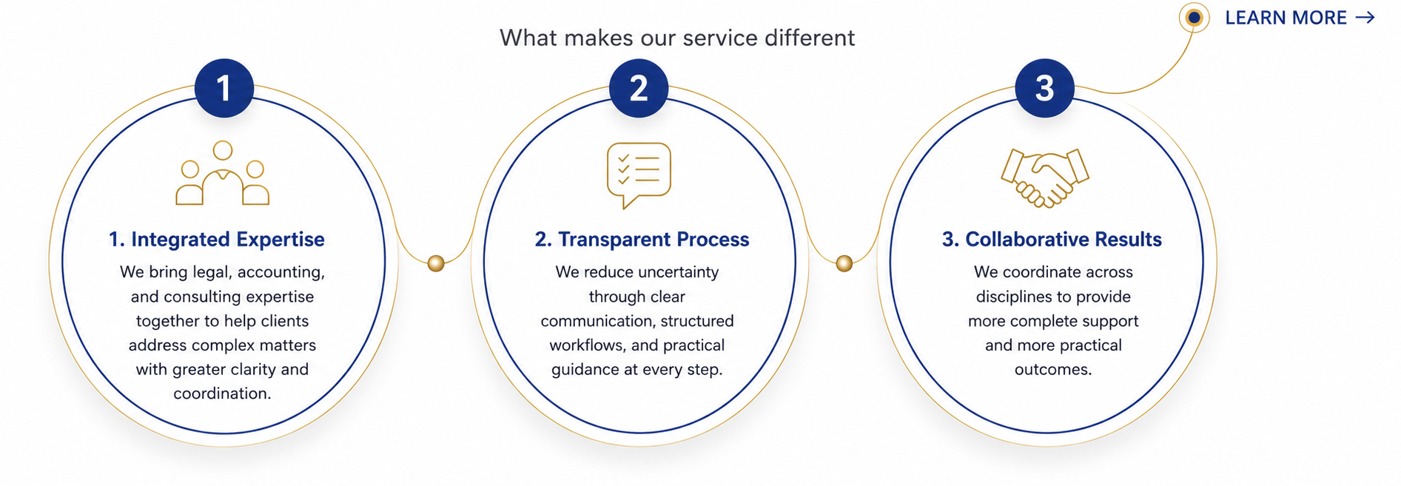
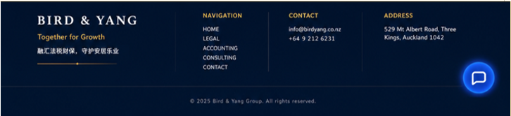

BIRD & YANG
At Bird & Yang, we support the matters that shape how people live, settle, work, and grow.
By integrating Legal, Accounting, and Consulting expertise under one roof, we provide coordinated support for individuals, families, and businesses navigating important decisions in life and commerce. From legal structure and financial clarity to tax compliance, immigration pathways, insurance protection, and advisory support, our goal is to make complex matters clearer and more manageable.
Integrated in Expertise, Together for Growth means that when our clients seek stability, opportunity, and long-term prosperity, Bird & Yang is ready to stand with you.
OUR EXPERTISE
WHY BIRD & YANG

