Slide 1
L2D Deep reinforcement learning
Dr Neythen Treloar

Slide 2
Function approximation in reinforcement learning
So far, we have restricted ourselves to learning tabular Q-functions
Function approximation allows us to work in continuous state-action spaces
And allows generalization between similar states and hence application to much larger problems
However, function approximation with off-policy temporal difference methods can lead to instability problems (“the deadly triad” pg 264 of Sutton and Barto)
We will look at using neural networks for Q learning and how to overcome the stability issues
Sutton, R. S., & Barto, A. G. (2018). Reinforcement learning: and introduction (2nd ed.). The MIT Press.

Slide 3


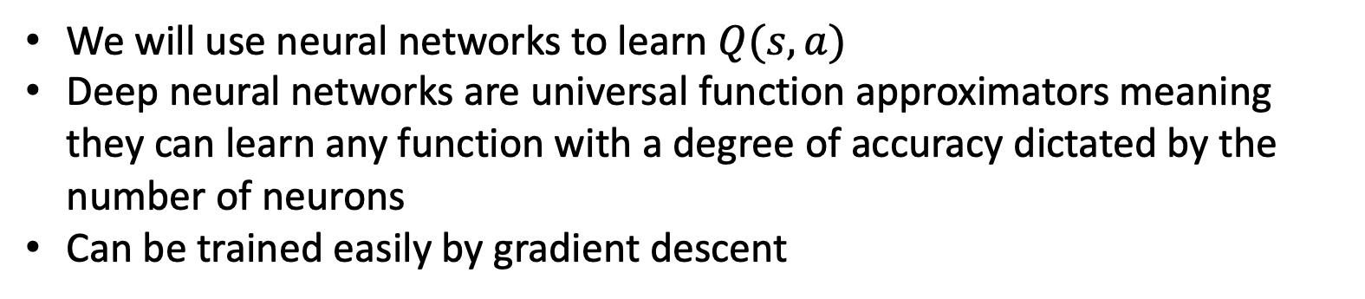
Neural networks
We will use neural networks to learn $Q(s,a)$
Deep neural networks are universal function approximators meaning they can learn any function with a degree of accuracy dictated by the number of neurons
Can be trained easily by gradient descent
$$s,a$$
$$Q(s,a)$$

Slide 4
Difficulties
Q-learning can be unstable when using neural networks
This is for a few reasons:
Temporal correlations in data mean that samples aren’t independent
The data distribution is non-stationary and small changes in the learned Q value can lead to large changes in the policy and hence the distribution of data
The Q values and the target values can be highly correlated with each other
We will explain these in a bit more detail (see the paper for more detail)
Mnih, V., Kavukcuoglu, K., Silver, D. et al. Human-level control through deep reinforcement learning. Nature 518, 529–533 (2015). https://doi.org/10.1038/nature14236

Slide 5
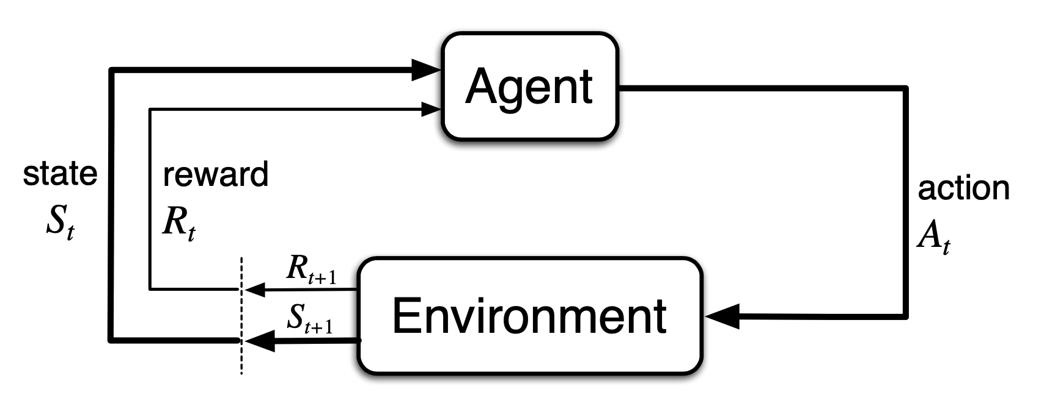

1. Temporal correlations in data mean that samples aren’t independent
For neural networks, each sample should be independently taken
The stream of consecutive data points are highly correlated e.g. timestep 2 will be highly dependent on timestep 1
$\left(s_{1}, a_{1}, r_{1}\right),\left(s_{2}, a_{2}, r_{2}\right),…,(s_{N}, a_{N}, r_{N})$

Slide 6
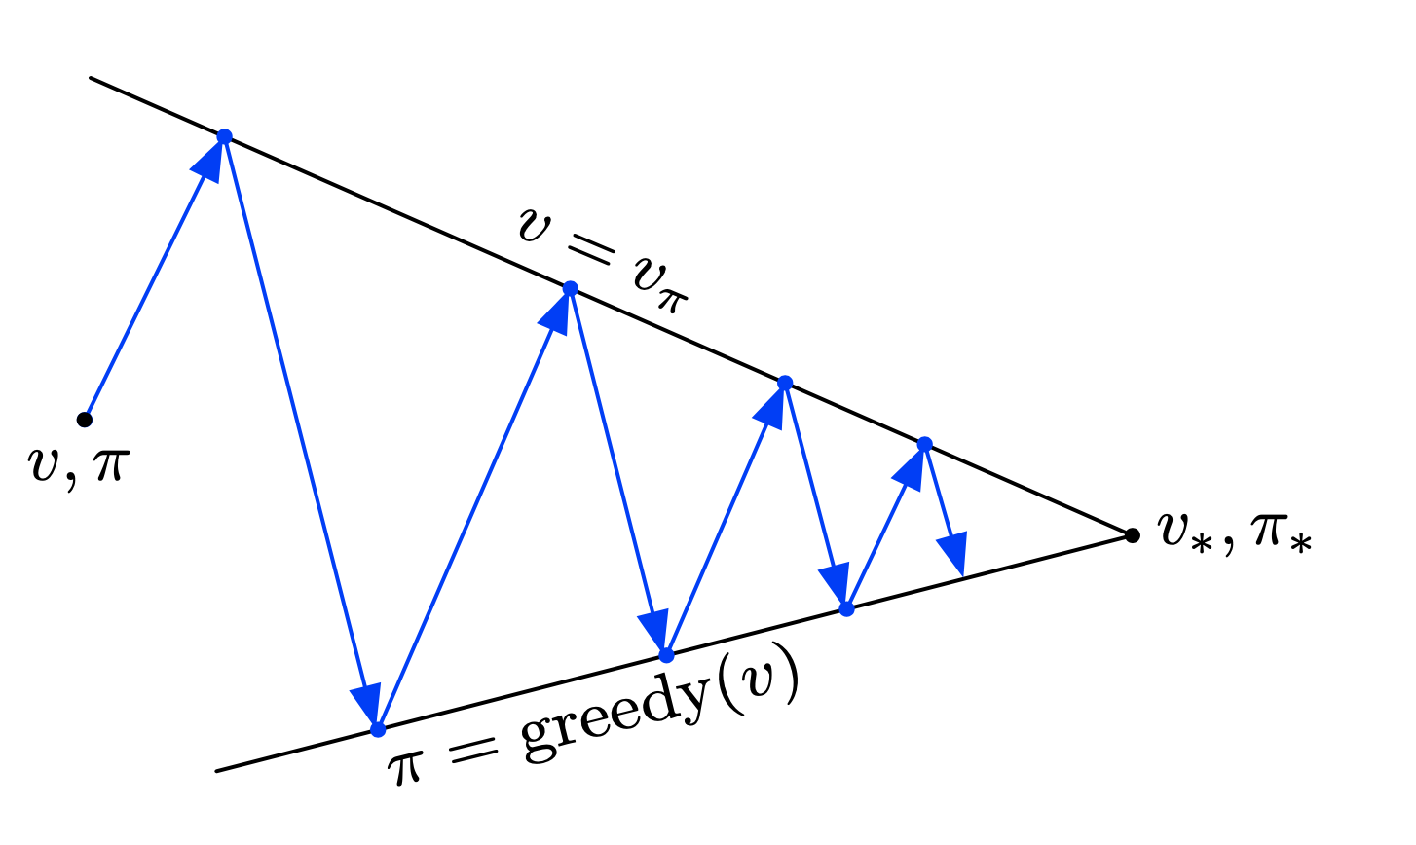
2. The data distribution is non-stationary
When training on a supervised learning task the data distribution is stationary e.g. for an image classification task the desired result for each image will be constant
However, in RL the value of a state-action pair depends on the actions that you take after visiting the state-action pair
The actions are dictated by the policy, but the policy is dependent on the value function
Changing the value function changes the policy which changes the value function and so on, meaning that the value of a given state-action pair will change throughout training
Sutton, R. S., & Barto, A. G. (2018). Reinforcement learning: and introduction (2nd ed.). The MIT Press.

Slide 7
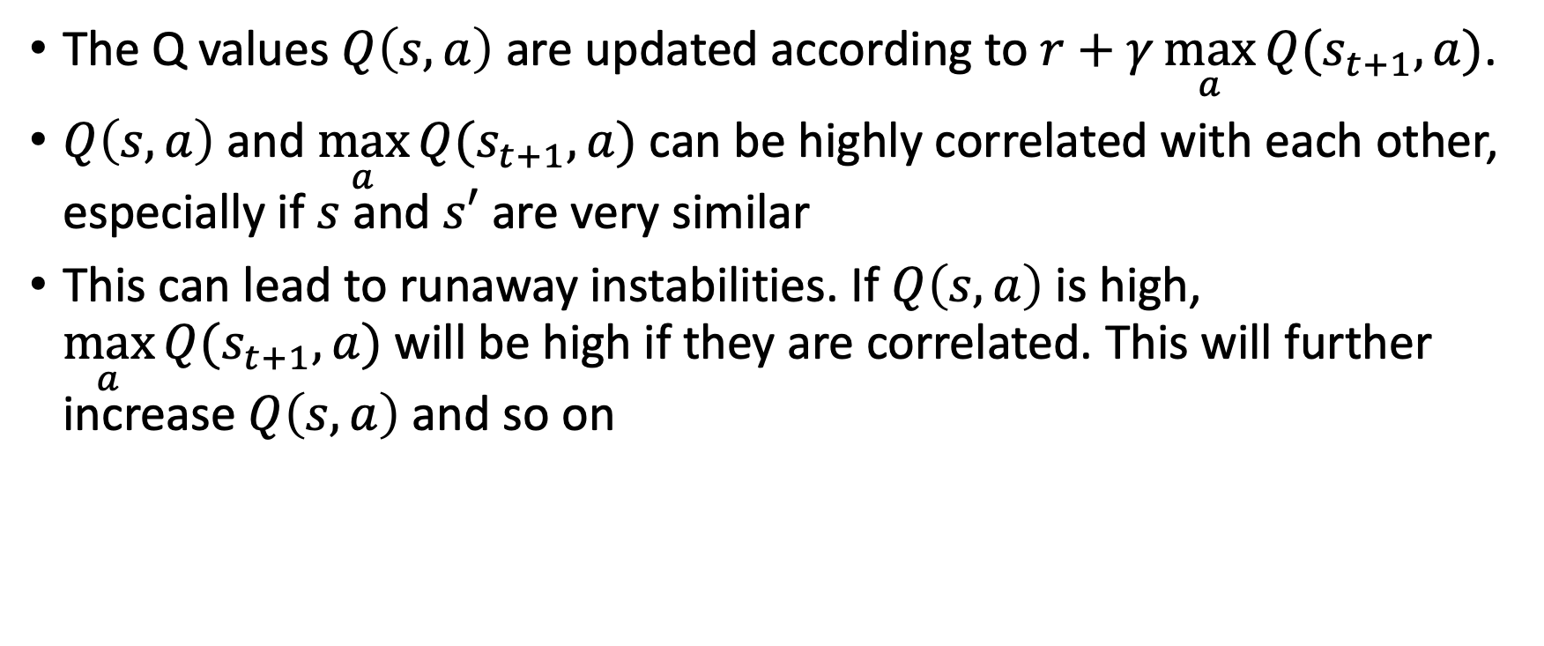
3. Correlations between the Q value and the target
The Q values $Q\left(s,a\right)$ are updated according to $r+γ\max_{a}{Q(s_{t+1},a)}$.
$Q\left(s,a\right)$ and $\max_{a}{Q(s_{t+1},a)}$ can be highly correlated with each other, especially if $s$ and $s′$ are very similar
This can lead to runaway instabilities. If $Q\left(s,a\right)$ is high, $\max_{a}{Q(s_{t+1},a)}$ will be high if they are correlated. This will further increase $Q\left(s,a\right)$ and so on
$$Q\left(s_{t}, a_{t}\right)=Q\left(s_{t}, a_{t}\right)+α (r_{t}+γ\max_{a}{Q\left(s_{t+1}, a\right) −Q\left(s_{t}, a_{t}\right)})$$
Target

Slide 8
Solutions
Experience replay
Delayed target updates

Slide 9
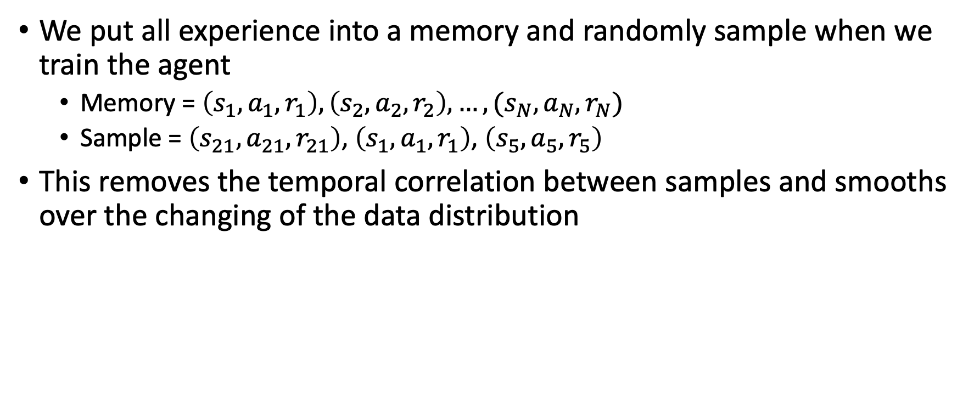
SOLUTION 1: experience replay
We put all experience into a memory and randomly sample when we train the agent
Memory = $\left(s_{1}, a_{1}, r_{1}\right),\left(s_{2}, a_{2}, r_{2}\right),…,(s_{N}, a_{N}, r_{N})$
Sample = $\left(s_{21}, a_{21}, r_{21}\right)$, $\left(s_{1}, a_{1}, r_{1}\right)$, $\left(s_{5}, a_{5}, r_{5}\right)$
This removes the temporal correlation between samples and smooths over the changing of the data distribution

Slide 10
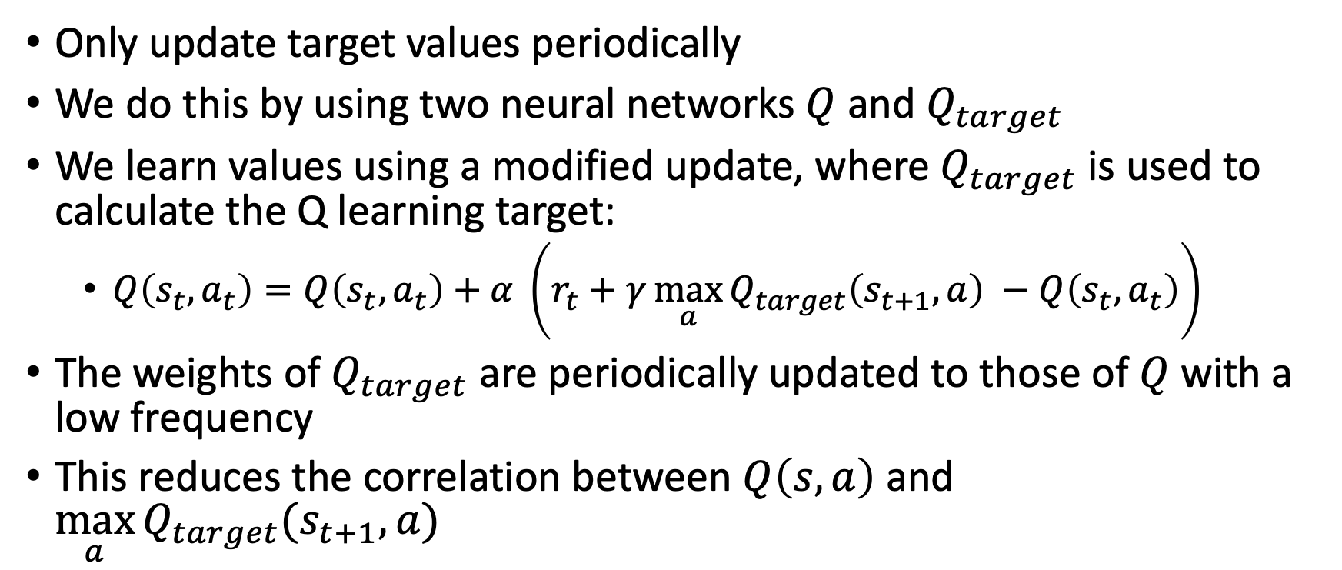
SOLUTION 2: delayed target updates
Only update target values periodically
We do this by using two neural networks $Q$ and $Q_{target}$
We learn values using a modified update, where $Q_{target}$is used to calculate the Q learning target:
$Q\left(s_{t}, a_{t}\right)=Q\left(s_{t}, a_{t}\right)+α \left(r_{t}+γ\max_{a}{Q_{target}\left(s_{t+1}, a\right) }−Q\left(s_{t}, a_{t}\right)\right)$
The weights of $Q_{target}$ are periodically updated to those of $Q$ with a low frequency
This reduces the correlation between $Q\left(s,a\right)$ and $\max_{a}{Q_{target}(s_{t+1},a)}$

Slide 11
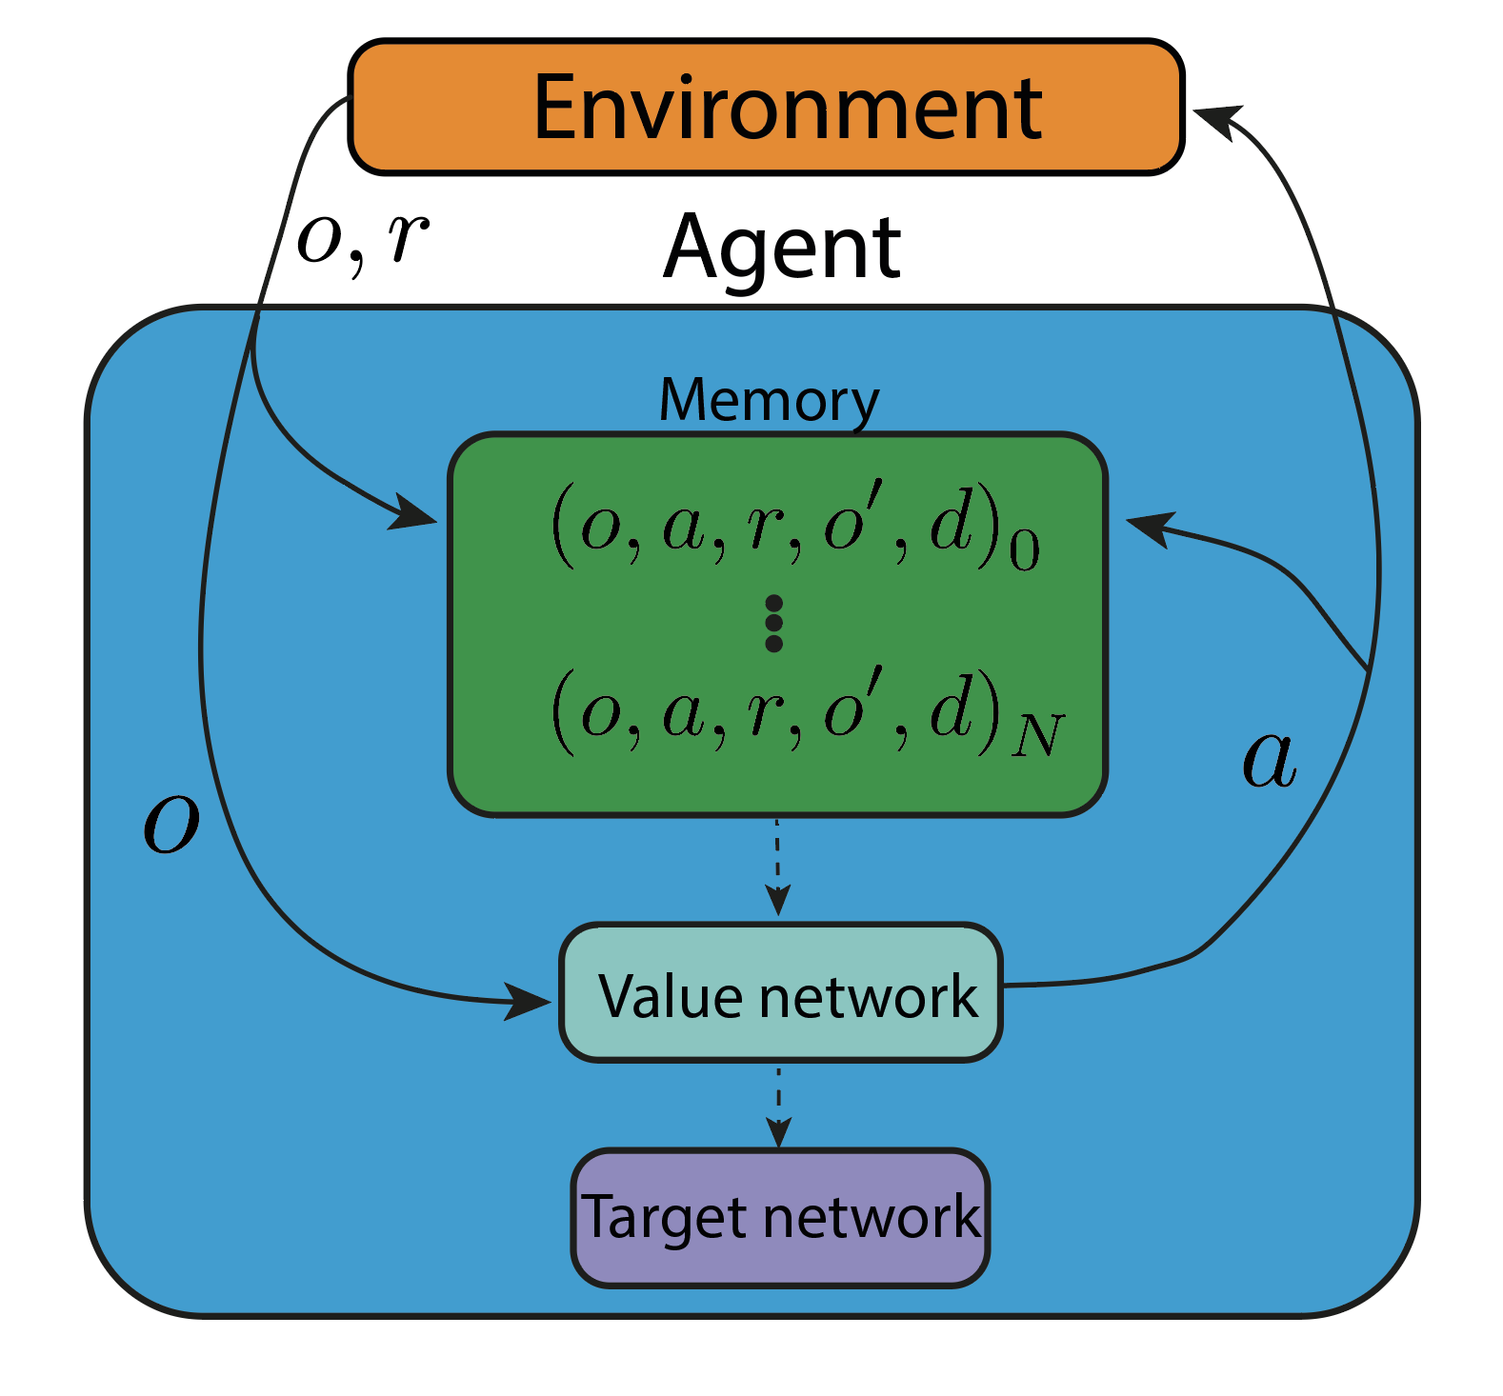
DQN overview
Incorporating these modifications leads to the deep Q network (DQN) algorithm
We put all experience into a memory and randomly sample when we train the agent
Experience is sampled and used to update the value network (using targets generated from the target network)
The target network is periodically updated to match the value network.
Mnih, V., Kavukcuoglu, K., Silver, D. et al. Human-level control through deep reinforcement learning. Nature 518, 529–533 (2015). https://doi.org/10.1038/nature14236

Slide 12
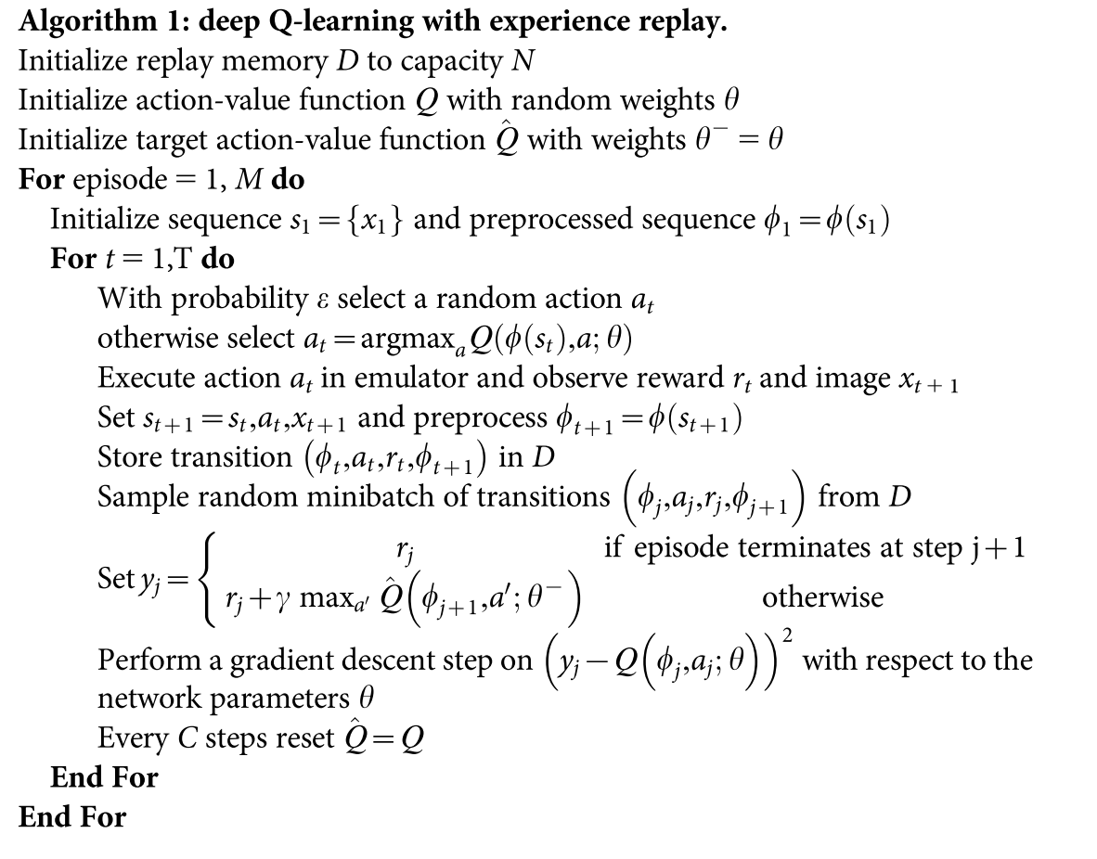
Putting all this together results in the Deep Q Network algorithm (DQN).
This paper allowed us to use neural networks with RL
Since then, more sophisticated algorithms have been developed using these principles
Mnih, V., Kavukcuoglu, K., Silver, D. et al. Human-level control through deep reinforcement learning. Nature 518, 529–533 (2015). https://doi.org/10.1038/nature14236

