Slide 1
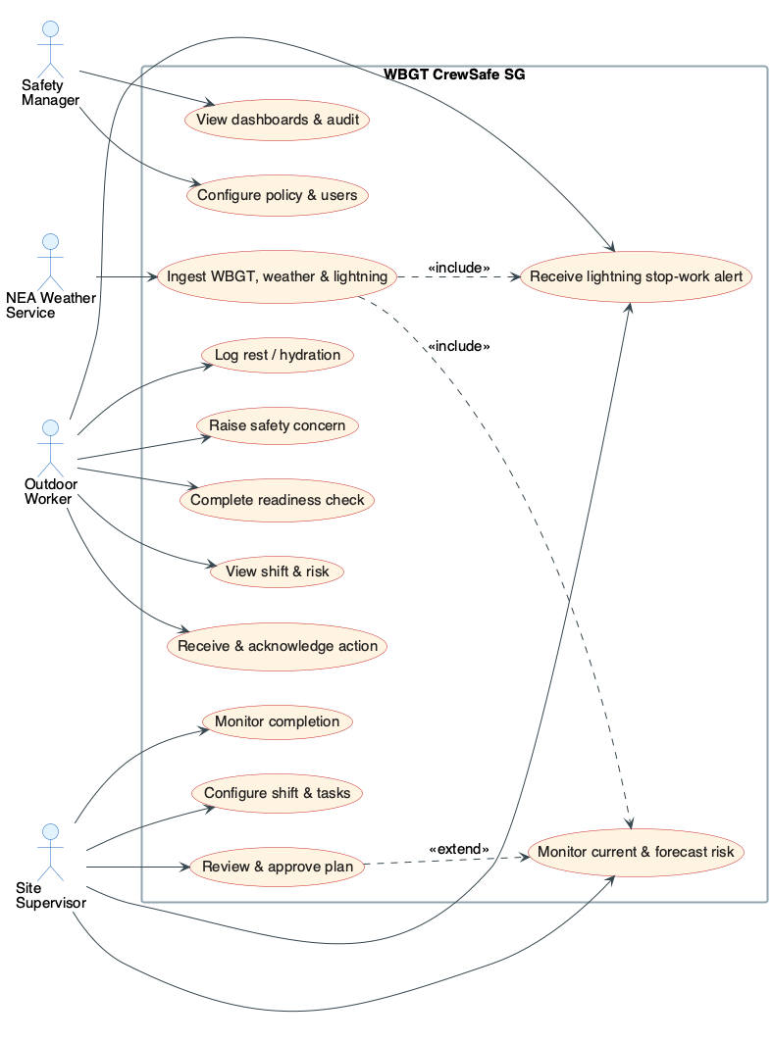
W
WBGT CrewSafe SG
AD Project · Sprint 0 Proposal · Group 4
Human-supervised heat-safety operations for small outdoor crews in Singapore
Closed loop: weather signal → ML forecast → MOM policy → supervisor approval → worker action → audit evidence
PROJECT DESCRIPTION
HIGH-LEVEL USE CASE DIAGRAM
WBGT CrewSafe SG turns Singapore's public NEA WBGT data into timely, MOM-aligned rest, hydration and task decisions for crews (landscaping, estate & campus maintenance, event setup) that refer to myENV instead of an on-site meter. NEA lightning-strike observations sit above the WBGT reading as an overriding stop-work hazard. A guarded AI agent drafts a plan from deterministic policy rules; the supervisor approves it; workers receive and acknowledge it on mobile — every step recorded end-to-end.
VALUE TO STAKEHOLDERS
Outdoor workers — clear one-tap instructions and acknowledgement — no wearables, no location tracking.
Site supervisors — a live board that turns a heat signal into an approve-in-seconds decision, with proof of who received what.
Safety managers — consistent MOM policy application plus an append-only audit trail as enforcement evidence.
Employer / operations — closes the gap between seeing a reading and proving action — lower heat-illness and compliance risk.

Slide 2
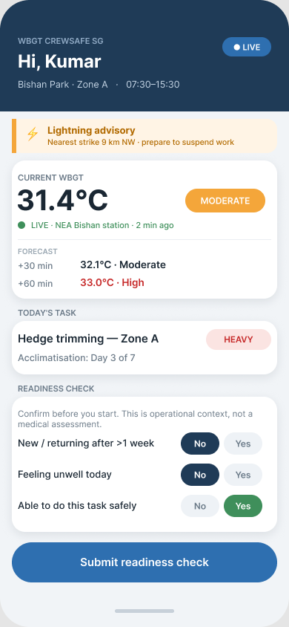
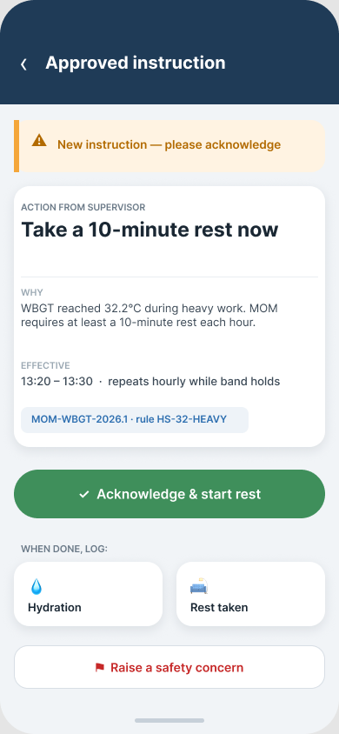
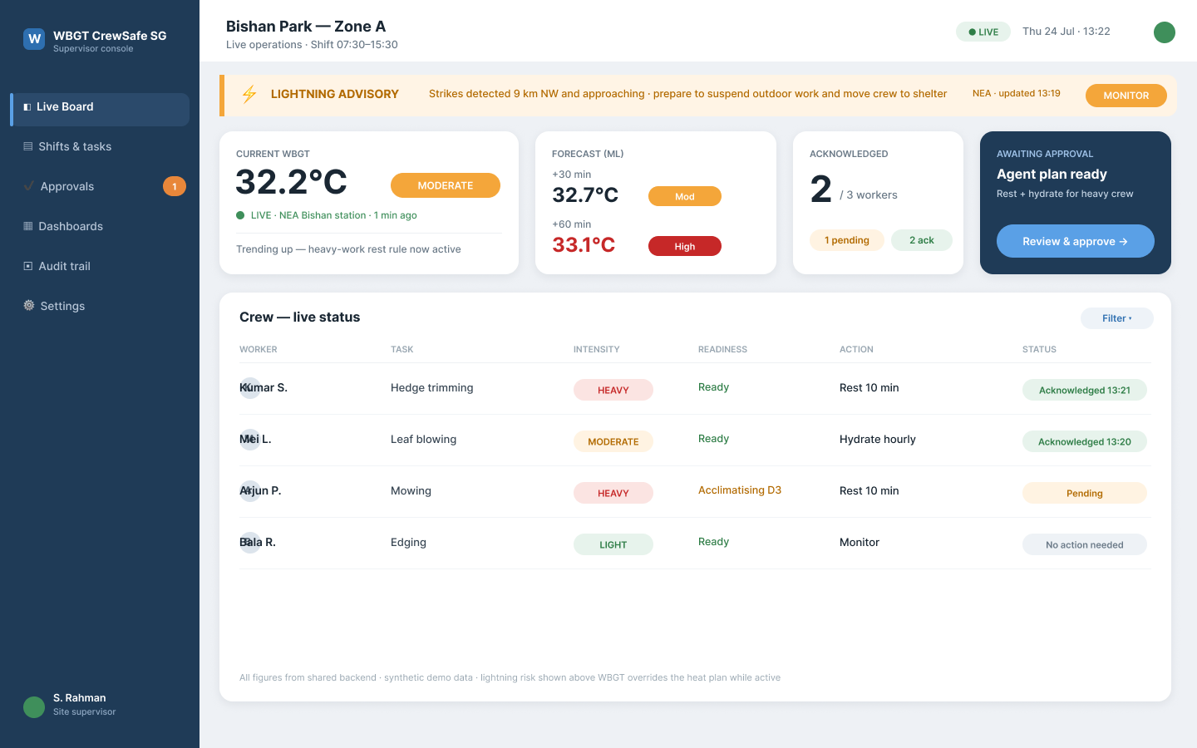
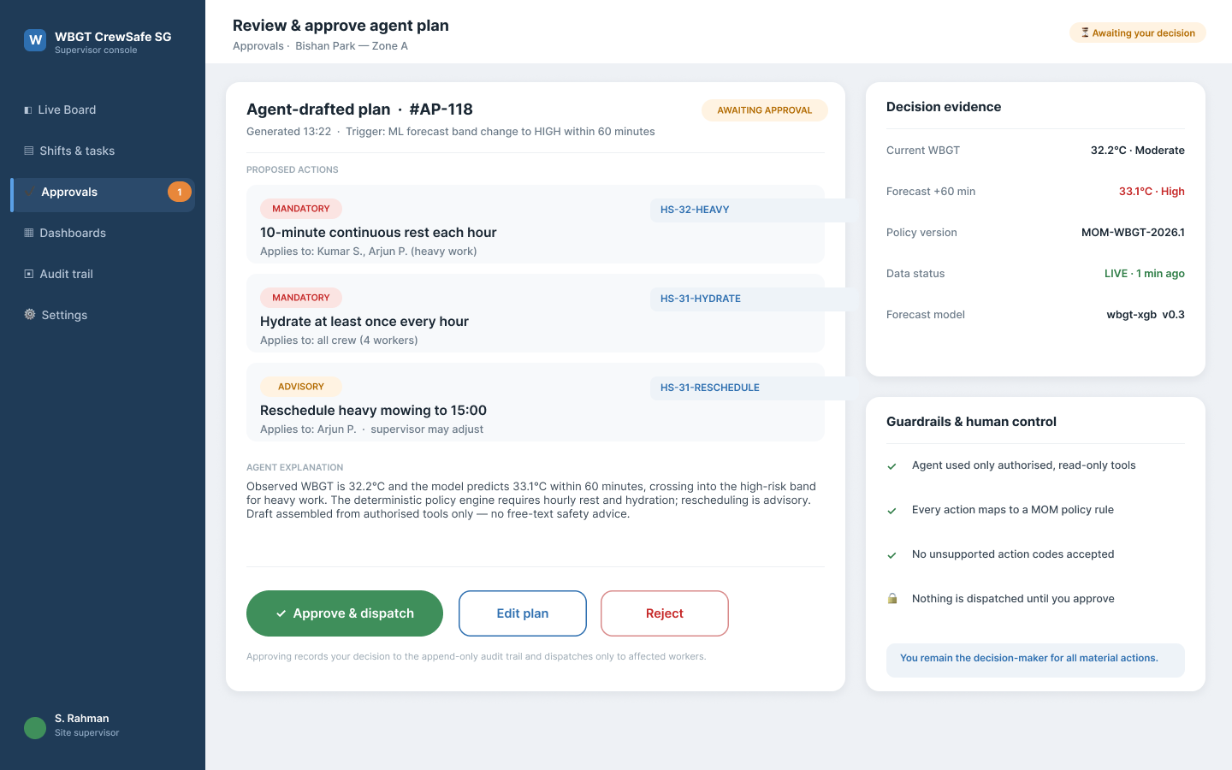
Product Backlog & Prototype Screens
WBGT CrewSafe SG
Proposed features, the technologies behind them, and Figma prototype screens
PRIORITISED PRODUCT BACKLOG (extract — full 19-story backlog in the accompanying workbook)
PROTOTYPE SCREENS (Figma)
Pri
Feature / user story
Key technologies
Pts
Spr
Must
Authenticate & site-scoped access
React · React Native · Spring Security · JWT
5
1
Must
Ingest WBGT / weather with freshness
Spring Boot · NEA data.gov.sg API · PostgreSQL
8
1
Must
Lightning stop-work warning above WBGT
Spring Boot · NEA lightning API · React / React Native
5
1
Must
Forecast 30 / 60-min WBGT
Python · FastAPI · scikit-learn / XGBoost
8
2
Must
Evaluate deterministic heat policy
Java 21 rules engine · PostgreSQL config
8
2
Must
Explainable agent draft plan
Tool-calling LLM · JSON-schema guarded tools
8
2
Must
Dispatch & acknowledge worker action
React Native · Spring Boot · idempotency
8
2
Must
Compliance & response-time dashboards
React · Chart.js · backend aggregation
8
3
Worker · readiness
Worker · action
Must
Export audit timeline
Backend CSV / PDF · append-only audit
5
3
Must
Safe degraded (NEA / ML / LLM) mode
Fallback adapters · persistence forecast
8
3
Cross-cutting: Cloud — AWS infra with Terraform · ECS on Fargate · RDS for PostgreSQL · S3 · Secrets Manager
DevSecOps — GitHub Actions CI/CD · SAST + secret scan · dependency & container scanning · security-remediation evidence
Supervisor · live board
Supervisor · approve plan

