Slide 1
WBGT CrewSafe SG
AD Project · Sprint 0 Proposal · Group 4
Human-supervised heat-safety operations for small outdoor crews in Singapore
Closed loop: weather signal → ML forecast → MOM policy → supervisor approval → worker action → audit evidence
PROBLEM STATEMENT
Singapore's heat is intensifying — 29 high heat stress days in 2025, up from 21 in 2024 ^{[6]} — and a 2026 nationwide study found that 85% of the 41 outdoor heat-illness cases reported to MOM from 2009 to 2023 were heat exhaustion or heat stroke, with under-reporting likely.^{[5]} MOM requires hourly WBGT monitoring and shaded rest breaks of 10 to 15 minutes once WBGT reaches 32°C^{[1][2]}, yet crews below the mandatory on-site meter threshold^{[3]} check myENV by hand^{[4]}: readings are missed, the right rest rule is applied unevenly, and little is recorded.
PROJECT DESCRIPTION
WBGT CrewSafe SG turns Singapore's public NEA WBGT data into timely, MOM-aligned rest, hydration and task decisions for smaller outdoor crews such as landscaping, estate & campus maintenance, outdoor cleaning and event setup teams that refer to myENV rather than an on-site meter, not the mandatory-meter sites (construction of S$5m or more, shipyards, process industry). NEA lightning-strike observations sit above the WBGT reading as an overriding stop-work hazard. A guarded AI agent drafts a plan from policy rules, the supervisor approves it, and workers acknowledge it on mobile, with every step recorded.
VALUE TO STAKEHOLDERS
Outdoor workers: a simple rest and hydrate alert on their phone, confirmed with one tap. No wearables, no tracking.
Site supervisors: one screen shows the heat risk; approve the plan in seconds and see who has read it.
Safety managers: the same MOM rules applied every time, with a tamper proof record to show inspectors.
Employer / operations: fewer heat illness incidents and less compliance risk, because action is taken and proven, not just seen.
Notes:
SOURCES — Slide 1 problem statement
All online sources accessed 26 July 2026.
[1] Ministry of Manpower, Singapore. “Enhanced Measures to Reduce Heat Stress for Outdoor Workers.” Press release, 24 October 2023.
https://www.mom.gov.sg/newsroom/press-releases/2023/1024-enhanced-measures-to-reduce-heat-stress-for-outdoor-workers
Cited for: hourly WBGT monitoring during outdoor work; at least 10 minutes of shaded rest per hour for heavy physical work when WBGT is 32°C to below 33°C; at least 15 minutes per hour when WBGT is 33°C or above; encouragement of a buddy system for early recognition of heat-related illness.
[2] Ministry of Manpower, Singapore. “Revised Framework to Guide Employers and Protect Outdoor Workers Against Heat Stress.” Press release, 6 September 2024.
https://www.mom.gov.sg/newsroom/press-releases/2024/0906-revised-framework-to-guide-employers-and-protect-outdoor-workers-against-heat-stress
Cited for: alignment of the outdoor-worker framework with the three-tier Heat Stress Advisory; WBGT bands of below 31°C, 31°C to below 33°C, and 33°C or above; required and recommended measures applicable at each band.
[3] Ministry of Manpower, Singapore. “Heat Stress Measures for Outdoor Work.” Framework infographic, current version.
https://www.mom.gov.sg/-/media/mom/documents/heat-stress-measures/heat-stress-framework-outdoor-workers.pdf
Cited for: acclimatisation, hydration, rest, shade and hourly WBGT monitoring measures; on-site WBGT-meter requirements for construction sites with contract sums of S$5 million or more, shipyards and the process industry; use of NEA’s myENV app by other workplaces.
[4] National Environment Agency and Ministry of Sustainability and the Environment, Singapore. “New Heat Stress Advisory Launched to Guide Public on Minimising Risk of Heat-Related Illnesses.” Joint news release, 24 July 2023; page updated 19 August 2025.
https://www.nea.gov.sg/media/news/news/index/new-heat-stress-advisory-launched-to-guide-public-on-minimising-risk-of-heat-related-illnesses
Cited for: availability of location-based Heat Stress Advisory information through the myENV app and weather information website; use of NEA’s WBGT sensor network; low, moderate and high heat-stress levels.
[5] Goei, Anne, Lucy Leong, and Joel Aik. “Urban Heat Exposure and Outdoor Occupational Heat-Related Illnesses in Singapore—A Nationwide Time-Stratified Case-Crossover Study.” Urban Climate 66 (2026): 102847.
https://doi.org/10.1016/j.uclim.2026.102847
Cited for: 41 reported outdoor occupational heat-related illness cases from 2009–2023, with 40 included in the regression analysis; 46.3% heat-exhaustion and 39.0% heat-stroke cases; slightly under two-thirds of cases from construction; slightly over two-thirds involving non-Singaporeans; associations between increases in temperature, humidity and reported heat-related illness.
[6] Workplace Safety and Health Council, Singapore. “Strengthening Workplace Preparedness for Heat Stress.” Announcement, 23 March 2026.
https://www.tal.sg/wshc/media/announcements/2026/strengthening-workplace-preparedness-for-heat-stress
Cited for: 29 high heat-stress days recorded in Singapore in 2025, compared with 21 in 2024. The announcement attributes these figures to Meteorological Service Singapore’s Singapore Climate 2025: The Year in Numbers.
[7] Ministry of Manpower, Singapore. “Written Answer to PQ on Heat Injuries.” Parliamentary question and reply, 9 May 2023; updated 14 March 2024.
https://www.mom.gov.sg/newsroom/parliament-questions-and-replies/2023/0509-written-answer-to-pq-on-heat-injuries
Cited for: targeted heat-stress inspections at 497 worksites in 2022 and enforcement action against 25 companies.

Slide 2
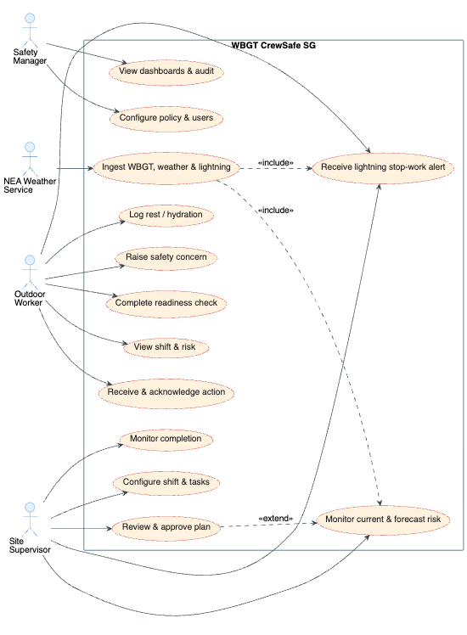
Use Case Overview
WBGT CrewSafe SG
Actors and system use cases for WBGT CrewSafe SG
HIGH-LEVEL USE CASE DIAGRAM

Slide 3
Product Backlog
WBGT CrewSafe SG
Proposed features and the technologies behind them
PRIORITISED PRODUCT BACKLOG (10 Must-priority MVP stories of 36 · source: WBGT-CrewSafe-SG-Product-Backlog.xlsx › Product Backlog)
Pri
Feature / user story
Key technologies
Pts
Spr
Must
Authenticate and see only my assigned site
Amazon Cognito + JWT · Spring Security · React · React Native
5
1
Must
Create a shift with workers, tasks and intensity
React · MUI · Spring Boot · Spring Data JPA · PostgreSQL
8
1
Must
Worker views shift and submits readiness flags
React Native · Expo · Spring Boot · PostgreSQL
5
1
Must
Ingest and store WBGT / weather with freshness
Spring Boot scheduler · NEA data.gov.sg APIs · PostgreSQL
8
1
Must
Lightning stop-work warning shown above WBGT
Spring Boot · NEA lightning API · React · React Native
5
1
Must
Supervisor sees conditions and active shift context
React · Chart.js · Server-Sent Events · Spring Boot
5
1
Must
System forecasts 30 / 60-minute WBGT
scikit-learn · HistGradientBoosting · Ridge / persistence baselines
8
2
Must
Evaluate the correct deterministic policy actions
Java 21 rules engine · PostgreSQL policy config
8
2
Must
Supervisor receives an explainable agent draft plan
Python · FastAPI · LangChain / LangGraph · Bedrock · Pydantic
8
2
Must
Supervisor approves, edits or rejects a plan
React · Spring Boot
5
2
Cross-cutting · Cloud (F-19): AWS via Terraform — CloudFront + private S3 · ECS Fargate/ALB · ECR · RDS · Cognito · Bedrock · EventBridge Scheduler · Secrets Manager
DevSecOps (F-20): CI/CD build → test → scan → publish → deploy approved releases · app, dependency, secret, IaC & container scanning
AI observability (F-21): LangSmith · agent run tracing · plan-quality evaluation · tool-call monitoring · prompt testing (not the authoritative audit record)
Observability & health (F-26): structured JSON logs · correlation IDs · Spring Boot Actuator health checks · Amazon CloudWatch
Security testing (F-27): OWASP-style tests — authz, injection, XSS, prompt injection, audit tamper · CI/CD scan evidence retained
Accessibility & performance (F-28): React + React Native · axe / Lighthouse · WCAG 2.1 AA basics · load testing to p95 latency

Slide 4
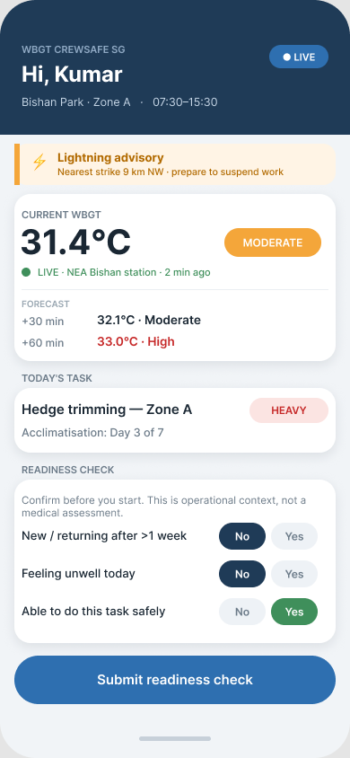
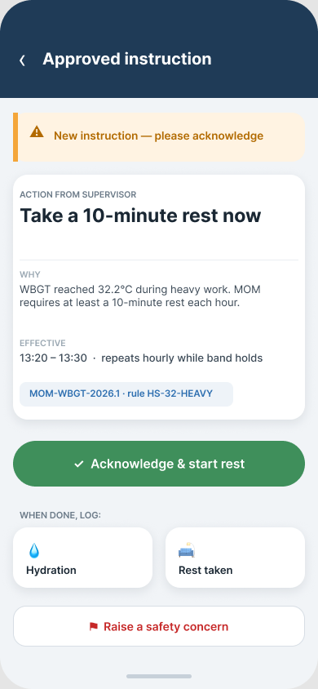
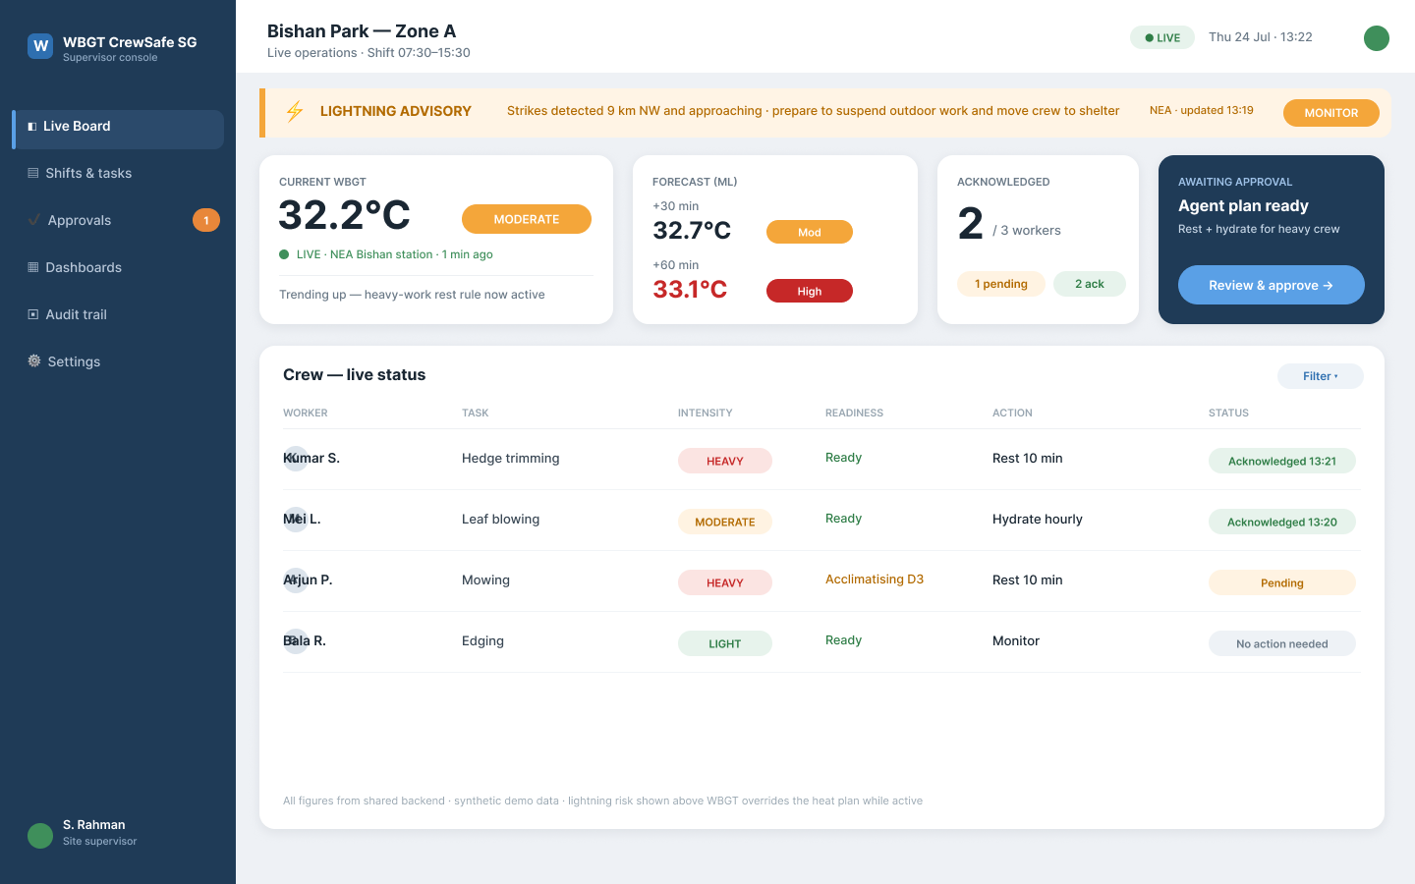
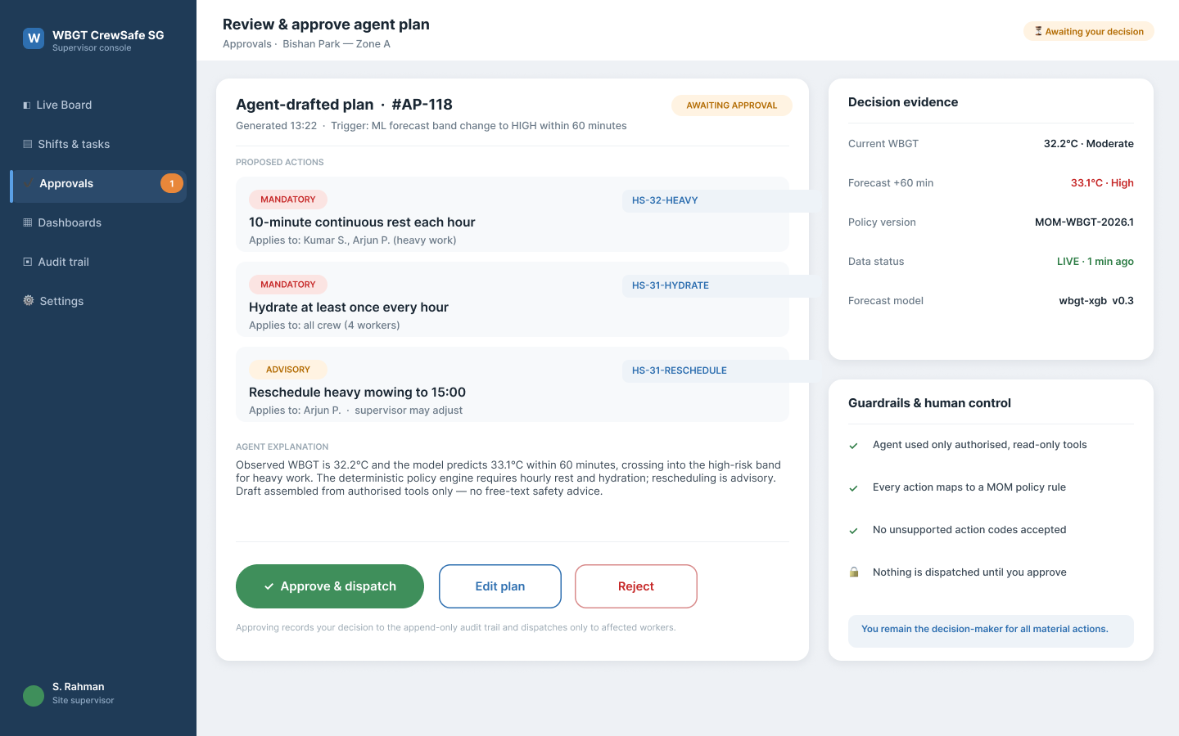
Prototype Screens
WBGT CrewSafe SG
Figma screens for the worker mobile app and the supervisor web board
PROTOTYPE SCREENS (Figma)
Worker · readiness
Worker · action
Supervisor · live board
Supervisor · approve plan

