Slide 1
Tournaments
Zach Culp

Slide 2
Why?
Many tournaments recently changed their formats, most notably the CFB changed to the 12-team playoff format.
But which tournament is objectively the best structure at accurately getting the true best team first
What about the top 3, top 5, etc.?

Slide 3

Game Simulations
Each team is assigned a “known strength”
A game is simulated using the Bradley-Terry model
A number is randomly selected from a Uniform distribution from 0 to 1 and if the number is less than the probability, then team 1 wins.

Slide 4
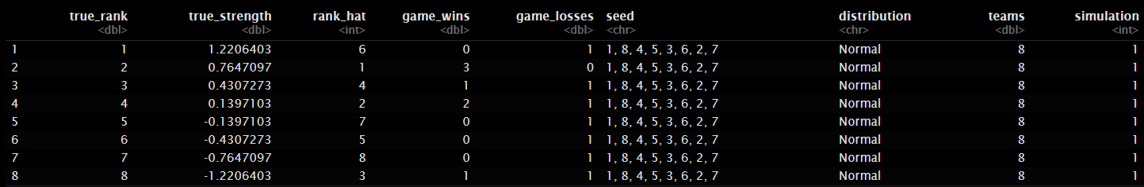
Tournament Simulations
Each tournament is simulated given the number of teams, “known” team strengths, and other notable variations in each tournament (e.g. third place game)

Slide 5


Mutual Information
If one views the true ranking of the teams in a tournament as a message to be sent to a receiver and the outcome of the tournament as a message that is received, we can measure the “goodness” of a tournament in terms of its ability to accurately transmit the true ranking.

Slide 6

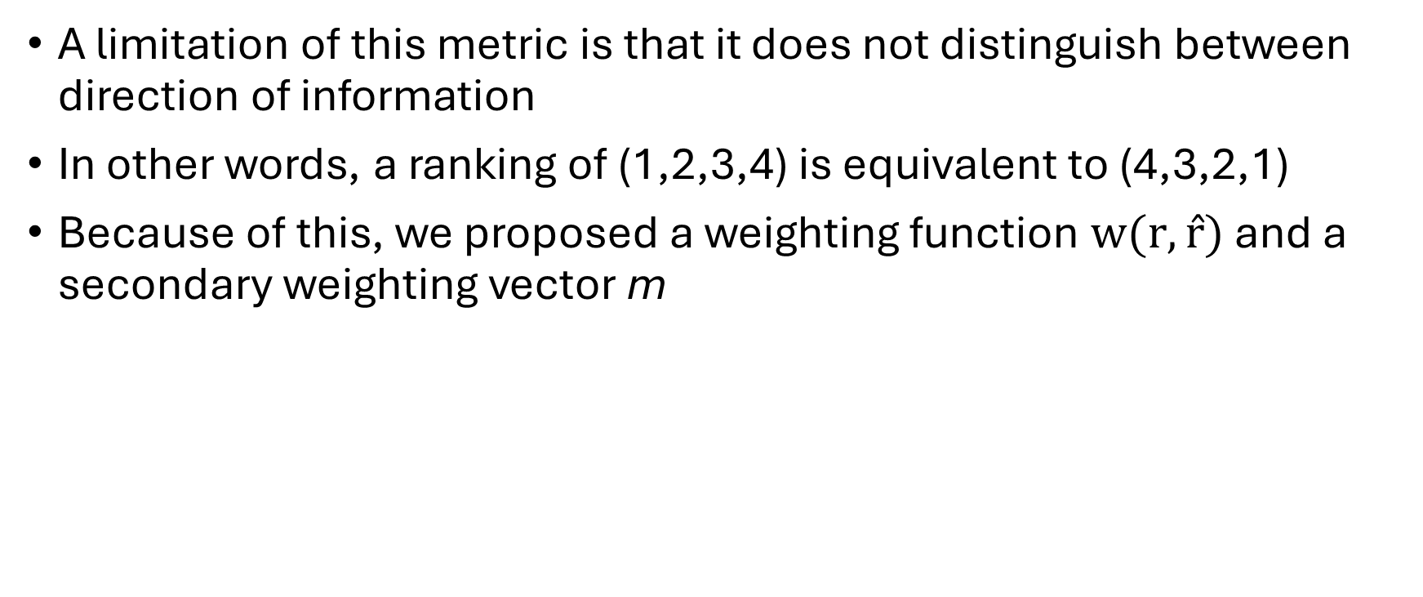
Mutual Information (Continued)
A limitation of this metric is that it does not distinguish between direction of information
In other words, a ranking of (1,2,3,4) is equivalent to (4,3,2,1)
Because of this, we proposed a weighting function $w(r,r̂)$and a secondary weighting vector m

Slide 7

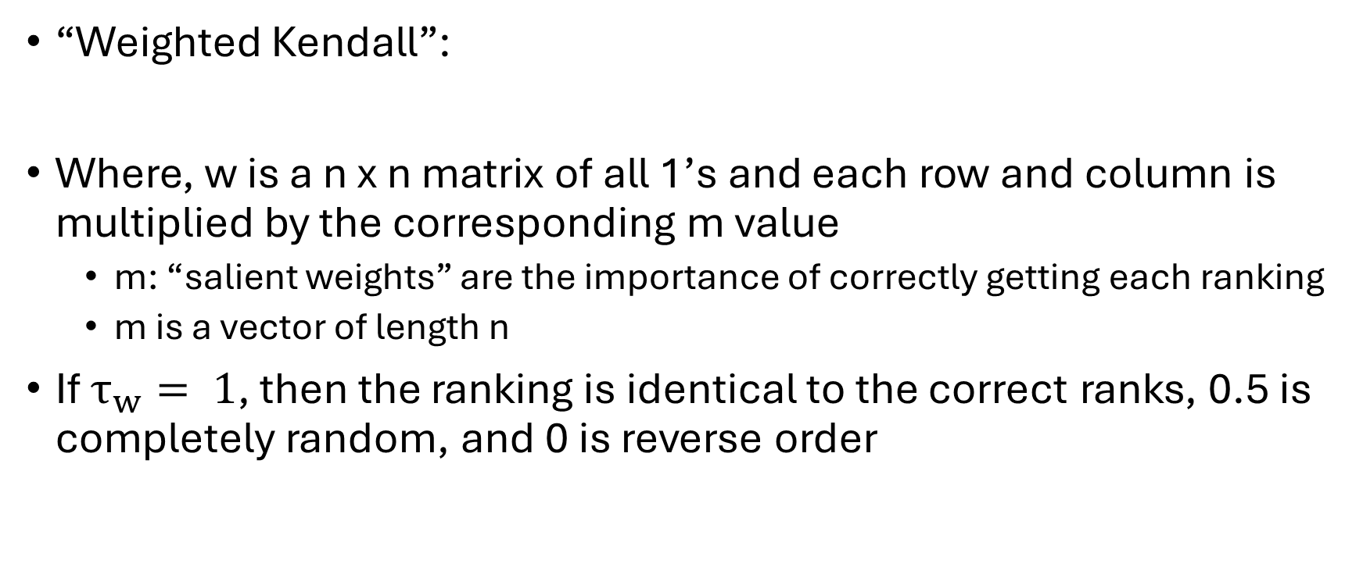
Weighting Function
“Weighted Kendall”:
Where, w is a n x n matrix of all 1’s and each row and column is multiplied by the corresponding m value
  m: “salient weights” are the importance of correctly getting each ranking
  m is a vector of length n
If $τ_{w}= 1$, then the ranking is identical to the correct ranks, 0.5 is completely random, and 0 is reverse order

Slide 8
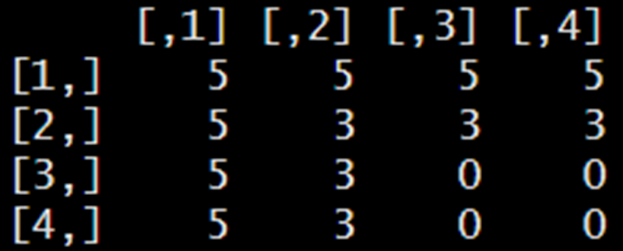
“Salient Weights”
If there are 4 teams in total, and m = (5,3,0,0) then the matrix, w, looks like:

Slide 9
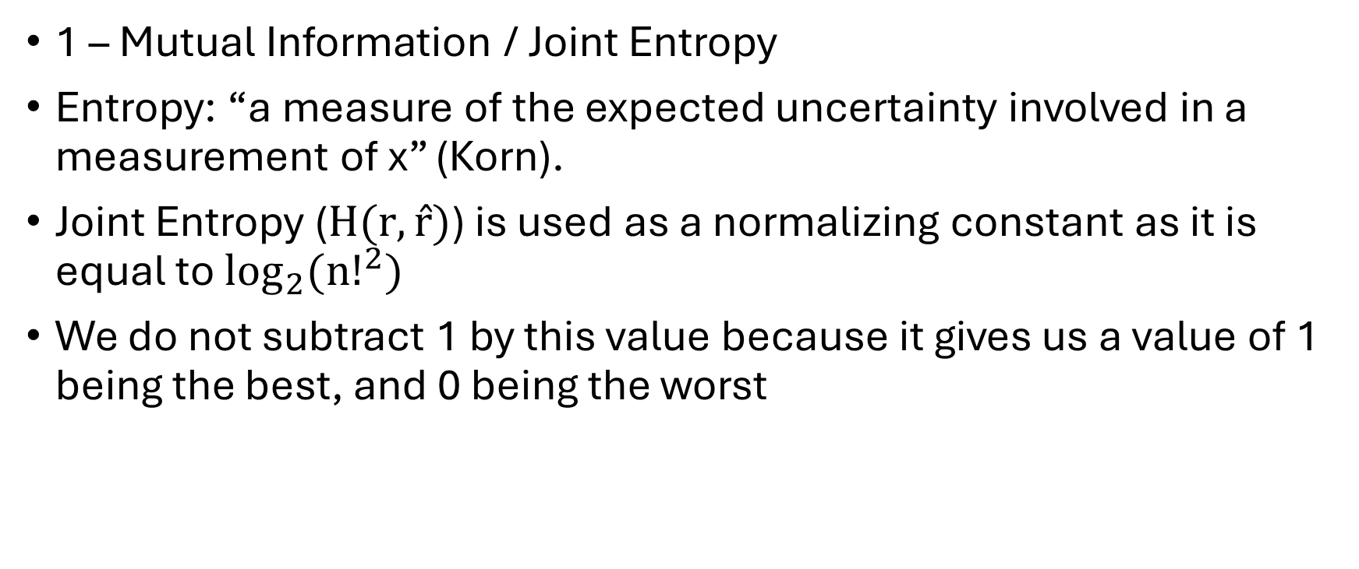
Rajski’s Distance
1 – Mutual Information / Joint Entropy
Entropy: “a measure of the expected uncertainty involved in a measurement of x” (Korn).
Joint Entropy ($H(r,r̂)$) is used as a normalizing constant as it is equal to $\log_{2}{({n!}^{2})}$
We do not subtract 1 by this value because it gives us a value of 1 being the best, and 0 being the worst

Slide 10
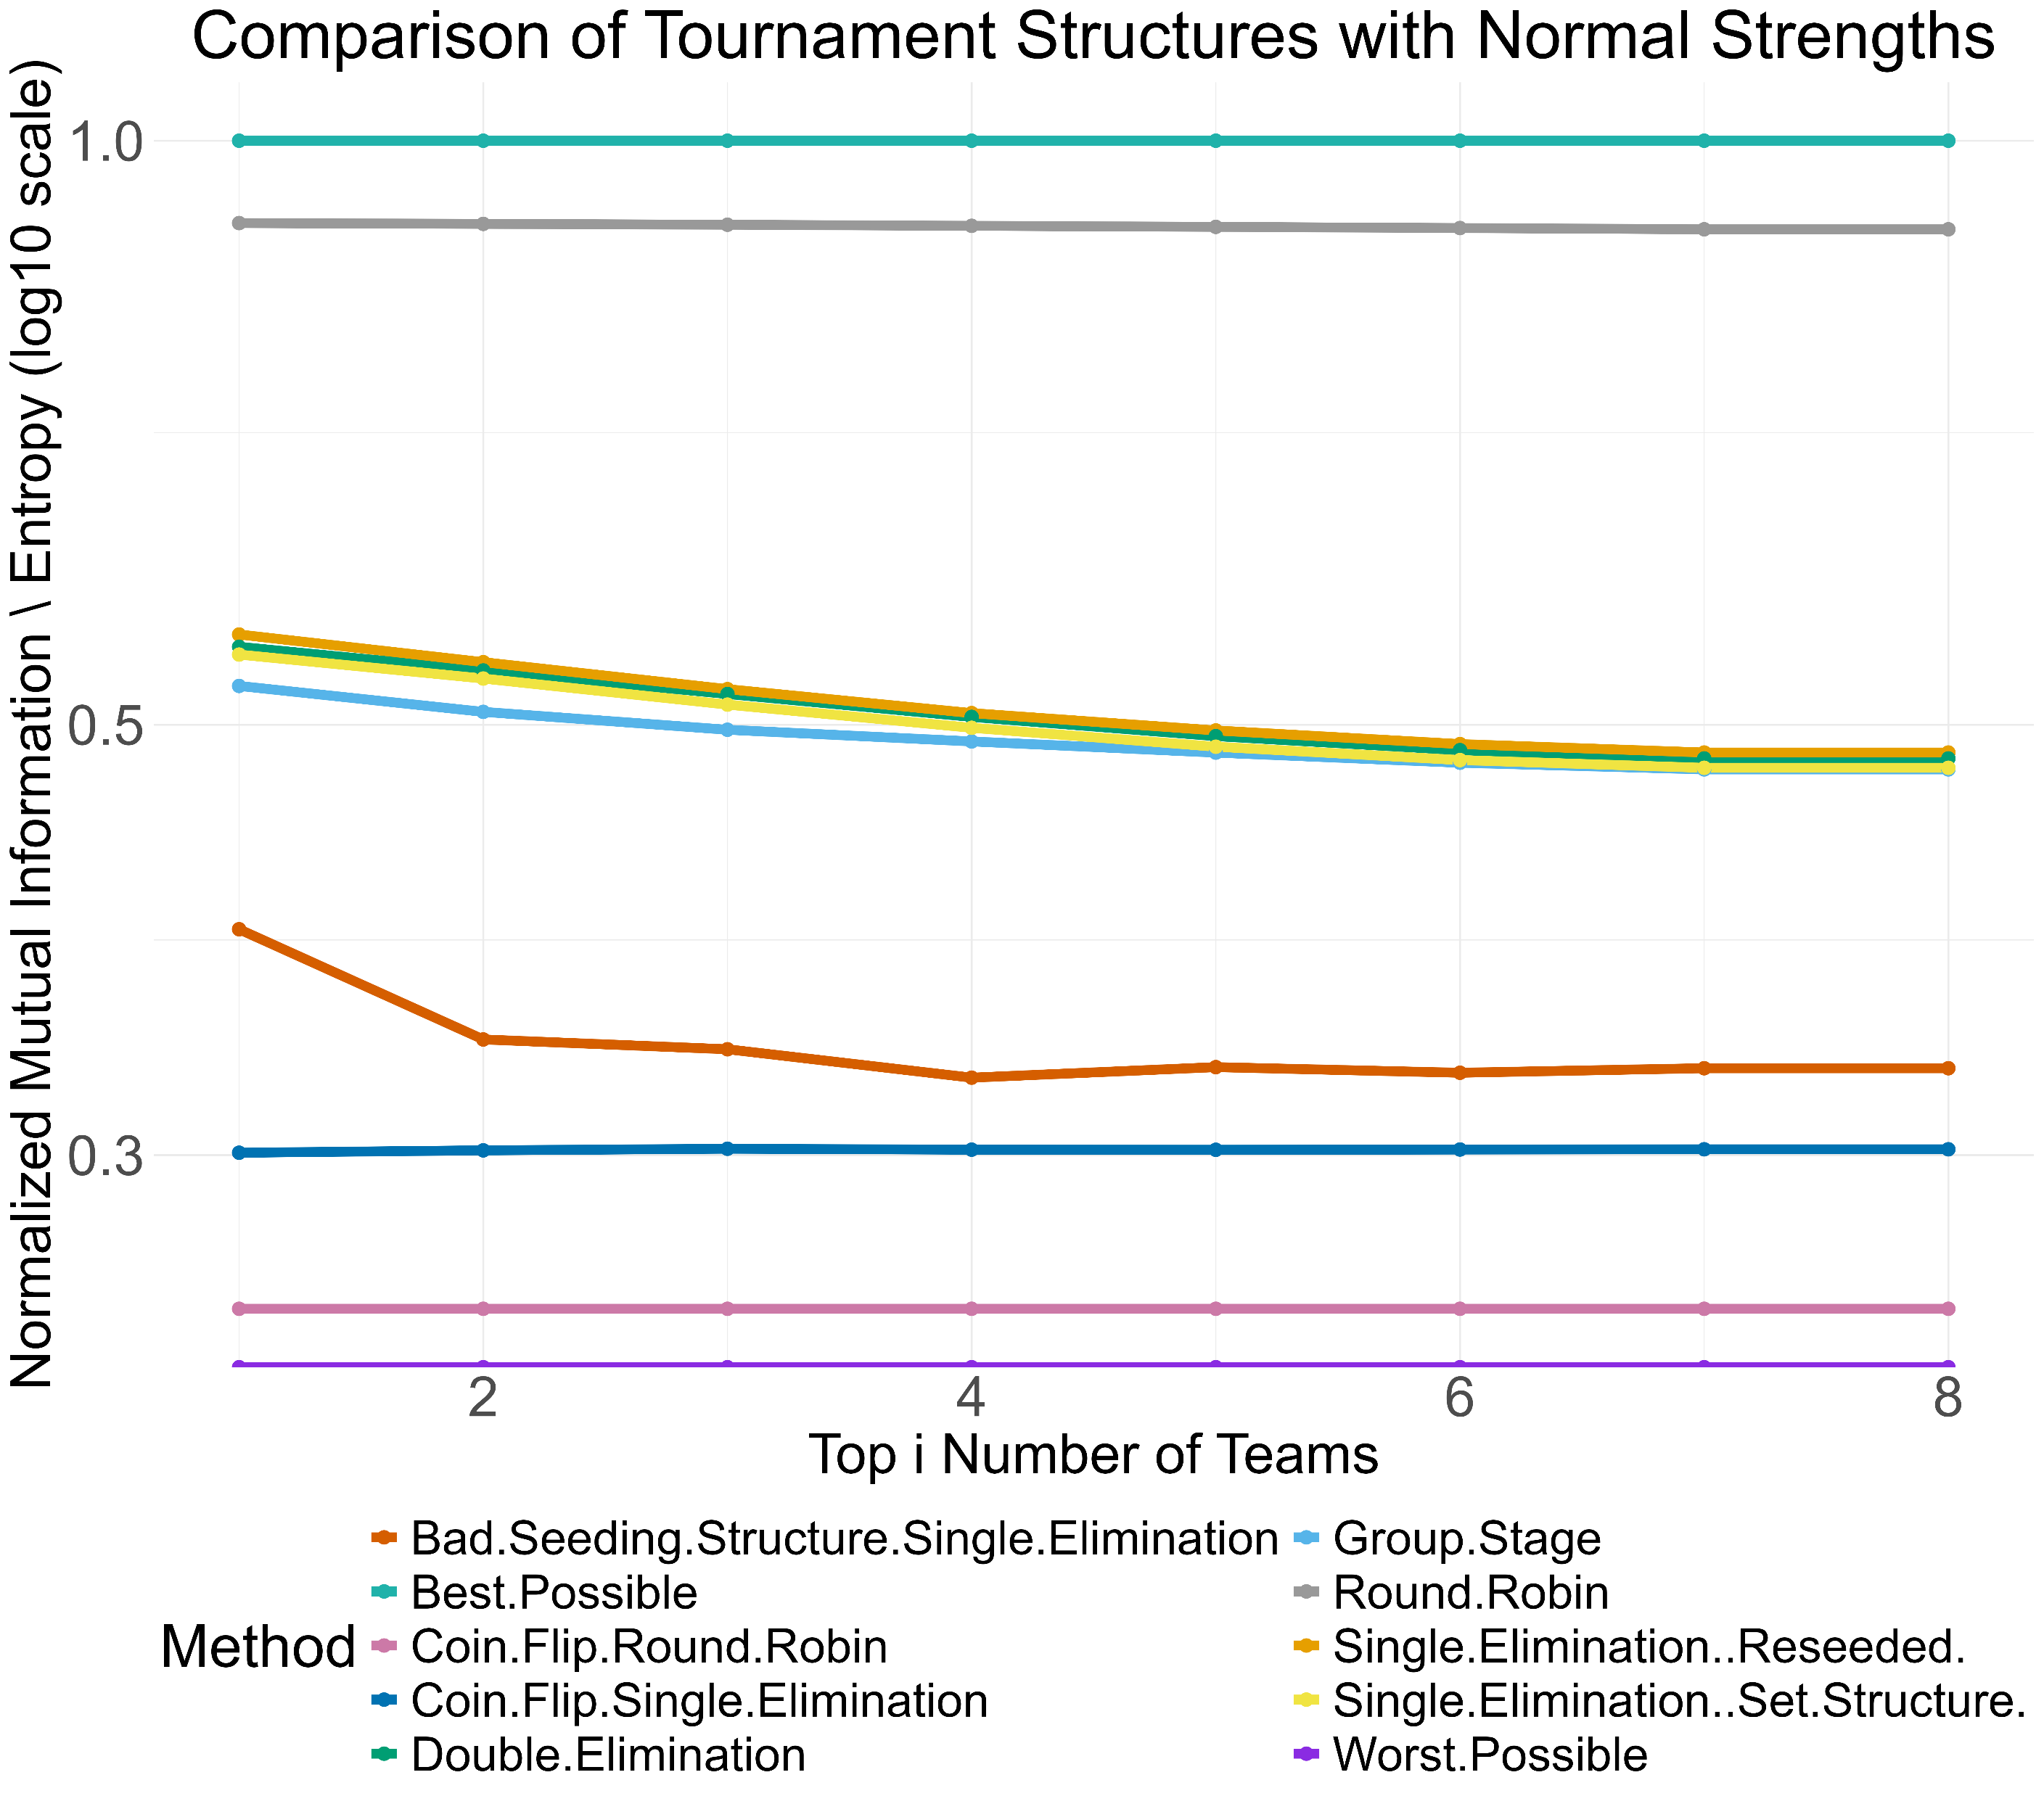
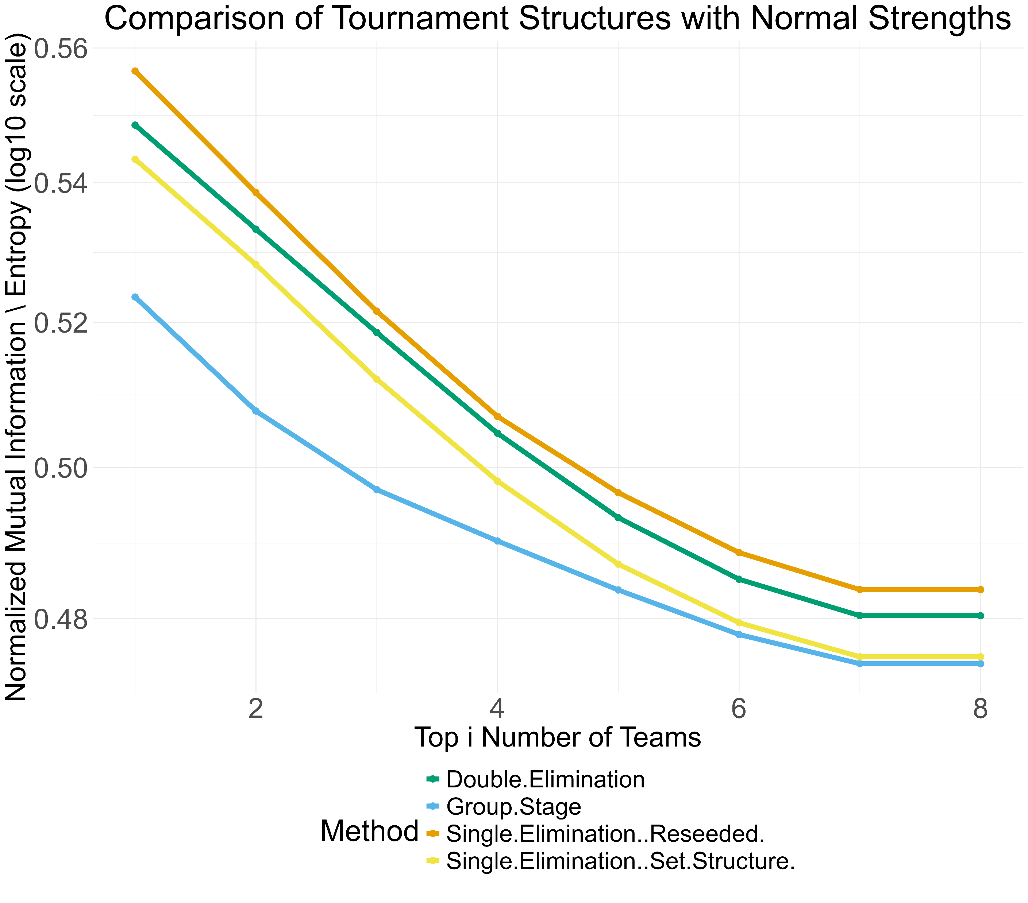
Results
Each tournament is run with 10,000 simulations
The plots below are tournaments with 8 teams:

Slide 11
Limitations
The results are heavily dependent on the weighting structure
  Attempted with Sum Squared Error, Spearman Correlation, Absolute Error, and more with varying results
The “known” strengths are assumptions that can be estimated but never truly known
Ties are not addressed in any of the games
Ties in the overall ranking are randomly sorted (e.g. teams that lose the first game of a single elimination tournament)

Slide 12
Next Steps
Use estimated strengths from a real league and calculate the metric for different structures
Publish findings

Slide 13
References
Appleton, David R. 1995. “May the Best Man Win?” Statistician 44 (4): 529. Csato, L. 2021. Tournament Design: How Operations Research Can Improve Sports Rules. 1st Ed. Cham, Switzerland: Palgrave Macmillan.
Devriesere, Csató, K., and D. Goossens. 2025. “Tournament Design: A Review from an Operational Research Perspective.” European Journal of Operational Research 324 (1): 1–21.
Glenn, W A. 1960. “A Comparison of the Effectiveness of Tournaments.” Biometrika 47 (3-4): 253–62.
Guiasu, Silviu. 1977. Information Theory with Applications. New York, NY: McGraw-Hill.
Johnson, Sidney, and Rodney Fort. 2022. “Match Outcome Uncertainty and Sports Fan Demand: An Agnostic Review and the Standard Economic Theory of Ports Leagues.” Int. J. Emp. Econ. 01 (02).
Korn, Granino A., and Theresa M. Korn. 1961. Mathematical Handbook for Scientists and Engineers: Definitions, Theorems, and Formulas for Reference and Review. New York, NY: McGraw-Hill.
Lasek, Jan, and Marek Gagolewski. 2018. “The Efficacy of League Formats in Ranking Teams.” Stat. Modelling 18 (5-6): 411–35.
Sziklai, Balázs R, Péter Biró, and László Csató. 2022. “The Efficacy of Tournament Designs.” Comput. Oper. Res. 144 (105821): 105821.

Slide 14
Additional Slides

Slide 15
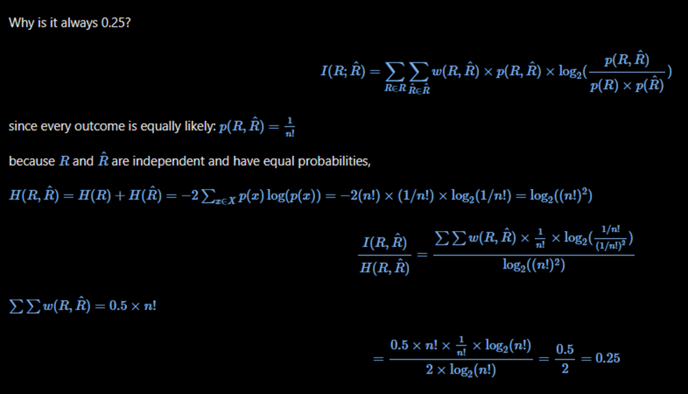
Perfectly Random Proof

Slide 16
Paper and Github Links
https://github.com/gjm112/tournaments/tree/main
https://github.com/gjm112/tournaments/blob/main/manuscript/paper.pdf

