Slide 1
RISC-V Server Platform OS Test proposal
Hengbo Zhu
2024/09/11

Slide 2
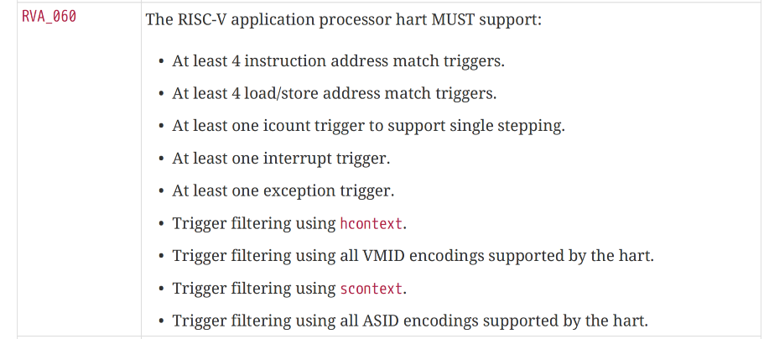
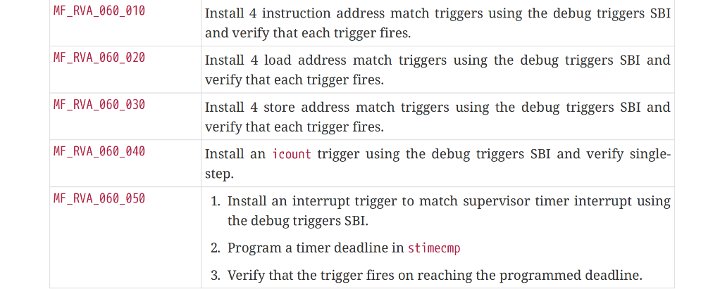
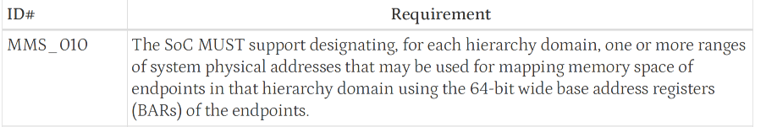
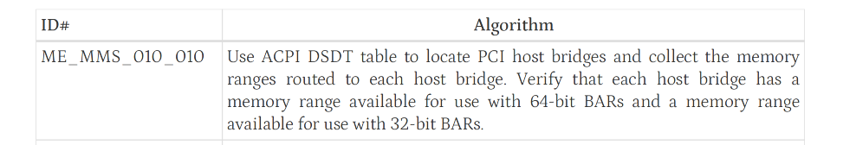
01 Server Platform OS Test proposal
server platform spec
server platform test spec
server soc spec
server soc test spec
Notes:
Hello everyone, I am Hengbo from ISCAS, professor yu's team. very excited to be here
Today, we have a proposal for risc-v server platform OS test.
so as you all know, currently, the server platform specification has clear descriptions of the requirements for each component. like server soc, BRS. Correspondingly, in the server platform test specification, there are test cases for each requirement. Each test case has a number and algorithm description. the number is associated with specific requirements, and the algorithm description contains test procedure step-by-step, and it can help to implement test cases. In the server SoC specification, it's the same. testcase and requirement is also related.

Slide 3
01 Server Platform OS Test proposal
Server Platform Tests
CTS Application
OS/Linux
user
Procfs interface
ACPI table
kernel
OS/Linux
Drivers
CTS ko
testcase
Firmware
Hardware
PCIe
Clock
PMU
Firmware
Security
...
Hardware
Notes:
And at present, most test cases in BRS are tested in the UEFI shell. thus we found that RISC-V may need some test cases executed in the Linux shell, like the Linux applications in ARM Server Ready, to cover scenarios that cannot be tested in the UEFI shell. The aim is still to evaluate the hardware's functionality. to see if it meets server platform specification, such as PCIe, clock, PMU, security, etc.
So here is our idea, and we are still in the early stages. It is quite similar to BSA or SBSA test in ARM Server Ready, where the entire framework executes in the Linux shell after Linux boots up.
In user space, we have a CTS application that interacts with the kernel through procfs, passing control information to the kernel, such as which tests to run and which tests to skip. In kernel space, we compile all the test cases into a kernel module, because some test cases may need to call kernel functions, and then insert it into the kernel. After the tests are completed, the results are sent back to user space via procfs.
Currently, the repository and code have not yet started and we plan to begin by implementing the test cases for PCIe
so that's all and we would like to hear your opinions.
is there any plan about Linux shell testing ? porting from ARM server ready, implementing from scratch or other plan.

