Slide 1
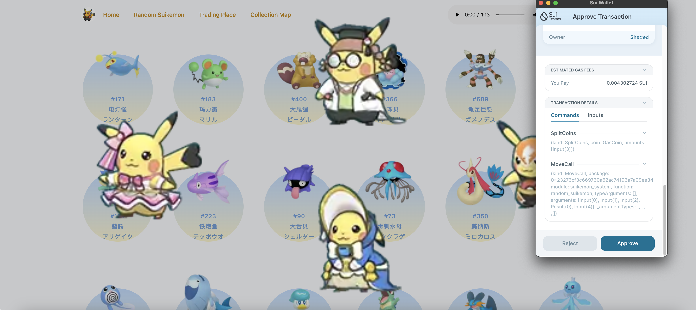
Suikemon
This is a simple card drawing and selling platform. The card contents are all Pokémon with the main attribute or secondary attribute being water, so it is called Suikemon. Here, you can extract suikemon and sell them at a customized price. It also provides a picture book collection function. Believe in yourself, you can become a Suikémon training master!

Slide 2
Improvements
Sui Move
Obelisk engine
Next.js
Redux
Typescript
Tailwindcss
…
Next.js Pages Router -> App Router
Optimization and improvement of trading functions
Publish to Walrus testnet

Slide 3
Thanks
Through the cross-chain token transfer technology provided by Wormhole, multiple payment methods are supported to randomize Suikemon cards in future.
In the current project, the card is just a simple object. In the future, you can consider making it into an NFT, and then use Wormhole to give the extracted NFT across the chain.

