Slide 1
Algorithms
Chapter 3
With Question/Answer Animations

Slide 2
Chapter Summary
Algorithms
Example Algorithms
Algorithmic Paradigms
Growth of Functions
Big-O and other Notation
Complexity of Algorithms

Slide 3
Algorithms
Section 3.1

Slide 4
Section Summary
Properties of Algorithms
Algorithms for Searching and Sorting
Greedy Algorithms
Halting Problem

Slide 5
Problems and Algorithms
In many domains there are key general problems that ask for output with specific properties when given valid input.
The first step is to precisely state the problem, using the appropriate structures to specify the input and the desired output.
We then solve the general problem by specifying the steps of a procedure that takes a valid input and produces the desired output. This procedure is called an algorithm.

Slide 6
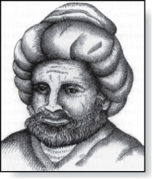
Algorithms
Abu Ja’far Mohammed Ibin Musa Al-Khowarizmi
(780-850)
Definition: An algorithm is a finite set of precise instructions for performing a computation or for solving a problem.
Example 1: Describe an algorithm for finding the maximum value in a finite sequence of integers.
Solution: Perform the following steps:
Set the temporary maximum equal to the first integer in the sequence.
Compare the next integer in the sequence to the temporary maximum.
If it is larger than the temporary maximum, set the temporary maximum equal to this integer.
Repeat the previous step if there are more integers. If not, stop.
When the algorithm terminates, the temporary maximum is the largest integer in the sequence.

Slide 7
Specifying Algorithms
Algorithms can be specified in different ways. Their steps can be described in English or in pseudocode.
Pseudocode is an intermediate step between an English language description of the steps and a coding of these steps using a programming language.
The form of pseudocode we use is specified in Appendix 3. It uses some of the structures found in popular languages such as C++ and Java.
Programmers can use the description of an algorithm in pseudocode to construct a program in a particular language.
Pseudocode helps us analyze the time required to solve a problem using an algorithm, independent of the actual programming language used to implement algorithm.

Slide 8
Properties of Algorithms
Input: An algorithm has input values from a specified set.
Output: From the input values, the algorithm produces the output values from a specified set. The output values are the solution.
Correctness: An algorithm should produce the correct output values for each set of input values.
Finiteness: An algorithm should produce the output after a finite number of steps for any input.
Effectiveness: It must be possible to perform each step of the algorithm correctly and in a finite amount of time.
Generality: The algorithm should work for all problems of the desired form.

Slide 9
Finding the Maximum Element in a Finite Sequence
The algorithm in pseudocode:
Algorithm 1： Finding the maximum value
Does this algorithm have all the properties listed on the previous slide?
procedure max(a₁, a₂, …., a_{n}: integers)
max := a₁
for i := 2 to n
if max < a_{i} then max := a_{i}
return max{max is the largest element}

Slide 10
Some Example of Algorithm Problems
Three classes of problems will be studied in this section.
Searching Problems: finding the position of a particular element in a list.
Sorting problems: putting the elements of a list into increasing order.
Optimization Problems: determining the optimal value (maximum or minimum) of a particular quantity over all possible inputs.

Slide 11
Searching Problems
Definition: The general searching problem is to locate an element x in the list of distinct elements a₁,a₂,...,a_{n}, or determine that it is not in the list.
The solution to a searching problem is the location of the term in the list that equals x (that is, i is the solution if x = a_{i}) or 0 if x is not in the list.
For example, a library might want to check to see if a patron is on a list of those with overdue books before allowing him/her to checkout another book.
We will study two different searching algorithms; linear search and binary search.

Slide 12
Linear Search Algorithm
The linear search algorithm locates an item in a list by examining elements in the sequence one at a time, starting at the beginning.
First compare x with a₁. If they are equal, return the position 1.
If not, try a₂. If x = a₂, return the position 2.
Keep going, and if no match is found when the entire list is scanned, return 0.
procedure linear search(x:integer,
a₁, a₂, …,a_{n}: distinct integers)
i := 1
while (i ≤ n and x ≠ a_{i})
i := i + 1
if i ≤ n then location := i
else location := 0
return location{location is the subscript of the term that equals x, or is 0 if x is not found}

Slide 13
Binary Search
Assume the input is a list of items in increasing order.
The algorithm begins by comparing the element to be found with the middle element.
If the middle element is lower, the search proceeds with the upper half of the list.
If it is not lower, the search proceeds with the lower half of the list (through the middle position).
Repeat this process until we have a list of size 1.
If the element we are looking for is equal to the element in the list, the position is returned.
Otherwise, 0 is returned to indicate that the element was not found.
In Section 3.3, we show that the binary search algorithm is much more efficient than linear search.

Slide 14
Binary Search
Here is a description of the binary search algorithm in pseudocode.
procedure binary search(x: integer, a₁,a₂,…, a_{n}: increasing integers)
i := 1 {i is the left endpoint of interval}
j := n {j is right endpoint of interval}
while i < j
m := ⌊(i + j)/2⌋
if x > a_{m} then i := m + 1
else j := m
if x = a_{i} then location := i
else location := 0
return location{location is the subscript i of the term a_{i} equal to x,
or 0 if x is not found}

Slide 15
Binary Search
Example: The steps taken by a binary search for 19 in the list:
1 2 3 5 6 7 8 10 12 13 15 16 18 19 20 22
The list has 16 elements, so the midpoint is 8. The value in the 8th position is 10. Since 19 > 10, further search is restricted to positions 9 through 16.
1 2 3 5 6 7 8 10 12 13 15 16 18 19 20 22
The midpoint of the list (positions 9 through 16) is now the 12th position with a value of 16. Since 19 > 16, further search is restricted to the 13th position and above.
1 2 3 5 6 7 8 10 12 13 15 16 18 19 20 22
The midpoint of the current list is now the 14th position with a value of 19. Since 19 ≯ 19, further search is restricted to the portion from the 13th through the 14th positions .
1 2 3 5 6 7 8 10 12 13 15 16 18 19 20 22
The midpoint of the current list is now the 13th position with a value of 18. Since 19> 18, search is restricted to the portion from the 18th position through the 18th.
1 2 3 5 6 7 8 10 12 13 15 16 18 19 20 22
Now the list has a single element and the loop ends. Since 19=19, the location 16 is returned.

Slide 16
Sorting
To sort the elements of a list is to put them in increasing order (numerical order, alphabetic, and so on).
Sorting is an important problem because:
A nontrivial percentage of all computing resources are devoted to sorting different kinds of lists, especially applications involving large databases of information that need to be presented in a particular order (e.g., by customer, part number etc.).
An amazing number of fundamentally different algorithms have been invented for sorting. Their relative advantages and disadvantages have been studied extensively.
Sorting algorithms are useful to illustrate the basic notions of computer science.
A variety of sorting algorithms are studied in this book; binary, insertion, bubble, selection, merge, quick, and tournament.
In Section 3.3, we’ll study the amount of time required to sort a list using the sorting algorithms covered in this section.

Slide 17
Bubble Sort
Bubble sort makes multiple passes through a list. Every pair of elements that are found to be out of order are interchanged.
procedure bubblesort(a₁,…,a_{n}: real numbers
with n ≥ 2)
for i := 1 to n− 1
for j := 1 to n − i
if a_{j} >a_{j+1} then interchange a_{j} and a_{j+1}
{a₁,…, a_{n} is now in increasing order}

Slide 18
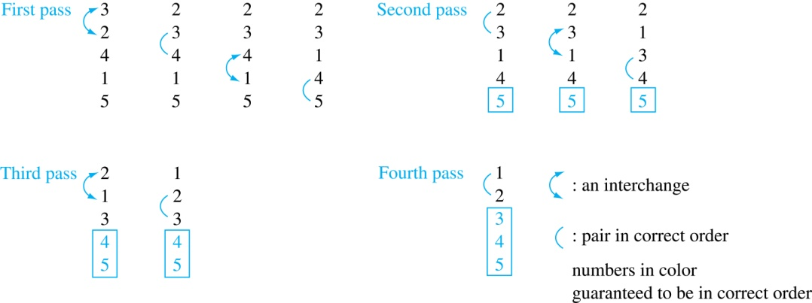
Bubble Sort
Example: Show the steps of bubble sort with 3 2 4 1 5
At the first pass the largest element has been put into the correct position
At the end of the second pass, the 2nd largest element has been put into the correct position.
In each subsequent pass, an additional element is put in the correct position.

Slide 19
Insertion Sort
Insertion sort begins with the 2nd element. It compares the 2nd element with the 1st and puts it before the first if it is not larger.
procedure insertion sort
(a₁,…,a_{n}:
real numbers with n ≥ 2)
for j := 2 to n
i := 1
while a_{j} > a_{i}
i := i + 1
m := a_{j}
for k := 0 to j − i − 1
a_{j-k} := a_{j-k-1}
a_{i} := m
{Now a₁,…,a_{n} is in increasing order}
Next the 3rd element is put into the correct position among the first 3 elements.
In each subsequent pass, the n+1st element is put into its correct position among the first n+1 elements.
Linear search is used to find the correct position.

Slide 20
Insertion Sort
Example: Show all the steps of insertion sort with the input: 3 2 4 1 5
2 3 4 1 5 (first two positions are interchanged)
2 3 4 1 5 (third element remains in its position)
1 2 3 4 5 (fourth is placed at beginning)
1 2 3 4 5 (fifth element remains in its position)

Slide 21
Greedy Algorithms
Optimization problems minimize or maximize some parameter over all possible inputs.
Among the many optimization problems we will study are:
Finding a route between two cities with the smallest total mileage.
Determining how to encode messages using the fewest possible bits.
Finding the fiber links between network nodes using the least amount of fiber.
Optimization problems can often be solved using a greedy algorithm, which makes the “best” choice at each step. Making the “best choice” at each step does not necessarily produce an optimal solution to the overall problem, but in many instances, it does.
After specifying what the “best choice” at each step is, we try to prove that this approach always produces an optimal solution, or find a counterexample to show that it does not.
The greedy approach to solving problems is an example of an algorithmic paradigm, which is a general approach for designing an algorithm. We return to algorithmic paradigms in Section 3.3.

Slide 22
Greedy Algorithms: Making Change
Example: Design a greedy algorithm for making change (in U.S. money) of n cents with the following coins: quarters (25 cents), dimes (10 cents), nickels (5 cents), and pennies (1 cent) , using the least total number of coins.
Idea: At each step choose the coin with the largest possible value that does not exceed the amount of change left.
If n = 67 cents, first choose a quarter leaving 67−25 = 42 cents. Then choose another quarter leaving 42 −25 = 17 cents
Then choose 1 dime, leaving 17 − 10 = 7 cents.
Choose 1 nickel, leaving 7 – 5 = 2 cents.
Choose a penny, leaving one cent. Choose another penny leaving 0 cents.

Slide 23
Greedy Change-Making Algorithm
Solution: Greedy change-making algorithm for n cents. The algorithm works with any coin denominations c₁, c₂, …,c_{r} .
For the example of U.S. currency, we may have quarters, dimes, nickels and pennies, with c₁ = 25, c₂ = 10, c₃ = 5, and c₄ = 1.
procedure change(c₁, c₂, …, c_{r}: values of coins, where c₁> c₂> … > c_{r} ; n: a positive integer)
for i := 1 to r
d_{i} := 0 [d_{i} counts the coins of denomination c_{i}]
while n ≥ c_{i}
d_{i} := d_{i} + 1 [add a coin of denomination c_{i}]
n = n - c_{i}
[d_{i} counts the coins c_{i}]

Slide 24
Proving Optimality for U.S. Coins
Show that the change making algorithm for U.S. coins is optimal.
Lemma 1: If n is a positive integer, then n cents in change using quarters, dimes, nickels, and pennies, using the fewest coins possible has at most 2 dimes, 1 nickel, 4 pennies, and cannot have 2 dimes and a nickel. The total amount of change in dimes, nickels, and pennies must not exceed 24 cents.
Proof: By contradiction
If we had 3 dimes, we could replace them with a quarter and a nickel.
If we had 2 nickels, we could replace them with 1 dime.
If we had 5 pennies, we could replace them with a nickel.
If we had 2 dimes and 1 nickel, we could replace them with a quarter.
The allowable combinations, have a maximum value of 24 cents; 2 dimes and 4 pennies.

Slide 25
Proving Optimality for U.S. Coins
Theorem: The greedy change-making algorithm for U.S. coins produces change using the fewest coins possible.
Proof: By contradiction.
Assume there is a positive integer n such that change can be made for n cents using quarters, dimes, nickels, and pennies, with a fewer total number of coins than given by the algorithm.
Then, q̍ ≤ q where q̍ is the number of quarters used in this optimal way and q is the number of quarters in the greedy algorithm’s solution. But this is not possible by Lemma 1, since the value of the coins other than quarters can not be greater than 24 cents.
Similarly, by Lemma 1, the two algorithms must have the same number of dimes, nickels, and quarters.

Slide 26
Greedy Change-Making Algorithm
Optimality depends on the denominations available.
For U.S. coins, optimality still holds if we add half dollar coins (50 cents) and dollar coins (100 cents).
But if we allow only quarters (25 cents), dimes (10 cents), and pennies (1 cent), the algorithm no longer produces the minimum number of coins.
Consider the example of 31 cents. The optimal number of coins is 4, i.e., 3 dimes and 1 penny. What does the algorithm output?

Slide 27
A failure of the greedy algorithm
In some (fictional) monetary system, “Asiarons” come in 1 Asiaron, 7 Asiaron, and 10 Asiaron coins
Using a greedy algorithm to count out 15 Asiarons, you would get
A 10 Asiaron piece
Five 1 Asiaron pieces, for a total of 15 Asiarons
This requires six coins
A better solution would be to use two 7 Asiaron pieces and one 1 Asiaron piece
This only requires three coins
The greedy algorithm results in a solution, but not in an optimal solution

Slide 28
Greedy Scheduling
Example: We have a group of proposed talks with start and end times. Construct a greedy algorithm to schedule as many as possible in a lecture hall, under the following assumptions:
When a talk starts, it continues till the end.
No two talks can occur at the same time.
A talk can begin at the same time that another ends.
Once we have selected some of the talks, we cannot add a talk which is incompatible with those already selected because it overlaps at least one of these previously selected talks.
How should we make the “best choice” at each step of the algorithm? That is, which talk do we pick ?
The talk that starts earliest among those compatible with already chosen talks?
The talk that is shortest among those already compatible?
The talk that ends earliest among those compatible with already chosen talks?

Slide 29
Greedy Scheduling
Picking the talk that starts earliest among the talks compatible with those already selected doesn’t work
Start: 8:00 AM
Talk 1
Start: 9:00 AM
Talk 2
Start: 10:45 AM
End :12:00 noon
End: 10:00 AM
Talk 3
End: 11:30 AM
Can you find a counterexample here?

Slide 30
Greedy Scheduling
Picking the shortest talk doesn’t work.
Can you find a counterexample here?
But picking the one that ends soonest does work. The algorithm is specified on the next page.
Start: 8:00 AM
Talk 1
Start: 9:00 AM
Talk 2
Start: 9:45 AM
End :9:45 AM
Talk 3
End: 10:00 AM
End: 11:00 AM

Slide 31
Greedy Scheduling algorithm
Solution: At each step, choose the talks with the earliest ending time among the talks compatible with those selected.
Will be proven correct by induction in Chapter 5.
procedure schedule(s₁ ≤ s₂ ≤ … ≤ s_{n} : start times, e₁ ≤ e₂ ≤ … ≤ e_{n} : end times)
sort talks by finish time and reorder so that e₁ ≤ e₂ ≤ … ≤ e_{n}
S := ∅
for j := 1 to n
if talk j is compatible with S then
S := S ∅∪{talk j}
return S [ S is the set of talks scheduled]

Slide 32
Halting Problem
Example: Can we develop a procedure that takes as input a computer program along with its input and determines whether the program will eventually halt with that input.
Solution: Proof by contradiction.
Assume that there is such a procedure and call it H(P,I). The procedure H(P,I) takes as input a program P and the input I to P.
H outputs “halt” if it is the case that P will stop when run with input I.
Otherwise, H outputs “loops forever.”

Slide 33
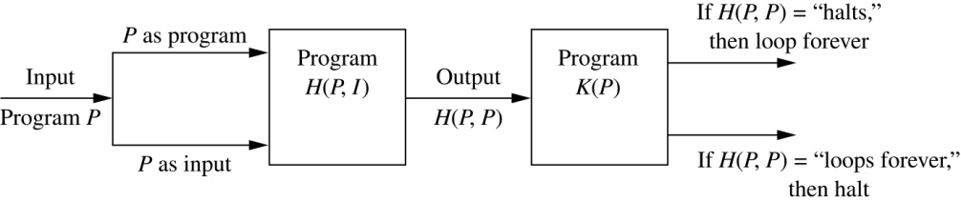
Halting Problem
Since a program is a string of characters, we can call H(P,P). Construct a procedure K(P), which works as follows.
If H(P,P) outputs “loops forever” then K(P) halts.
If H(P,P) outputs “halt” then K(P) goes into an infinite loop printing “ha” on each iteration.

Slide 34
Halting Problem
Now we call K with K as input, i.e. K(K).
If the output of H(K,K) is “loops forever” then K(K) halts. A Contradiction.
If the output of H(K,K) is “halts” then K(K) loops forever. A Contradiction.
Therefore, there can not be a procedure that can decide whether or not an arbitrary program halts. The halting problem is unsolvable.

Slide 35
Halting Problem
Bool DOES-HALT(P, I)
{
if (P will stop when run with input I)
return 1
else
return 0
}
Bool SELF-HALT(program)
{ if(DOES-HALT(program, program))
infinite loop
else
halt
}
Then how about SELF-HALT(SELF-HALT)

Slide 36
Exercise
P202-203 15, 29 7th edition
P178 15, 29 6th edition

Slide 37
The Growth of Functions
Section 3.2

Slide 38
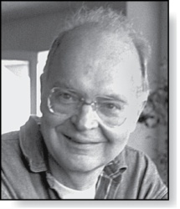
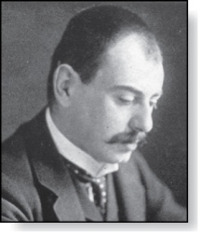
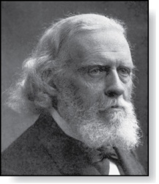
Section Summary
Donald E. Knuth
(Born 1938)
Big-O Notation
Big-O Estimates for Important Functions
Big-Omega and Big-Theta Notation
Edmund Landau
(1877-1938)
Paul Gustav Heinrich Bachmann
(1837-1920)

Slide 39
The Growth of Functions
In both computer science and in mathematics, there are many times when we care about how fast a function grows.
In computer science, we want to understand how quickly an algorithm can solve a problem as the size of the input grows.
We can compare the efficiency of two different algorithms for solving the same problem.
We can also determine whether it is practical to use a particular algorithm as the input grows.
We’ll study these questions in Section 3.3.
Two of the areas of mathematics where questions about the growth of functions are studied are:
number theory (covered in Chapter 4)
combinatorics (covered in Chapters 6 and 8)

Slide 40
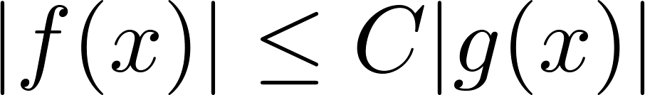
Big-O Notation
Definition: Let f and g be functions from the set of integers or the set of real numbers to the set of real numbers. We say that f(x) is O(g(x)) if there are constants C and k such that
whenever x > k. (illustration on next slide)
This is read as “f(x) is big-O of g(x)” or “g asymptotically dominates f.”
The constants C and k are called witnesses to the relationship f(x) is O(g(x)). Only one pair of witnesses is needed.

Slide 41
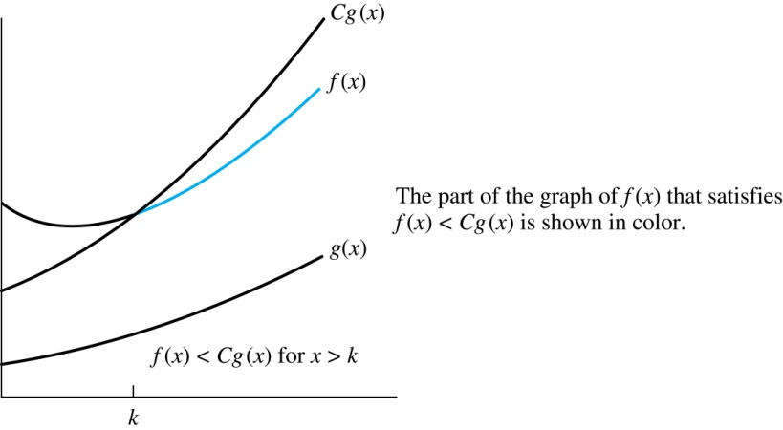
Illustration of Big-O Notation
f(x) is O(g(x)

Slide 42

Some Important Points about Big-O Notation
If one pair of witnesses is found, then there are infinitely many pairs. We can always make the k or the C larger and still maintain the inequality .
Any pair C ̍ and k̍ where C < C̍ and k < k ̍ is also a pair of witnesses since whenever x > k̍ > k.
You may see “ f(x) = O(g(x))” instead of “ f(x) is O(g(x)).”
But this is an abuse of the equals sign since the meaning is that there is an inequality relating the values of f and g, for sufficiently large values of x.
It is ok to write f(x) ∊ O(g(x)), because O(g(x)) represents the set of functions that are O(g(x)).
Usually, we will drop the absolute value sign since we will always deal with functions that take on positive values.

Slide 43
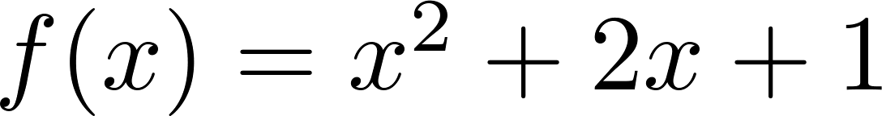
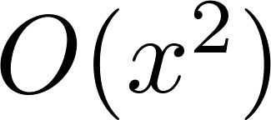
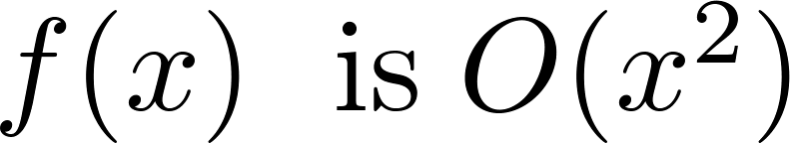
Using the Definition of Big-O Notation
Example: Show that is .
Solution: Since when x > 1, x < x² and 1 < x²
Can take C = 4 and k = 1 as witnesses to show that
(see graph on next slide)
Alternatively, when x > 2, we have 2x ≤ x² and 1 < x². Hence, when x > 2.
Can take C = 3 and k = 2 as witnesses instead.

Slide 44
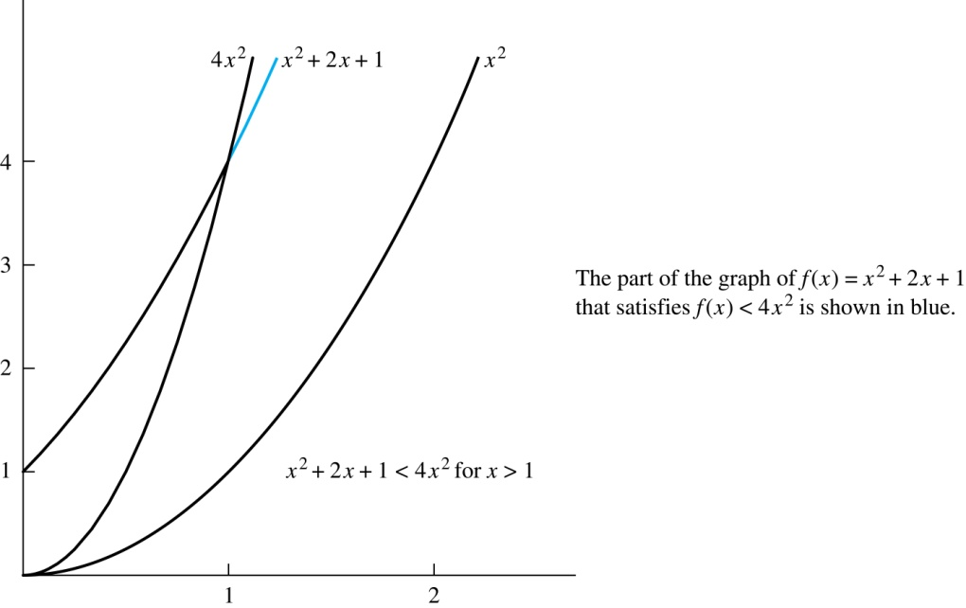
Illustration of Big-O Notation
is

Slide 45
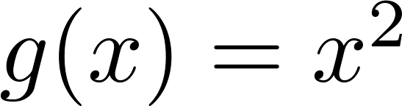
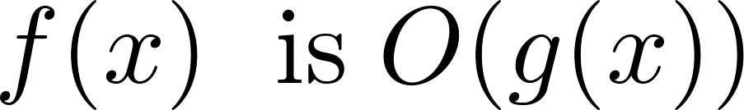

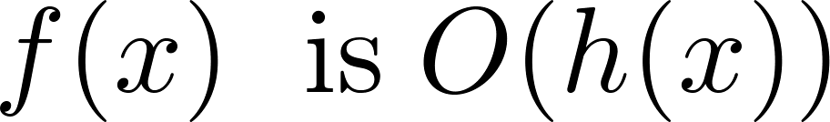
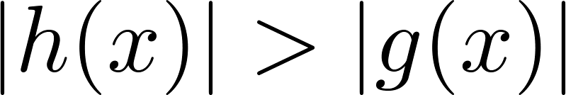
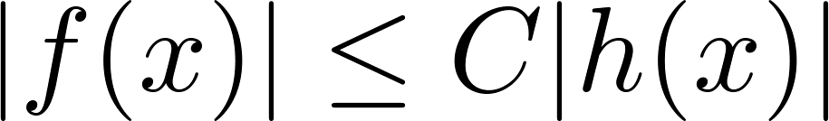
Big-O Notation
Both and
are such that and .
We say that the two functions are of the same order. (More on this later)
If and h(x) is larger than g(x) for all positive real numbers, then .
Note that if for x > k and if
for all x, then if x > k. Hence, .
For many applications, the goal is to select the function g(x) in O(g(x)) as small as possible (up to multiplication by a constant, of course).

Slide 46
Using the Definition of Big-O Notation
Example: Show that 7x² is O(x³).
Solution: When x > 7, 7x² < x³. Take C =1 and k = 7 as witnesses to establish that 7x² is O(x³).
(Would C = 7 and k = 1 work?)
Example: Show that n² is not O(n).
Solution: Suppose there are constants C and k for which n² ≤ Cn, whenever n > k. Then (by dividing both sides of n² ≤ Cn) by n, then n ≤ C must hold for all n > k. A contradiction!

Slide 47

Big-O Estimates for Polynomials
Example: Let
where are real numbers with a_{n} ≠0.
Then f(x) is O(x^{n}).
Proof: |f(x)| = |a_{n}x^{n} + a_{n-1} x^{n-1} + ∙∙∙ + a₁x¹ + a₁|
≤ |a_{n}|x^{n} + |a_{n-1}| x^{n-1} + ∙∙∙ + |a₁|x¹ + |a₁|
= x^{n} (|a_{n}| + |a_{n-1}| /x + ∙∙∙ + |a₁|/x^{n-1} + |a₁|/ x^{n})
≤ x^{n} (|a_{n}| + |a_{n-1}| + ∙∙∙ + |a₁|+ |a₁|)
Take C = |a_{n}| + |a_{n-1}| + ∙∙∙ + |a₁|+ |a₁| and k = 1. Then f(x) is O(x^{n}).
The leading term a_{n}x^{n} of a polynomial dominates its growth.
Uses triangle inequality, an exercise in Section 1.8.
Assuming x > 1

Slide 48
Big-O Estimates for some Important Functions
Example: Use big-O notation to estimate the sum of the first n positive integers.
Solution:
Example: Use big-O notation to estimate the factorial function
Solution:
Continued →

Slide 49
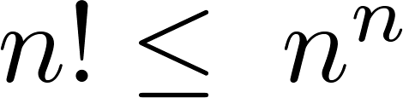
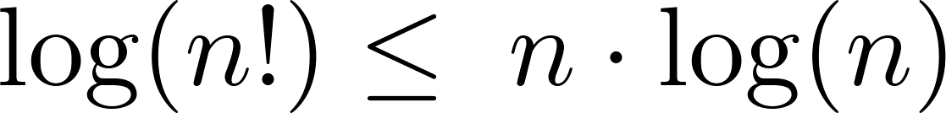
Big-O Estimates for some Important Functions
Example: Use big-O notation to estimate log n!
Solution: Given that (previous slide)
then .
Hence, log(n!) is O(n∙log(n)) taking C = 1 and k = 1.

Slide 50
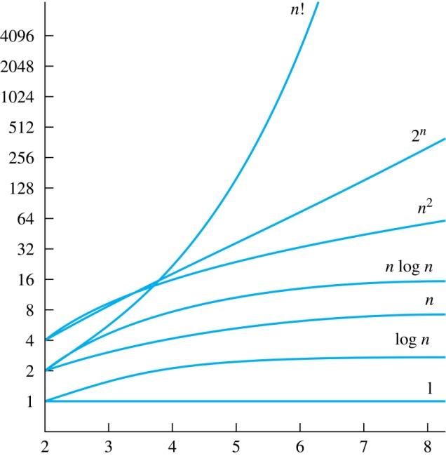
Display of Growth of Functions
Note the difference in behavior of functions as n gets larger

Slide 51
Useful Big-O Estimates Involving Logarithms, Powers, and Exponents
If d > c > 1, then
n^{c} is O(n^{d}), but n^{d} is not O(n^{c}).
If b > 1 and c and d are positive, then
(log_{b} n)^{c} is O(n^{d}), but n^{d} is not O((log_{b} n)^{c}).
If b > 1 and d is positive, then
n^{d} is O(b^{n}), but b^{n} is not O(n^{d}).
If c > b > 1, then
b^{n} is O(c^{n}), but c^{n} is not O(b^{n}).

Slide 52
Combinations of Functions
If f₁ (x) is O(g₁(x)) and f₂ (x) is O(g₂(x)) then
( f₁ + f₂ )(x) is O(max(|g₁(x) |,|g₂(x) |)).
See next slide for proof
If f₁ (x) and f₂ (x) are both O(g(x)) then
( f₁ + f₂ )(x) is O(g(x)).
See text for argument
If f₁ (x) is O(g₁(x)) and f₂ (x) is O(g₂(x)) then
( f₁ f₂ )(x) is O(g₁(x)g₂(x)).
See text for argument

Slide 53
Combinations of Functions
If f₁ (x) is O(g₁(x)) and f₂ (x) is O(g₂(x)) then
( f₁ + f₂ )(x) is O(max(|g₁(x) |,|g₂(x) |)).
By the definition of big-O notation, there are constants C₁,C₂ ,k₁,k₂ such that | f₁ (x) ≤ C₁|g₁(x) | when x > k₁ and f₂ (x) ≤ C₂|g₂(x) | when x > k₂ .
|( f₁ + f₂ )(x)| = |f₁(x) + f₂(x)|
≤ |f₁ (x)| + |f₂ (x)| by the triangle inequality |a + b| ≤ |a| + |b|
|f₁ (x)| + |f₂ (x)| ≤ C₁|g₁(x) | + C₂|g₂(x) |
≤ C₁|g(x) | + C₂|g(x) | where g(x) = max(|g₁(x)|,|g₂(x)|)
= (C₁ + C₂) |g(x)|
= C|g(x)| where C = C₁ + C₂
Therefore |( f₁ + f₂ )(x)| ≤ C|g(x)| whenever x > k, where k = max(k₁,k₂).

Slide 54
Ordering Functions by Order of Growth
Put the functions below in order so that each function is big-O of the next function on the list.
f₁(n) = (1.5)^{n}
f₂(n) = 8n³+17n² +111
f₃(n) = (log n )²
f₄(n) = 2^{n}
f₅(n) = log (log n)
f₆(n) = n² (log n)³
f₇(n) = 2^{n} (n² +1)
f₈(n) = n³+ n(log n)²
f₉(n) = 10000
f₁₀(n) = n!
We solve this exercise by successively finding the function that grows slowest among all those left on the list.
f₉(n) = 10000 (constant, does not increase with n)
f₅(n) = log (log n) (grows slowest of all the others)
f₃(n) = (log n )² (grows next slowest)
f₆(n) = n² (log n)³ (next largest, (log n)³ factor smaller than any power of n)
f₈(n) = n³+ n(log n)² (tied with the one above)
f₂(n) = 8n³+17n² +111 (tied with the one below)
f₁(n) = (1.5)^{n} (next largest, an exponential function)
f₄(n) = 2^{n} (grows faster than one above since 2 > 1.5)
f₇(n) = 2^{n} (n² +1) (grows faster than above because of the n² +1 factor)
f₁₀(n) = n! ( n! grows faster than c^{n} for every c)

Slide 55
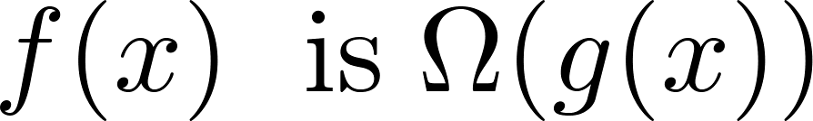
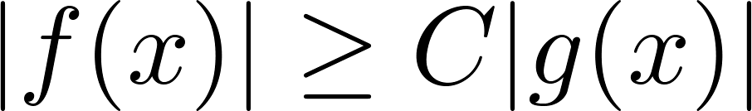
Big-Omega Notation
Definition: Let f and g be functions from the set of integers or the set of real numbers to the set of real numbers. We say that
if there are constants C and k such that
when x > k.
We say that “f(x) is big-Omega of g(x).”
Big-O gives an upper bound on the growth of a function, while Big-Omega gives a lower bound. Big-Omega tells us that a function grows at least as fast as another.
f(x) is Ω(g(x)) if and only if g(x) is O(f(x)). This follows from the definitions. See the text for details.
Ω is the upper case version of the lower case Greek letter ω.

Slide 56
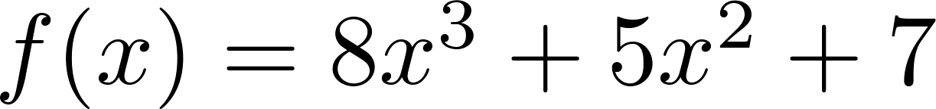
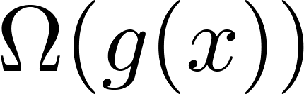
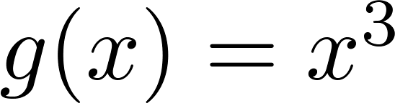
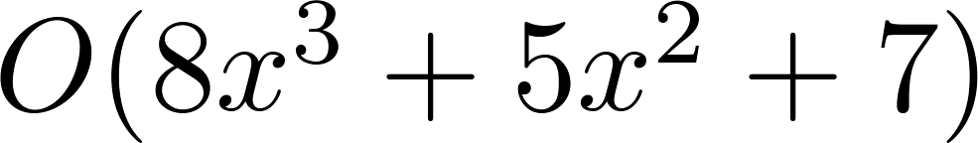
Big-Omega Notation
Example: Show that is
where .
Solution: for all positive real numbers x.
Is it also the case that is ?

Slide 57
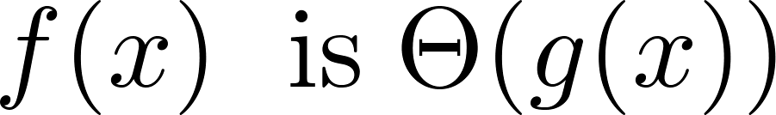
Big-Theta Notation
Θ is the upper case version of the lower case Greek letter θ.
Definition: Let f and g be functions from the set of integers or the set of real numbers to the set of real numbers. The function if
and .
We say that “f is big-Theta of g(x)” and also that “f(x) is of order g(x)” and also that “f(x) and g(x) are of the same order.”
if and only if there exists constants C₁ , C₂ and k such that C₁g(x) < f(x) < C₂ g(x) if x > k. This follows from the definitions of big-O and big-Omega.

Slide 58
Big Theta Notation
Example: Show that the sum of the first n positive integers is Θ(n²).
Solution: Let f(n) = 1 + 2 + ∙∙∙ + n.
We have already shown that f(n) is O(n²).
To show that f(n) is Ω(n²), we need a positive constant C such that f(n) > Cn² for sufficiently large n. Summing only the terms greater than n/2 we obtain the inequality
1 + 2 + ∙∙∙ + n ≥ ⌈ n/2⌉ + (⌈ n/2⌉ + 1) + ∙∙∙ + n
≥ ⌈ n/2⌉ + ⌈ n/2⌉ + ∙∙∙ + ⌈ n/2⌉
= (n − ⌈ n/2⌉ + 1 ) ⌈ n/2⌉
≥ (n/2)(n/2) = n²/4
Taking C = ¼, f(n) > Cn² for all positive integers n. Hence, f(n) is Ω(n²), and we can conclude that f(n) is Θ(n²).

Slide 59
Big-Theta Notation
Example: Sh0w that f(x) = 3x² + 8x log x is Θ(x²).
Solution:
3x² + 8x log x ≤ 11x² for x > 1, since 0 ≤ 8x log x ≤ 8x² .
Hence, 3x² + 8x log x is O(x²).
x² is clearly O(3x² + 8x log x)
Hence, 3x² + 8x log x is Θ(x²).

Slide 60
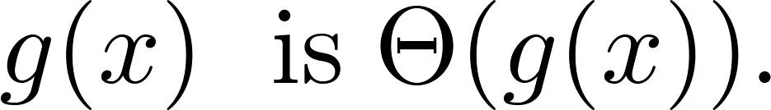
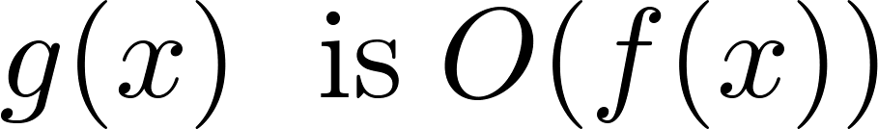
Big-Theta Notation
When it must also be the case that
Note that if and only if it is the case that and .
Sometimes writers are careless and write as if big-O notation has the same meaning as big-Theta.

Slide 61
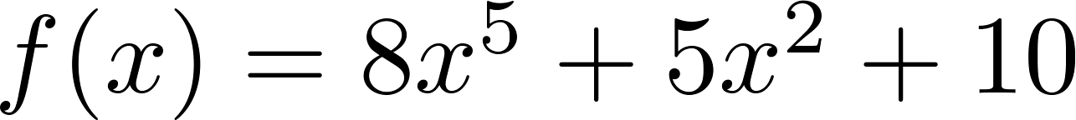
Big-Theta Estimates for Polynomials
Theorem: Let
where are real numbers with a_{n} ≠0.
Then f(x) is of order x^{n} (or Θ(x^{n})).
(The proof is an exercise.)
Example:
The polynomial is order of x⁵ (or Θ(x⁵)).
The polynomial is order of x¹⁹⁹ (or Θ(x¹⁹⁹) ).

Slide 62
Exercises
Pages 217 25, 37 7th edition
Pages 191-193 19, 31 6th edition

Slide 63
Complexity of Algorithms
Section 3.3

Slide 64
Section Summary
Time Complexity
Worst-Case Complexity
Algorithmic Paradigms
Understanding the Complexity of Algorithms

Slide 65
The Complexity of Algorithms
Given an algorithm, how efficient is this algorithm for solving a problem given input of a particular size? To answer this question, we ask:
How much time does this algorithm use to solve a problem?
How much computer memory does this algorithm use to solve a problem?
When we analyze the time the algorithm uses to solve the problem given input of a particular size, we are studying the time complexity of the algorithm.
When we analyze the computer memory the algorithm uses to solve the problem given input of a particular size, we are studying the space complexity of the algorithm.

Slide 66
The Complexity of Algorithms
In this course, we focus on time complexity. The space complexity of algorithms is studied in later courses.
We will measure time complexity in terms of the number of operations an algorithm uses and we will use big-O and big-Theta notation to estimate the time complexity.
We can use this analysis to see whether it is practical to use this algorithm to solve problems with input of a particular size. We can also compare the efficiency of different algorithms for solving the same problem.
We ignore implementation details (including the data structures used and both the hardware and software platforms) because it is extremely complicated to consider them.

Slide 67
Time Complexity
To analyze the time complexity of algorithms, we determine the number of operations, such as comparisons and arithmetic operations (addition, multiplication, etc.). We can estimate the time a computer may actually use to solve a problem using the amount of time required to do basic operations.
We ignore minor details, such as the “house keeping” aspects of the algorithm.
We will focus on the worst-case time complexity of an algorithm. This provides an upper bound on the number of operations an algorithm uses to solve a problem with input of a particular size.
It is usually much more difficult to determine the average case time complexity of an algorithm. This is the average number of operations an algorithm uses to solve a problem over all inputs of a particular size.

Slide 68
Complexity Analysis of Algorithms
Example: Describe the time complexity of the algorithm for finding the maximum element in a finite sequence.
procedure max(a₁, a₂, …., a_{n}: integers)
max := a₁
for i := 2 to n
if max < a_{i} then max := a_{i}
return max{max is the largest element}
Solution: Count the number of comparisons.
The max < a_{i} comparison is made n − 1 times.
Each time i is incremented, a test is made to see if i ≤ n.
One last comparison determines that i > n.
Exactly 2(n − 1) + 1 = 2n − 1 comparisons are made.
Hence, the time complexity of the algorithm is Θ(n).

Slide 69
Worst-Case Complexity of Linear Search
Example: Determine the time complexity of the linear search algorithm.
procedure linear search(x:integer,
a₁, a₂, …,a_{n}: distinct integers)
i := 1
while (i ≤ n and x ≠ a_{i})
i := i + 1
if i ≤ n then location := i
else location := 0
return location{location is the subscript of the term that equals x, or is 0 if x is not found}
Solution: Count the number of comparisons.
At each step two comparisons are made; i ≤ n and x ≠ a_{i} .
To end the loop, one comparison i ≤ n is made.
After the loop, one more i ≤ n comparison is made.
If x = a_{i} , 2i + 1 comparisons are used. If x is not on the list, 2n + 1 comparisons are made and then an additional comparison is used to exit the loop. So, in the worst case 2n + 2 comparisons are made. Hence, the complexity is Θ(n).

Slide 70
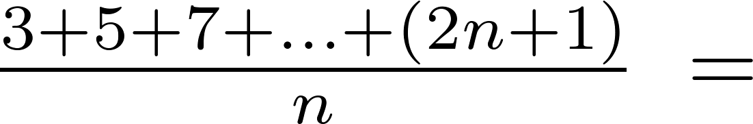
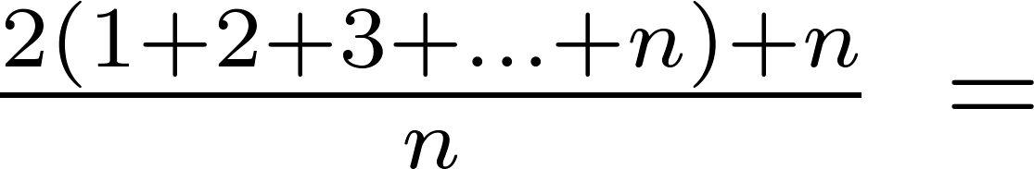
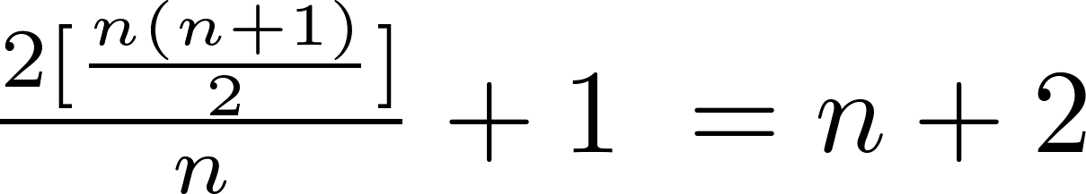
Average-Case Complexity of Linear Search
Example: Describe the average case performance of the linear search algorithm. (Although usually it is very difficult to determine average-case complexity, it is easy for linear search.)
Solution: Assume the element is in the list and that the possible positions are equally likely. By the argument on the previous slide, if x = a_{i} , the number of comparisons is 2i + 1.
Hence, the average-case complexity of linear search is Θ(n).

Slide 71
Worst-Case Complexity of Binary Search
Example: Describe the time complexity of binary search in terms of the number of comparisons used.
procedure binary search(x: integer, a₁,a₂,…, a_{n}: increasing integers)
i := 1 {i is the left endpoint of interval}
j := n {j is right endpoint of interval}
while i < j
m := ⌊(i + j)/2⌋
if x > a_{m} then i := m + 1
else j := m
if x = a_{i} then location := i
else location := 0
return location{location is the subscript i of the term a_{i} equal to x, or 0 if x is not found}
Solution: Assume (for simplicity) n = 2^{k} elements. Note that k = log n.
Two comparisons are made at each stage; i < j, and x > a_{m} .
At the first iteration the size of the list is 2^{k} and after the first iteration it is 2^{k-1}. Then 2^{k-2} and so on until the size of the list is 2¹ = 2.
At the last step, a comparison tells us that the size of the list is the size is 2⁰ = 1 and the element is compared with the single remaining element.
Hence, at most 2k + 2 = 2 log n + 2 comparisons are made.
Therefore, the time complexity is Θ (log n), better than linear search.

Slide 72
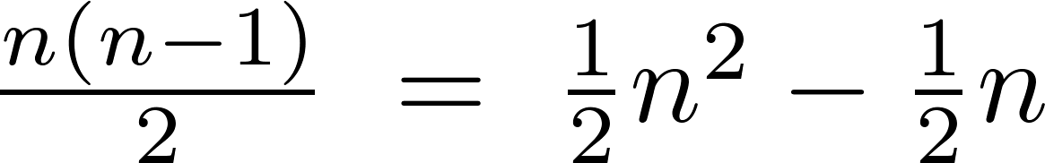
Worst-Case Complexity of Bubble Sort
Example: What is the worst-case complexity of bubble sort in terms of the number of comparisons made?
procedure bubblesort(a₁,…,a_{n}: real numbers
with n ≥ 2)
for i := 1 to n− 1
for j := 1 to n − i
if a_{j} >a_{j+1} then interchange a_{j} and a_{j+1}
{a₁,…, a_{n} is now in increasing order}
Solution: A sequence of n−1 passes is made through the list. On each pass n − i comparisons are made.
The worst-case complexity of bubble sort is Θ(n²) since .

Slide 73
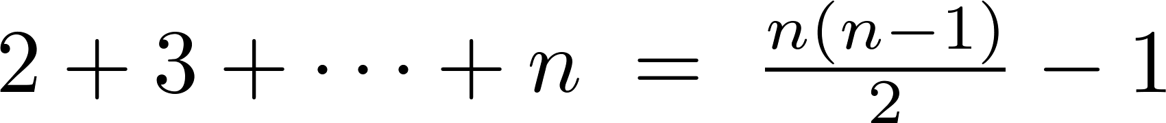
Worst-Case Complexity of Insertion Sort
Example: What is the worst-case complexity of insertion sort in terms of the number of comparisons made?
procedure insertion sort(a₁,…,a_{n}:
real numbers with n ≥ 2)
for j := 2 to n
i := 1
while a_{j} > a_{i}
i := i + 1
m := a_{j}
for k := 0 to j − i − 1
a_{j-k} := a_{j-k-1}
a_{i} := m
Solution: The total number of comparisons are:
Therefore the complexity is Θ(n²).

Slide 74

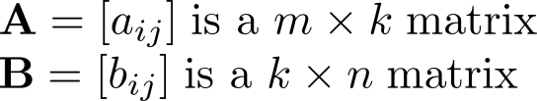
Matrix Multiplication Algorithm
The definition for matrix multiplication can be expressed as an algorithm; C = A B where C is an m n matrix that is the product of the m k matrix A and the k n matrix B.
This algorithm carries out matrix multiplication based on its definition.
procedure matrix multiplication(A,B: matrices)
for i := 1 to m
for j := 1 to n
c_{ij} := 0
for q := 1 to k
c_{ij} := c_{ij} + a_{iq} b_{qj}
return C{C = [c_{ij}] is the product of A and B}

Slide 75
Complexity of Matrix Multiplication
Example: How many additions of integers and multiplications of integers are used by the matrix multiplication algorithm to multiply two n n matrices.
Solution: There are n² entries in the product. Finding each entry requires n multiplications and n − 1 additions. Hence, n³ multiplications and n²(n − 1) additions are used.
Hence, the complexity of matrix multiplication is O(n³).

Slide 76
Boolean Product Algorithm
The definition of Boolean product of zero-one matrices can also be converted to an algorithm.
procedure Boolean product(A,B: zero-one matrices)
for i := 1 to m
for j := 1 to n
c_{ij} := 0
for q := 1 to k
c_{ij} := c_{ij} ∨ (a_{iq} ∧ b_{qj})
return C{C = [c_{ij}] is the Boolean product of A and B}

Slide 77
Complexity of Boolean Product Algorithm
Example: How many bit operations are used to find A ⊙ B, where A and B are n n zero-one matrices?
Solution: There are n² entries in the A ⊙ B. A total of n Ors and n ANDs are used to find each entry. Hence, each entry takes 2n bit operations. A total of 2n³ operations are used.
Therefore the complexity is O(n³)

Slide 78
Matrix-Chain Multiplication
How should the matrix-chain A₁A₂∙ ∙ ∙A_{n} be computed using the fewest multiplications of integers, where A₁ , A₂ , ∙ ∙ ∙ , A_{n} are m₁ m₂, m₂ m₃ , ∙ ∙ ∙ m_{n} m_{n+1} integer matrices. Matrix multiplication is associative (exercise in Section 2.6).
Example: In which order should the integer matrices A₁A₂A₃ - where A₁ is 30 20 , A₂ 20 40, A₃ 40 10 - be multiplied to use the least number of multiplications.
Solution: There are two possible ways to compute A₁A₂A₃.
A₁(A₂A₃): A₂A₃ takes 20 ∙ 40 ∙ 10 = 8000 multiplications. Then multiplying A₁ by the 20 10 matrix A₂A₃ takes 30 ∙ 20 ∙ 10 = 6000 multiplications. So the total number is 8000 + 6000 = 14,000.
(A₁A₂)A₃: A₁A₂ takes 30 ∙ 20 ∙ 40 = 24,000 multiplications. Then multiplying the 30 40 matrix A₁A₂ by A₃ takes 30 ∙ 40 ∙ 10 = 12,000 multiplications. So the total number is 24,000 + 12,000 = 36,000.
So the first method is best.
An efficient algorithm for finding the best order for matrix-chain multiplication can be based on the algorithmic paradigm known as dynamic programming. (see Ex. 57 in Section 8.1)

Slide 79
Algorithmic Paradigms
An algorithmic paradigm is a general approach based on a particular concept for constructing algorithms to solve a variety of problems.
Greedy algorithms were introduced in Section 3.1.
We discuss brute-force algorithms in this section.
We will see divide-and-conquer algorithms (Chapter 8), dynamic programming (Chapter 8), backtracking (Chapter 11), and probabilistic algorithms (Chapter 7). There are many other paradigms that you may see in later courses.

Slide 80
Brute-Force Algorithms
A brute-force algorithm is solved in the most straightforward manner, without taking advantage of any ideas that can make the algorithm more efficient.
Brute-force algorithms we have previously seen are sequential search, bubble sort, and insertion sort.

Slide 81
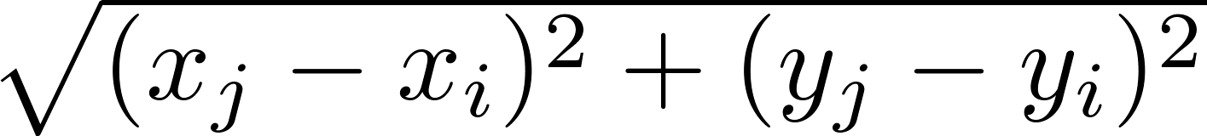
Computing the Closest Pair of Points by Brute-Force
Example: Construct a brute-force algorithm for finding the closest pair of points in a set of n points in the plane and provide a worst-case estimate of the number of arithmetic operations.
Solution: Recall that the distance between (x_{i},y_{i}) and (x_{j}, y_{j}) is . A brute-force algorithm simply computes the distance between all pairs of points and picks the pair with the smallest distance.
Note: There is no need to compute the square root, since the square of the distance between two points is smallest when the distance is smallest.
Continued →

Slide 82
Computing the Closest Pair of Points by Brute-Force
Algorithm for finding the closest pair in a set of n points.
The algorithm loops through n(n −1)/2 pairs of points, computes the value (x_{j} − x_{i})² + (y_{j} − y_{i})² and compares it with the minimum, etc. So, the algorithm uses Θ(n²) arithmetic and comparison operations.
We will develop an algorithm with O(log n) worst-case complexity in Section 8.3.
procedure closest pair((x₁, y₁), (x₂, y₂), … ,(x_{n}, y_{n}): x_{i}, y_{i} real numbers)
min = ∞
for i := 1 to n
for j := 1 to i
if (x_{j} − x_{i})² + (y_{j} − y_{i})² < min
then min := (x_{j} − x_{i})² + (y_{j} − y_{i})²
closest pair := (x_{i}, y_{i}), (x_{j}, y_{j})
return closest pair

Slide 83
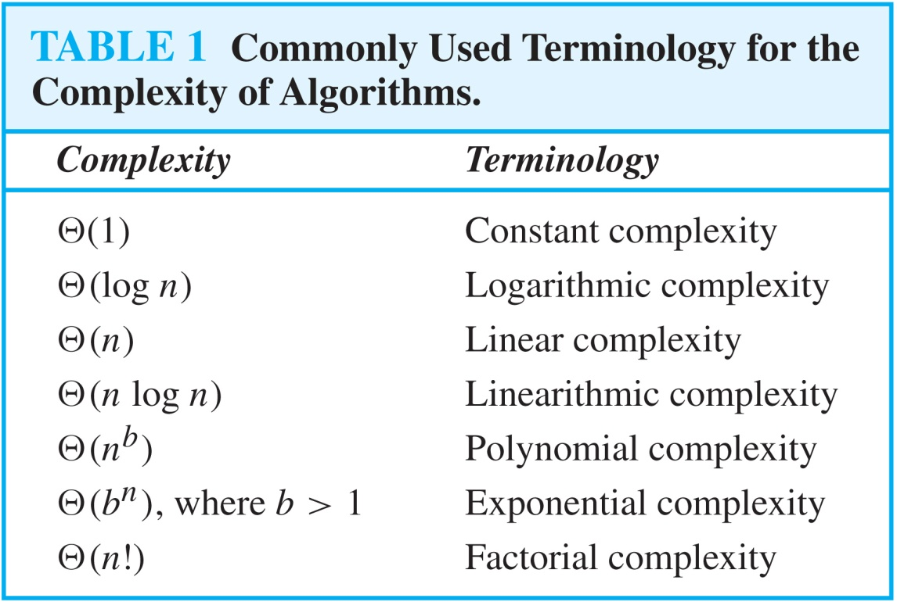
Understanding the Complexity of Algorithms

Slide 84
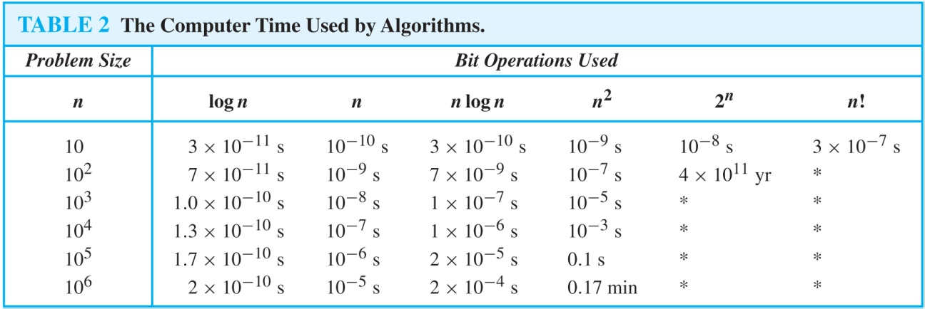
Understanding the Complexity of Algorithms
Times of more than 10¹⁰⁰ years are indicated with an *.

Slide 85
Complexity of Problems
Tractable Problem: There exists a polynomial time algorithm to solve this problem. These problems are said to belong to the Class P.
Intractable Problem: There does not exist a polynomial time algorithm to solve this problem
Unsolvable Problem : No algorithm exists to solve this problem, e.g., halting problem.
Class NP: Solution can be checked in polynomial time. But no polynomial time algorithm has been found for finding a solution to problems in this class.
NP Complete Class: If you find a polynomial time algorithm for one member of the class, it can be used to solve all the problems in the class.

Slide 86

P Versus NP Problem
Stephen Cook
(Born 1939)
The P versus NP problem asks whether the class P = NP? Are there problems whose solutions can be checked in polynomial time, but can not be solved in polynomial time?
Note that just because no one has found a polynomial time algorithm is different from showing that the problem can not be solved by a polynomial time algorithm.
If a polynomial time algorithm for any of the problems in the NP complete class were found, then that algorithm could be used to obtain a polynomial time algorithm for every problem in the NP complete class.
Satisfiability (in Section 1.3) is an NP complete problem.
It is generally believed that P≠NP since no one has been able to find a polynomial time algorithm for any of the problems in the NP complete class.
The problem of P versus NP remains one of the most famous unsolved problems in mathematics (including theoretical computer science). The Clay Mathematics Institute has offered a prize of $1,000,000 for a solution.

Slide 87
Example
以计算 nxn 阶行列式为例子。
如果我们用行列式定义去计算，其计算复杂度为 O(n•n!)
如果我们通过行消元将行列式化上三角行列计算，其计算复杂度为 O(n⁴)
如果 n= 50,采用第一种方法所需要计算的乘法次数 1.5x10^{65，}第二种方法所需要的乘法次数为6x10⁶，如果用一台计算速度是每秒可执行1000亿次乘法的计算机计算，其计算时间分别为5x10⁴⁶年及6x10⁻⁵秒

Slide 88
Exercise
Page 231 39 7th edition
Page 200 27 6th edition

