Slide 1
Advanced Counting Techniques
Chapter 8
With Question/Answer Animations

Slide 2
Chapter Summary
Applications of Recurrence Relations
Solving Linear Recurrence Relations
Homogeneous Recurrence Relations
Nonhomogeneous Recurrence Relations
Divide-and-Conquer Algorithms and Recurrence Relations
Generating Functions
Inclusion-Exclusion
Applications of Inclusion-Exclusion

Slide 3
Applications of Recurrence Relations
Section 8.1

Slide 4
Section Summary
Applications of Recurrence Relations
Fibonacci Numbers
The Tower of Hanoi
Counting Problems
Algorithms and Recurrence Relations (not currently included in overheads)

Slide 5
Recurrence Relations (recalling definitions from Chapter 2)
Definition: A recurrence relation for the sequence {a_{n}} is an equation that expresses a_{n} in terms of one or more of the previous terms of the sequence, namely, a₀, a₁, …, a_{n-1}, for all integers n with n ≥ n₀, where n₀ is a nonnegative integer.
A sequence is called a solution of a recurrence relation if its terms satisfy the recurrence relation.
The initial conditions for a sequence specify the terms that precede the first term where the recurrence relation takes effect.

Slide 6
Rabbits and the Fiobonacci Numbers
Example: A young pair of rabbits (one of each gender) is placed on an island. A pair of rabbits does not breed until they are 2 months old. After they are 2 months old, each pair of rabbits produces another pair each month. Find a recurrence relation for the number of pairs of rabbits on the island after n months, assuming that rabbits never die.
This is the original problem considered by Leonardo Pisano (Fibonacci) in the thirteenth century.

Slide 7
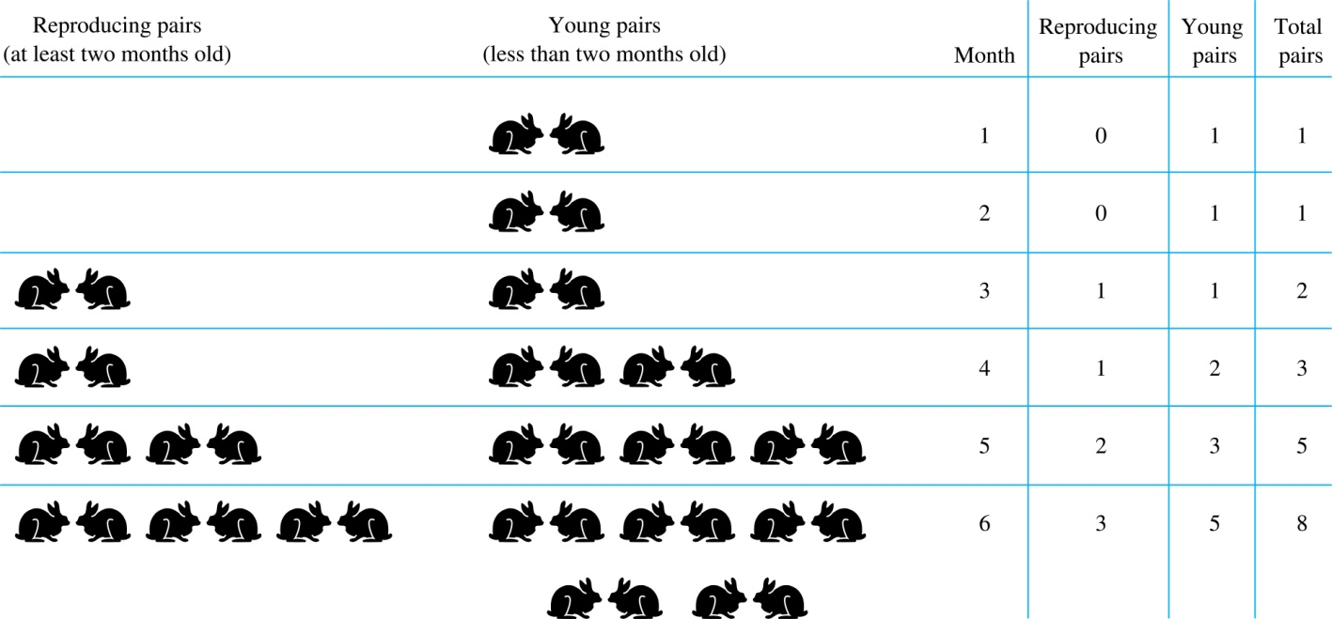
Rabbits and the Fiobonacci Numbers (cont.)
Modeling the Population Growth of Rabbits on an Island

Slide 8
Rabbits and the Fibonacci Numbers (cont.)
Solution: Let f_{n} be the the number of pairs of rabbits after n months.
There are is f₁ = 1 pairs of rabbits on the island at the end of the first month.
We also have f₂ = 1 because the pair does not breed during the first month.
To find the number of pairs on the island after n months, add the number on the island after the previous month, f_{n-1}, and the number of newborn pairs, which equals f_{n-2}, because each newborn pair comes from a pair at least two months old.
Consequently the sequence {f_{n} } satisfies the recurrence relation f_{n} = f_{n-1} + f_{n-2} for n ≥ 3 with the initial conditions f₁ = 1 and f₂ = 1.
The number of pairs of rabbits on the island after n months is given by the nth Fibonacci number.

Slide 9
The Tower of Hanoi
In the late nineteenth century, the French mathematician Édouard Lucas invented a puzzle consisting of three pegs on a board with disks of different sizes. Initially all of the disks are on the first peg in order of size, with the largest on the bottom.
Rules: You are allowed to move the disks one at a time from one peg to another as long as a larger disk is never placed on a smaller.
Goal: Using allowable moves, end up with all the disks on the second peg in order of size with largest on the bottom.

Slide 10
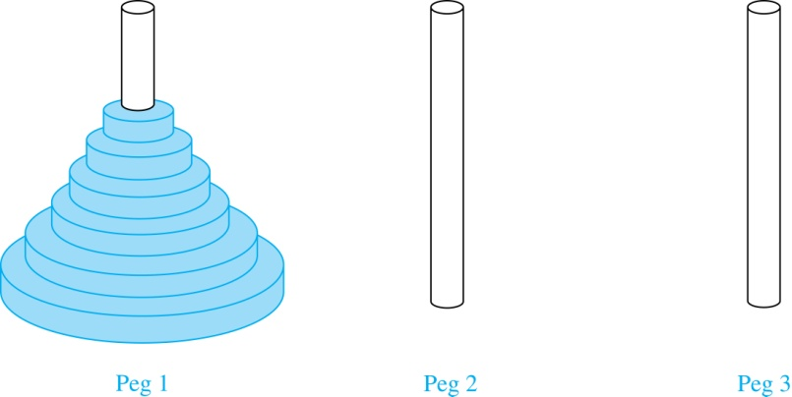
The Tower of Hanoi (continued)
The Initial Position in the Tower of Hanoi Puzzle

Slide 11
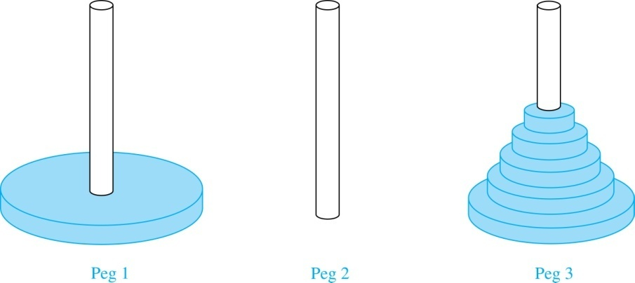
The Tower of Hanoi (continued)
Solution: Let {H_{n}} denote the number of moves needed to solve the Tower of Hanoi Puzzle with n disks. Set up a recurrence relation for the sequence {H_{n}}. Begin with n disks on peg 1. We can transfer the top n −1 disks, following the rules of the puzzle, to peg 3 using H_{n−1} moves.
First, we use 1 move to transfer the largest disk to the second peg. Then we transfer the n −1 disks from peg 3 to peg 2 using H_{n−1} additional moves. This can not be done in fewer steps. Hence,
H_{n} = 2H_{n−1} + 1.
The initial condition is H₁= 1 since a single disk can be transferred from peg 1 to peg 2 in one move.

Slide 12
The Tower of Hanoi (continued)
We can use an iterative approach to solve this recurrence relation by repeatedly expressing H_{n} in terms of the previous terms of the sequence.
H_{n} = 2H_{n−1} + 1
= 2(2H_{n−2} + 1) + 1 = 2² H_{n−2} +2 + 1
= 2²(2H_{n−3} + 1) + 2 + 1 = 2³ H_{n−3} +2² + 2 + 1
⋮
= 2^{n-1}H₁ + 2^{n−2} + 2^{n−3} + …. + 2 + 1
= 2^{n−1} + 2^{n−2} + 2^{n−3} + …. + 2 + 1 because H₁= 1
= 2^{n} − 1 using the formula for the sum of the terms of a geometric series
There was a myth created with the puzzle. Monks in a tower in Hanoi are transferring 64 gold disks from one peg to another following the rules of the puzzle. They move one disk each day. When the puzzle is finished, the world will end.
Using this formula for the 64 gold disks of the myth,
2⁶⁴ −1 = 18,446, 744,073, 709,551,615
days are needed to solve the puzzle, which is more than 500 billion years.
Reve’s puzzle (proposed in 1907 by Henry Dudeney) is similar but has 4 pegs. There is a well-known unsettled conjecture for the the minimum number of moves needed to solve this puzzle. (see Exercises 38-45)

Slide 13
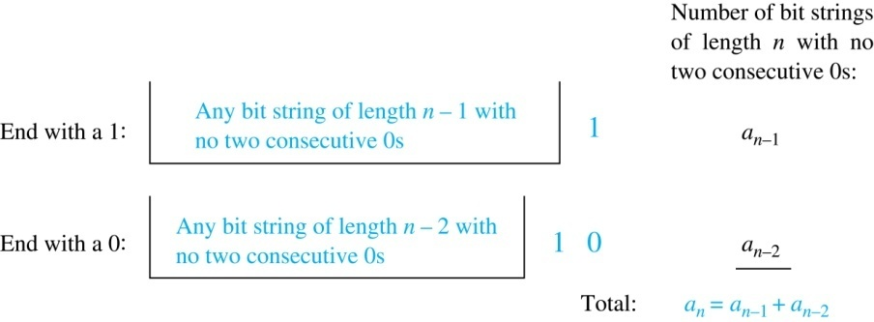
Counting Bit Strings
Example 3: Find a recurrence relation and give initial conditions for the number of bit strings of length n without two consecutive 0s. How many such bit strings are there of length five?
Solution: Let a_{n} denote the number of bit strings of length n without two consecutive 0s. To obtain a recurrence relation for {a_{n} } note that the number of bit strings of length n that do not have two consecutive 0s is the number of bit strings ending with a 0 plus the number of such bit strings ending with a 1.
Now assume that n ≥ 3.
The bit strings of length n ending with 1 without two consecutive 0s are the bit strings of length n −1 with no two consecutive 0s with a 1 at the end. Hence, there are a_{n−1} such bit strings.
The bit strings of length n ending with 0 without two consecutive 0s are the bit strings of length n −2 with no two consecutive 0s with 10 at the end. Hence, there are a_{n−2} such bit strings.
We conclude that a_{n} = a_{n−1} + a_{n−2} for n ≥ 3.

Slide 14
Bit Strings (continued)
The initial conditions are:
a₁ = 2, since both the bit strings 0 and 1 do not have consecutive 0s.
a₂ = 3, since the bit strings 01, 10, and 11 do not have consecutive 0s, while 00 does.
To obtain a₅ , we use the recurrence relation three times to find that:
a₃ = a₂ + a₁ = 3 + 2 = 5
a₄ = a₃ + a₂ = 5+ 3 = 8
a₅ = a₄ + a₃ = 8+ 5 = 13
Note that {a_{n} } satisfies the same recurrence relation as the Fibonacci sequence. Since a₁ = f₃ and a₂ = f₄ , we conclude that a_{n} = f_{n+2} .

Slide 15
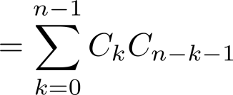
Counting the Ways to Parenthesize a Product
Example: Find a recurrence relation for C_{n} , the number of ways to parenthesize the product of
n + 1 numbers, x₀ ∙ x₁ ∙ x₂ ∙ ⋯ ∙ x_{n}, to specify the order of multiplication.
For example, C₃ = 5, since all the possible ways to parenthesize 4 numbers are
((x₀ ∙ x₁ )∙ x₂ )∙ x₃ , (x₀ ∙ (x₁ ∙ x₂ ))∙ x₃ , (x₀ ∙ x₁ )∙ (x₂ ∙ x₃ ), x₀ ∙ (( x₁ ∙ x₂ ) ∙ x₃ ), x₀ ∙ ( x₁ ∙ ( x₂ ∙ x₃ ))
Solution: Note that however parentheses are inserted in x₀ ∙ x₁ ∙ x₂ ∙ ⋯ ∙ x_{n}, one “∙” operator remains outside all parentheses. This final operator appears between two of the n + 1 numbers, say x_{k} and x_{k+1}. Since there are C_{k} ways to insert parentheses in the product x₀ ∙ x₁ ∙ x₂ ∙ ⋯ ∙ x_{k} and C_{n−k−1} ways to insert parentheses in the product x_{k+1} ∙ x_{k+2} ∙ ⋯ ∙ x_{n}, we have
The initial conditions are C₀ = 1 and C₁ = 1.
The sequence {C_{n} } is the sequence of Catalan Numbers. This recurrence relation can be solved using the method of generating functions; see Exercise 41 in Section 8.4.

Slide 16
Exercise
P510-511 7, 17 7th edition
P457-460 23, 33 6th edition

Slide 17
Solving Linear Recurrence Relations
Section 8.2

Slide 18
Section Summary
Linear Homogeneous Recurrence Relations
Solving Linear Homogeneous Recurrence Relations with Constant Coefficients.
Solving Linear Nonhomogeneous Recurrence Relations with Constant Coefficients.

Slide 19
Linear Homogeneous Recurrence Relations
Definition: A linear homogeneous recurrence relation of degree k with constant coefficients is a recurrence relation of the form a_{n} = c₁a_{n−1} + c₂a_{n−2} + ….. + c_{k} a_{n−k ,} where c₁, c₂, ….,c_{k} are real numbers, and c_{k} ≠ 0
it is linear because the right-hand side is a sum of the previous terms of the sequence each multiplied by a function of n.
it is homogeneous because no terms occur that are not multiples of the a_{j}s. Each coefficient is a constant.
the degree is k because a_{n} is expressed in terms of the previous k terms of the sequence.
By strong induction, a sequence satisfying such a recurrence relation is uniquely determined by the recurrence relation and the k initial conditions a₀ = C₁, a₀ = C₁ ,… , a_{k−1} = C_{k−1}.

Slide 20
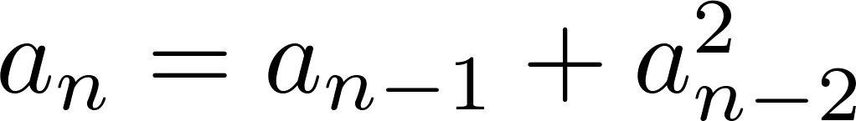
Examples of Linear Homogeneous Recurrence Relations
P_{n} = (1.11)P_{n-1} linear homogeneous recurrence relation of degree one
f_{n} = f_{n-1} + f_{n-2} linear homogeneous recurrence relation of degree two
not linear
H_{n} = 2H_{n−1} + 1 not homogeneous
B_{n} = nB_{n−1} coefficients are not constants

Slide 21
Solving Linear Homogeneous Recurrence Relations
The basic approach is to look for solutions of the form a_{n} = r^{n}, where r is a constant.
Note that a_{n} = r^{n} is a solution to the recurrence relation a_{n} = c₁a_{n−1} + c₂a_{n−2} + ⋯ + c_{k} a_{n−k} if and only if r^{n} = c₁r^{n−1} + c₂r^{n−2} + ⋯ + c_{k} r^{n−k} .
Algebraic manipulation yields the characteristic equation:
r^{k} − c₁r^{k−1} − c₂r^{k−2} − ⋯ − c_{k−1}r − c_{k} = 0
The sequence {a_{n}} with a_{n} = r^{n} is a solution if and only if r is a solution to the characteristic equation.
The solutions to the characteristic equation are called the characteristic roots of the recurrence relation. The roots are used to give an explicit formula for all the solutions of the recurrence relation.

Slide 22
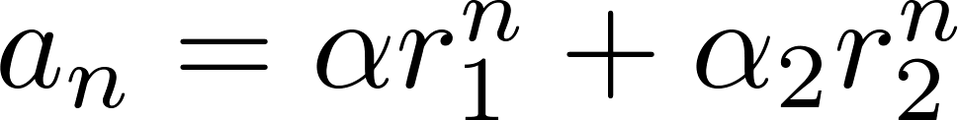
Solving Linear Homogeneous Recurrence Relations of Degree Two
Theorem 1: Let c₁ and c₂ be real numbers. Suppose that r² – c₁r – c₂ = 0 has two distinct roots r₁ and r₂. Then the sequence {a_{n}} is a solution to the recurrence relation a_{n} = c₁a_{n−1} + c₂a_{n−2} if and only if
for n = 0,1,2,… , where α₁ and α₂ are constants.

Slide 23
Using Theorem 1
Example: What is the solution to the recurrence relation
a_{n} = a_{n−1} + 2a_{n−2} with a₀ = 2 and a₁ = 7?
Solution: The characteristic equation is r² − r − 2 = 0.
Its roots are r = 2 and r = −1 . Therefore, {a_{n}} is a solution to the recurrence relation if and
only if a_{n} = α₁2^{n} + α₂(−1)^{n}, for some constants α₁ and α₂.
To find the constants α₁ and α₂, note that
a₀ = 2 = α₁ + α₂ and a₁ = 7 = α₁2 + α₂(−1).
Solving these equations, we find that α₁ = 3 and α₂ = −1.
Hence, the solution is the sequence {a_{n}} with a_{n} = 3∙2^{n} − (−1)^{n}.

Slide 24
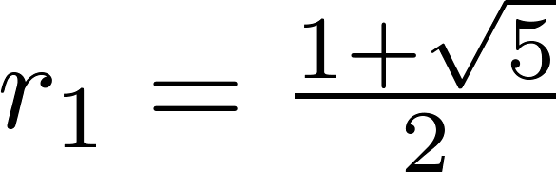
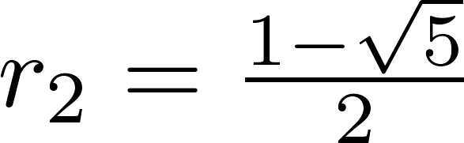
An Explicit Formula for the Fibonacci Numbers
We can use Theorem 1 to find an explicit formula for the Fibonacci numbers. The sequence of Fibonacci numbers satisfies the recurrence relation f_{n} = f_{n−1} + f_{n−2} with the initial conditions: f₀ = 0 and f₁ = 1.
Solution: The roots of the characteristic equation r² – r – 1 = 0 are

Slide 25
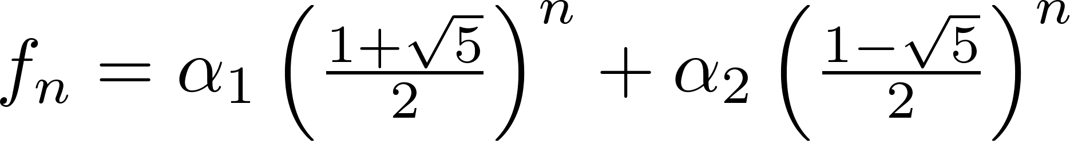
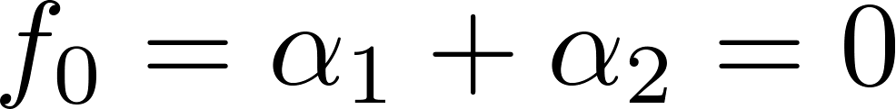
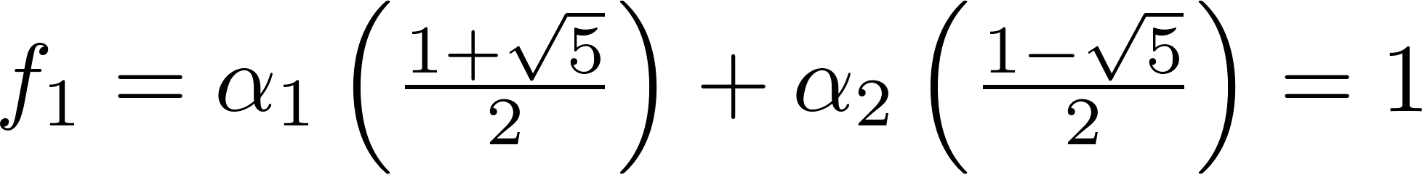
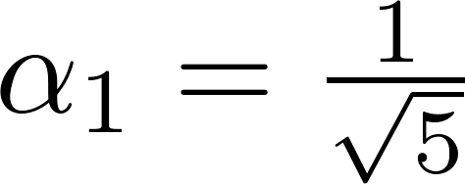
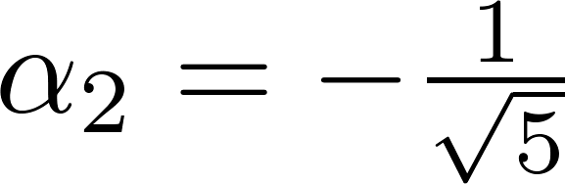
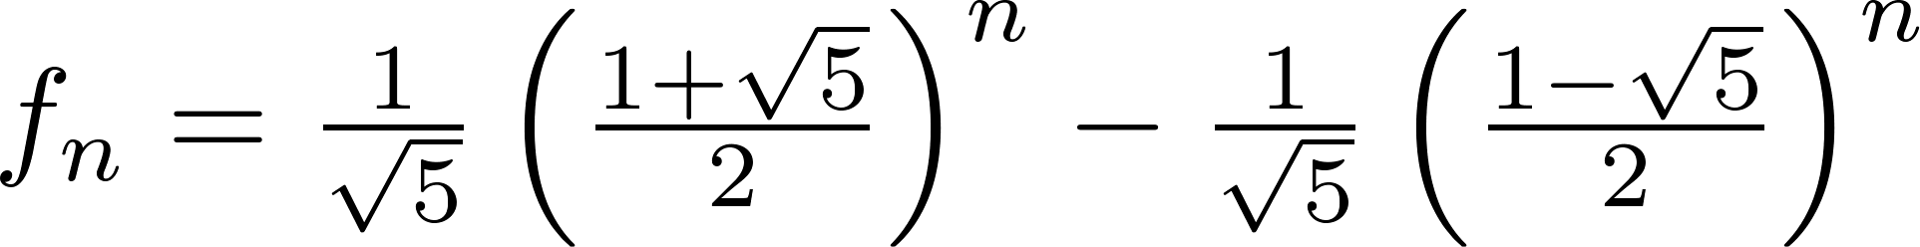
Fibonacci Numbers (continued)
Therefore by Theorem 1
for some constants α₁ and α₂.
Using the initial conditions f₀ = 0 and f₁ = 1 , we have
Solving, we obtain .
Hence,
.
,

Slide 26
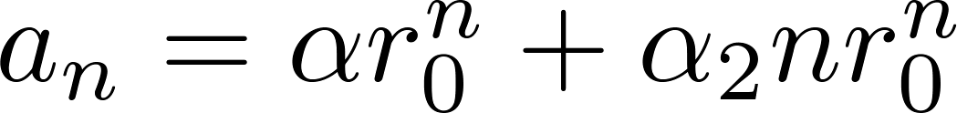
The Solution when there is a Repeated Root
Theorem 2: Let c₁ and c₂ be real numbers with c₂ ≠ 0. Suppose that r² – c₁r – c₂ = 0 has one repeated root r₀. Then the sequence {a_{n}} is a solution to the recurrence relation a_{n} = c₁a_{n−1} + c₂a_{n−2} if and only if
for n = 0,1,2,… , where α₁ and α₂ are constants.

Slide 27
Using Theorem 2
Example: What is the solution to the recurrence relation a_{n} = 6a_{n−1} − 9a_{n−2} with a₀ = 1 and a₁ = 6?
Solution: The characteristic equation is r² − 6r + 9 = 0.
The only root is r = 3. Therefore, {a_{n}} is a solution to the recurrence relation if and only if
a_{n} = α₁3^{n} + α₂n(3)^{n}
where α₁ and α₂ are constants.
To find the constants α₁ and α₂, note that
a₀ = 1 = α₁ and a₁ = 6 = α₁ ∙ 3 + α₂ ∙3.
Solving, we find that α₁ = 1 and α₂ = 1 .
Hence,
a_{n} = 3^{n} + n3^{n} .

Slide 28
Solving Linear Homogeneous Recurrence Relations of Arbitrary Degree
This theorem can be used to solve linear homogeneous recurrence relations with constant coefficients of any degree when the characteristic equation has distinct roots.
Theorem 3: Let c₁, c₂ ,…, c_{k} be real numbers. Suppose that the characteristic equation
r^{k} – c₁r^{k−1} –⋯ – c_{k} = 0
has k distinct roots r₁, r₂, …, r_{k}. Then a sequence {a_{n}} is a solution of the recurrence relation
a_{n} = c₁a_{n−1} + c₂a_{n−2} + ….. + c_{k} a_{n−k}
if and only if
for n = 0, 1, 2, …, where α₁, α₂,…, α_{k} are constants.

Slide 29
Example
Recurrence relation:
a_{n} = 6a_{n-1} - 11a_{n-2} + 6a_{n-3} with a₀=2, a₁=5, a₂=15
Characteristic equation: r³-6r²+11r-6=0
The distinct roots are 1,2,3 hence
a_{n} = l₁ 1^{n} + l₂ 2^{n} +l₃ 3^{n}
Use the initial condition we find that
l₁ =1, l₂ =-1,l₃ =2. a_{n} = 1 - 2^{n} +2 •3^{n}

Slide 30
The General Case with Repeated Roots Allowed
Theorem 4: Let c₁, c₂ ,…, c_{k} be real numbers. Suppose that the characteristic equation
r^{k} – c₁r^{k−1} –⋯ – c_{k} = 0
has t distinct roots r₁, r₂, …, r_{t} with multiplicities m₁, m₂, …, m_{t}, respectively so that m_{i} ≥ 1 for i = 0, 1, 2, …,t and m₁ + m₂ + … + m_{t} = k. Then a sequence {a_{n}} is a solution of the recurrence relation
a_{n} = c₁a_{n−1} + c₂a_{n−2} + ….. + c_{k} a_{n−k}
if and only if
for n = 0, 1, 2, …, where α_{i,j} are constants for 1≤ i ≤ t and 0≤ j ≤ m_{i−1}.

Slide 31
The General Case with Repeated Roots Allowed
E.g., Roots of C.E. are 2, 2, 2, 5, 5 and 9.
Solution:
(α_{1,0} + α_{1,1}n + α_{1,2}n2)*2^{n} + (α_{2,0} + α_{2,1}n)*5^{n} + α_{3,0}9^{n}

Slide 32
Example 8
Find the solution to the recurrence relation
a_{n} = -3a_{n-1} -3 a_{n-2} - a_{n-3} with initial condition
a₀=1, a₁ = -2, a₂ = -1
Solution: the characteristic equation is :
r³+3r² +3r + 1=0 , -1 is the single root of multiplicity 3. hence
a_{n} = (l_{1,0} + l_{1,1} n+l_{1,2} n²)(-1)^{n}

Slide 33
Cont..
Use the initial conditions, we obtain
a₀=1=l_{1,0}
a₁=-2=-l_{1,0}-l_{1,1}-l_{1,2}
a₂=-1= l_{1,0}+2l_{1,1}+4l_{1,2} solving the equation we get
l_{1,0}=1, l_{1,1}=3 and l_{1,2} =-2
Hence a_{n}=(1+3n-2n²)(-1)^{n}

Slide 34
More Example
the recurrence relation
a_{n} = 3a_{n-1}+6a_{n-2} -28a_{n-3} +24 a_{n-4}
with initial condition a₀=-2, a₁ = 12, a₂ = 22, a₃ = 222
Solution: the characteristic equation is :
r⁴-3r³ -6r²+28r-24=(r-2)³(r+3)=0,
2 is the root of multiplicity 3; and –3 is a root of multiplicity 1, then

Slide 35
Cont.
a_{n} = (l_{1,0} + l_{1,1} n+l_{1,2} n²)2^{n} + l_{2,0} (-3)^{n}
Use the initial conditions, we obtain
a₀=l_{1,0} + l_{2,0}= -2
a₁=2l_{1,0}+2 l_{1,1}+2l_{1,2} -3 l_{2,0} = 12
a₂=4l_{1,0}+8 l_{1,1}+16l_{1,2} +9 l_{2,0} = 22
a₃=8l_{1,0}+24l_{1,1}+72l_{1,2} -27 l_{2,0} = 222
solving the equation we get l_{1,0}=0, l_{1,1}=1 and l_{1,2} =2, l_{2,0}= -2 Hence a_{n}=(n+2n²)2^{n}-2(-3)^{n}

Slide 36
Linear Nonhomogeneous Recurrence Relations with Constant Coefficients
Definition: A linear nonhomogeneous recurrence relation with constant coefficients is a recurrence relation of the form:
a_{n} = c₁a_{n−1} + c₂a_{n−2} + ….. + c_{k} a_{n−k} + F(n) ,
where c₁, c₂, ….,c_{k} are real numbers, and F(n) is a function not identically zero depending only on n.
The recurrence relation
a_{n} = c₁a_{n−1} + c₂a_{n−2} + ….. + c_{k} a_{n−k ,}
is called the associated homogeneous recurrence relation.

Slide 37
Linear Nonhomogeneous Recurrence Relations with Constant Coefficients (cont.)
The following are linear nonhomogeneous recurrence relations with constant coefficients:
a_{n} = a_{n−1} + 2^{n} ,
a_{n} = a_{n−1} + a_{n−2} + n² + n + 1,
a_{n} = 3a_{n−1} + n3^{n} ,
a_{n} = a_{n−1} + a_{n−2} + a_{n−3} + n!
where the following are the associated linear homogeneous recurrence relations, respectively:
a_{n} = a_{n−1 ,}
a_{n} = a_{n−1} + a_{n−2},
a_{n} = 3a_{n−1} ,
a_{n} = a_{n−1} + a_{n−2} + a_{n−3}

Slide 38
Solving Linear Nonhomogeneous Recurrence Relations with Constant Coefficients
Theorem 5: If {a_{n}^{(p)}} is a particular solution of the nonhomogeneous linear recurrence relation with constant coefficients
a_{n} = c₁a_{n−1} + c₂a_{n−2} + ⋯ + c_{k} a_{n−k} + F(n) ,
then every solution is of the form {a_{n}^{(p)} + a_{n}^{(h)}}, where {a_{n}^{(h)}} is a solution of the associated homogeneous recurrence relation
a_{n} = c₁a_{n−1} + c₂a_{n−2} + ⋯ + c_{k} a_{n−k .}

Slide 39
Solving Linear Nonhomogeneous Recurrence Relations with Constant Coefficients (continued)
Example: Find all solutions of the recurrence relation a_{n} = 3a_{n−1} + 2n.
What is the solution with a₁ = 3?
Solution: The associated linear homogeneous equation is a_{n} = 3a_{n−1}.
Its solutions are a_{n}^{(h)} = α3^{n}, where α is a constant.
Because F(n)= 2n is a polynomial in n of degree one, to find a particular solution we might try a linear function in n, say p_{n} = cn + d, where c and d are constants. Suppose that p_{n} = cn + d is such a solution.
Then a_{n} = 3a_{n−1} + 2n becomes cn + d = 3(c(n− 1) + d)+ 2n.
Simplifying yields (2 + 2c)n + (2d − 3c) = 0. It follows that cn + d is a solution if and only if
2 + 2c = 0 and 2d − 3c = 0. Therefore, cn + d is a solution if and only if c = − 1 and d = − 3/2.
Consequently, a_{n}^{(p)} = −n − 3/2 is a particular solution.
By Theorem 5, all solutions are of the form a_{n} = a_{n}^{(p)} + a_{n}^{(h)} = −n − 3/2 + α3^{n}, where α is a constant.
To find the solution with a₁ = 3, let n = 1 in the above formula for the general solution.
Then 3 = −1 − 3/2 + 3 α, and α = 11/6. Hence, the solution is a_{n} = −n − 3/2 + (11/6)3^{n}.

Slide 40
Step of solution
A. find the general form of the solution of associated homogeneous recurrence relation,say g(n)
B. find a particular solution of linear non-homogeneous recurrence with constant coefficients,say f(n)
C. use the initial condition to solve out the parameters in f(n)+g(n)

Slide 41
The key problem
The key problem is how to find a particular solution to a linear non-homogeneous recurrence with constant coefficients. We cannot always “guess” the particular solution, but if f(n) is the product of a polynomial in n and the nth power of a constant, we know exactly what form a particular solution is.

Slide 42
Theorem 6
a_{n} = c₁a_{n-1} + c₂a_{n-2} + … + c_{k}a_{n-k}+F(n)
F(n)=(b_{t}n^{t}+b_{t-1}n^{t-1}+…+b₁n+b₀)s^{n}
When s is not a root of the characteristic equation of the associated linear homogeneous recurrence solution, this is a particular solution of the form f(n)=(p_{t}n^{t}+p_{t-1}n^{t-1}+…+p₁n+p₀)s^{n}

Slide 43
Cont…
When s is a root of the characteristic equation and its multiplicity is m, this is a particular solution of the form f(n)=n^{m}(p_{t}n^{t}+p_{t-1}n^{t-1} +…+p₁n+p₀)s^{n}
Example a_{n}=6a_{n-1}-9a_{n-2}+F(n) what form does a particular solution has?
(a) F(n)=3^{n},(b)F(n)=n²3^{n},(c)F(n)=(n²+1)3^{n}
Solution: 3 is root of characteristic equation with multiplicity 2.

Slide 44
Cont
(a) F(n)=3^{n}, f(n)=p₀n²3^{n}
(b)F(n)=n²3^{n}, f(n)=n²(p₂n²+p₁n+p₀)3^{n}
(c)F(n)=(n²+1)3^{n ,} f(n)=n²(p₂n²+p₁n+p₀)3^{n}
(d)F(n)=n²2^{n}, f(n)= (p₂n²+p₁n+p₀)2^{n}
Example 13 a_{n}=a_{n-1}+n, a₁=1, the general solution of its associated linear homogeneous recurrence solution is g(n)=c

Slide 45
Cont…
Since F(n) = n =n·1^{n} and 1 is also a root of degree one of the characteristic equation, from theorem 6 there is a particular solution of the form f(n) = n· (p₁n+p₀) ·1^{n} = p₁n²+p₀n substituting it to original equation we obtain:
p₁n²+p₀n = p₁(n-1)²+p₀(n-1) + n
p₁= p₀=1/2 at last a_{n}=n(n+1)/2

Slide 46
More example
Exercise 31 find all the solutions of recurrence relation
a_{n}=5a_{n-1}- 6 a_{n-2} +2^{n}+3n, a₀=0, a₁=1,
It can be seen two recurrence relations
a_{n}=5a_{n-1}- 6 a_{n-2} + 2^{n} and
a_{n}=5a_{n-1}- 6 a_{n-2} + 3n
the general form of the solution of this two

Slide 47
Cont…
recurrence relations are:
p₀n2^{n}, p₁n+p₂ respectively, since
2 and 3 are single roots of characteristic equation, the general solution of its associated linear homogeneous recurrence solution is g(n) = c₁2^{n}+c₂3^{n}
So the all solutions are:
a_{n}= c₁2^{n}+c₂3^{n} + p₀n2^{n}+p₁n+p₂

Slide 48
More example
Exercise 40 solve the simultaneous recurrence relations:
a_{n}=3a_{n-1}+ 2 b_{n-1}
b_{n}=a_{n-1}+ 2 b_{n-1} with a₀=1 and b₀ =2

Slide 49
Exercises
P524-526 13, 35 7th edition
P471-473 13, 35 6th edition

Slide 50
Divide-and-Conquer Algorithms and Recurrence Relations
Section 8.3

Slide 51
Section Summary
Divide-and-Conquer Algorithms and Recurrence Relations
Examples
Binary Search
Merge Sort
Fast Multiplication of Integers
Master Theorem
Closest Pair of Points (not covered yet in these slides)

Slide 52
Divide-and-Conquer
The most-well known algorithm design strategy:
Divide instance of problem into two or more smaller instances
Solve smaller instances recursively
3.Conquer the solution to original (larger) instance by combining these solutions

Slide 53
Divide-and-Conquer (cont.)
a problem of size n
(instance)
subproblem 1
of size n/2
subproblem 2
of size n/2
a solution to
subproblem 1
a solution to
subproblem 2
a solution to
the original problem
It generally leads to a recursive algorithm!

Slide 54
Divide-and-Conquer Algorithmic Paradigm
Definition: A divide-and-conquer algorithm works by first dividing a problem into one or more instances of the same problem of smaller size and then conquering the problem using the solutions of the smaller problems to find a solution of the original problem.
Examples:
Binary search, covered in Chapters 3 and 5: It works by comparing the element to be located to the middle element. The original list is then split into two lists and the search continues recursively in the appropriate sublist.
Merge sort, covered in Chapter 5: A list is split into two approximately equal sized sublists, each recursively sorted by merge sort. Sorting is done by successively merging pairs of lists.

Slide 55
Divide-and-Conquer Recurrence Relations
Suppose that a recursive algorithm divides a problem of size n into a (a is a positive integer) subproblems.
Assume each subproblem is of size n/b. (b is a positive integer)
Suppose g(n) extra operations are needed in the conquer step.
Then f(n) represents the number of operations to solve a problem of size n satisisfies the following recurrence relation:
f(n) = af(n/b) + g(n)
This is called a divide-and-conquer recurrence relation.

Slide 56
Example: Binary Search
Binary search reduces the search for an element in a sequence of size n to the search in a sequence of size n/2. Two comparisons are needed to implement this reduction;
one to decide whether to search the upper or lower half of the sequence and
the other to determine if the sequence has elements.
Hence, if f(n) is the number of comparisons required to search for an element in a sequence of size n, then
when n is even.
f(n) = f(n/2) + 2

Slide 57
Example: Merge Sort
The merge sort algorithm splits a list of n (assuming n is even) items to be sorted into two lists with n/2 items. It uses fewer than n comparisons to merge the two sorted lists.
Hence, the number of comparisons required to sort a sequence of size n, is no more than than M(n) where
M(n) = 2M(n/2) + n.

Slide 58
Example: Fast Multiplication of Integers
An algorithm for the fast multiplication of two 2n-bit integers (assuming n is even) first splits each of the 2n-bit integers into two blocks, each of n bits.
Suppose that a and b are integers with binary expansions of length 2n. Let
a = (a_{2n−1}a_{2n−2} … a₁a₀)₂ and b = (b_{2n−1}b_{2n−2} … b₁b₀)₂ .
Let a = 2^{n}A₁ + A₀, b = 2^{n}B₁ + B₀ , where
A₁ = (a_{2n−1} … a_{n+1}a_{n})₂ , A₀ = (a_{n−1} … a₁a₀)₂ ,
B₁ = (b_{2n−1} … b_{n+1}b_{n})₂ , B₀ = (b_{n−1} … b₁b₀)₂.
The algorithm is based on the fact that ab can be rewritten as:
ab = 2^{2n} A₁B₁ + 2^{n} (A₁ B₀ + A₀ B₁) + A₀B₀.
ab = (2^{2n} + 2^{n})A₁B₁ +2^{n} (A₁−A₀)(B₀ − B₁) +(2^{n} + 1)A₀B₀.
This identity shows that the multiplication of two 2n-bit integers can be carried out using three multiplications of n-bit integers, together with additions, subtractions, and shifts.
Hence, if f(n) is the total number of operations needed to multiply two n-bit integers, then
f(2n) = 3f(n) + Cn
where Cn represents the total number of bit operations; the additions, subtractions and shifts that are a constant multiple of n-bit operations.

Slide 59
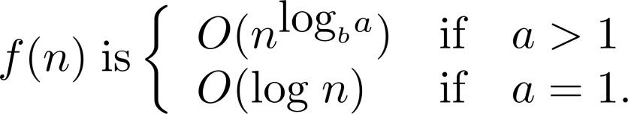
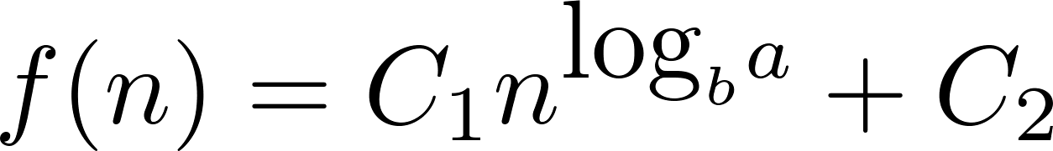
Estimating the Size of Divide-and-Conquer Functions
Theorem 1: Let f be an increasing function that satisfies the recurrence relation
f(n) = af(n/b) + c
whenever n is divisible by b, where a≥ 1, b is an integer greater than 1, and c is a positive real number. Then
Furthermore, when n = b^{k} and a ≠1, where k is a positive integer,
where C₁ = f(1) + c/(a−1) and C₂ = −c/(a−1).

Slide 60

f(n) = af(n/b) + c
Theorem 1:
If a = 1, f(n) ∈ Θ(log n)
If a > 1, f(n) ∈ Θ(n^{log b a} )
f(n) = af(n/b) + C = a² f(n/b²) + aC + C
= a³ f(n/b³) + a² C + aC + C
=……
= a^{k} f(n/b^{k}) + a^{k-1} C + a^{k-2}C + ……+ C
Let n = b^{k ,} n/b^{k} = 1,
= a^{k} f(1) +

Slide 61
f(n) = af(n/b) + C
If a = 1, then f(n) = f(1) + Ck
Since n= b^{k} , k = logbn, hence
f(n) = f(1) + c logbn
When a>1 and n= b^{k} ,
f(n)= a^{k} f(1) +
=
=

Slide 62
Complexity of Binary Search
Binary Search Example: Give a big-O estimate for the number of comparisons used by a binary search.
Solution: Since the number of comparisons used by binary search is f(n) = f(n/2) + 2 where n is even, by
Theorem 1, it follows that f(n) is O(log n). because
a=1
b=2

Slide 63
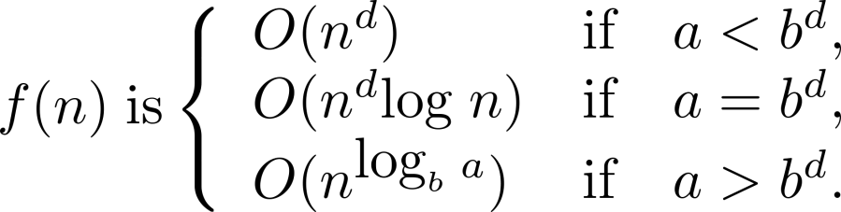
Estimating the Size of Divide-and-conquer Functions (continued)
Theorem 2. Master Theorem: Let f be an increasing function that satisfies the recurrence relation
f(n) = af(n/b) + cn^{d}
whenever n = b^{k}, where k is a positive integer greater than 1, and c and d are real numbers with c positive and d nonnegative. Then

Slide 64
Complexity of Merge Sort
Merge Sort Example: Give a big-O estimate for the number of comparisons used by merge sort.
Solution: Since the number of comparisons used by merge sort to sort a list of n elements is less than M(n) where M(n) = 2M(n/2) + n, therefore a = 2, b = 2, d = 1, a = b^{d} by the master theorem M(n) is O(n log n).
Examples: a= 4, b = 2
f(n) = 4f(n/2) + n ⇒ f(n) ∈ ? Θ(n²), a=4,b=2, d=1, a > b^{d}
f(n) = 4f(n/2) + n² ⇒ f(n) ∈ ? Θ(n²log n), d=2, a = b^{d}
f(n) = 4f(n/2) + n³ ⇒ f(n) ∈ ? Θ(n³), d=3, a < b^{d}

Slide 65
Complexity of Fast Integer Multiplication Algorithm
Integer Multiplication Example: Give a big-O estimate for the number of bit operations used needed to multiply two n-bit integers using the fast multiplication algorithm.
Solution: We have shown that f(n) = 3f(n/2) + Cn, when n is even, where f(n) is the number of bit operations needed to multiply two n-bit integers. Hence by the master theorem with a = 3, b = 2, c = C, and d = 1, a > b^{d} (so that we have the case where a > b^{d}), it follows that f(n) is O(n^{log 3}).
Note that log 3 ≈ 1.6. Therefore the fast multiplication algorithm is a substantial improvement over the conventional algorithm that uses O(n²) bit operations.

Slide 66
Strassen’s Matrix Multiplication
Strassen observed [1969] that the product of two matrices can be computed in general as follows:
C₀₀ C₀₁ A₀₀ A₀₁ B₀₀ B₀₁
= *
C₁₀ C₁₁ A₁₀ A₁₁ B₁₀ B₁₁
M₁ + M₄ - M₅ + M₇ M₃ + M₅
=
M₂ + M₄ M₁ + M₃ - M₂ + M₆

Slide 67
Formulas for Strassen’s Algorithm
M₁ = (A₀₀ + A₁₁) ∗ (B₀₀ + B₁₁)
M₂ = (A₁₀ + A₁₁) ∗ B₀₀
M₃ = A₀₀ ∗ (B₀₁ - B₁₁)
M₄ = A₁₁ ∗ (B₁₀ - B₀₀)
M₅ = (A₀₀ + A₀₁) ∗ B₁₁
M₆ = (A₁₀ - A₀₀) ∗ (B₀₀ + B₀₁)
M₇ = (A₀₁ - A₁₁) ∗ (B₁₀ + B₁₁)

Slide 68
Analysis of Strassen’s Algorithm
If n is not a power of 2, matrices can be padded with zeros.
Number of multiplications:
M(n) = 7M(n/2), M(1) = 1
Solution: M(n) = 7^{log 2n} = n^{log 27} ≈ n^{2.807} vs. n³ of brute-force alg.
Algorithms with better asymptotic efficiency are known but they
are even more complex and not used in practice.
What if we count both multiplications and additions?

Slide 69
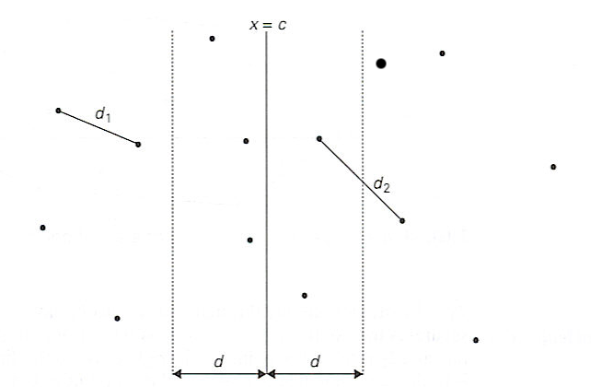
Closest-Pair Problem by Divide-and-Conquer
Step 1 Sort the points by x (list one) and then by y (list two).
Step 2 Divide the points given into two subsets S₁ and S₂ by a vertical line x = c so that half the points lie to the left or on the line and half the points lie to the right or on the line.

Slide 70
Closest Pair by Divide-and-Conquer (cont.)
Step 3 Find recursively the closest pairs for the left and right subsets.
Step 4 Set d = min{d₁, d₂}
We can limit our attention to the points in the symmetric vertical strip of width 2d as possible closest pair. Let C₁ and C₂ be the subsets of points in the left subset S₁ and of the right subset S₂, respectively, that lie in this vertical strip. The points in C₁ and C₂ are stored in increasing order of their y coordinates, taken from the second list.
Step 5 For every point P(x,y) in C₁, we inspect points in C₂ that may be closer to P than d. There can be no more than 6 such points (because d ≤ d₂)!
Notes:
Unfortunately, d is not necessarily the smallest distance between all pairs of points in S1 and
S2 because a closer pair of points can lie on the opposite sides separating the line. When we
combine the two sets, we must examine such points. (Illustrate this on the diagram)

Slide 71
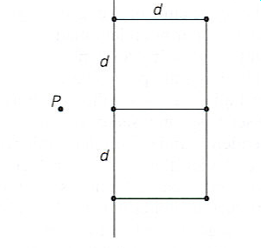
Closest Pair by Divide-and-Conquer: Worst Case
The worst case scenario is depicted below:

Slide 72
Efficiency of the Closest-Pair Algorithm
Running time of the algorithm (without sorting) is:
f(n) = 2f(n/2) + 7n,
By the Master Theorem (with a = 2, b = 2, d = 1)
f(n) ∈ Θ(n log n)
So the total time is Θ(n log n).

Slide 73
Complexity of Fast Integer Multiplication Algorithm
Integer Multiplication Example: Give a big-O estimate for the number of bit operations used needed to multiply two n-bit integers using the fast multiplication algorithm.
Solution: We have shown that f(n) = 3f(n/2) + Cn, when n is even, where f(n) is the number of bit operations needed to multiply two n-bit integers. Hence by the master theorem with a = 3, b = 2, c = C, and d = 1 (so that we have the case where a > b^{d}), it follows that f(n) is O(n^{log 3}).
Note that log 3 ≈ 1.6. Therefore the fast multiplication algorithm is a substantial improvement over the conventional algorithm that uses O(n²) bit operations.

Slide 74
Exercise
P535 21 7th edition
P483 21 6th edition

Slide 75
Generating Functions
Section 8.4

Slide 76
Section Summary
Generating Functions
Counting Problems and Generating Functions
Useful Generating Functions
Solving Recurrence Relations Using Generating Functions (not yet covered in the slides)
Proving Identities Using Generating Functions (not yet covered in the slides)

Slide 77
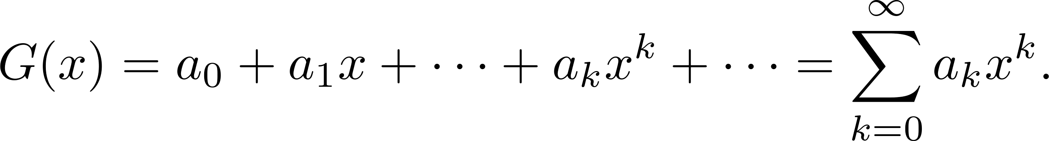
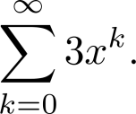
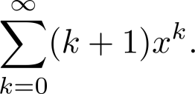
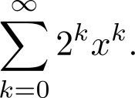
Generating Functions
Definition: The generating function for the sequence a₀, a₁,…, a_{k}, … of real numbers is the infinite series
Examples:
The sequence {a_{k}} with a_{k} = 3 has the generating function
The sequence {a_{k}} with a_{k} = k + 1 has the generating function has the generating function
The sequence {a_{k}} with a_{k} = 2^{k} has the generating function has the generating function

Slide 78
Generating Functions for Finite Sequences
Generating functions for finite sequences of real numbers can be defined by extending a finite sequence a₀,a₁, … , a_{n} into an infinite sequence by setting a_{n+1} = 0, a_{n+2} = 0, and so on.
The generating function G(x) of this infinite sequence {a_{n}} is a polynomial of degree n because no terms of the form a_{j}x^{j} with j > n occur, that is,
G(x) = a₀ + a₁x + ⋯ + a_{n} x^{n}.

Slide 79
Generating Functions for Finite Sequences (continued)
Example: What is the generating function for the sequence 1,1,1,1,1,1?
Solution: The generating function of 1,1,1,1,1,1 is
1 + x + x² + x³ + x⁴ + x⁵.
By Theorem 1 of Section 2.4, we have
(x⁶ − 1)/(x −1) = 1 + x + x² + x³ + x⁴ + x⁵
when x ≠ 1.
Consequently G(x) = (x⁶ − 1)/(x −1) is the generating function of the sequence.

Slide 80
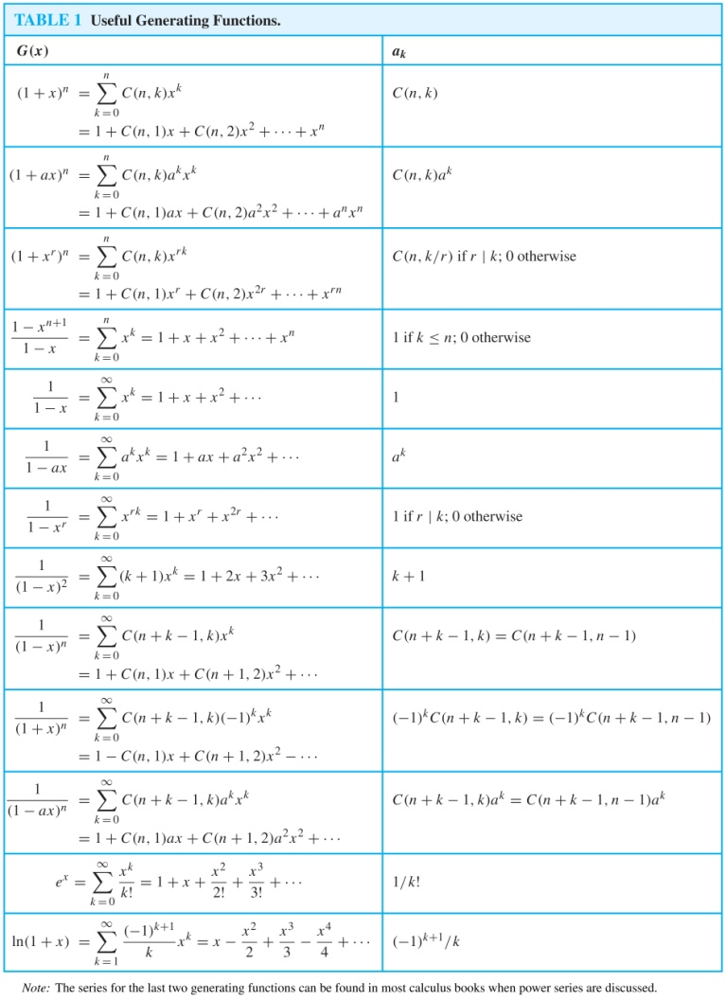
Useful Generating Functions

Slide 81
Counting Problems and Generating Functions
Example: Find the number of solutions of
e₁ + e₂ + e₃ = 17,
where e₁, e₂, and e₃ are nonnegative integers with 2 ≤ e₁≤ 5, 3 ≤ e₂ ≤ 6, and 4 ≤ e₃ ≤ 7.
Solution: The number of solutions is the coefficient of x¹⁷ in the expansion of
(x² + x³ + x⁴ + x⁵) (x³ + x⁴ + x⁵ + x⁶) (x⁴ + x⁵ + x⁶ + x⁷).
This follows because a term equal to is obtained in the product by picking a term in the first sum x^{e1}, a term in the second sum x^{e2}, and a term in the third sum x^{e3}, where e₁ + e₂ + e₃ = 17.
There are three solutions since the coefficient of x¹⁷ in the product is 3.

Slide 82

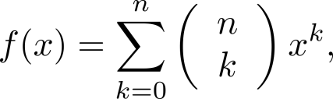
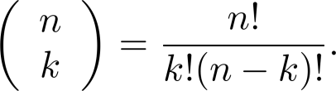
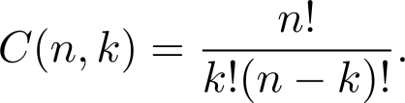
Counting Problems and Generating Functions (continued)
Example: Use generating functions to find the number of k-combinations of a set with n elements, i.e., C(n,k).
Solution: Each of the n elements in the set contributes the term (1 + x) to the generating function
Hence f(x) = (1 + x)^{n} where f(x) is the generating function for {a^{k}}, where a^{k} represents the number of k-combinations of a set with n elements.
By the binomial theorem, we have
where
Hence,

Slide 83
Exercises
P550 23, 33 7th edition
P496-499 23, 33 6th edition

Slide 84
Inclusion-Exclusion
Section 8.5

Slide 85
Section Summary
The Principle of Inclusion-Exclusion
Examples

Slide 86
Principle of Inclusion-Exclusion
In Section 2.2, we developed the following formula for the number of elements in the union of two finite sets:
We will generalize this formula to finite sets of any size.

Slide 87
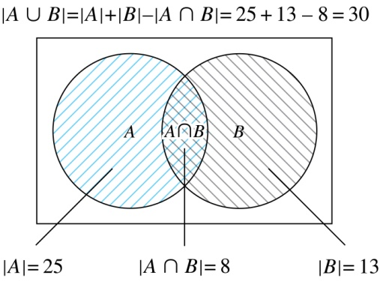
Two Finite Sets
Example: In a discrete mathematics class every student is a major in computer science or mathematics or both. The number of students having computer science as a major (possibly along with mathematics) is 25; the number of students having mathematics as a major (possibly along with computer science) is 13; and the number of students majoring in both computer science and mathematics is 8. How many students are in the class?
Solution: |A∪B| = |A| + |B| −|A∩B|
= 25 + 13 −8 = 30

Slide 88
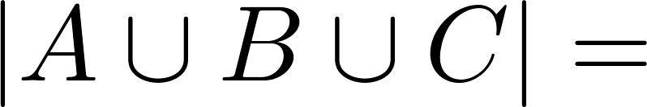
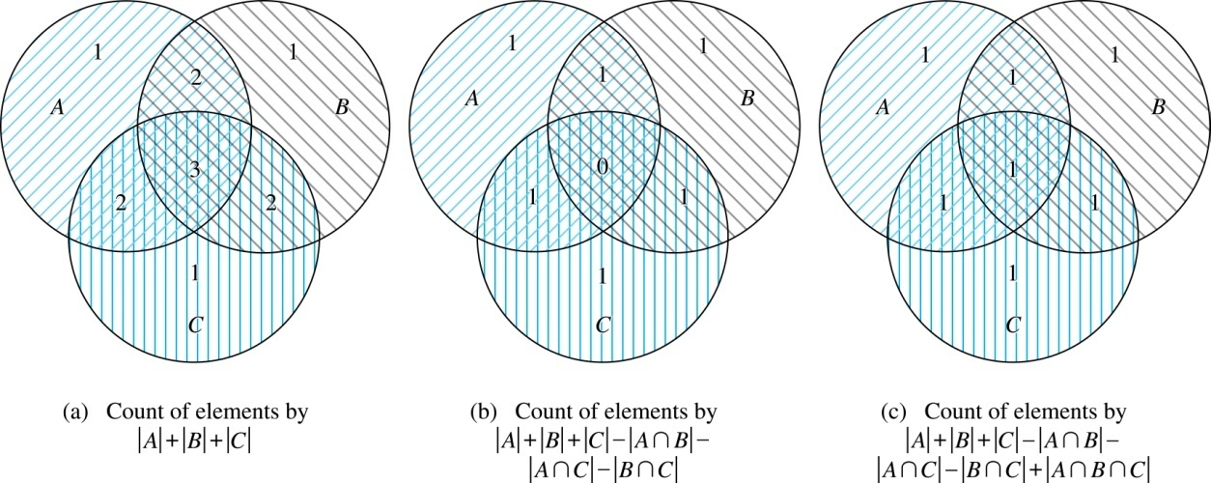
Three Finite Sets

Slide 89
Three Finite Sets Continued
Example: A total of 1232 students have taken a course in Spanish, 879 have taken a course in French, and 114 have taken a course in Russian. Further, 103 have taken courses in both Spanish and French, 23 have taken courses in both Spanish and Russian, and 14 have taken courses in both French and Russian. If 2092 students have taken a course in at least one of Spanish French and Russian, how many students have taken a course in all 3 languages.
Solution: Let S be the set of students who have taken a course in Spanish, F the set of students who have taken a course in French, and R the set of students who have taken a course in Russian. Then, we have
|S| = 1232, |F| = 879, |R| = 114, |S∩F| = 103, |S∩R| = 23, |F∩R| = 14, and |S∪F∪R| = 23.
Using the equation
|S∪F∪R| = |S|+ |F|+ |R| − |S∩F| − |S∩R| − |F∩R| + |S∩F∩R|,
we obtain 2092 = 1232 + 879 + 114 −103 −23 −14 + |S∩F∩R|.
Solving for |S∩F∩R| yields 7.

Slide 90
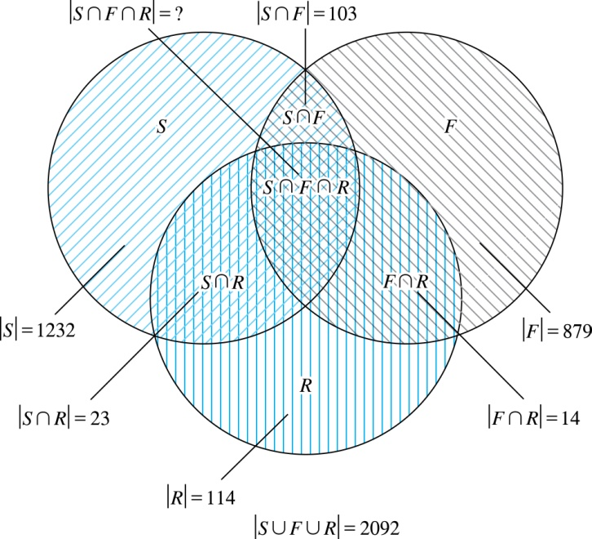
Illustration of Three Finite Set Example

Slide 91
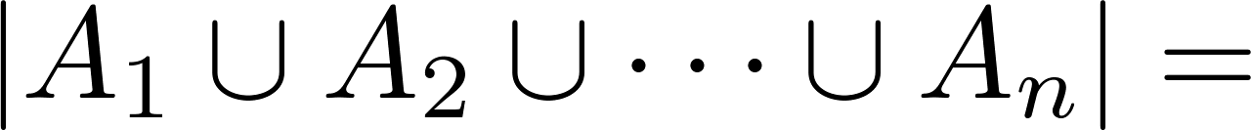
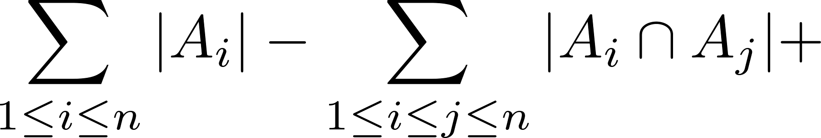
The Principle of Inclusion-Exclusion
Theorem 1. The Principle of Inclusion-Exclusion: Let A₁, A₂, …, A_{n} be finite sets. Then:

Slide 92
The Principle of Inclusion-Exclusion (continued)
Proof: An element in the union is counted exactly once in the right-hand side of the equation. Consider an element a that is a member of r of the sets A₁,…., A_{n} where 1≤ r ≤ n.
It is counted C(r,1) times by Σ|A_{i}|
It is counted C(r,2) times by Σ|A_{i} ⋂A_{j}|
In general, it is counted C(r,m) times by the summation of m of the sets A_{i}.

Slide 93
The Principle of Inclusion-Exclusion (cont)
Thus the element is counted exactly
C(r,1) − C(r,2) + C(r,3) − ⋯ + (−1)^{r+1} C(r,r)
times by the right hand side of the equation.
By Corollary 2 of Section 6.4, we have
C(r,0) − C(r,1) + C(r,2) − ⋯ + (−1)^{r} C(r,r) = 0.
Hence,
1 = C(r,0) = C(r,1) − C(r,2) + ⋯ + (−1)^{r+1} C(r,r).

Slide 94
Exercise
P558 9 7th edition
P505 9 6th edition

Slide 95
Applications of Inclusion-Exclusion
Section 8.6

Slide 96
Section Summary
Counting Onto-Functions
Derangements

Slide 97
The Number of Onto Functions
Example: How many onto functions are there from a set with six elements to a set with three elements?
Solution: Suppose that the elements in the codomain are b₁, b₂, and b₃. Let P₁, P₂, and P₃ be the properties that b₁, b₂, and b₃ are not in the range of the function, respectively. The function is onto if none of the properties P₁, P₂, and P₃ hold.
By the inclusion-exclusion principle the number of onto functions from a set with six elements to a set with three elements is
N − [N(P₁) + N(P₂) + N(P₃)] +
[N(P₁P₂) + N(P₁P₃) + N(P₂P₃)] − N(P₁P₂P₃)
Here the total number of functions from a set with six elements to one with three elements is N = 3⁶.
The number of functions that do not have in the range is N(P₁) = 2⁶. Similarly, N(P₂) = N(3₁) = 2⁶ .
Note that N(P₁P₂) = N(P₁P₃) = N(P₂P₃) = 1 and N(P₁P₂P₃)= 0.
Hence, the number of onto functions from a set with six elements to a set with three elements is:
3⁶ − 3∙ 2⁶ + 3 = 729 − 192 + 3 = 540

Slide 98
The Number of Onto Functions (continued)
Theorem 1: Let m and n be positive integers with m ≥ n. Then there are
onto functions from a set with m elements to a set with n elements.
Proof follows from the principle of inclusion-exclusion (see Exercise 27).

Slide 99
Derangements
Definition: A derangement is a permutation of objects that leaves no object in the original position.
Example: The permutation of 21453 is a derangement of 12345 because no number is left in its original position. But 21543 is not a derangement of 12345, because 4 is in its original position.

Slide 100
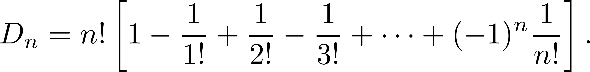
Derangements (continued)
Theorem 2: The number of derangements of a set with n elements is
Proof follows from the principle of inclusion-exclusion (see text).

Slide 101
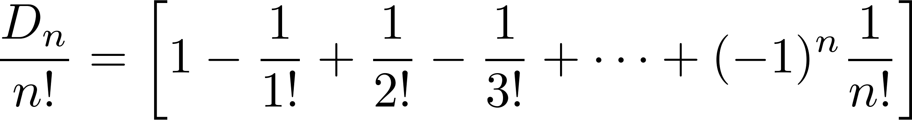
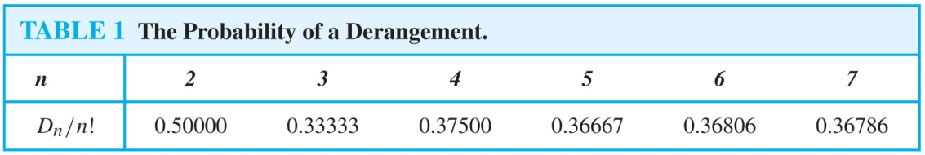
Derangements (continued)
The Hatcheck Problem: A new employee checks the hats of n people at restaurant, forgetting to put claim check numbers on the hats. When customers return for their hats, the checker gives them back hats chosen at random from the remaining hats. What is the probability that no one receives the correct hat.
Solution: The answer is the number of ways the hats can be arranged so that there is no hat in its original position divided by n!, the number of permutations of n hats.
Remark: It can be shown that the probability of a derangement approaches 1/e as n grows without bound.

Slide 102
Exercise
P564-565 5，9 7th edition
P513 5, 9 6th edition

