Slide 1


Chapter 1 Sets, Relations, and Languages

Slide 2






Slide 3





Slide 4
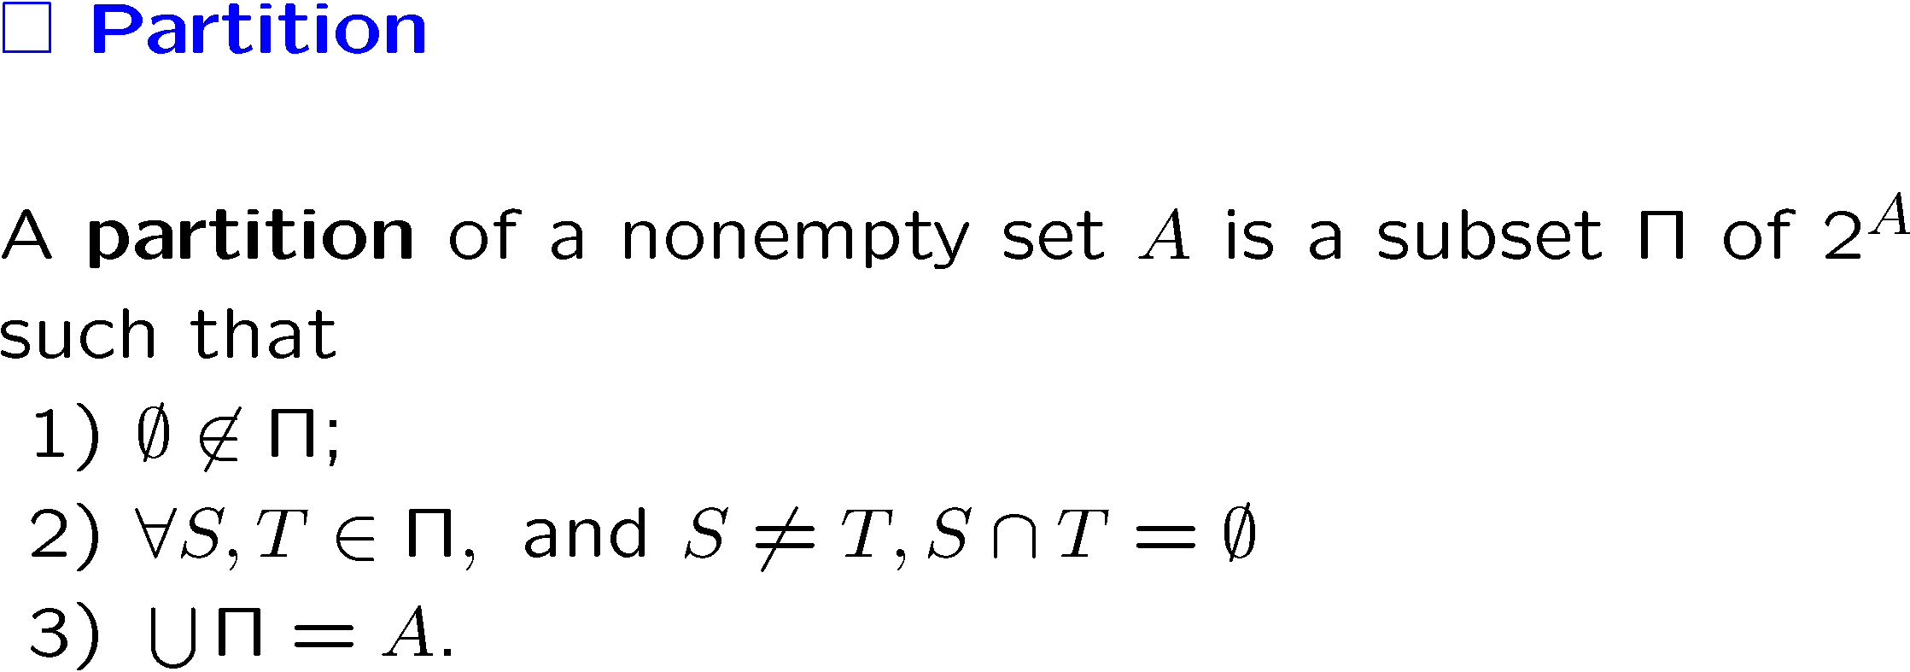
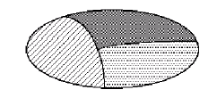

Slide 5
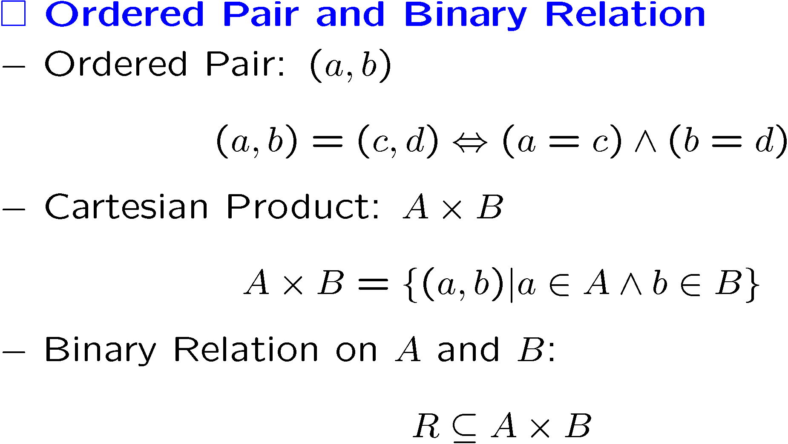

Slide 6
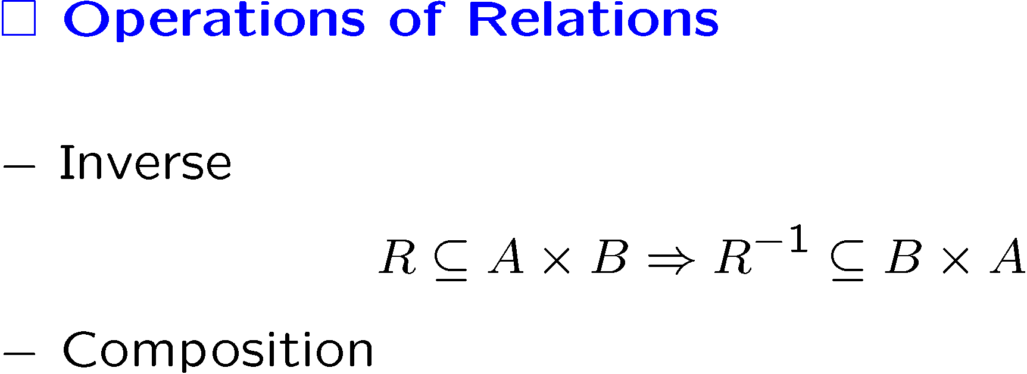

Slide 7





Slide 8




Slide 9



Slide 10
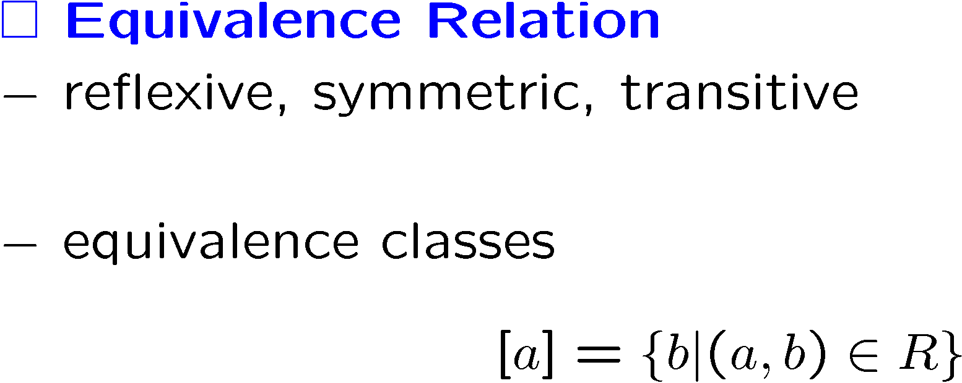


Slide 11
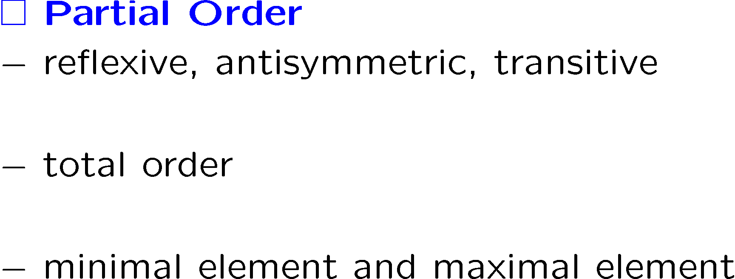


Slide 12



Slide 13


Slide 14


Slide 15


Slide 16



Slide 17



Slide 18


Slide 19




Slide 20



Slide 21




Slide 22



Slide 23



Slide 24



Slide 25




Slide 26



Slide 27


Slide 28





Slide 29




Slide 30
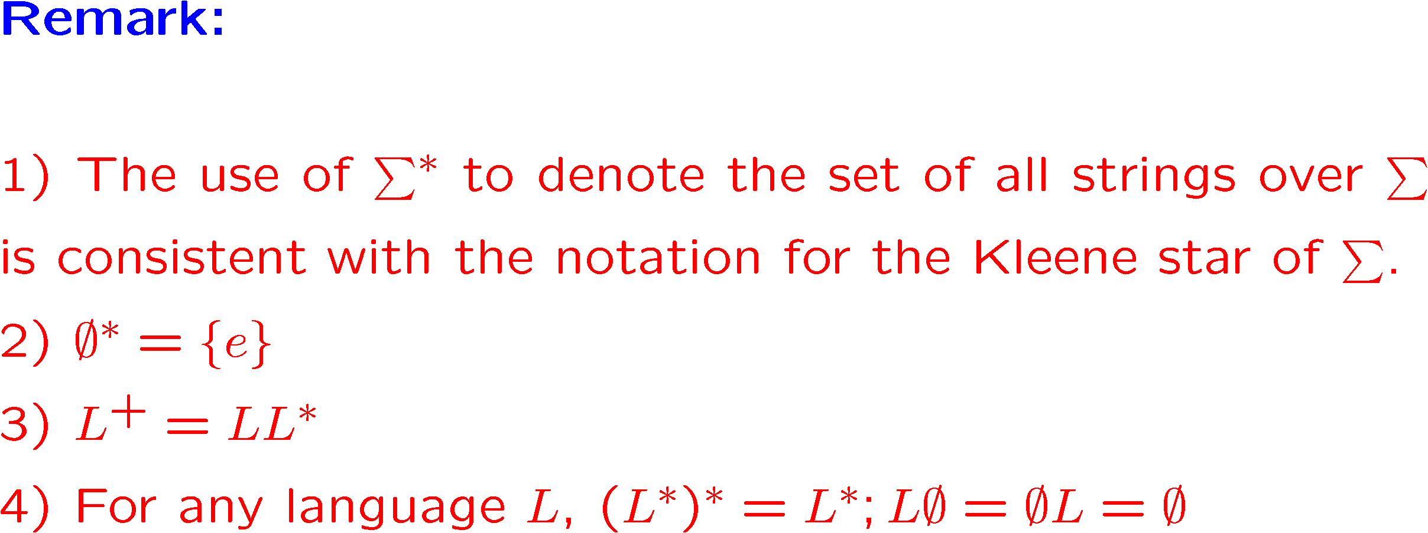

Slide 31




Slide 32




Slide 33


Slide 34
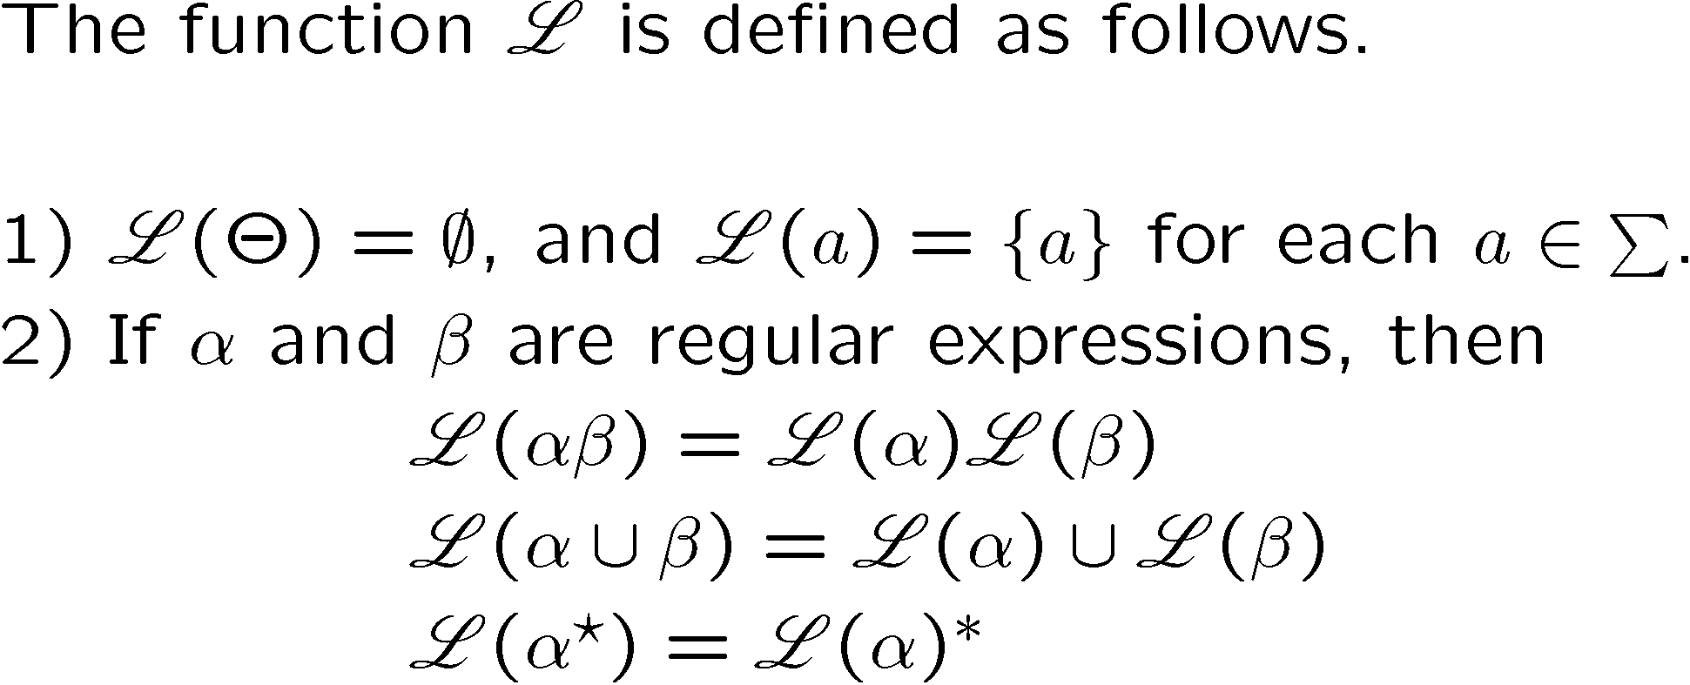

Slide 35






Slide 36
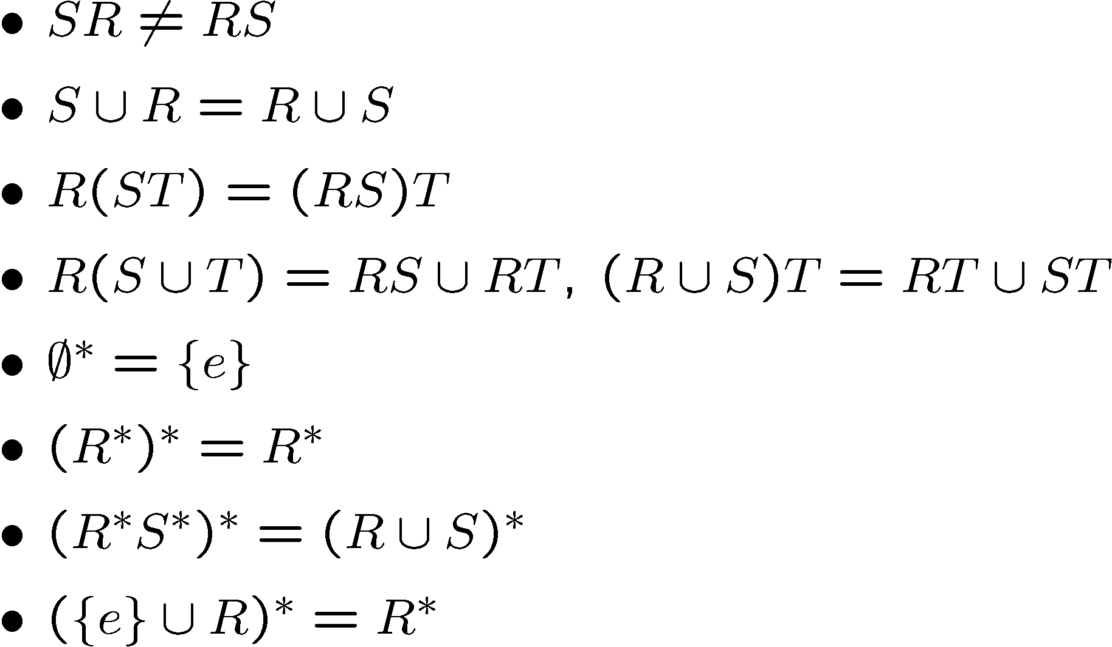

Slide 37



Slide 38



Slide 39
