Slide 1
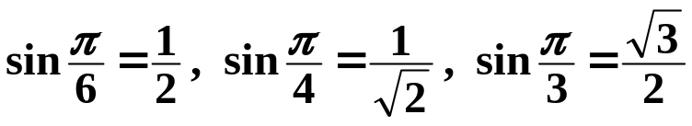
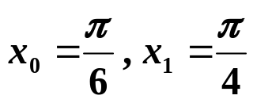
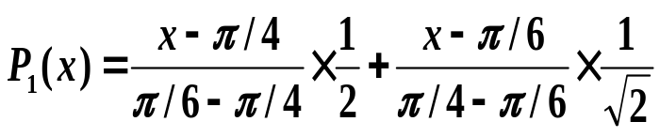
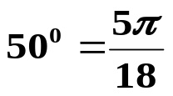



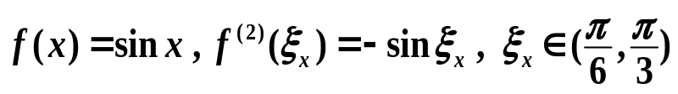
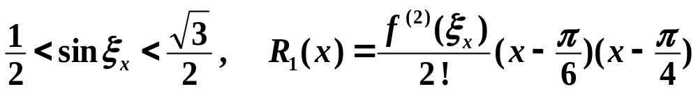
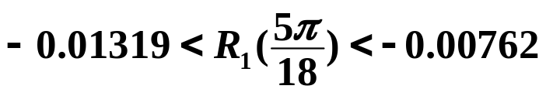
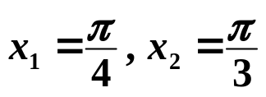

Chapter 3 Interpolation and Polynomial Approximation -- Interpolation and the Lagrange Polynomial
Example: Given
Use the linear and the quadratic Lagrange polynomial of
sin x to compute sin 50° and then estimate the errors.
Solution: First use x₀, x₁ and x₁, x₂ to compute the linear interpolations.
 Use
5
π
In general, interpolation is better than extrapolation.
sin
50
0
≈
P
(
)
≈
0.77614
1
18
Here
and
sin 50° = 0.7660444…
Error of extrapolation ≈ −0.01001
 Use
sin 50° ≈ 0.76008,
Error of interpolation ≈ 0.00596
1/13

Slide 2
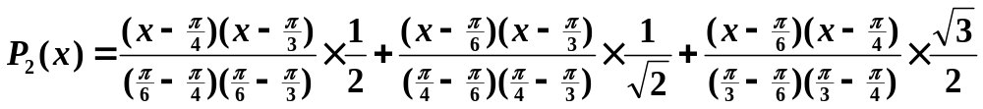
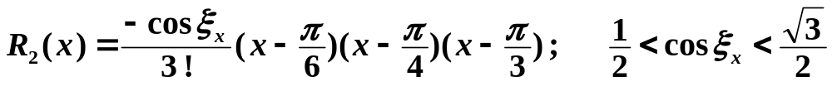


Chapter 3 Interpolation and Polynomial Approximation -- Interpolation and the Lagrange Polynomial
Now use x₀, x₁ and x₂ to compute the quadratic interpolation.
sin
50
0
≈
P
(
5
π
)
≈
0.76543
2
18
sin 50° = 0.7660444…
Error of the quadratic interpolation ≈ 0.00061
Interpolation with higher degree
usually obtain better results.
The higher the better? Nooooooo….
2/13

Slide 3
Chapter 3 Interpolation and Polynomial Approximation -- Interpolation and the Lagrange Polynomial
When you start writing the program,
you will find how easy it is to calculate
the Lagrange polynomial.
Oh yeah? What if I find the current interpolation not accurate enough?
Right. Then all
the Lagrange basis, L_{n,i}(x),
will have to be re-calculated.
Then you might want to take
more interpolating points into account.
Excellent point !
Let’s look at Neville’s Method…
3/13

Slide 4


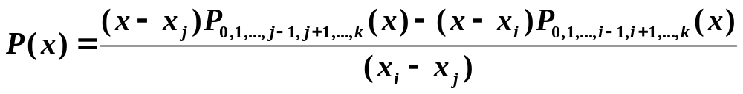
Chapter 3 Interpolation and Polynomial Approximation -- Interpolation and the Lagrange Polynomial
Definition: Let f be a function defined at x₀, x₁, …, x_{n}, and suppose that m₁, …, m_{k} are k distinct integers with 0 ≤ m_{i} ≤ n for each i. The Lagrange polynomial that agrees with f(x) at the k points
denoted by
Theorem: Let f be defined at x₀, x₁, …, x_{k}, and let x_{i} and x_{j} be two distinct numbers in this set. Then
describes the k-th Lagrange polynomial that interpolates f at the k+1 points x₀, x₁, …, x_{k} .
Proof: For any 0 ≤ r ≤ k and r ≠ i and j, the two interpolating polynomials on the numerator are equal to f(x_{r}) at x_{r} , so P(x_{r}) = f(x_{r}).
The first polynomials on the numerator equals f(x_{i}) at x_{i} , while the second term is zero, so P(x_{i}) = f(x_{i}). Similarly P(x_{j}) = f(x_{j}).
The k-th Lagrange polynomial that interpolates f at the k+1 points x₀, x₁, …, x_{k} is unique.
4/13

Slide 5
Chapter 3 Interpolation and Polynomial Approximation -- Interpolation and the Lagrange Polynomial
➢ Neville’s Method
x₀
x₁
x₂
x₃
x₄
P₀
P₁
P₂
P₃
P₄
P_{0,1}
P_{1,2}
P_{2,3}
P_{3,4}
P_{0,1,2}
P_{1,2,3}
P_{2,3,4}
P_{0,1,2,3}
P_{1,2,3,4}
P_{0,1,2,3,4}
HW:
p.119 #5; p.120 #17
5/13

Slide 6

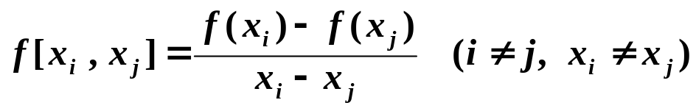
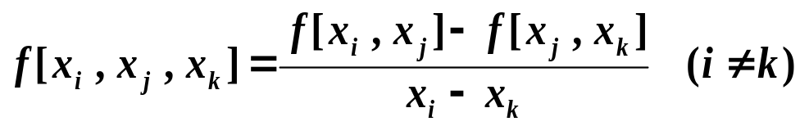
Chapter 3 Interpolation and Polynomial Approximation -- Divided Differences
☑ 3.2 Divided Differences
The 1st divided difference of f w.r.t. x_{i} and x_{j}
The 2nd divided difference of f w.r.t. x_{i} , x_{j} and x_{k}
The k+1st divided difference of f w.r.t. x₀ … x_{k+1}
f
[
x
,
x
,
...
,
x
]
−
f
[
x
,
...
,
x
,
x
]
f
[
x
,
...
,
x
]
=
0
1
k
1
k
k
+
1
0
k
+
1
x
−
x
0
k
+
1
f
[
x
,
...
,
x
,
x
]
−
f
[
x
,
...
,
x
,
x
]
=
0
k
−
1
k
0
k
−
1
k
+
1
x
−
x
k
k
+
1
6/13

Slide 7
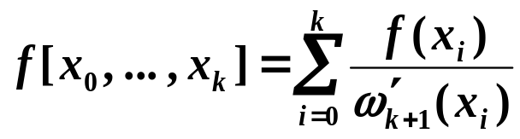
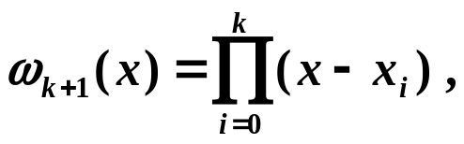
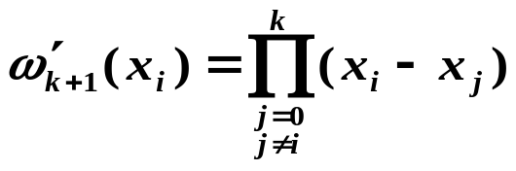

Chapter 3 Interpolation and Polynomial Approximation -- Divided Differences
As a matter of fact,
where
Warning: my head is exploding…
What is the point of this formula?
The value of f [ x₀, …, x_{k} ] is independent of the order of the numbers x₀, …, x_{k} .
7/13

Slide 8



Chapter 3 Interpolation and Polynomial Approximation -- Divided Differences
➢ Newton’s Interpolation
1
2
… … … …
n−1
1
+ (x − x₀) ×
+ … … + (x − x₀)…(x − x_{n−1}) ×
2
n−1
N_{n}(x)
a_{i} =
f [ x₀, …, x_{i} ]
R_{n}(x)
8/13

Slide 9

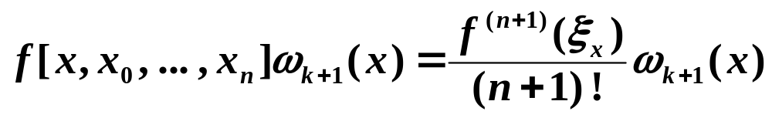
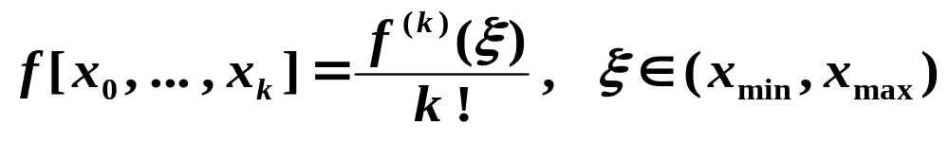
Chapter 3 Interpolation and Polynomial Approximation -- Divided Differences
Note:
☞ Since the n-th interpolating polynomial is unique, N_{n}(x) ≡ P_{n}(x).
☞ They must have the same truncation error. That is,
☞ The procedure is similar to Neville’s method.
f (x₀)
f (x₁)
f (x₂)
…
f (x_{n−1})
f (x_{n})
f [x₀, x₁]
f [x₁, x₂]
… …
… …
f [x_{n−1}, x_{n}]
f [x₀, x₁ , x₂]
… …
… …
f [x_{n−2}, x_{n−1}, x_{n}]
f [x₀, …, x_{n}]
f (x_{n+1}) f [x_{n}, x_{n+1}] f [x_{n−1}, x_{n}, x_{n+1}] f [x₁, …, x_{n+1}] f [x₀, …, x_{n+1}]
9/13

Slide 10

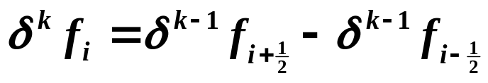
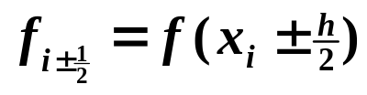
Chapter 3 Interpolation and Polynomial Approximation -- Divided Differences
➢ Formulae with Equal Spacing
If the points are equally spaced:
forward difference
Δ
f
=
f
−
f
i
i
+
1
i
Δ
k
f
=
Δ
(
Δ
k
−
1
f
)
=
Δ
k
−
1
f
−
Δ
k
−
1
f
i
i
i
+
1
i
backward difference
∇
f
=
f
−
f
i
i
i−1
∇
k
f
=
∇
k
−
1
f
−
∇
k
−
1
f
i
i
i
−
1
centered difference
其中
10/13

Slide 11


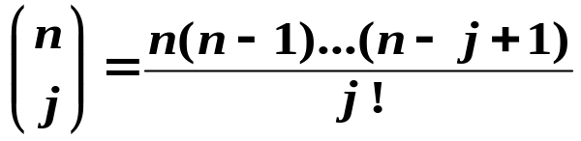
Chapter 3 Interpolation and Polynomial Approximation -- Divided Differences
 Some important properties
 Linearity:
 If f (x) is a polynomial of degree m , then is a polynomial of degree m – k and
 The values of the differences can be obtained from the function
n
n
n
n
Δ
n
f
=
Σ
(
−
1
)
j
f
∇
n
=
Σ
−
n
−
j
k
n
+
k
−
j
f
(
1
)
f
=
j
k
=
j
k
+
j
−
n
j
0
j
0
where
/* binomial coefficients */
n
n
 And vice-versa
f
=
Σ
Δ
j
f
n
+
k
j
k
j
=
0
Δ
k
f
From R_{n}

f
[
x
,
...
,
x
]
=
0
0
k
k
!
h
k
∇
k
f
Δ
k
f
f
[
x
,
x
,
...
,
x
]
=
n
f
(
k
)
(
ξ
)
=
0
n
n
−
1
n
−
k
k
!
h
k
h
k
11/13

Slide 12


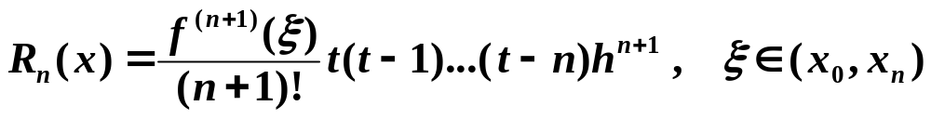

Chapter 3 Interpolation and Polynomial Approximation -- Divided Differences
Newton’s
formulae
 Newton’s forward-difference formula
n
t
Let
Σ
HW:
p.131 #5(a)(b);
p.132 #13
, then
=
+
=
Δ
k
N
(
x
)
N
(
x
t
h
)
f
(
x
)
n
n
0
k
0
k
=
0
 Newton’s backward-difference formula
Reverse the order of the points
n
−
t
Let
, then
=
+
=
Σ
−
k
∇
k
N
(
x
)
N
(
x
t
h
)
(
1
)
f
(
x
)
n
n
n
k
n
k
=
0
12/13

Slide 13

Chapter 3 Interpolation and Polynomial Approximation
Research topic 9:
Try to interpolate the following blue curve with the coordinates of 9 points given:
1: (0.0, 7.0); 2: (1.0, 6.8); 3: (2.8, 5.8); 4: (5.5, 6.8); 5: (8.0, 9.0);
6: (6.5, 6.0); 7: (3.0, 3.5); 8: (1.0, 0.2); 9: (0.0, 0.0).
5
1
2
4
3
6
7
8
9
13/13

