Slide 1


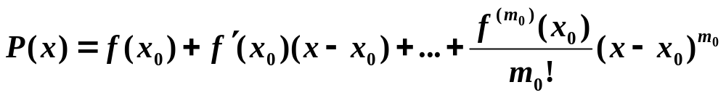
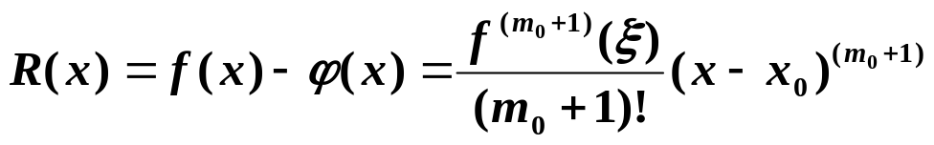
Chapter 3 Interpolation and Polynomial Approximation -- Hermite Interpolation
☑ 3.3 Hermite Interpolation
Find the osculating polynomial P(x) such that P(x_{i}) = f (x_{i}), P’ (x_{i}) = f ’ (x_{i}), …, P^{(m_i)} (x_{i}) = f ^{(m_i)} (x_{i}) for all i = 0, 1, …, n.
Note:
☞ Given N conditions (and hence N equations), a polynomial of degree can be determined.
N − 1
The osculating polynomial that agrees with f and all its derivatives of order ≤ m₀ at one point x₀ is just the Taylor polynomial
with remainder
The case when m_{i} = 1 for each i = 0, 1, …, n gives the Hermite polynomials.
1/13

Slide 2
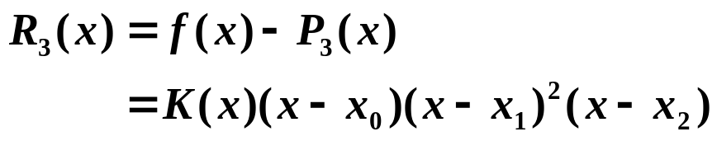


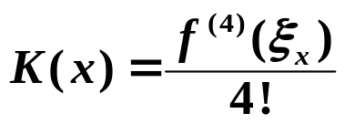
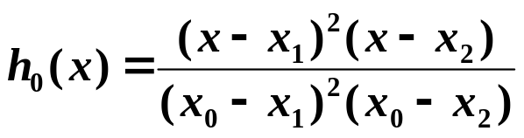
Chapter 3 Interpolation and Polynomial Approximation -- Hermite Interpolation
Example: Suppose x₀ ≠ x₁ ≠ x₂. Given f(x₀), f(x₁), f(x₂) and f ’(x₁), find the polynomial P(x) such that P(x_{i}) = f (x_{i})，i = 0, 1, 2, and P’(x₁) = f ’(x₁). Analyze the errors.
Solution: First of all, the degree of P(x) must be …
3.
Similar to Lagrange polynomials, we may assume the form of Hermite polynomial as
Similar to Lagrange error analysis
2
∧
P
(
x
)
=
Σ
f
(
x
)
h
(
x
)
+
f ’

(
x₁
)
h
(
x
)
3
i
=
0
i
i
1
∧
∧
where h_{i}(x_{j}) = δ_{ij} , h_{i}’(x₁) = 0, (x_{i}) = 0, ’(x₁) = 1
h₁
h₁
h₀(x)
Has roots
x₁, x₂, and h₀’(x₁) = 0 ⇒ x₁ is a multiple root.
h
(
x
)
=
C
(
x
−
x
)
2
(
x
−
x
)
0
0
1
2
h₀(x₀) = 1 ⇒ C₀
h₂(x)
Similar to h₀(x).
Has roots x₀, x₂ ⇒
=
+
−
−
h₁(x)
h
(
x
)
(
Ax
B
)(
x
x
)(
x
x
)
1
0
2
A and B can be solved with h₁(x₁) = 1 and h₁’(x₁) = 0.
∧
∧
(x)
Has roots x₀, x₁, x₂ ⇒
h₁
=
−
−
−
h₁
(
x
)
C
(
x
x
)(
x
x
)(
x
x
)
∧
1
0
1
2
’(x₁) = 1 ⇒ C₁ can be solved.
h₁
2/13

Slide 3
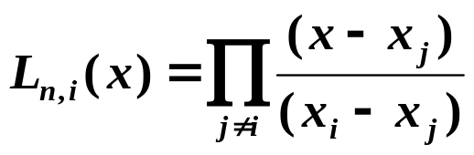

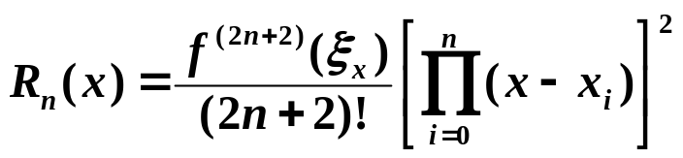

Chapter 3 Interpolation and Polynomial Approximation -- Hermite Interpolation
In general, given x₀ , …, x_{n}; y₀ , …, y_{n} and y₀’ , …, y_{n}’ . The Hermite polynomial H_{2n+1}(x) satisfies H_{2n+1}(x_{i}) = y_{i} and H’_{2n+1}(x_{i}) = y_{i}’ for all i.
n
n
∧
Solution: Let
H_{2n+1}
(
x
)
=
Σ
y_{i}
h
(
x
)
+
Σ
y_{i}’
h
(
x
)
i
i
i
=
0
i
=
0
∧
∧
where h_{i}(x_{j}) = δ_{ij}, h_{i}’(x_{j}) = 0, (x_{j}) = 0, ’(x_{j}) = δ_{ij}
h_{i}
h_{i}
∧
h_{i}(x)
x₀ , …, x_{i} , …, x_{n} are all roots with multiplicity 2 ⇒
h
(
x
)
=
(
A
x
+
B
)
L²
(
x
)
i
i
i
n, i
A_{i} and B_{i} can be solved by h_{i}(x_{i}) = 1 and h_{i}’(x_{i}) = 0 ⇒
Such a Hermite interpolating polynomial is unique
∧
(x)
All the roots x₀ , …, x_{n} have multiplicity 2 except x_{i} ⇒
h_{i}
∧
h_{i}
=
−
(
x
)
C
(
x
x
)
L_{n, i}²(x)
∧
i
i
h_{i}
=
−
∧
(
x
)
(
x
x
)
L_{n, i}²(x)
’(x_{i}) = 1 ⇒ C_{i} = 1
i
h_{i}
If
, then
3/13

Slide 4
Chapter 3 Interpolation and Polynomial Approximation -- Hermite Interpolation
∧
Quiz: Given x_{i} = i +1, i = 0, 1, 2, 3, 4, 5. Which one is h₂(x)?
y
y
✓
1
-
1
-
slope=1
0.5
-
0.5
-
0
1
2
3
4
5
6
x
-
0
1
2
3
4
5
6
x
HW:
p.140 #7
4/13

Slide 5
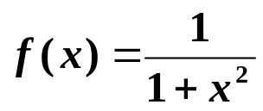
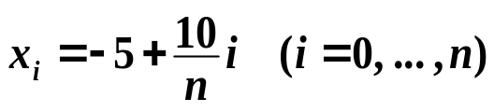


Chapter 3 Interpolation and Polynomial Approximation -- Cubic Spline Interpolation
☑ 3.4 Cubic Spline Interpolation
Example: Consider the Lagrange polynomial P_{n}(x) of on
[−5, 5]. Take
2.5
Remember what I have said?
Increasing the degree of interpolating polynomial
will NOT guarantee a good result,
since high-degree polynomials are
oscillating.
×
P_{n}(x) → f (x)
2
1.5
Discussion 18: How would you solve this problem?
1
0.5
Piecewise polynomial approximation
0
-
0.5
-
5
-
4
-
3
-
2
-
1
0
1
2
3
4
5
5/13

Slide 6

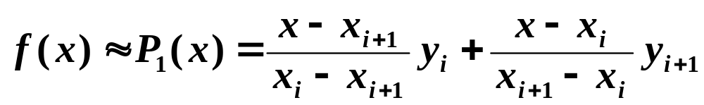




Chapter 3 Interpolation and Polynomial Approximation -- Cubic Spline Interpolation
➢ Piecewise linear interpolation
Approximate f (x) by linear polynomials on each subinterval :
uniform
Let . Then as
No longer smooth.
How can we make a smooth interpolation without asking too much from f ?
Headache …
➢ Hermite piecewise polynomials
Given
Construct the Hermite polynomial of degree 3 with y and y’ on the two endpoints of .
It is not easy to obtain the derivatives.
6/13

Slide 7
Chapter 3 Interpolation and Polynomial Approximation -- Cubic Spline Interpolation
➢ Cubic Spline
Definition: Given a function f defined on [a, b] and a set of nodes
a = x₀ < x₁ < … < x_{n} = b, a cubic spline interpolant S for f is a function that satisfies the following conditions:
S(x) is a cubic polynomial, denoted S_{i}(x), on the subinterval
[ x_{i} , x_{i+1}] for each i = 0, 1, …, n – 1;
S(x_{i}) = f (x_{i}) for each i = 0, 1, …, n;
S_{i+1}(x_{i+1}) = S_{i}(x_{i+1}) for each i = 0, 1, …, n – 2;
S’_{i+1}(x_{i+1}) = S’_{i}(x_{i+1}) for each i = 0, 1, …, n – 2;
S”_{i+1}(x_{i+1}) = S”_{i}(x_{i+1}) for each i = 0, 1, …, n – 2;
f(x)
H(x)
S(x)
7/13

Slide 8
Chapter 3 Interpolation and Polynomial Approximation -- Cubic Spline Interpolation
❖ Method of Bending Moment
Let h_{j} = x_{j} – x_{j – 1} and S(x) = S_{j}(x) for x ∈ [ x_{j – 1}, x_{j} ].
The bending moment
Then S_{j}”(x) is a polynomial of degree , which can be determined by the values of f on nodes.
1
2
Assume S_{j}”(x_{j−1}) = M_{j−1}， S_{j}”(x_{j}) = M_{j} . Then for all x ∈ [ x_{j – 1}, x_{j} ],
For each j it is a cubic polynomial
x
−
x
x
−
x
S_{j}”(x) =
j
+
j
−
1
M
M
j
−
1
h
j
h
j
j
Integrate S_{j}”(x) twice, we obtain S_{j}’(x) and S_{j} (x) ：
S_{j}’(x) =
(
x
−
x
)
2
(
x
−
x
)
2
−
M
j
+
M
j
−
1
+
A
Can be
solved by
S_{j}(x_{j−1}) = y_{j−1}
S_{j}(x_{j}) = y_{j}
j
−
1
2
h
j
−
1
2
h
j
j
j
S_{j}(x) =
(
x
−
x
)
3
(
x
−
x
)
3
M
j
+
M
j
−
1
+
A
x
+
B
j
−
1
6
h
j
6
h
j
j
j
j
8/13

Slide 9
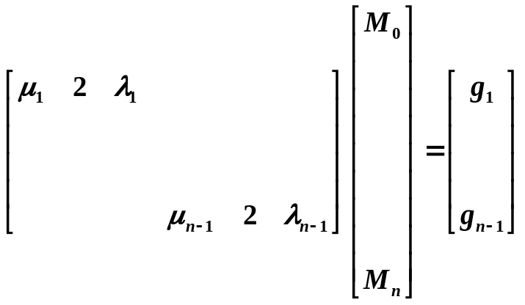
Chapter 3 Interpolation and Polynomial Approximation -- Cubic Spline Interpolation
y
−
y
M
−
M
M
x
−
x
M
x
−
x
A
=
j
j
−
1
−
j
j
−
1
h
A
x
+
B
=
(
y
−
j
−
1
h
2
)
j
+
(
y
−
j
h
2
)
j
−
1
j
h
6
j
j
j
j
−
1
6
j
h
j
6
j
h
j
j
j
Now solve for M_{j} ：
Since S’ is continuous at x_{j}
(
x
−
x
)
2
(
x
−
x
)
2
M
−
M
[x_{j−1}, x_{j} ]: S_{j}’(x) =
j
j
−
1
j
j
−
1
−
M
+
M
+
f
[
x
,
x
]
−
h
j
−
1
2
h
j
2
h
j
−
1
j
6
j
j
j
(
x
−
x
)
2
(
x
−
x
)
2
M
−
M
[x_{j} , x_{j+1}]: S_{j+1}’(x) =
−
M
j
+
1
+
M
j
+
f
[
x
,
x
]
−
j
+
1
j
h
j
2
h
j
+
1
2
h
j
j
+
1
6
j
+
1
j
+
1
j
+
1
From S_{j}’(x_{j}) = S_{j+1}’(x_{j}), we can combine the coefficients for M_{j−1}, M_{j}, and M_{j+1}. Define , , and
h
6
λ
=
j
+
1
μ
=
1
−
λ
g
=
(
f
[
x
,
x
]
−
f
[
x
,
x
])
j
h
+
h
j
j
j
h
+
h
j
j
+
1
j
−
1
j
j
j
+
1
j
j
+
1
μ
M
+
2
M
+
λ
M
=
g
j
j
−
1
j
j
j
+
1
j
for ≤ j ≤
1
n−1
That is, we have unknowns but only
equations.
n+1
n−1
Extra 2 boundary conditions are needed.
9/13

Slide 10

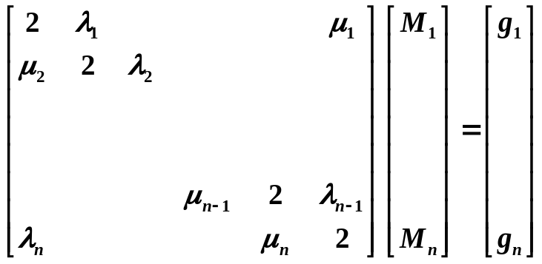
Chapter 3 Interpolation and Polynomial Approximation -- Cubic Spline Interpolation
 S’(a) = y₀’， S’(b) = y_{n}’ /* Clamped boundary */
[ a , x₁ ]: S₁’(x) =
(
x
−
x
)
2
(
x
−
a
)
2
M
−
M
−
M
1
+
M
+
f
[
x
,
x
]
−
1
0
h
0
2
h
1
2
h
0
1
6
1
1
1
Similar for S_{n}’(x) on [ x_{n−1}, b ]
2
M
+
M
=
6
(
f
[
x
,
x
]
−
)
=
g
0
1
0
1
y₀’
0
h
1
M
+
2
M
=
6
(
y_{n}’
−
f
[
x
,
x
])
=
g
n
−
1
n
h
n
−
1
n
n
 S”(a) = y₀” = M₀， S”(b) = y_{n}” = M_{n}
n
Then
The case when M₀ = M_{n} = 0 is called a free boundary, and when that occurs, the spline is called a Natural Spline.
 Periodic boundary:
If f is a periodic function,
that is, y_{n} = y₀ and
S’(a⁺) = S’(b⁻)
⇒ M₀ = M_{n}
10/13

Slide 11
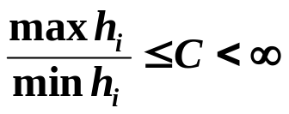

Chapter 3 Interpolation and Polynomial Approximation -- Cubic Spline Interpolation
Note:
☞ Cubic Spline can be uniquely determined by its boundary conditions as long as the coefficient matrix is strictly diagonally dominant.
If f ∈ C[ a, b ] and . Then
as max h_{i} → 0.
Discussion 19: What does this conclusion tell us? How can we obtain more accurate approximation with splines?
That is, the accuracy of approximation can be improved by adding more nodes without increasing the degree of the splines.
Sketch of the Algorithm: Cubic Spline
^{①} Compute μ_{j} , λ _{j} , g_{j} ; ^{②} Solve for M_{j} ;
^{③} Find the subinterval which contains x
(i.e. find the corresponding j );
^{④} Approximate f(x) by S_{j}(x).
HW:
p.153-154 #9, 17
11/13

Slide 12
Chapter 3 Interpolation and Polynomial Approximation -- Cubic Spline Interpolation
Lab 06. Cubic Spline
Time Limit: 1 second; Points: 4
Construct the cubic spline interpolant S for the function f, defined at points x₀ < x₁ < … < x_{n}, satisfying some given boundary conditions. Partition an given interval into m equal-length subintervals, and approximate the function values at the endpoints of these subintervals.
12/13

Slide 13


Chapter 3 Interpolation and Polynomial Approximation -- Cubic Spline Interpolation
Research topic 10:
Try to interpolate the profile of the following red bull. Can any of the interpolation methods that we have discussed be applied directly?
13/13

