Slide 1

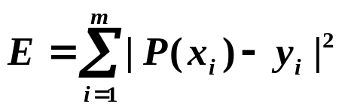
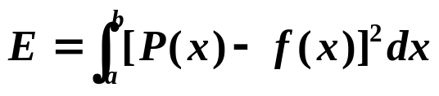
Chapter 8 Approximation Theory -- Orthogonal Polynomials and Least Squares Approximation
☑ 8.2 Orthogonal Polynomials and Least Squares Approximation
Given x₁ … x_{m} and y₁ … y_{m}. Find a simpler function P(x) ≈ f(x) such that is minimized.
Given a function f(x) defined on [a, b]. Find a simpler function P(x) ≈ f(x) such that is minimized.
Definition: The set of functions { ϕ₀(x), ϕ₁(x), … , ϕ_{n}(x) } is said to be linearly independent on [a, b] if, whenever
a₀ϕ₀(x)+a₁ϕ₁(x)+… +a_{n}ϕ_{n}(x)=0 for all x∈[a, b],
we have a₀= a₁=… =a_{n}=0. Otherwise the set of functions is said to be linearly dependent.
1/11

Slide 2
Chapter 8 Approximation Theory -- Orthogonal Polynomials and Least Squares Approximation
Theorem: If ϕ_{j}(x) is a polynomial of degree j for each j = 0, …, n, then { ϕ₀(x), ϕ₁(x), … , ϕ_{n}(x) } is linearly independent on any interval [a, b].
Proof: If not, then there exist a₀, a₁, … a_{n} such that
P(x) = a₀ϕ₀(x)+a₁ϕ₁(x)+… +a_{n}ϕ_{n}(x)=0 for all x∈[a, b].
P(x) is a zero polynomial.
The coefficient of x^{n} is zero.
a_{n} = 0
P(x) = a₀ϕ₀(x)+ … +a_{n–1}ϕ_{n –1}(x) = 0
a_{n–1} = 0
… …
a₀ = 0
2/11

Slide 3
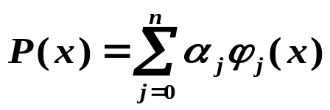

Chapter 8 Approximation Theory -- Orthogonal Polynomials and Least Squares Approximation
Theorem: Let ∏_{n} be the set of all polynomials of degree at most n. If { ϕ₀(x), ϕ₁(x), … , ϕ_{n}(x) } is a collection of linearly independent polynomials in ∏_{n}, then any polynomials in ∏_{n} can be written uniquely as a linear combination of ϕ₀(x), ϕ₁(x), … , ϕ_{n}(x).
Definition: For a general linear independent set of functions { ϕ₀(x), ϕ₁(x), … , ϕ_{n}(x) }, a linear combination of ϕ₀(x), ϕ₁(x), … , ϕ_{n}(x),
is called a generalized polynomial.
Other polynomials
➢ { ϕ_{j}(x) = cos jx }、{ ψ_{j}(x) = sin jx } ⇒ { ϕ_{j}(x), ψ_{j}(x) } generates trigonometric polynomial.
➢ { ϕ_{j}(x) = e ^{kj x} , k_{i} ≠ k_{j} } generates exponential polynomial.
3/11

Slide 4
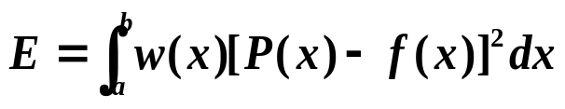
Chapter 8 Approximation Theory -- Orthogonal Polynomials and Least Squares Approximation
Definition: The weight function
^{①} discrete type
When approximating a set of discrete points (x_{i} , y_{i}) for i = 1, …, n, we assign each error term a positive real number w_{i}. That is, to consider minimizing E = Σ w_{i} [ P(x_{i}) – y_{i}]². The set of {w_{i}} is called the weight. The purpose of the weight is to assign varying degrees of importance to approximations on certain points.
^{②} continuous type
An integrable function w is called a weight function on the interval I if w(x) ≥ 0 for all x in I, but w(x) does not vanish on any subinterval of I. We are to consider minimizing .
4/11

Slide 5
Chapter 8 Approximation Theory -- Orthogonal Polynomials and Least Squares Approximation
Definition: The general least squares approximation problem:
^{①} discrete type
Given a set of discrete points (x_{i} , y_{i}) and a set of weights {w_{i}} for
i = 1, …, m. Find a generalized polynomial P(x) such that the error E = Σ w_{i} [ P(x_{i}) – y_{i}]² is minimized.
^{②} continuous type
Given a function f(x) and a weight function w(x) defined on an interval [a, b]. Find a generalized polynomial P(x) such that the error is minimized.
E
=
∫
b
w
(
x
)[
P
(
x
)
−
f
(
x
)]
2
dx
a
5/11

Slide 6

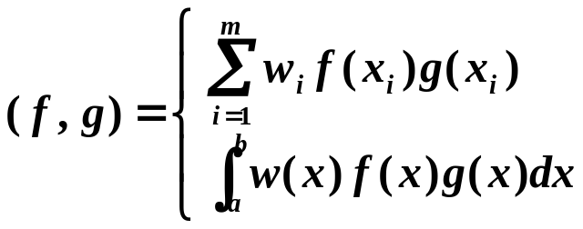


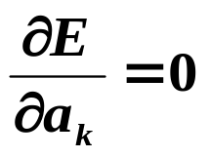
Chapter 8 Approximation Theory -- Orthogonal Polynomials and Least Squares Approximation
f and g are said to be orthogonal if ( f, g )=0.
Inner product and Norm
It can be shown that ( f, g ) is an inner product and is a norm.
The general least squares approximation problem is to find a generalized polynomial P(x) such that E = (P – y, P – y) = || P – y ||² is minimized.
Let P(x) = a₀ϕ₀(x)+a₁ϕ₁(x)+… +a_{n}ϕ_{n}(x). Then similar to the discrete
problem:
n
Σ
(
ϕ
,
ϕ
)
a
=
(
ϕ
,
f
)
,
k
=
0
,
...
,
n
=
k
j
j
k
j
0
a
(
ϕ
,
f
)
normal equations
0
0
= c
That is,
b
=
(
ϕ
,
ϕ
)
=
ij
i
j
a
(
ϕ
,
f
)
n
n
6/11

Slide 7
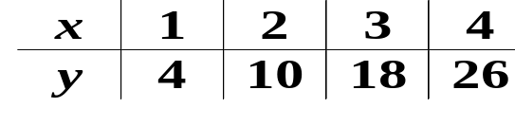

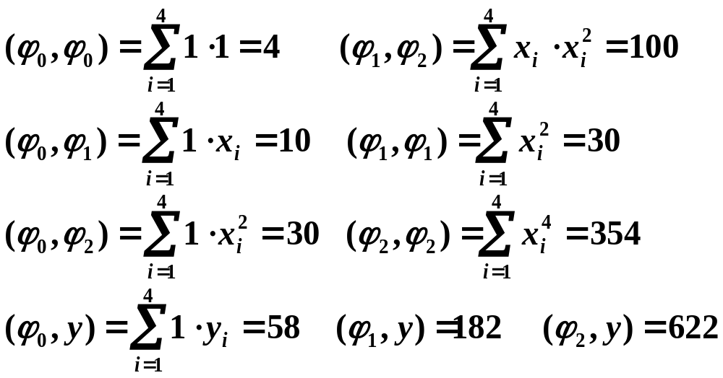
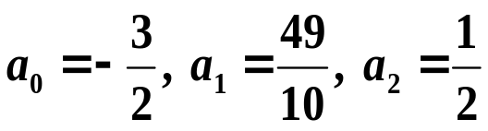
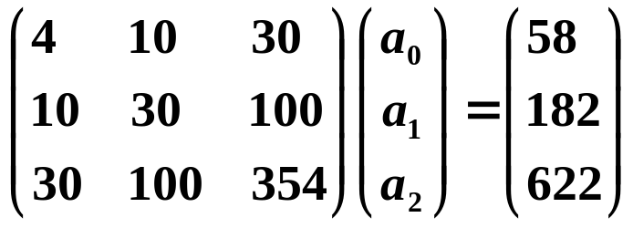
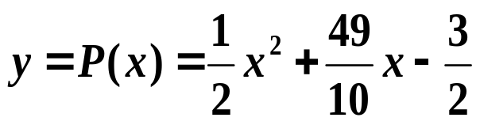
Chapter 8 Approximation Theory -- Orthogonal Polynomials and Least Squares Approximation
Discussion 22: Approximate with
and w ≡ 1.
It is soooo simple! What can possibly go wrong?
Solution: ϕ₀(x) = 1， ϕ₁(x) = x， ϕ₂(x) = x²
63
||
B
||
=
484,
||
B
−
1
||
=
K
(
B
)
=
7623
∞
∞
4

7/11

Slide 8
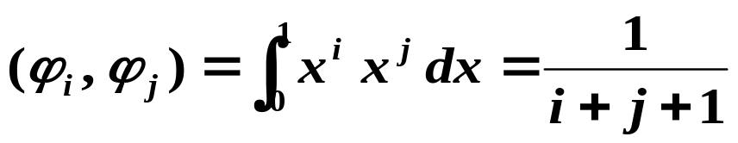
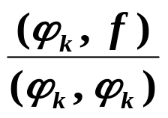


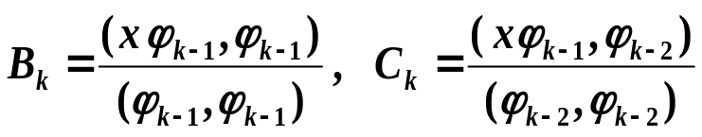
Chapter 8 Approximation Theory -- Orthogonal Polynomials and Least Squares Approximation
Example: When approximating f(x) ∈C[0, 1] with ϕ_{j}(x) = x ^{j} and w(x) ≡ 1…
Hilbert Matrix!
Then
Improvement:
If we can find a general linear independent set of functions { ϕ₀(x), ϕ₁(x), … , ϕ_{n}(x)} such that any pair of ϕ_{i}(x) and ϕ_{j}(x) are orthogonal, then the normal matrix will be diagonal!
In this case we have a_{k} =
Well, no free lunch anyway…
➢ Construction of the orthogonal polynomials
Theorem: The set of polynomial functions { ϕ₀(x), ϕ₁(x), … , ϕ_{n}(x)} defined in the following way is orthogonal on [a, b] with respect to the weight function w.
where
8/11

Slide 9

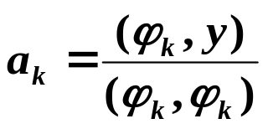
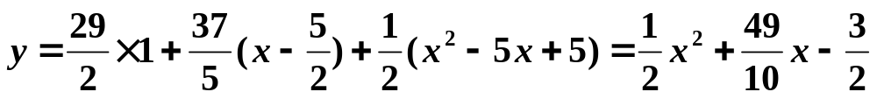
Chapter 8 Approximation Theory -- Orthogonal Polynomials and Least Squares Approximation
Example: Approximate with
and w ≡ 1.
Solution: First construct the orthogonal polynomials ϕ₀(x), ϕ₁(x), ϕ₂(x).
Let y = a₀ϕ₀(x)+a₁ϕ₁(x)+ a₂ϕ₂(x)
(
ϕ
,
y
)
29
ϕ
(
x
)
=
1
a
=
0
=
0
0
(
ϕ
,
ϕ
)
2
(
x
ϕ
,
ϕ
)
5
0
0
5
ϕ
Β
=
0
0
=
ϕ
=
−
Β
=
−
(
,
y
)
37
(
x
)
(
x
)
x
a
=
1
=
1
(
ϕ
,
ϕ
)
2
1
1
2
1
(
ϕ
,
ϕ
)
5
0
0
1
1
(
x
ϕ
,
ϕ
)
5
(
xϕ₁
,
ϕ
)
5
Β
=
1
1
=
C
=
0
=
2
(
ϕ
,
ϕ
)
2
2
(
ϕ
,
ϕ
)
4
1
1
0
0
5
5
(
ϕ
,
y
)
1
ϕ
(
x
)
=
(
x
−
)
ϕ
(
x
)
−
ϕ
(
x
)
=
x
2
−
5
x
+
5
a
=
2
=
2
2
1
4
0
2
(
ϕ
,
ϕ
)
2
2
2
9/11

Slide 10
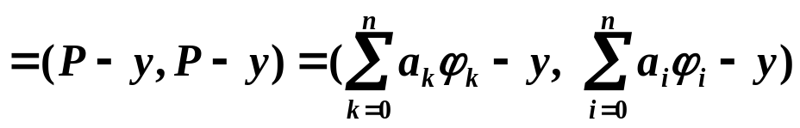


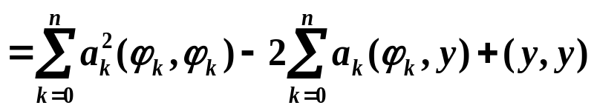
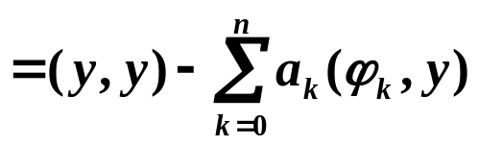
Chapter 8 Approximation Theory -- Orthogonal Polynomials and Least Squares Approximation
Algorithm: Orthogonal Polynomials Approximation
To approximate a given function by a polynomial with error bounded
by a given tolerance.
Input: number of data m; x[m]; y[m]; weight w[m]; tolerance TOL;
maximum degree of polynomial Max_n.
Output: coefficients of the approximating polynomial.
Step 1 Set ϕ₀(x) ≡ 1; a₀ = (ϕ₀, y)/(ϕ₀, ϕ₀); P(x) = a₀ ϕ₀(x); err = (y, y) − a₀ (ϕ₀, y);
Step 2 Set B₁= (xϕ₀, ϕ₀)/(ϕ₀, ϕ₀); ϕ₁(x) = x − B₁;
a₁ = (ϕ₁, y)/(ϕ₁, ϕ₁); P(x) += a₁ ϕ₁(x); err −= a₁ (ϕ₁, y);
Step 3 Set k = 1;
Step 4 While (( k < Max_n)&&(|err|≥TOL)) do steps 5-7
Step 5 k ++;
Step 6 B_{k}= (xϕ₁, ϕ₁)/(ϕ₁, ϕ₁); C_{k} = (xϕ₁, ϕ₀)/(ϕ₀, ϕ₀);
ϕ₂(x) = (x − B_{k}) ϕ₁(x) − C_{k} ϕ₀(x); a_{k} = (ϕ₂, y)/(ϕ₂, ϕ₂);
P(x) += a_{k} ϕ₂(x); err −= a_{k} (ϕ₂, y);
Step 7 Set ϕ₀(x) = ϕ₁(x); ϕ₁(x) = ϕ₂(x);
Step 8 Output ( ); STOP.
Discussion 23: Is err the least-square error? Why or why not?
10/11

Slide 11
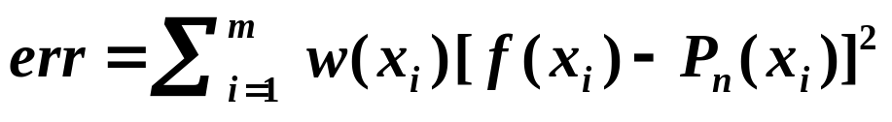
Chapter 8 Approximation Theory -- Orthogonal Polynomials and Least Squares Approximation
Another von Neumann quote : Young man, in mathematics you don't understand things, you just get used to them.
HW:
p.506 #3, 11
Lab 07. Orthogonal Polynomials Approximation
Time Limit: 1 second; Points: 4
Given a function f and a set of 200 ≥ m > 0 distinct points x₁ < x₂ < … x_{m}. You are supposed to write a function
void OPA ( double (*f)(double x), double x[], double w[], int m, double tol )
to approximate the function f by an orthogonal polynomial using the exact function values at the given m points x[ ]. The array w[m] contains the values of a weight function at the given points x[ ]. The total error
must be no larger than tol.
11/11

