Slide 1


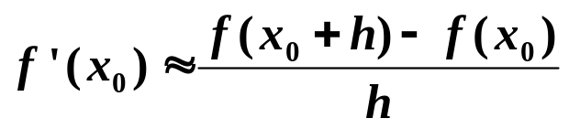
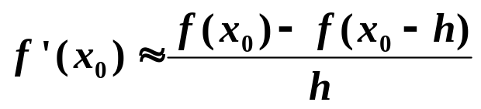
Chapter 4 Numerical Differentiation and Integration
☑ 4.1 Numerical Differentiation
Given x₀, approximate f ’(x₀).
f
(
x
+
h
)
−
f
(
x
)
f
'
(
x
)
=
lim
0
0
0
h
→
0
h
forward
backward
h
x₀
x₁
h
x₁
x₀
1/9

Slide 2

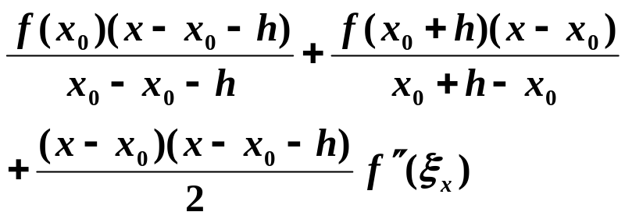
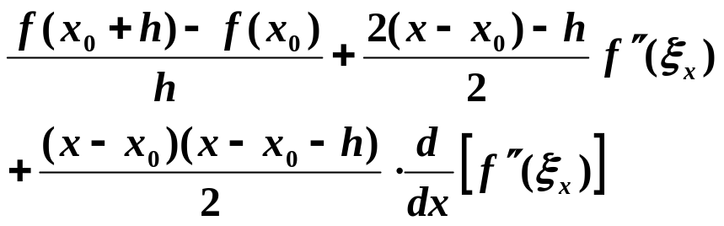
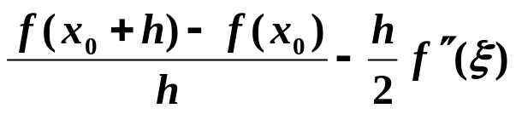
Chapter 4 Numerical Differentiation and Integration -- Numerical Differentiation
Approximate f(x) by its Lagrange polynomial with interpolating points x₀ and x₀ + h.
f (x) =
f ’(x) =
O(h)
f ’(x₀) =
2/9

Slide 3
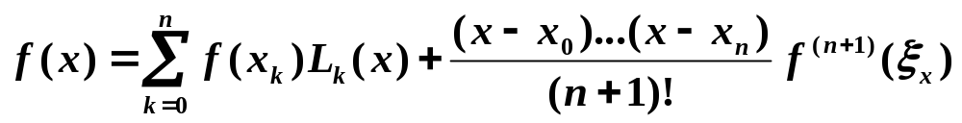
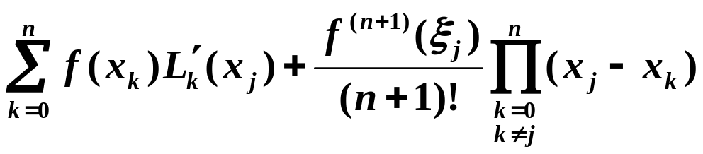

Chapter 4 Numerical Differentiation and Integration -- Numerical Differentiation
☞ Approximate f(x) by its Lagrange polynomial with interpolating points { x₀, x₁, …, x_{n} }.
f ’(x_{j}) =
Note:
In general, more evaluation points produce greater accuracy.
On the other hand, the number of functional evaluations grows and the roundoff error increases. Hence the numerical differentiation is unstable!
3/9

Slide 4
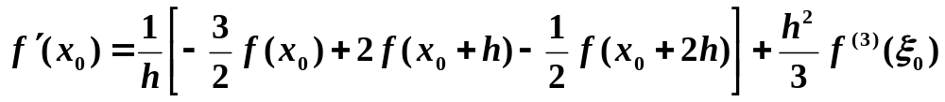
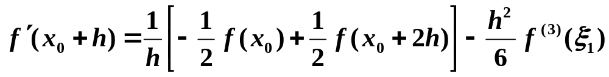
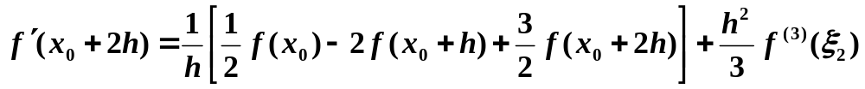
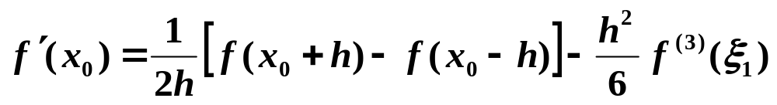
Chapter 4 Numerical Differentiation and Integration -- Numerical Differentiation
Discussion 26: Given three points x₀, x₀ + h, and x₀ + 2h, please derive the three-point formulae for each of the points. Then give the best three-point formula for f '(x).
Symmetric to formula 1, with h < 0.
Five-point formulae are given on p.171
x_{–1}
x₀
x₁
4/9

Slide 5

Chapter 4 Numerical Differentiation and Integration -- Numerical Differentiation
Discussion 27: Find a way to approximate f ”(x₀).
Consider Taylor expansions of f(x₀ + h) and f(x₀ – h) at x₀:
Excuses for not
doing homework
I could only get arbitrarily
close to my textbook.
I couldn't actually
reach it.
1
[
]
h
2
f
′′
=
−
−
+
+
−
(
4
)
ξ
(
x
)
f
(
x
h
)
2
f
(
x
)
f
(
x
h
)
f
(
)
0
h
2
0
0
0
12
HW:
p.176-177 #7, 13
5/9

Slide 6
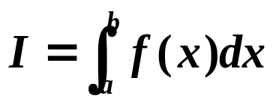

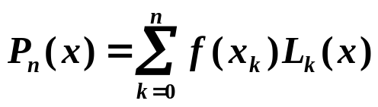
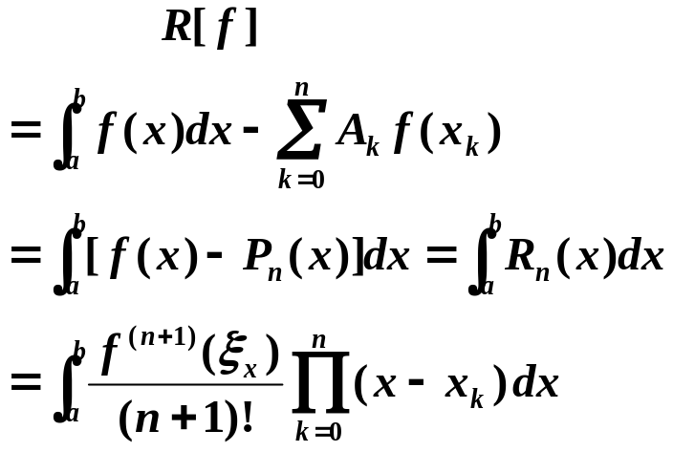

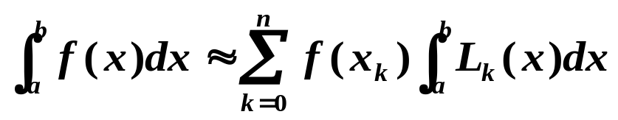
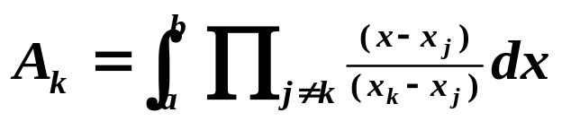
Chapter 4 Numerical Differentiation and Integration -- Elements of Numerical Integration
☑ 4.3 Elements of Numerical Integration
Approximate
-- Numerical Quadrature
Integrate the Lagrange interpolating polynomial of f (x) instead.
interpolatory quadrature
Idea
☞ Select a set of distinct nodes a ≤ x₀ < x₁ <…< x_{n} ≤ b from [a, b]. The Lagrange polynomial is
Error
A_{k}
6/9

Slide 7
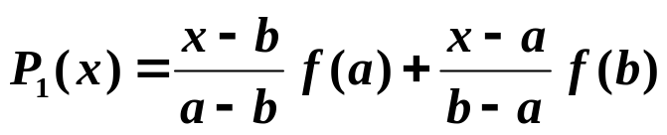
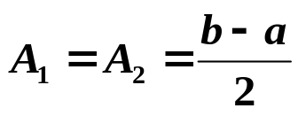
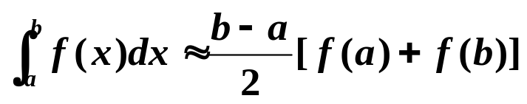
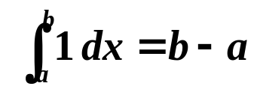

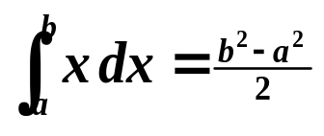

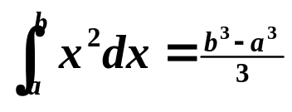

Chapter 4 Numerical Differentiation and Integration -- Elements of Numerical Integration
Definition: The degree of accuracy, or precision, of a quadrature formula is the largest positive integer n such that the formula is exact for x^{k} for each k = 0, 1, …, n.
Example: Consider the linear interpolation on [a, b], we have
Please determine the precision of this formula.
f(x)
Solution: Consider x^{k} for each k = 0, 1, …
trapezoidal rule
f(b)
x⁰ = 1：
=
f(a)
a
b
x ：
=
Degree of Precision = 1
x² ：
≠
7/9

Slide 8
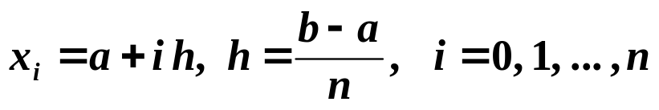
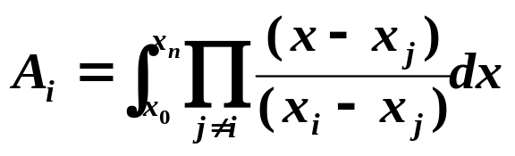
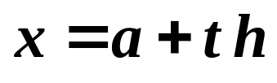
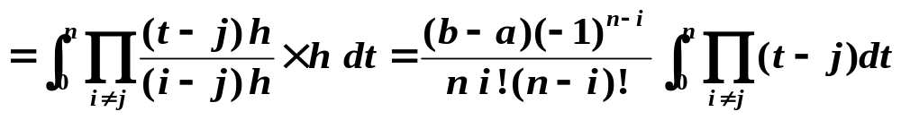
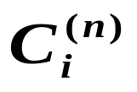
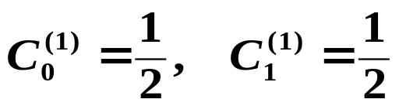
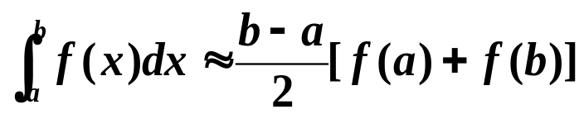
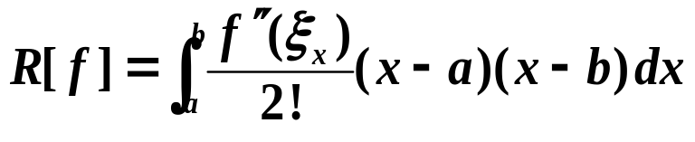
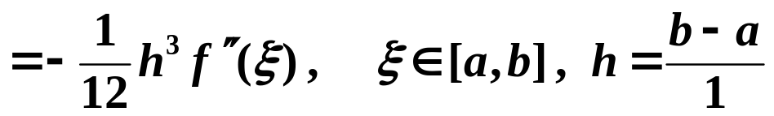
Chapter 4 Numerical Differentiation and Integration -- Elements of Numerical Integration
❖ For equally spaced nodes：
Let
Note: Cotes coefficients does not depend on either f(x) or [a, b], and can be determined by n and i only. Hence we can find these coefficients from a table. The formulae are called Newton-Cotes formulae.
Cotes coefficient

n = 1:
Trapezoidal Rule
Precision = 1
8/9

Slide 9
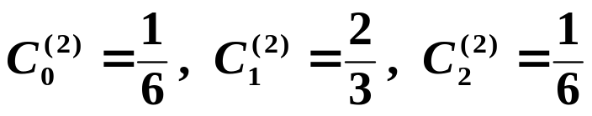
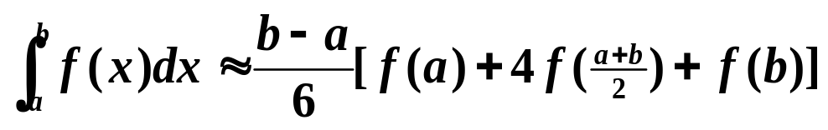
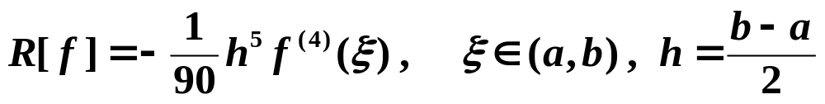
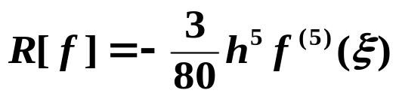
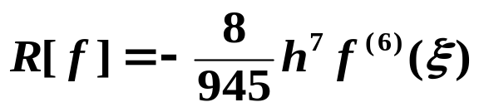
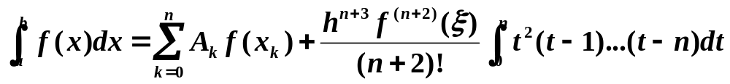
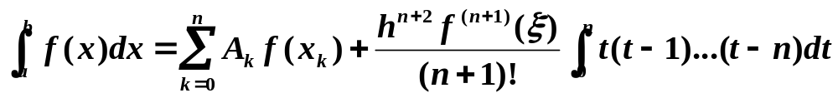
Chapter 4 Numerical Differentiation and Integration -- Elements of Numerical Integration
n = 2:
Simpson’s Rule
Precision =
3
n = 3: Simpson’s 3/8-Rule. Precision = 3, and
HW: p.195
#7, 9, 11, 13
n = 4: Cotes Rule. Precision = 5, and
Theorem: For the (n+1)-point closed Newton-Cotes formula, there exists ξ ∈ (a, b) for which
if n is even and f ∈ C^{n+2}[a, b], and
if n is odd and f ∈ C^{n+1}[a, b].
9/9

