Slide 1

Chapter 8 Approximation Theory -- Chebyshev Polynomials and Economization of Power Series
☑ 8.3 Chebyshev Polynomials and Economization of Power Series
The general least squares approximation problem is to find a generalized polynomial P(x) such that E = (P – y, P – y) = || P – y ||² is minimized.
➢ Minimize || P – y ||∞ -- the minimax problem
Take it easy. It’s not so
difficult if we consider
polynomials only.
Didn’t you say it’s a very
difficult problem?
1/12

Slide 2


Chapter 8 Approximation Theory -- Chebyshev Polynomials and Economization of Power Series
v 1.0
Find a polynomial P_{n}(x) of degree n such that || P_{n} − f ||∞ is minimized.
Definition: If P(x₀) – f (x₀) = ± || P − f ||∞ , x₀ is called a (±) deviation point.
It is not easy to construct the polynomial from nowhere. However, we can examine the features of the polynomial:
① If f ∈ C[a, b] and f is not a polynomial of degree n, then there exists a unique polynomial P_{n}(x) such that || P_{n} − f ||∞ is minimized.
② P_{n}(x) exists, and must have both + and – deviation points.
P_{n}(x) − f(x)
has at least roots.
③ (Chebyshev Theorem) P_{n}(x) minimizes || P_{n} − f ||∞ ⇔ P_{n}(x) has at least n+2 alternating + and – deviation points with respect to f. That is, there exists a set of points a ≤ t₁ <…< t_{n+2} ≤ b such that
P_{n}(t_{k}) – f (t_{k}) = ±(–1)^{k} || P_{n} − f ||∞ .
The set { t_{k} } is called the Chebyshev alternating sequence.
n+1
2/12

Slide 3
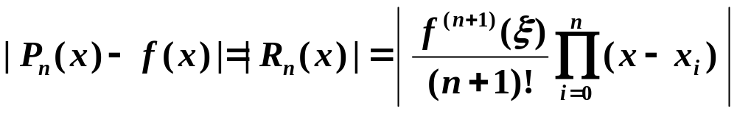
Chapter 8 Approximation Theory -- Chebyshev Polynomials and Economization of Power Series
y
y
=
f
(
x
)
+
E
n
y
=
P
(
x
)
n
y
=
f
(
x
)
y
=
f
(
x
)
−
E
n
P_{n}(x) is an
interpolating polynomial
of f(x)
x
0
Determine the interpolating points { x₀, …, x_{n} } such that P_{n}(x) minimizes the remainder
v 2.0
3/12

Slide 4
Chapter 8 Approximation Theory -- Chebyshev Polynomials and Economization of Power Series
v 2.1
Find { x₁, …, x_{n} } such that ||w_{n}||∞ is minimized on [ −1, 1],
where
n
w
(
x
)
=
Π
(
x
−
x
)
n
i
i
=
1
Notice that w_{n}(x) = x^{n} – P_{n–1}(x). The problem becomes to …
Find a polynomial P_{n–1}(x) such that || x^{n} – P_{n–1}(x) ||∞ is minimized on [ −1, 1].
v 3.0
From Chebyshev theorem we know that P_{n−1}(x) has n+1 deviation points with respect to x^{n} , that is, w_{n}(x) obtains its maximum and minimum values alternatively on n+1 points.
4/12

Slide 5

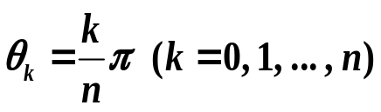
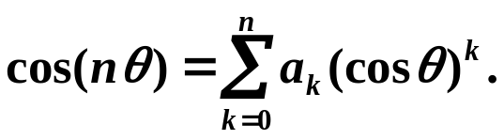
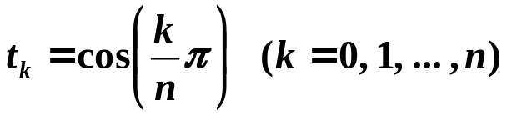

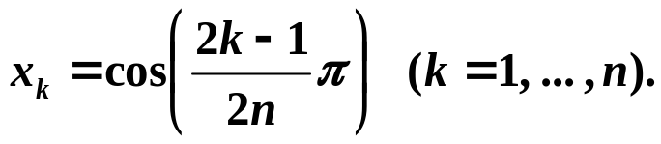
Chapter 8 Approximation Theory -- Chebyshev Polynomials and Economization of Power Series
➢ Chebyshev polynomials
Consider the extreme values of cos(nθ ) on [ 0, π ].
n + 1
cos(nθ ) assumes its maximum value 1 and minimum value −1 alternatively
at points . And there exist coefficients a₀, …, a_{n} such that
Discussion 24: What is the connection between cos(nθ) and the polynomial we are looking for?
☞ Let x = cos(θ ), then x ∈[ −1 , 1 ].
T_{n}(x) = cos( nθ ) = cos( n · arc cos x ) is called the Chebyshev polynomial.
❖ More about T_{n}:
 T_{n}(x) assumes its maximum value 1 and minimum value −1 alter-natively at . That is,
1
 T_{n}(x) has n roots
5/12

Slide 6

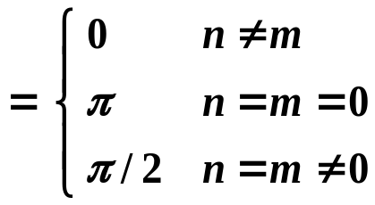
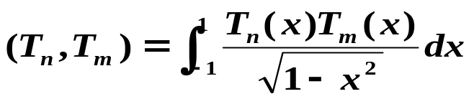
Chapter 8 Approximation Theory -- Chebyshev Polynomials and Economization of Power Series
 T_{n}(x) has the recurrence relation:
T₀(x) = 1, T₁(x) = x, T_{n+1}(x) = 2x T_{n}(x) – T_{n–1}(x).
T_{n}(x) is a polynomial of degree n with leading coefficient .
2^{n−1}
 { T₀(x), T₁(x), … } are orthogonal on [ −1 , 1 ] with respect to the weight function
That is,
OKOK, I think it’s enough for us…
What’s our target again?
Find a polynomial P_{n–1}(x) such that || x^{n} – P_{n–1}(x) ||∞
is minimized on [ −1, 1].
v 3.0
w_{n}(x) = x^{n} – P_{n–1}(x)
= T_{n}(x) / 2^{n−1}
6/12

Slide 7
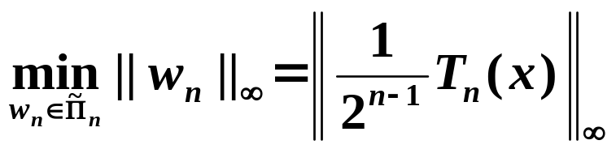
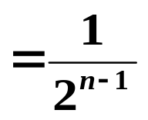

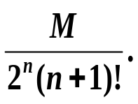
Chapter 8 Approximation Theory -- Chebyshev Polynomials and Economization of Power Series
v 2.1
Find { x₁, …, x_{n} } such that ||w_{n}||∞ is minimized on [ −1, 1],
where
n
w
(
x
)
=
Π
(
x
−
x
)
n
i
i
=
1
❖ { x₁, …, x_{n} } are
the n roots of T_{n}(x).
= { monic polynomials of degree n }
Determine the interpolating points { x₀, …, x_{n} } such that P_{n}(x) minimizes the remainder
v 2.0
❖ Take the n+1 roots of T_{n+1}(x) as the interpolating points { x₀, …, x_{n} }. Then the interpolating polynomial P_{n}(x) of f(x) assumes the minimum upper bound of the absolute error
7/12

Slide 8
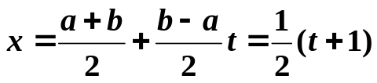
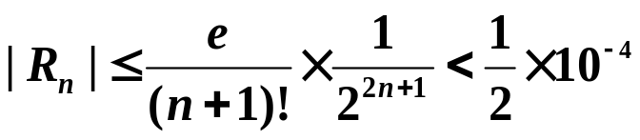
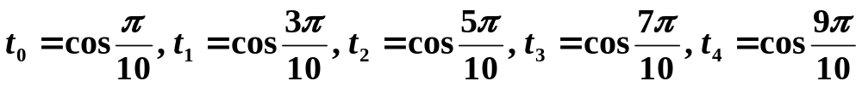
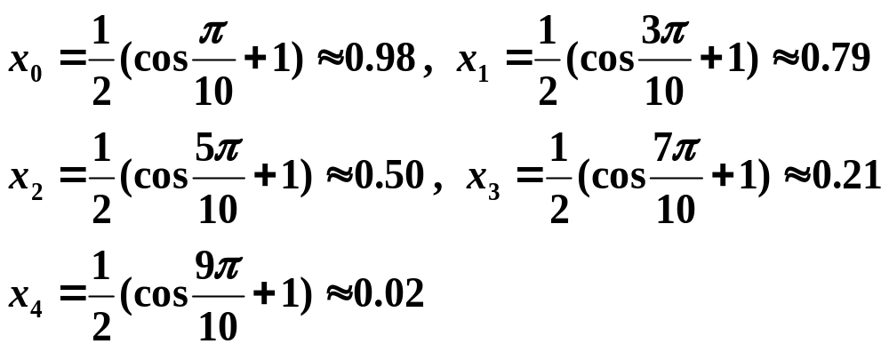
Chapter 8 Approximation Theory -- Chebyshev Polynomials and Economization of Power Series
Discussion 25: Find the best approximating polynomial of f (x) = e^{x} on
[0, 1] such that the absolute error is no larger than 0.5×10⁻⁴.
Solution: ① Determine n: Make a change of the variable
n =
4
② Find the roots of T₅(t):
③ Make a change of the variable:
④ Compute L₄(x) with interpolating points x₀, …, x₄.
8/12

Slide 9

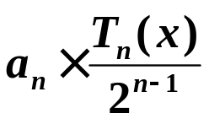
Chapter 8 Approximation Theory -- Chebyshev Polynomials and Economization of Power Series
➢ Economization of Power Series
Given P_{n}(x) ≈ f (x), economization of power series is to reduce the degree of polynomial with a minimal loss of accuracy.
Consider approximating an arbitrary n-th degree polynomial
P_{n}(x) = a_{n}x^{n} + a_{n–1} x^{n–1} + … + a₁x + a₀
with a polynomial P_{n–1}(x) by removing an n-th degree polynomial Q_{n}(x) that has the coefficient a_{n} for x^{n}. Then
max
|
f
(
x
)
−
P
(
x
)
≤
−
+
|
max
|
f
(
x
)
P
(
x
)
|
max
|
Q
(
x
)
|
[
−
1
,
1
]
n
−
1
[
−
1
,
1
]
n
[
−
1
,
1
]
n
To minimize the loss of accuracy, Q_{n}(x) must be
The loss of accuracy.
9/12

Slide 10
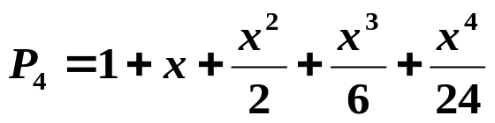
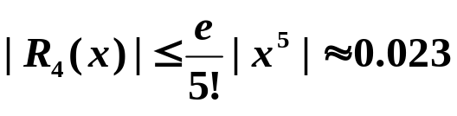
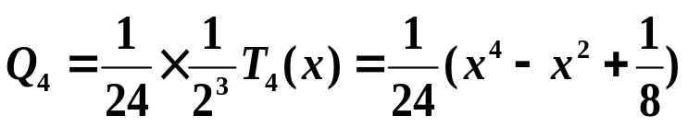

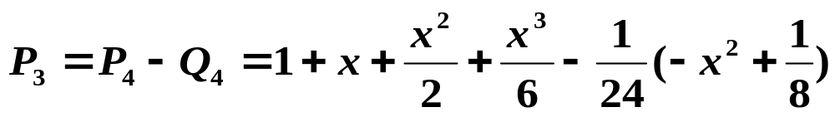
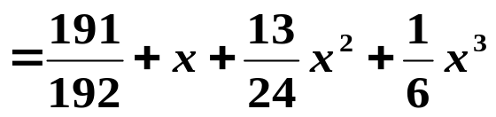
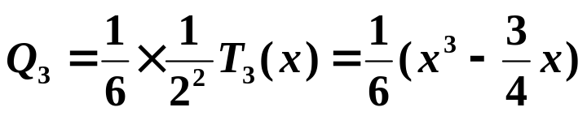

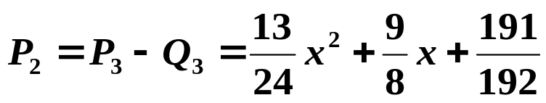

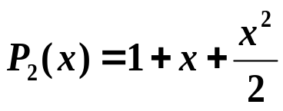
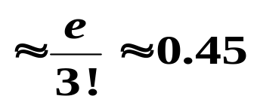
Chapter 8 Approximation Theory -- Chebyshev Polynomials and Economization of Power Series
Example: The 4-th order Taylor polynomial for f (x) = e^{x} on [−1, 1] is
The upper bound of truncation error is
Please reduce the degree of the approximating polynomial to 2.
Solution:
If we simply take
, then the error is
10/12

Slide 11
Chapter 8 Approximation Theory -- Chebyshev Polynomials and Economization of Power Series
Note:
☞ A change of variable is needed for a general interval [a, b]. That is, let x = [(b – a)t + (a + b)]/2, then find the polynomial P_{n}(t) for f (t) on [−1, 1] and finally obtain P_{n}(x).
☞ Another method is to write each term of x^{k} as a linear combination of T₀(x), …, T_{k}(x). For example, x = T₁(x) and x³ = [T₃(x) + 3 T₁(x)] / 4. Then simply remove the Chebyshev functions from the original polynomial.
HW:
p.517 #3, 7, 9
11/12

Slide 12

Chapter 8 Approximation Theory -- Chebyshev Polynomials and Economization of Power Series
Research topic 11:
Consider Taylor expansion and Fourier expansion. Can you extend the idea to discuss a possible Chebyshev expansion?
12/12

