Slide 1
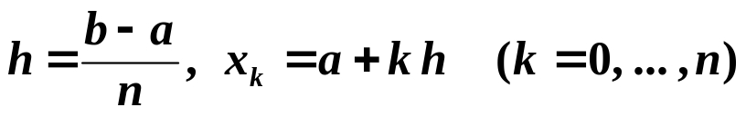
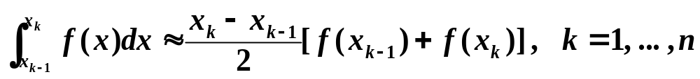
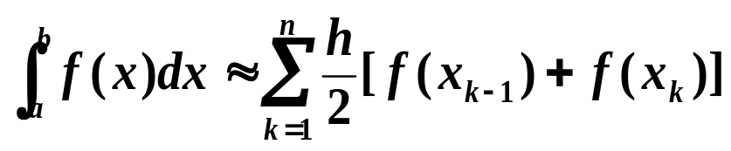
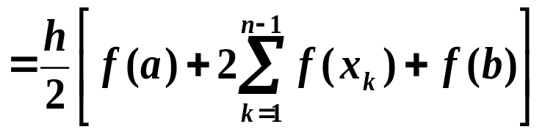
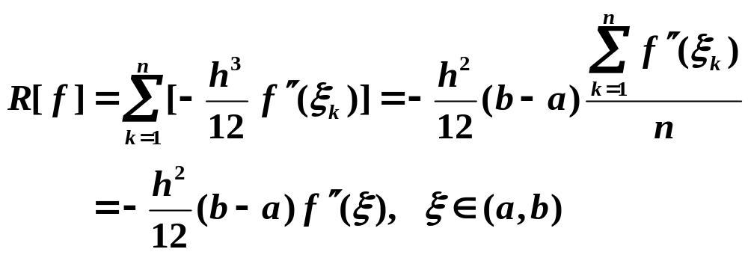
Chapter 4 Numerical Differentiation and Integration -- Composite Numerical Integration
☑ 4.4 Composite Numerical Integration
Due to the oscillatory nature of high-degree polynomials, piecewise interpolation is applied to approximate f(x) ⇒ a piecewise approach that uses the low-order Newton-Cotes formulae.
➢ Composite Trapezoidal Rule:
Apply Trapezoidal Rule on each [x_{k – 1}, x_{k}]:
Oh come on,
you don’t seriously consider
h=(b−a)/2 acceptable,
do you?
Don’t you forget
the oscillatory nature of high-
degree polynomials!
Haven’t we had enough formulae? What’s up now?
Why can’t you simply
refine the partition if you have to
be so picky?
Uh-oh
= T_{n}
/*MVT*/
1/10

Slide 2
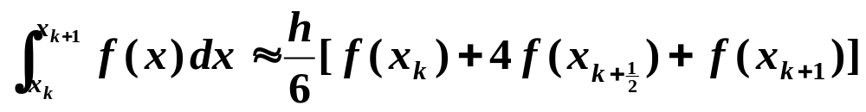

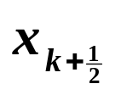

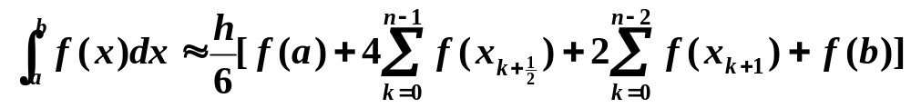

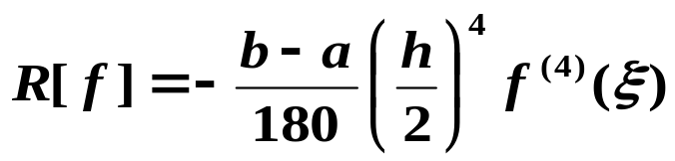

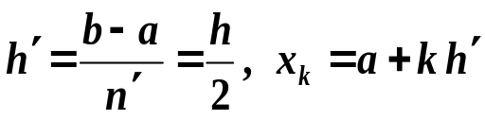
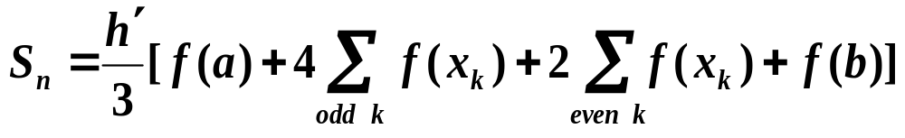
Chapter 4 Numerical Differentiation and Integration -- Composite Numerical Integration
➢ Composite Simpson’s Rule:
4
4
4
4
4
Discussion 28: Please derive the composite Simpson's formula.
= S_{n}
Note:
To simplify the notation, we may let n’ = 2n. Then
and
2/10

Slide 3
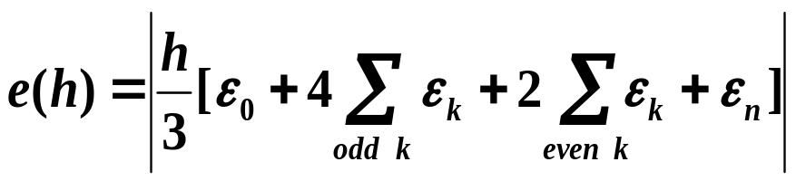
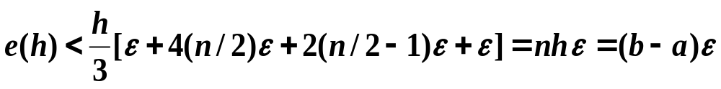
Chapter 4 Numerical Differentiation and Integration -- Composite Numerical Integration
❖ Composite integration techniques are all stable.
Example: Consider the Simpson’s Rule with n subintervals on [a, b]. Assume that f (x_{i}) is approximated by f *(x_{i}) such that
f (x_{i}) = f *(x_{i}) + ε_{i} for each i = 0, 1, …, n. Then the accumulated error e(h) is
If | ε_{i} | < ε for all i = 0, 1, …, n, then
☞ When we refine the partition to ensure accuracy, the increased computation will NOT increase the roundoff error.

3/10

Slide 4
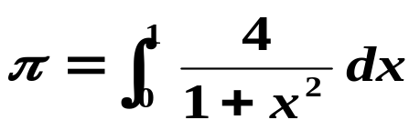
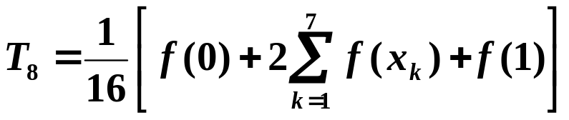
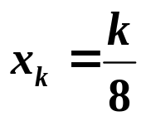
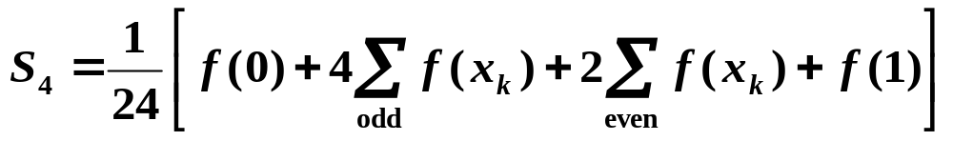
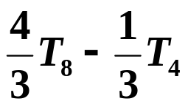
Chapter 4 Numerical Differentiation and Integration -- Composite Numerical Integration
Discussion 29: Use Trapezoidal rule and Simpson’s rule with n = 8 to approximate
Solution:
where
= 3.138988494
where
= 3.141592502
When programming we usually keep dividing the subintervals into 2 equally spaced smaller subintervals. That is, take n = 2^{k} for k = 0, 1, …
HW:
p.204 #7(a)(b)
When k = 9, T₅₁₂ = 3.14159202
= 3.141592502
= S₄
4/10

Slide 5
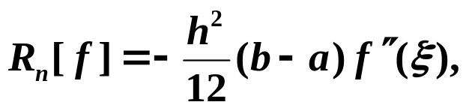
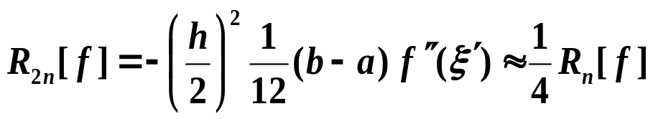
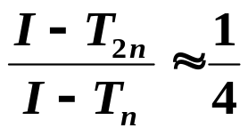
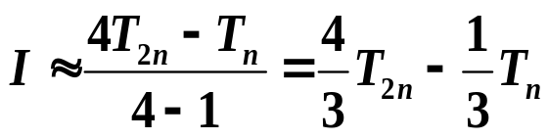

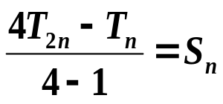
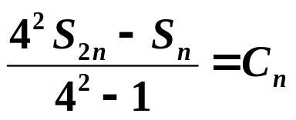
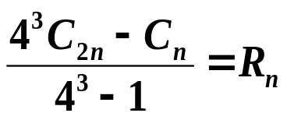
Chapter 4 Numerical Differentiation and Integration -- Romberg Integration
☑ 4.5 Romberg Integration
Since the error of Trapezoidal rule is
when we reduce the length of each subinterval into a half,
Romberg sequence
Solve for I :
= S_{n}
In general:
① T₁ =
(
0
)
T
< ε ?
0
➢ Romberg method:
② T₂ =
(
1
)
③ S₁ =
(
0
)
T
T
< ε ?
0
1
④ T₄ =
(
2
)
⑤ S₂ =
T
T
(
1
)
⑥ C₁ =
(
0
)
T
< ε ?
0
1
2
⑦ T₈ =
(
3
)
⑧ S₄ =
(
2
)
⑨ C₂ =
(
1
)
⑩ R₁ =
(
0
)
T
T
T
T
0
1
2
3
… … … … … …
5/10

Slide 6


Lab 08. Shape Roof
Time Limit: 2 seconds; Points: 4
The kind of roof shown in Figure 1 is shaped from plain flat rectangular plastic board in Figure 2.
Figure 1 Figure 2
The transection of the roof is a sine curve with altitude l centimeters. Given the length of the roof, your task is to calculate the length of the flat board needed to shape the roof.
6/10

Slide 7

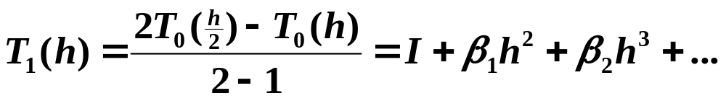
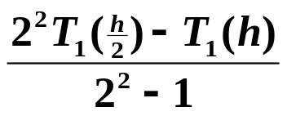
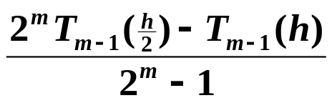
Chapter 4 Numerical Differentiation and Integration -- Richardson’s Extrapolation
☑ 4.2 Richardson’s Extrapolation
Generate high-accuracy results while using low-order formulae
Suppose that for some h ≠ 0, we have a formula T₀(h) that approximates an unknown I, and that the truncation error has the form:
T₀(h) − I = α₁ h + α₂ h² + α₃ h³ + …
Replace h by half its value, we have
T₀(h/2) − I = α₁ (h/2) + α₂ (h/2)² + α₃ (h/2)³ + …
Q：How to improve the accuracy from O(h) to O(h²) ？
2
T
(
h
)
−
T
(
h
)
1
3
0
2
0
−
I
=
−
α
h
2
−
α
h
3
−
...
2
−
1
2
2
4
3
7/10

Slide 8
Chapter 4 Numerical Differentiation and Integration -- Adaptive Quadrature Methods
☑ 4.6 Adaptive Quadrature Methods
Predict the amount of functional variation and adapt the step size to the varying requirements.
ε
ε/2
ε/2
ε/8
ε/8
✓
ε/4
ε/4
8/10

Slide 9
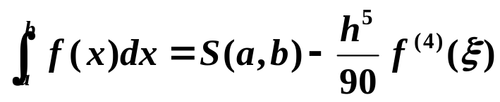
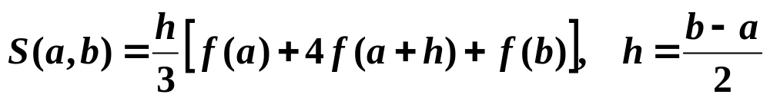
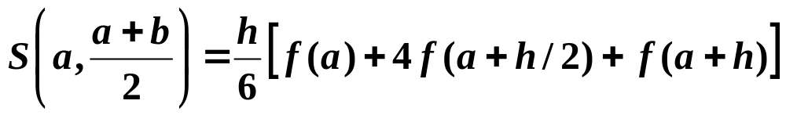
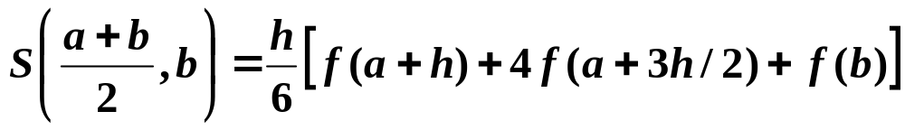
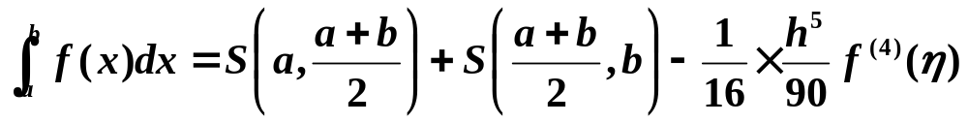
Chapter 4 Numerical Differentiation and Integration -- Adaptive Quadrature Methods
Example: Consider the adaptive method based on Composite Simpson’s rule.
where
Let
Then
< ε
9/10

Slide 10

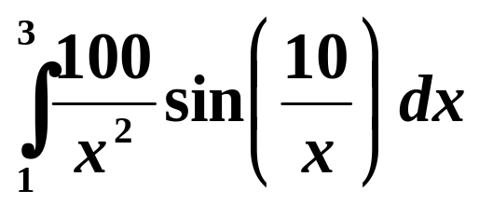
Chapter 4 Numerical Differentiation and Integration -- Adaptive Quadrature Methods
Research topic 12:
Discuss the adaptive method based on the Composite Trapezoidal rule. Apply your method to approximate the following integral with tolerance 10⁻³. Compare the amount of computations with the standard Trapezoidal rule.
10/10

