Slide 1
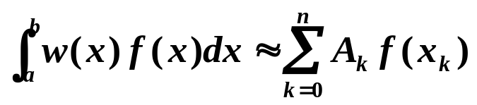



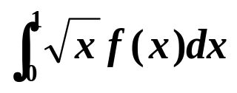
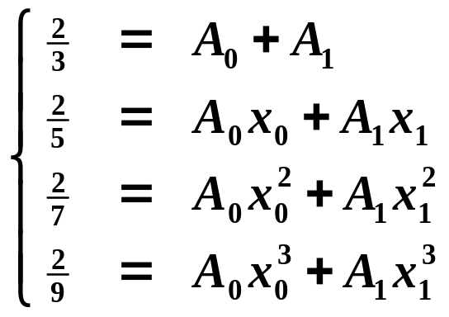
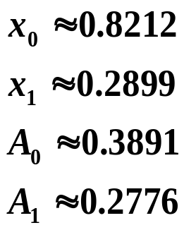
Chapter 4 Numerical Differentiation and Integration -- Gaussian Quadrature
☑ 4.7 Gaussian Quadrature
Construct a formula
of precision degree 2n+1 with n+1 points.
Determine 2n+2 unknowns x₀ … x_{n} and A₀ … A_{n} such that the formula is accurate for f (x) = 1, x, x², …, x^{2n+1}. The points x₀ … x_{n} are called Gaussian points, and the method is called Gaussian quadrature.
Discussion 30: What would you do to obtain higher precision?
Idea
Discussion 31: Approximate using Gaussian quadrature with n = 1.
1
∫
Solution:
Assume
x
f
(
x
)
dx
≈
A
f
(
x
)
+
A
f
(
x
)
0
0
0
1
1
The formula must be accurate for f (x) = 1, x, x², x³
Nonlinear!
1/5

Slide 2
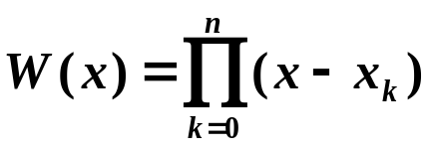
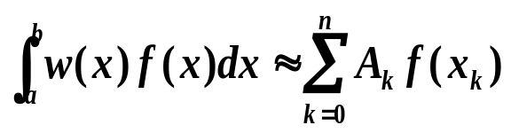
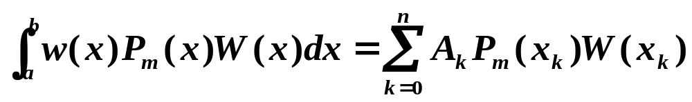
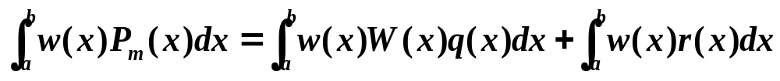
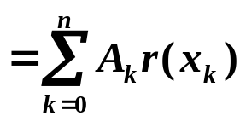
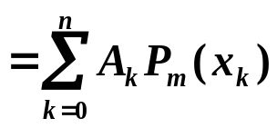
Chapter 4 Numerical Differentiation and Integration -- Gaussian Quadrature
Theorem: x₀ … x_{n} are Gaussian points iff is orthogonal to all the polynomials of degree no greater than n.
Proof: ① If x₀ … x_{n} are Gaussian points, then
The degree of precision of the formula
is at least 2n+1 .
Finding the Gaussian points ⇔ Finding W(x)
Then for any polynomial P_{m}(x) with m ≤ n, the degree of P_{m}(x)W(x) must be no greater than 2n+1. Hence the formula is accurate for P_{m}(x)W(x). That is
0
✓
= 0
② To prove that x₀ … x_{n} are Gaussian points, we just have to prove that the formula is accurate for any polynomial P_{m}(x) with m ≤ 2n+1.
Let P_{m}(x) = W(x)q(x) + r(x). Then
0
✓
2/5

Slide 3
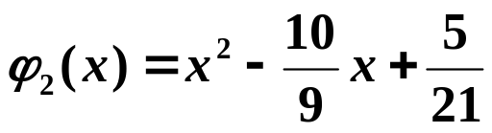
Chapter 4 Numerical Differentiation and Integration -- Gaussian Quadrature
 The set of orthogonal polynomials { ϕ₀, ϕ₁, …, ϕ_{n}, … } is linearly independent and ϕ_{n+1} is orthogonal to any polynomial P_{m}(x) with m ≤ n.
If we take ϕ_{n+1} to be W(x), then the roots of ϕ_{n+1} are the Gaussian points.
Example: Approximate using Gaussian quadrature with n = 1.
1
∫
Solution:
Assume
x
f
(
x
)
dx
≈
A
f
(
x
)
+
A
f
(
x
)
0
0
0
1
1
Step 1：Construct the orthogonal polynomial ϕ₂
Let ϕ₀(x) = 1, ϕ₁(x) = x + a, ϕ₂(x) = x² + bx + c
∫
1
=
−
3
(
ϕ
,
ϕ
)
=
0
⇒
x
(
x
+
a
)
dx
=
0
⇒
a
0
1
0
5
10
(
ϕ
,
ϕ
)
=
0
⇒
∫
1
x
(
x
2
+
bx
+
c
)
dx
=
0
b
=
−
0
2
0
9
1
3
=
5
(
ϕ
,
ϕ
)
=
0
⇒
∫
x
(
x
−
)(
x
+
bx
+
c
)
dx
=
0
c
1
2
0
5
21
3/5

Slide 4
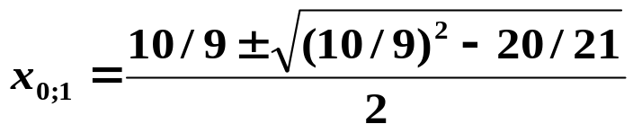
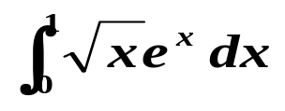
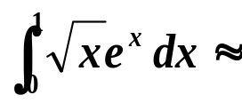

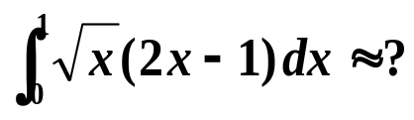
Chapter 4 Numerical Differentiation and Integration -- Gaussian Quadrature
Step 2：Find the two roots of ϕ₂ which are the Gaussisan points x₀ and x₁
Step 3：Since the formula must be accurate for f (x) = 1, x, we can easily solve a linear system of equations for A₀ and A₁.
The results are the same as we have obtained:
 Use this formula to approximate
Accurate!
= 2/15
HW: p.226 #1, 5
4/5

Slide 5

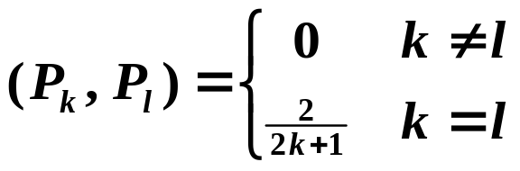
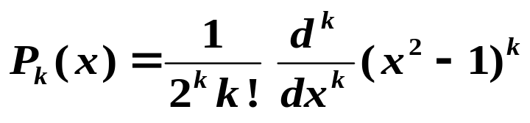

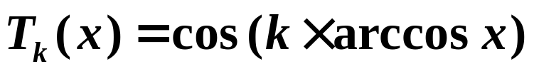
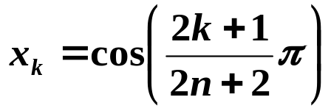
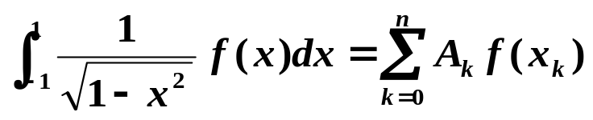
Chapter 4 Numerical Differentiation and Integration -- Gaussian Quadrature
➢ Some special families of orthogonal functions
Notice that the end points ±1 of the integration could be the singular points of the integral. Using Newton-Cotes with equally spaced points might cause trouble. Gaussian quadrature formulae can avoid such a problem.
① Legendre Polynomials:
Defined on [−1, 1] with w(x) ≡ 1.
From P₀ = 1 and P₁ = x we have
The formula that uses the roots of P_{n+1} is called the Gauss-Legendre quadrature formula.
② Chebyshev Polynomials:
Defined on [−1, 1] with w(x) =
1
1
−
x
2
The roots of T_{n+1} are
for k = 0, …, n
The formula
is called the Gauss-Chebyshev quadrature formula.
5/5

