Slide 1

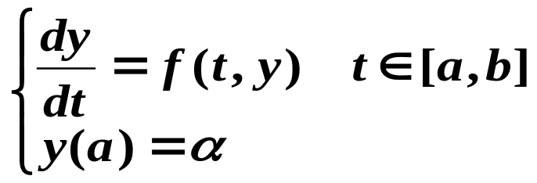

Chapter 5 Initial-Value Problems for Ordinary Differential Equations
☑ 5.1 The Elementary Theory of Initial-Value Problems
Initial-Value Problems for the 1st order Ordinary Differential Equations
Compute the approximations of y(t) at a set of ( usually equally-spaced ) mesh points a = t₀< t₁ <…< t_{n}= b.
That is, to compute w_{i} ≈ y(t_{i}) = y_{i} for i = 1, …, n.
1/12

Slide 2
Chapter 5 Initial-Value Problems for Ordinary Differential Equations -- The Elementary Theory
Definition: A function f(t, y) is said to satisfy a Lipschitz condition in the variable y on a set D ⊂ R² if a constant L > 0 exists with
| f(t, y₁) – f(t, y₂) | ≤ L| y₁ – y₂ |,
Whenever (t, y₁), (t, y₂) ∈ D. The constant L is called a Lipschitz constant for f.
Theorem: Suppose that D = { (t, y) | a ≤ t ≤ b, –∞ < y < ∞ } and that f(t, y) is continuous on D. If f satisfies a Lipschitz condition on D in the variable y, then the IVP
y’ (t) = f(t, y), a ≤ t ≤ b, y(a) = α
has a unique solution y(t) for a ≤ t ≤ b.
2/12

Slide 3
Chapter 5 Initial-Value Problems for Ordinary Differential Equations -- The Elementary Theory
Definition: The initial-value problem
y’(t) = f(t, y), a ≤ t ≤ b, y(a) = α
is said to be a well-posed problem if:
A unique solution, y(t), to the problem exists;
For any ε > 0, there exists a positive constant k(ε), such that whenever | ε₀ | < ε and δ(t) is continuous with | δ(t) | < ε on [a, b], a unique solution, z(t), to
z’(t) = f(t, z) + δ(t), a ≤ t ≤ b, z(a) = α + ε₀ /* perturbed problem*/
exists with | z(t) – y(t) | < k(ε) ε , for all a ≤ t ≤ b.
Theorem: Suppose that D = { (t, y) | a ≤ t ≤ b, –∞ < y < ∞ } and that f(t, y) is continuous on D. If f satisfies a Lipschitz condition on D in the variable y, then the IVP
y’ (t) = f(t, y), a ≤ t ≤ b, y(a) = α
is well-posed.
3/12

Slide 4
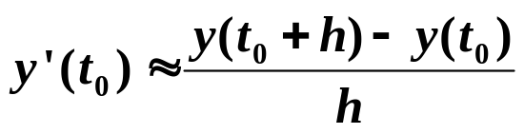
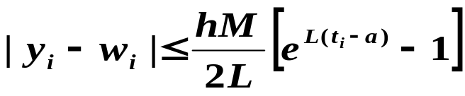
Chapter 5 Initial-Value Problems for Ordinary Differential Equations -- Euler’s Method
☑ 5.2 Euler’s Method
Compute the approximations of y(t) at a set of ( usually equally-spaced ) mesh points a = t₀< t₁ <…< t_{n}= b.
That is, to compute w_{i} ≈ y(t_{i}) = y_{i} for i = 1, …, n.
Theorem: Suppose f is continuous and satisfies a Lipschitz condition with constant L on D = { (t, y) | a ≤ t ≤ b, –∞ < y < ∞ } and that a constant M exists with |y”(t)| ≤ M for all a ≤ t ≤ b. Let y(t) denote the unique solution to the IVP y’ (t) = f(t, y), a ≤ t ≤ b, y(a) = α, and w₀, w₁ , …w_{n} be the approximations generated by Euler’s method for some positive integer n. Then for i = 0, 1, …, n
Difference equation
4/12

Slide 5

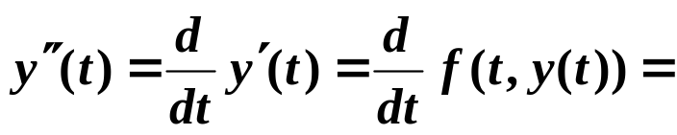
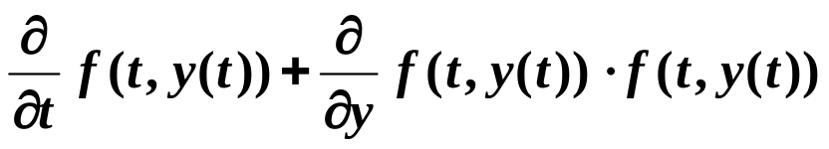
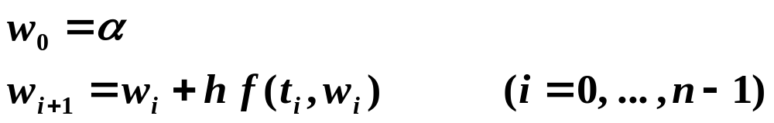
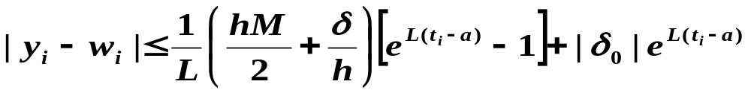

Chapter 5 Initial-Value Problems for Ordinary Differential Equations -- Euler’s Method
Note: y”(t) can be computed without explicitly knowing y(t).
➢ The roundoff error
+ δ₀
+ δ_{i+1}
Theorem: Let y(t) denote the unique solution to the IVP
y’ (t) = f(t, y), a ≤ t ≤ b, y(a) = α,
and w₀, w₁ , …w_{n} be the approximations obtained using the above difference equations. If | δ_{i} | < δ for i = 0, 1, …, n, then for each i
5/12

Slide 6
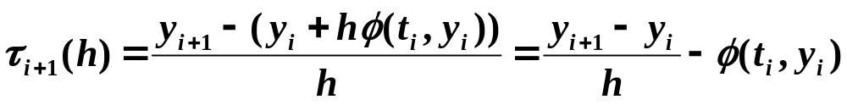

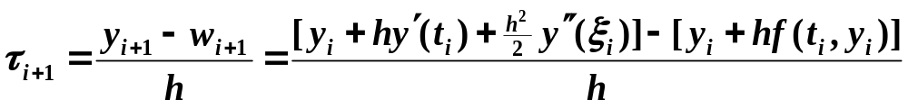
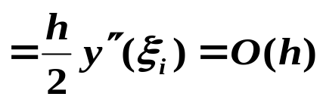
Chapter 5 Initial-Value Problems for Ordinary Differential Equations -- Higher Order Taylor Methods
☑ 5.3 Higher Order Taylor Methods
Definition: The difference method
w₀ = α; w_{i+1} = w_{i} + hφ( t_{i}, w_{i} ), for each i = 0, 1, …, n – 1
has local truncation error
for each i = 0, 1, …, n – 1.
Note: The local truncation error is just (y_{i+1} − w_{i+1})/h with the assumption that w_{i} = y_{i} .
☞ The local truncation error of Euler’s method
Discussion 32: What is the local truncation error of Euler’s method?
Method of order 1
6/12

Slide 7
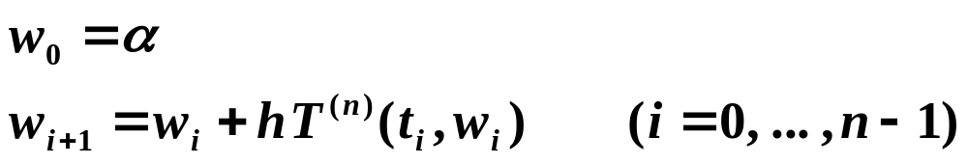
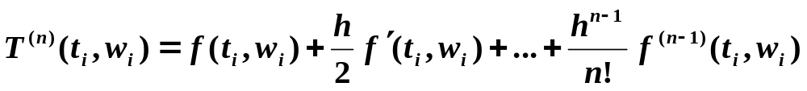
Chapter 5 Initial-Value Problems for Ordinary Differential Equations -- Higher Order Taylor Methods
Note: Euler’s method can be derived by using Taylor’s expansion with n = 1 to approximate y(t).
➢ Higher Order Taylor Methods
Taylor method of order n:
where
The local truncation error is O(h^{n}) if y ∈ C^{n+1}[a, b].
7/12

Slide 8
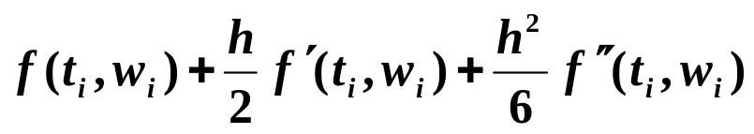
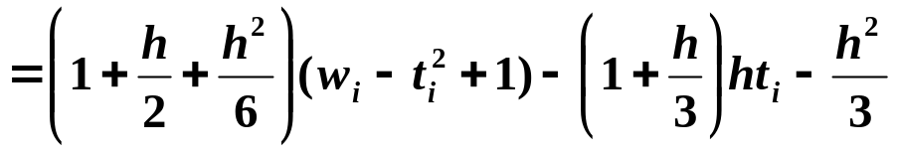
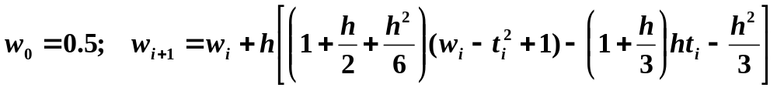
Chapter 5 Initial-Value Problems for Ordinary Differential Equations -- Higher Order Taylor Methods
Discussion 33: Apply Taylor’s method of order 3 with n = 10 to the IVP
y’ = y – t² + 1, 0 ≤ t ≤ 2, y(0) = 0.5
Solution: Find the first 2 derivatives of f
f(t, y(t)) = y(t) – t² + 1
f ’(t, y(t)) = y’(t) – 2t = y(t) – t² + 1 – 2t
HW:
p.271 #5 (a)(b)
f ”(t, y(t)) = y’(t) – 2t – 2 = y(t) – t²– 2t – 1
T ⁽³⁾(t_{i}, w_{i}) =
Taylor’s method of order 3:
Given n = 10, then
h = 0.2 and t_{i} = 0.2i
w_{i+1} = 1.22133w_{i} – 0.00885i² – 0.00853i + 0.21867
8/12

Slide 9
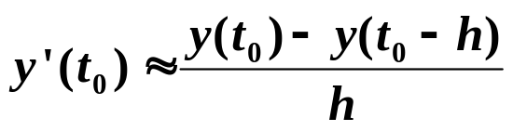
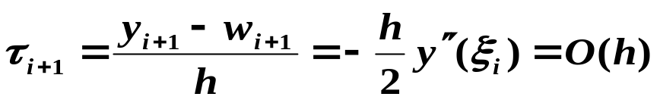

Chapter 5 Initial-Value Problems for Ordinary Differential Equations -- Higher Order Taylor Methods
➢ Other Euler’s Methods
 Implicit Euler’s method
y
(
t
)
≈
y
(
t
)
+
h
y’

=
α
+
(
t
)
h
f
(
t
,
y
(
t
))
1
0
1
1
1
w
=
α
;
w
=
w
+
h
f
(
t
,
w
)
(
i
=
0
,
...
,
n
−
1
)
0
i
+
1
i
i
+
1
i
+
1
Usually w_{i+1} has to be solved iteratively, with an initial value given by the explicit method.
☞ The local truncation error of the implicit Euler’s method
Hey! Isn’t the local truncation error
of Euler’s method ?
Seems that we can make a good use of it …
9/12

Slide 10
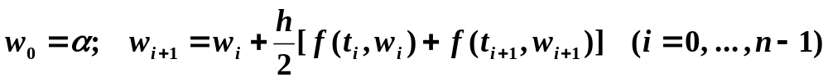
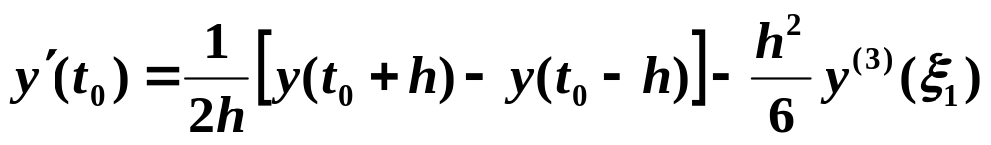

Chapter 5 Initial-Value Problems for Ordinary Differential Equations -- Higher Order Taylor Methods
 Trapezoidal Method
Two initial points are required to start
moving forward. Such a method is called
double-step method. All the previously discussed
methods are single-step methods.
Note: The local truncation error is indeed O(h²). However an implicit equation has to be solved iteratively.
 Double-step Method
Note: If we assume that w_{i – 1} = y_{i – 1} and w_{i} = y_{i}, the local truncation error is O(h²).
10/12

Slide 11
Chapter 5 Initial-Value Problems for Ordinary Differential Equations -- Higher Order Taylor Methods
Method


Euler’s explicit
Simple
Low order accuracy
Euler’s implicit
stable
Low order accuracy
and time consuming
Trapezoidal
More accurate
Time consuming
Double-step
More accurate,
and explicit
Requires one extra
initial point
Can’t you give me a method
with all the advantages yet without any
of the disadvantages?
Do you think it possible?
Well, call me greedy…
OK, let’s make it possible.
11/12

Slide 12

Chapter 5 Initial-Value Problems for Ordinary Differential Equations -- Higher Order Taylor Methods
Research topic 13:
Introduce a method with all the advantages and without any of the disadvantages of the methods we have discussed.
12/12

