Slide 1


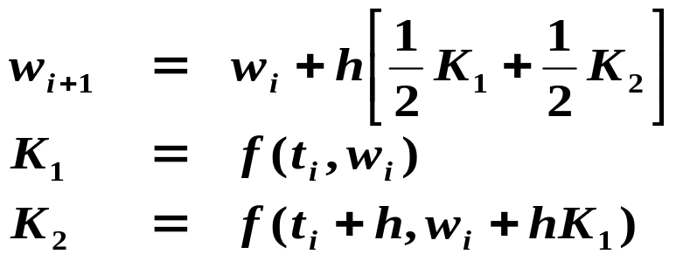
Chapter 5 Initial-Value Problems for Ordinary Differential Equations -- Runge-Kutta Methods
☑ 5.4 Runge-Kutta Methods
A single-step method with high-order local truncation error without evaluating the derivatives of f.
In a single-step method, a line segment is extended from (t_{i}, w_{i}) to reach the next point (t_{i+1}, w_{i +1}) according to some slope. We can improve the result by finding a better slope.
Idea
Must the slope
be the average of
K₁ and K₂ ?
 Check the modified Euler’s method:
Must the step size be h?
1/13

Slide 2
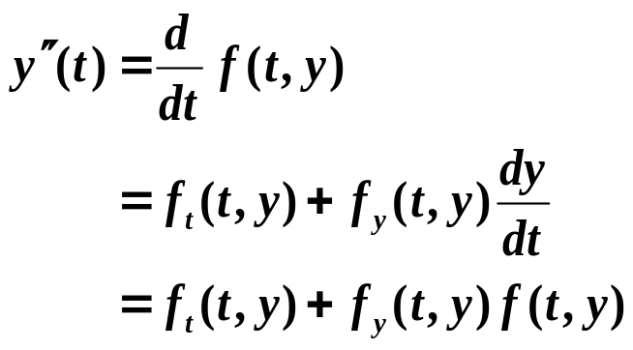
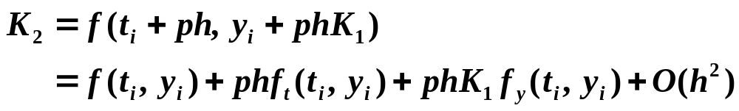

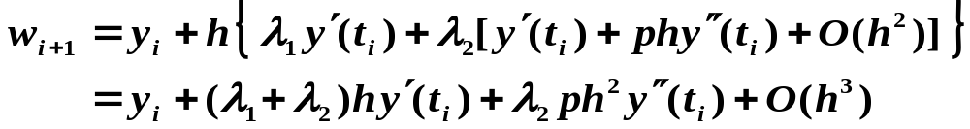
Chapter 5 Initial-Value Problems for Ordinary Differential Equations -- Runge-Kutta Methods
Generalize it to be:
w
=
w
+
h
[
λ
K
+
λ
K
]
Determine λ₁, λ₂, and p such that the method has local truncation error of order 2.
i
+
1
i
1
1
2
2
K
=
f
(
t
,
w
)
1
i
i
K
=
f
(
t
+
ph
,
w
+
phK
)
2
i
i
1
Step 1: Write the Taylor expansion of K₂ at ( t_{i} , y_{i} ) :
Step 2: Plug K₂ into the first equation
Step 3: Find λ₁, λ₂, and p such that τ_{i+1} = ( y_{i+1} – w_{i+1} )/h = O(h²).
2/13

Slide 3
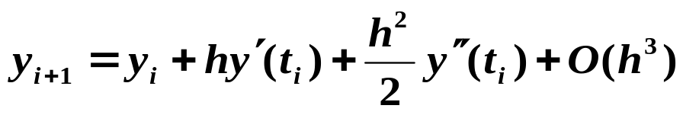

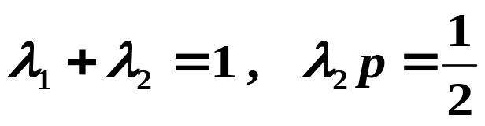

Chapter 5 Initial-Value Problems for Ordinary Differential Equations -- Runge-Kutta Methods
Here are unknowns
and equations.
3
2
There are infinitely many solutions. A family of methods generated from these two equations is called Runge-Kutta method of order 2.
Note: The modified Euler’s method is only a special case of Runge-Kutta methods with p = 1 and λ₁ = λ₂ = 1/2.
Q: How to obtain higher-ordered accuracy?
3/13

Slide 4

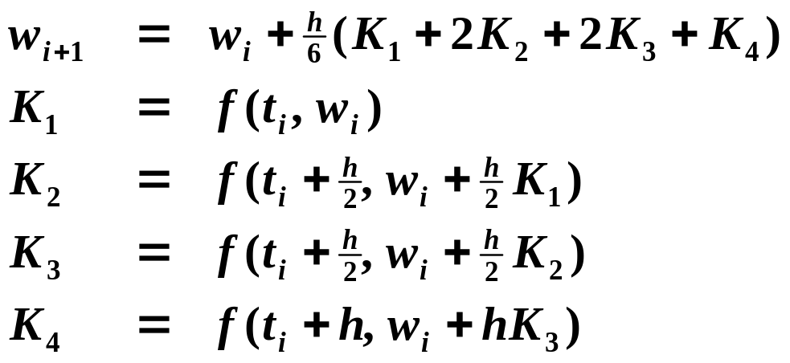
Chapter 5 Initial-Value Problems for Ordinary Differential Equations -- Runge-Kutta Methods
w
=
y
+
h
[
λ
K
+
λ
K
+
...
+
λ
K
]
i
+
1
i
1
1
2
2
m
m
K
=
f
(
t
,
w
)
1
i
i
K
=
f
(
t
+
α
h
,
w
+
β
hK
)
2
i
2
i
21
1
K
=
f
(
t
+
α
h
,
w
+
β
hK
+
β
hK
)
3
i
3
i
31
1
32
2
...
...
K
=
f
(
t
+
α
h
,
w_{i}
+
β
hK
+
β
hK
+
...
+
β
hK
)
m
i
m
m
1
1
m
2
2
m m
−
1
m
−
1
➢ Classical Runge-Kutta Order 4 Method – the most popular one
4/13

Slide 5






Chapter 5 Initial-Value Problems for Ordinary Differential Equations -- Runge-Kutta Methods
Note:
☞ The main computational effort in applying the Runge-Kutta methods is the evaluation of f. Butcher has established the relationship between the number of evaluations per step and the order of the local truncation error :
HW:
p.280-281
#1 (a), 10, 13
evaluations per step
2
3
4
5-7
8-9
n≥10
Best possible LTE
☞ Since Runge-Kutta methods are based on Taylor’s expansion, y has to be sufficiently smooth to obtain better accuracy with higher-order methods. Usually the methods of lower order are used with smaller step size in preference to the higher-order methods using a large step size.
5/13

Slide 6

Chapter 5 Initial-Value Problems for Ordinary Differential Equations
Research topic 14:
Apply the idea of Richardson's extrapolation method to solve IVP with equal-step mesh points.
6/13

Slide 7
Chapter 5 Initial-Value Problems for Ordinary Differential Equations
Research topic 15:
Introduce a method that aims at ensuring the global error | y( t_{i} ) – w_{i} | < ε with minimal number of mesh points.
(Hint: consider the idea of adaptive methods.)
7/13

Slide 8
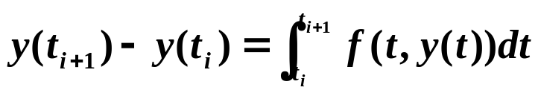
Chapter 5 Initial-Value Problems for Ordinary Differential Equations -- Multistep Methods
☑ 5.6 Multistep Methods
Implicit when b_{m} ≠ 0.
Explicit when b_{m} = 0.
Use a linear combination of y and y’ at several mesh points to better approximate y(t_{i+1}).
Idea
w
=
a
w
+
a
w
+
...
+
a
w
+
h
[
b
f
+
b
f
+
...
+
b
f
]
i
+
1
m
−
1
i
m
−
2
i
−
1
0
i
+
1
−
m
m
i
+
1
m
−
1
i
0
i
+
1
−
m
➢ Derive from integration
Integrate y’(t) = f(t, y) over [t_{i}, t_{i+1}], we have
The key is to approximate the integral. Different approximations give different difference equations.
Idea
8/13

Slide 9
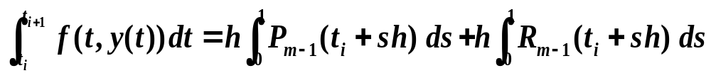
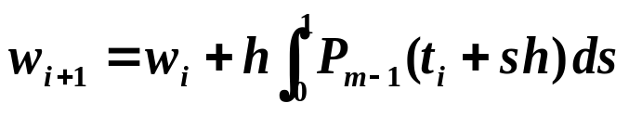
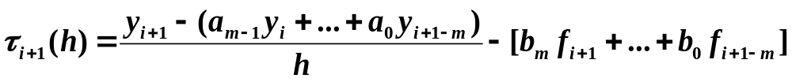
Chapter 5 Initial-Value Problems for Ordinary Differential Equations -- Multistep Methods
 Adams-Bashforth explicit m-step technique
Use the Newton backward-difference formula to interpolate f on ( t_{i}, f_{i} ), ( t_{i – 1} , f_{i – 1} ), …, ( t_{i +1–m}, f_{i +1–m} ) and obtain P_{m – 1}(t). Or let t = t_{i} + sh, then
s ∈ [0, 1] and we have
/* Explicit formula */
local truncation error
Definition: The local truncation error for a multistep method is
for each i = m – 1, m, …, n – 1.
9/13

Slide 10

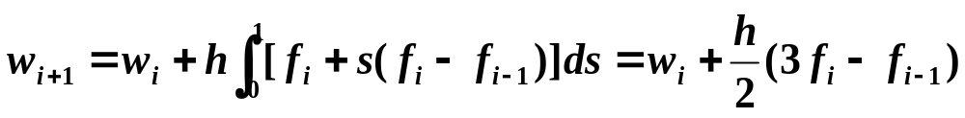
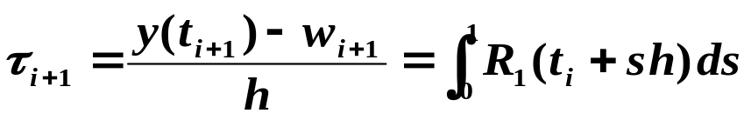
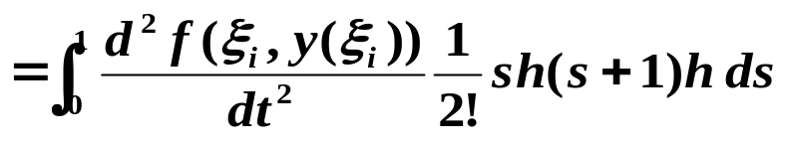
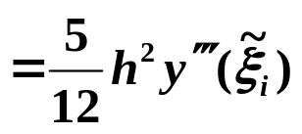
Chapter 5 Initial-Value Problems for Ordinary Differential Equations -- Multistep Methods
Example: Please derive the Adams-Bashforth two-step explicit method.
Solution: Use the Newton backward-difference formula to interpolate f on ( t_{i} , f_{i} ) and ( t_{i – 1} , f_{i – 1} ).
P₁(t_{i} + sh) =
The local truncation error is:
Note: In general, τ_{i+1} = A_{m} h^{m} y^{(m+1)}(ξ_{i}) where A_{m} and the coefficients of f_{i}, f_{i – 1}, …, f_{i +1–m} can be found from the table.
10/13

Slide 11













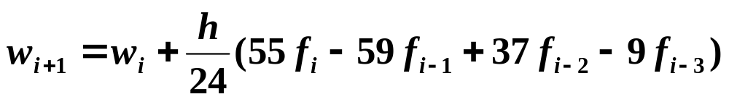
Chapter 5 Initial-Value Problems for Ordinary Differential Equations -- Multistep Methods
m
f_{i}
f_{i−1}
f_{i−2}
f_{i−3}
…
A_{k}
1
2
3
4
1
…
…
…
…
…
…
…
Adams-Bashforth Four-Step Explicit Method
11/13

Slide 12









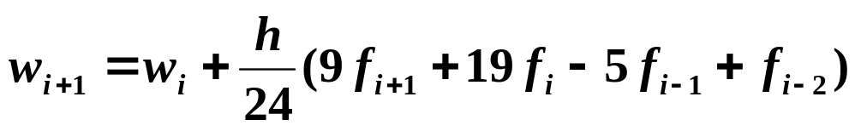
Chapter 5 Initial-Value Problems for Ordinary Differential Equations -- Multistep Methods
 Adams-Moulton implicit m-step technique
Use the Newton forward-difference formula to interpolate f on ( t_{i+1}, f_{i+1} ), ( t_{i} , f_{i} ), …, ( t_{i +1–m}, f_{i +1–m} ) and obtain P_{m}(t). Similarly we can obtain a family of implicit formulae with τ_{i+1} = B_{m} h^{m+1} y^{(m+2)}(ξ_{i}).
m
f_{i+1}
f_{i}
f_{i−1}
f_{i−2}
…
B_{k}
0
1
2
3
1
Less than A_{k}
…
…
…
…
…
…
…
Adams-Moulton Three-Step Implicit Method
12/13

Slide 13
Chapter 5 Initial-Value Problems for Ordinary Differential Equations -- Multistep Methods
 Adams predictor-corrector system
Step 1: Compute the first m initial values by Runge-Kutta method.
Step 2: Predict by Adams-Bashforth explicit method.
Step 3: Correct by Adams-Moulton implicit method.
Note: All the formulae used in the three steps must have the same order of local truncation error.
The most popularly used system is based on the 4th-order Adams-Bashforth method as predictor and one iteration of the Adams-Moulton method as corrector, with the starting values obtained from the 4th-order Runge-Kutta method.
13/13

