Slide 1


Chapter 5 Initial-Value Problems for Ordinary Differential Equations -- Multistep Methods
☑ 5.6 Multistep Methods (II)
➢ Derive from Taylor expansion
w
=
a
w
+
a
w
+
...
+
a
w
+
h
[
b
f
+
b
f
+
...
+
b
f
]
i
+
1
m
−
1
i
m
−
2
i
−
1
0
i
+
1
−
m
m
i
+
1
m
−
1
i
0
i
+
1
−
m
Expand y_{i−1}, … , y_{i+1−m} and f_{i+1}, f_{i−1}, … , f_{i+1−m} in
Taylor series about t_{i} , and equate the coefficients of
h^{k} to obtain a₀, … , a_{m–1} and b₀, … , b_{m}.
Example: Please derive a formula of order 4 with the form
w
=
a
w
+
a
w
+
a
w
+
h
[
b
f
+
b
f
+
b
f
+
b
f
]
i
+
1
2
i
1
i
−
1
0
i
−2
3
i
2
i–1
1
i–2
0
i–3
1/7

Slide 2
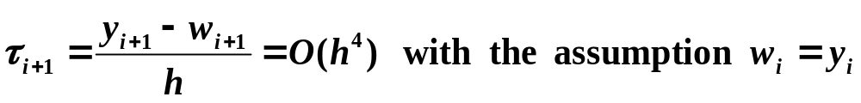
Chapter 5 Initial-Value Problems for Ordinary Differential Equations -- Multistep Methods
w
=
a
w
+
a
w
+
a
w
+
h
[
b
f
+
b
f
+
b
f
+
b
f
]
i
+
1
2
i
1
i
−
1
0
i
−2
3
i
2
i–1
1
i–2
0
i–3
Solution: Expand y_{i–1}, y_{i–2}, f_{i–1}, f_{i–2}, f_{i–3} and y( t_{i+1} ) at t_{i} .
5
7
equations and unknowns
2/7

Slide 3
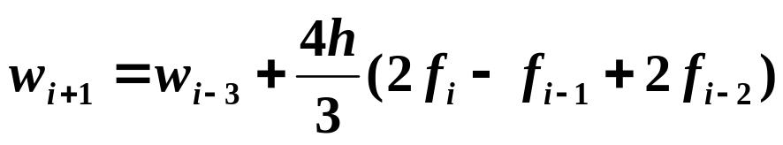
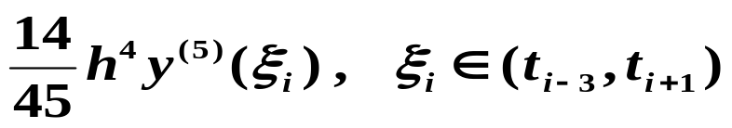
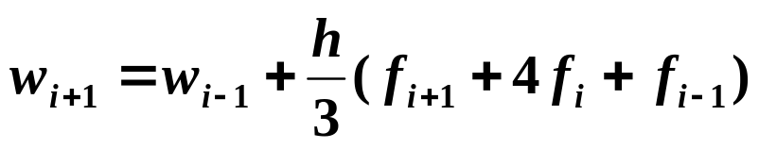
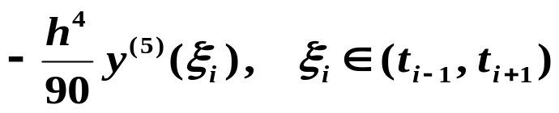
Chapter 5 Initial-Value Problems for Ordinary Differential Equations -- Multistep Methods
☞ Let a₀ = a₁ = 0
Adams-Bashforth explicit method
☞ Replace f_{i−1} by f_{i+1} and let a₀ = a₁ = 0
Adams-Moulton implicit method
☞ Replace f_{i−3} by w_{i−3} , we can obtain another family of methods of order 4, including the explicit Milne’s method:
HW: p.301 #10
which has local truncation error
☞ Let a₀ = 0 and a₁ = 1
Simpson implicit method
which has local truncation error
3/7

Slide 4

Chapter 5 Initial-Value Problems for Ordinary Differential Equations -- Multistep Methods
Research topic 16:
Carefully examine the local truncation errors of the Adams explicit and implicit methods. With the assumption that for small values of h, the ratio of the two leading terms of error is approximately a constant, can you further modify the predictor-corrector system to produce better results?
4/7

Slide 5
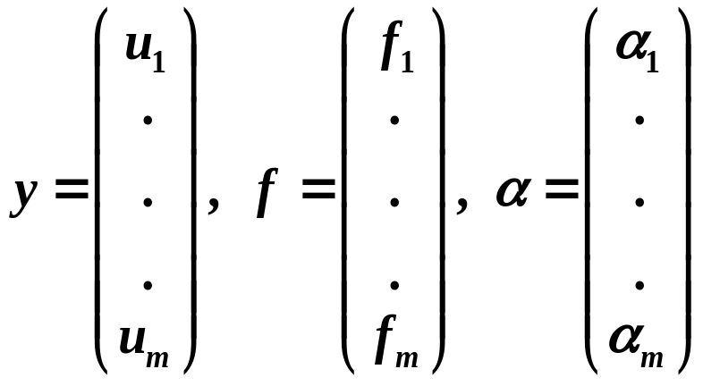
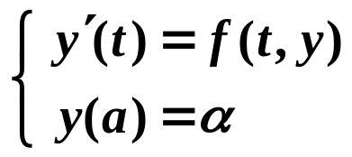
Chapter 5 IVP for ODE -- Higher-Order Equations and Systems of Differential Equations
☑ 5.9 Higher-Order Equations and Systems of Differential Equations
➢ m-th order system of 1st-order IVP
u
’
(
t
)
=
f
(
t
,
u
(
t
),
...
,
u
(
t
))
1
1
1
m
...
...
...
u
’
(
t
)
=
f
(
t
,
u
(
t
),
...
,
u
(
t
))
m
m
1
m
with the initial conditions: u₁(a) = α₁, u₂(a) = α₂, …, u_{m}(a) = α_{m}.
Let
5/7

Slide 6

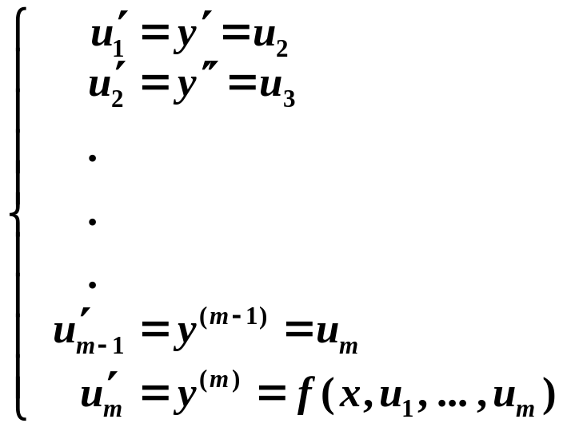
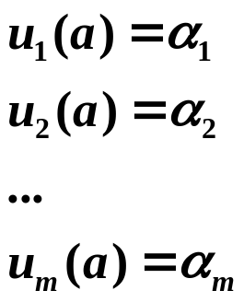
Chapter 5 IVP for ODE -- Higher-Order Equations and Systems of Differential Equations
➢ Higher-order differential equation
y
(
m
)
(
t
)
=
f
(
t
,
y
,
y
’
,...,
y
(
m
−
1
)
),
a
≤
t
≤
b
y
(
a
)
=
α
,
y’

=
α
(
m
−
1
)
=
α
(
a
)
,
...,
y
(
a
)
1
2
m
Reduce the higher-order differential equation into a system of 1st-order differential equations.
Let u₁(t) = y(t), u₂(t) = y’(t), …, u_{m}(t) = y^{(m – 1)}(t). This produces
with the initial conditions:
6/7

Slide 7
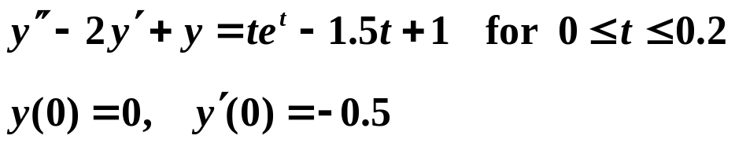
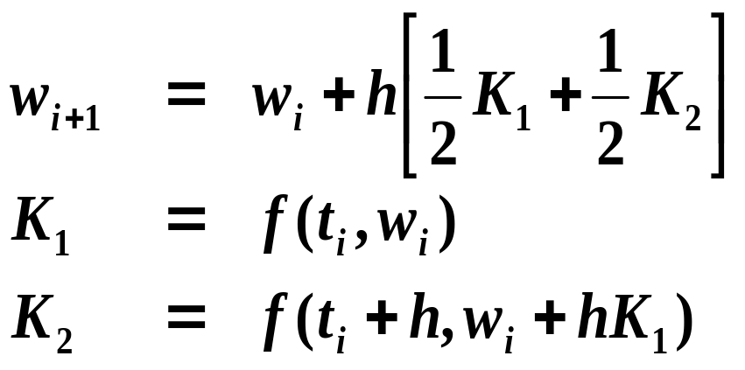
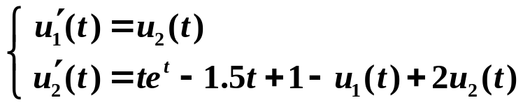

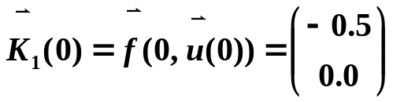
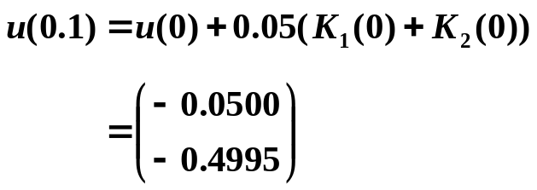
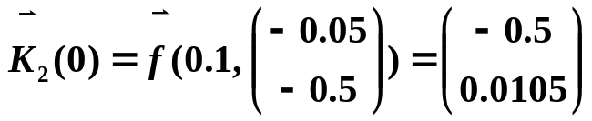
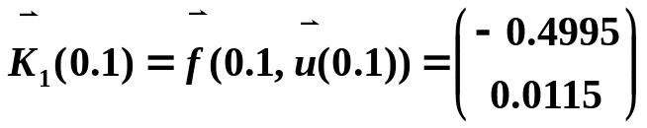
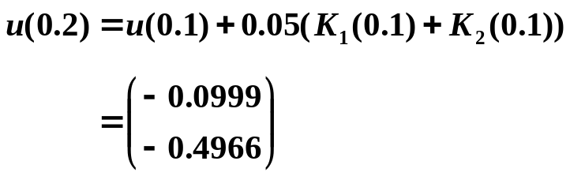
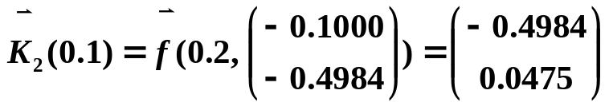
Chapter 5 IVP for ODE -- Higher-Order Equations and Systems of Differential Equations
Discussion 34: Use the modified Euler's method to solve the following IVP using h = 0.1.
Solution: Let u₁(t) = y(t) and u₂(t) = y’(t). This produces
with the initial conditions:
HW: p.323 #5
The accurate solution: y(t) = t³e^{t}/6 – te^{t} + 2e^{t} – 1.5t – 2
7/7

