Slide 1

ENT303TC / TEAM TECHNOPRENEURSHIP / ASSESSMENT 1
ONLINE MYSTERY GAME
DAWN HAS
NOT COME
Draw a role. Share clues.
Uncover the truth together.
A cooperative turtle-soup mystery game with asymmetric identities, distinct deduction mechanics and limited-use skills.
IDENTITY I
IDENTITY II
IDENTITY III
MINI PROGRAM
APP
A unique way
to investigate
A different clue
mechanic
A new way to
help the team
THURSDAY MORNING GROUP 1
LIMITED SKILL
LIMITED SKILL
LIMITED SKILL
Zeng Zihang • Zhuang Chenyi • Song Ziheng • Zhou Jinkun
Xu Tianze • Pang Chengren • Lin Xuanzheng • Wan Hengyu
CO-OPERATIVE • ROLE-BASED • REPLAYABLE
Current prototype exists; mini-program and app rollout is the proposed delivery path.
DAWN HAS NOT COME • WORKING PITCH DRAFT
01/06

Slide 2

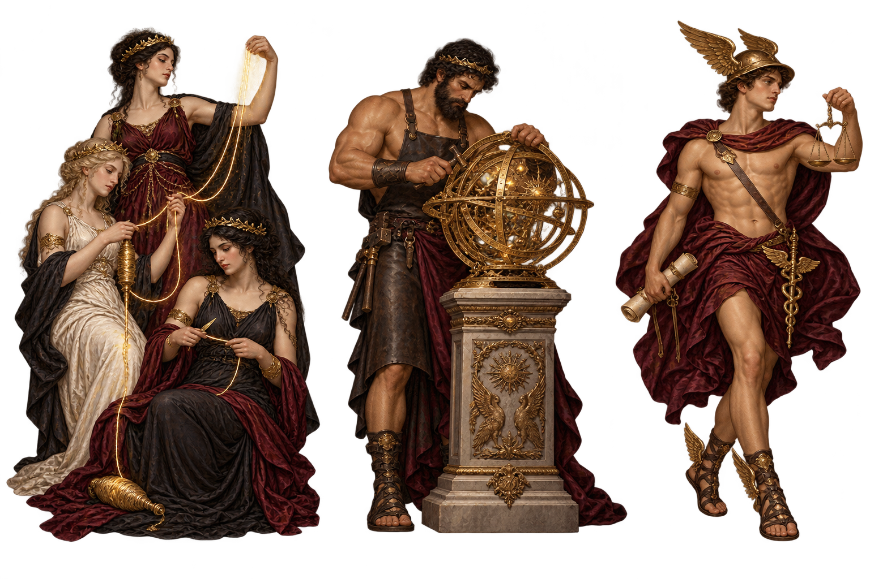
ENT303TC / TEAM TECHNOPRENEURSHIP / ASSESSMENT 1
Problem & Market Opportunity
Start with a focused user group and validate the problem before scaling.
NEED = HYPOTHESIS
PROBLEM HYPOTHESIS
LOW-COST MARKET VALIDATION
In online mystery sessions, a few players may dominate questioning while others struggle to contribute meaningfully.
1
Recruit 3–5 adult players
Mix mystery-game experience levels; use consent and anonymised IDs.
2
Observe one real session
FIRST TARGET USERS
Track completion, help requests, skill use, discussion and confusion points.
University students and friend groups who enjoy mystery, social deduction and short online co-op games.
3
Decide what to improve
Keep negative feedback; revise the rules before spending on wider launch.
WHAT WE CAN SHOW TODAY
EV-002
EV-003
OPEN GAP
Playable core loop
Testing is prepared
Demand not yet proven
44 case files, 5 identity-card models, clue unlocks, limited questions and final judgement.
A 3–5 adult participant protocol, with 15–20 minute sessions and anonymised observations.
Current logs do not contain completed external playtest findings; do not claim product-market fit.
Market entry hypothesis: start with campus groups and online friend circles; expand only if playtests show that role skills improve participation and repeat play.
DAWN HAS NOT COME • WORKING PITCH DRAFT
02/06

Slide 3
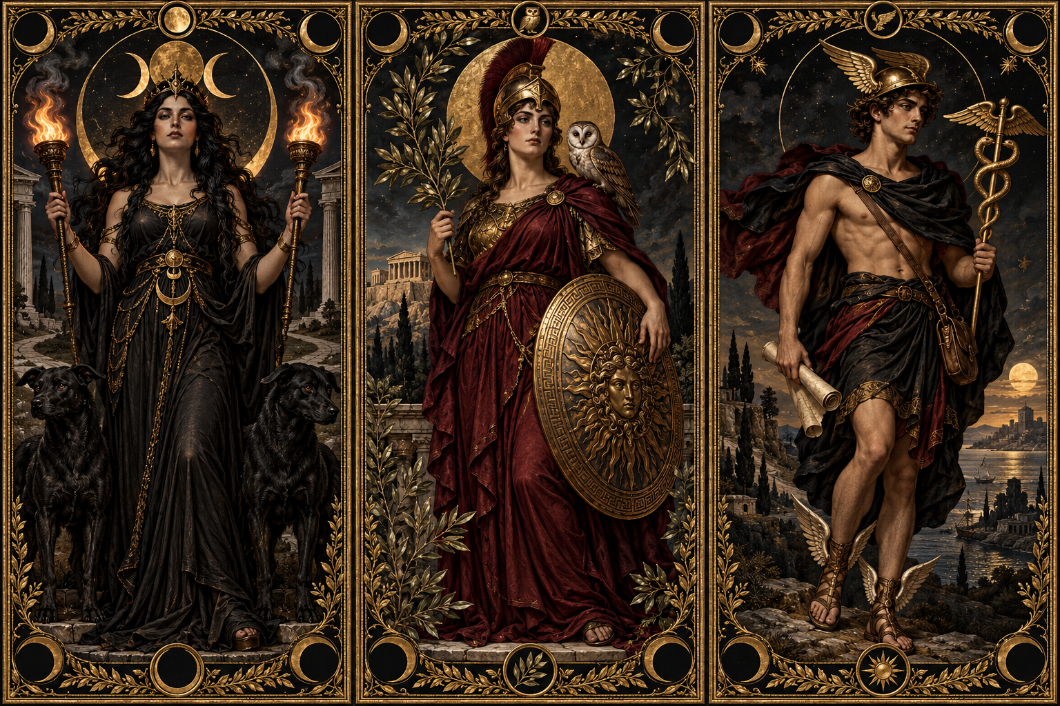
ENT303TC / TEAM TECHNOPRENEURSHIP / ASSESSMENT 1
Solution & Unique Value Proposition
Make every player useful: different roles change how the team accesses information.
THE CORE GAME LOOP
01
Draw an identity
02
Open a mystery
03
Discuss + use a skill
04
Submit a team verdict
Each player receives a role with its own mechanic.
A shared case begins with a hidden truth.
Players ask questions, exchange ideas and spend limited skills.
Combine clues and explain what happened.
ROLE DIFFERENTIATION • ILLUSTRATIVE MECHANICS
TESTABLE USP
ALTERNATIVES & OUR INTENDED DIFFERENCE
Compared with standard riddle formats, our game adds asymmetric roles and limited-use skills to structure group participation.
ALTERNATIVE
MAIN EXPERIENCE
OUR INTENDED DIFFERENCE
Black Stories
Group yes/no riddles
Digital rooms + role-specific skills
The Room
Immersive solo puzzle app
Live group discussion and shared verdict
DESIGN RULE
A skill changes how information is found—not the final answer. Each use is limited and tracked by the game.
Criminal Case
Hidden-object crime investigation
Open-ended lateral thinking + role mechanics
THE SEER
1 USE / CASE
THE ANALYST
1 USE / CASE
THE KEEPER
1 USE / CASE
Unlocks a clue
category
Tests one line
of reasoning
Reveals context
from the case
Role names above are examples; final names and effects should match the existing five identity-card models.
Positioning hypothesis; validate through a side-by-side playtest, not branding alone.
DAWN HAS NOT COME • WORKING PITCH DRAFT
03/06

Slide 4
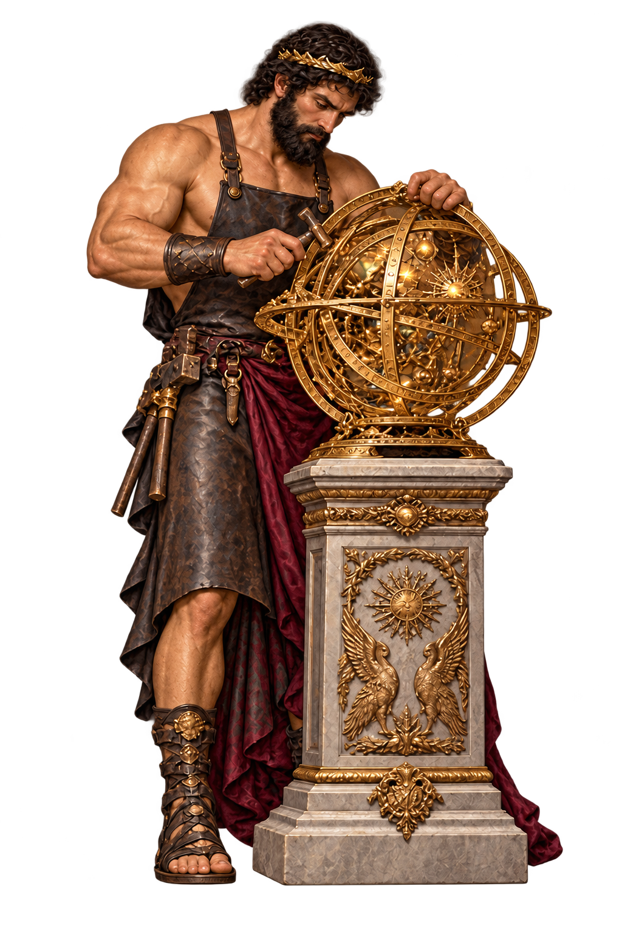
ENT303TC / TEAM TECHNOPRENEURSHIP / ASSESSMENT 1
Technology & Feasibility
Reuse the working core; build the smallest online version that tests the social game loop.
MVP: SIMPLE BY DESIGN
ALREADY BUILT
NEXT TO BUILD
Current prototype evidence • EV-002
Minimum online release
• 44 structured case files + 5 identity-card models
• Private room + invite code for friends
• Identity draw, case selection and yes/no host flow
• Shared question board and text discussion
• Limited questions, clue unlocking and one-use skills
• Role permissions + automatic skill-use counter
• Final judgement and end-of-game statistics
• One mobile-friendly case flow with a clear verdict screen
LIGHTWEIGHT TECHNICAL FLOW
1
Mini Program first
2
Room + chat
3
Rules-based engine
4
App expansion
Fast access via link / QR
Players share one case
Controls clues, skills and limits
Only after the MVP is validated
MAIN RISK
The desktop prototype is not yet proof of a polished mobile launch. First test one case end-to-end, measure playback and room stability, then port more content. Keep AI hosting optional—not a dependency for MVP.
Current implementation evidence: EV-002. Media draft and staged integration plan: EV-004 / EV-005.
DAWN HAS NOT COME • WORKING PITCH DRAFT
04/06

Slide 5
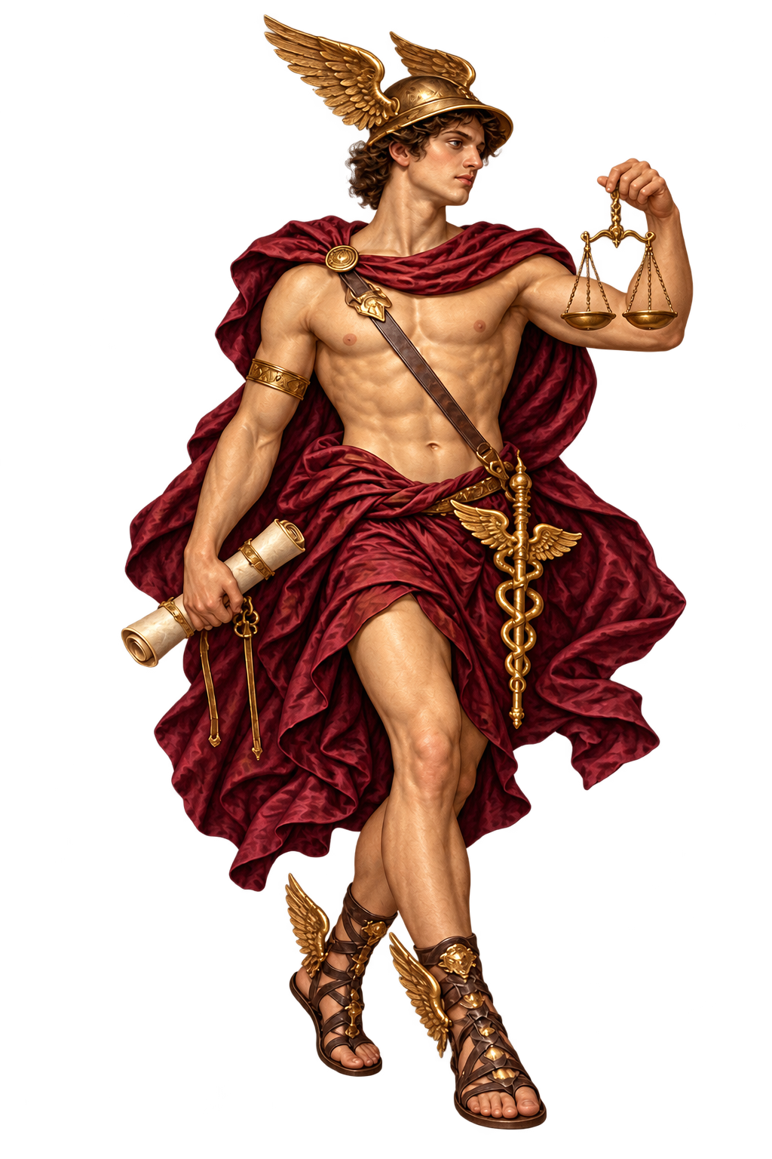
ENT303TC / TEAM TECHNOPRENEURSHIP / ASSESSMENT 1
Business Model: B2C First, Then B2B / B2G
A simple staged model reduces launch risk and avoids building three sales channels at once.
B2C • PHASE 1
B2B • PHASE 2
B2G • PHASE 3
Individual players
Organisations & venues
Public-sector pilots
Free starter cases
Paid story / role packs
Optional cosmetic card themes
Group / semester licence
Hosted event package
Custom mystery packs
Pilot licence / programme fee
Curated case bundle
Best first test: easy to reach through friend groups and campus communities.
Potential buyers: university societies, game cafés and team-building organisers.
Explore only after evidence of suitability for libraries, youth centres or cultural programmes.
BUSINESS MODEL CANVAS • SNAPSHOT
VALUE
CUSTOMERS
CHANNELS
Co-op mystery + role-based skills
Players first; clubs / venues next
Mini Program, app, campus communities
KEY WORK
PARTNERS
COSTS + REVENUE
Write cases, balance roles, maintain rooms
Platforms, creators, event venues
Content / dev / hosting; packs and licences
Main costs: game development • story / character / CG / audio production • hosting and moderation • user acquisition. Test willingness to pay before forecasting revenue.
DAWN HAS NOT COME • WORKING PITCH DRAFT
05/06

Slide 6
ENT303TC / TEAM TECHNOPRENEURSHIP / ASSESSMENT 1
Team & Execution Plan
The team has built the core prototype; the next milestone is a tested, mobile-friendly multiplayer slice.
Zeng Zihang
Zhuang Chenyi
Product & game flow
Narrative & cases
Core loop, rules and release priorities
Case logic, clue chain and final truth
Song Ziheng
Zhou Jinkun
Identity mechanics
Game implementation
Role differences, skill limits and balance
Room flow, question and skill logic
Xu Tianze
Pang Chengren
UI / UX
Media integration
EXECUTION EVIDENCE
Mobile-friendly screens and player onboarding
Broadcast, CG, image and audio assets
EV-002 • Core prototype: 44 cases + 5 identity models
EV-003 • Ethical playtest protocol prepared
Lin Xuanzheng
Wan Hengyu
EV-004 / EV-005 • Media draft + staged integration plan
Testing & evidence
Market & business
NEXT 2 MILESTONES
Playtest records, issue log and iteration
Competitor review, pricing and pitch logic
1. Integrate one complete case into the online room.
2. Run 3–5 playtests; report completion, confusion, skill use and feedback.
Role allocation is a proposed draft—confirm each member’s actual ownership and replace it with verifiable contributions before submission.
DAWN HAS NOT COME • WORKING PITCH DRAFT
06/06

