Slide 1
Cse 316
Information
Management

Slide 2
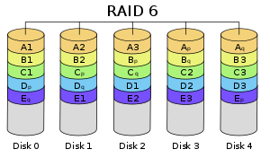
What is data storage?
The means by which a program stores its data
Can you name data associated with this program?
How about your favorite game?
How is this done?
temporarily
persistently

Slide 3
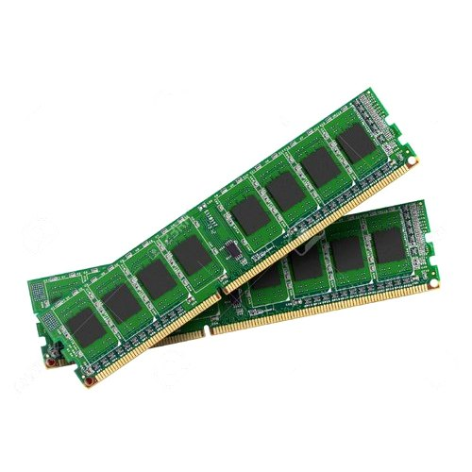
Temporary Data
Data loaded into RAM
stack, heap, and global segments of program space
Used for programs currently running
primitives
objects
arrays
What happens to this data (in RAM) when a program terminates?
It’s gone
Some other program will be given that region of RAM.

Slide 4
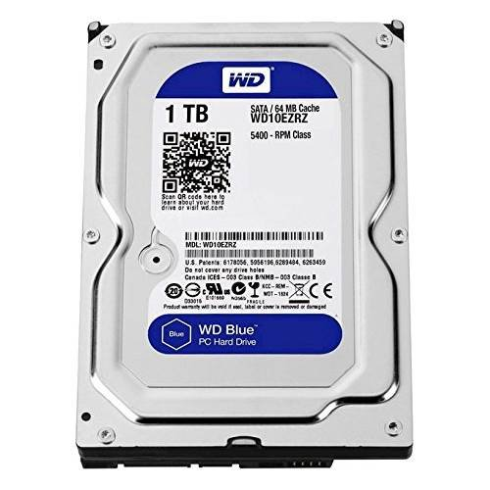
Persistent Data
After a program ends, this data is not destroyed
i.e. it persists
Why?
It’s not only (if at all) in RAM. Where is it then?
Hard drive, CD, DVD, Server, i.e. permanent storage
What on these devices store this data?
files
database (managed via a group of files)

Slide 5
How does temporary data get its values?
Potentially by many means. Ex:
Values hard-coded into a program:
Program instructions/calculations:
User input via a device & stream:
The Computer’s System:
An input stream from a file or server:
A database:
int i = 0;
int i = j + 5;
int i = keyboard.nextInt();
int i = (int)(Math.random() * 100) + 1;
int i = binaryFileReader.readInt();
int i = resultSet.getInt("SALARY");

Slide 6
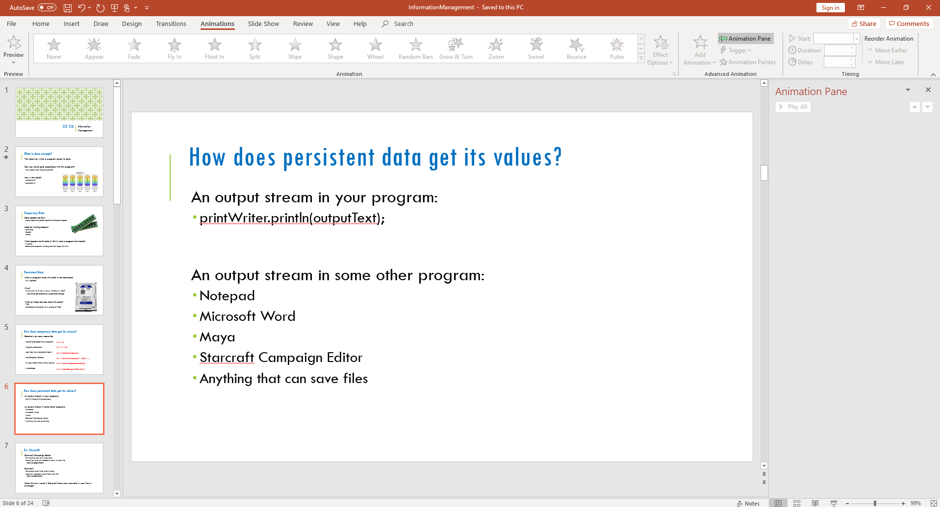
How does persistent data get its values?
An output stream in your program:
printWriter.println(outputText);
An output stream in some program:
Notepad
Microsoft Word
Maya
Starcraft Campaign Editor
Anything that can save files

Slide 7
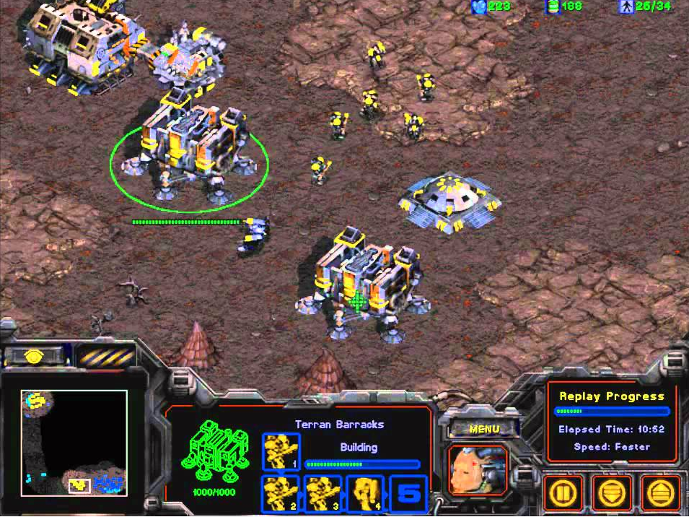
Ex: Starcraft
Starcraft Campaign Editor
for making your own map level
saves your and all necessary data to .scm file
done via output stream
Starcraft
lets player pick map level to play
loads all necessary data from .scm file
done via input stream
Note: this only works if Starcraft knows how the data in .scm files is arranged

Slide 8
Let’s open the Fastest.scm map in Notepad
What happened?
MPQ ã_ Ã Ã_ s(Oì¬“ÊÁÝ©ˆ¨ÀPæÒñwA'ŒŠ’'$¶›„qÚu!ÿA±7m_‘>Îû3®²E¿õµõ4‹‘.B¡]N™.>›ÝØ&ÜB,>Bžiã¥£ÂÛ?Ò€€¼âB´dqÝj|¨ç›4ê´Cº3Ñ.ÒÓõ(0J4q¶ñ~¢n‰¿wAŽÚY™×=nââpQ]À&¶‘©1,#õbw}ž}Ú5åNBˆÃYïŠ{sRøÃ¶‡Ë¤Vò_V˜i‰£k'CòÑœ]ñRê®Ÿþ’å„à^Ÿ³fJêöÄòK}S~c«“¬­$u\è¯£7<ºƒÚXAi¯LÃúvá·™õÙ^»W;õÄÇq»M˜p#´#ÈÎv
…

Slide 9

Internal vs. External Data Representations
Many applications make data for other applications
Ex: Photoshop
.psd vs .png/.jpg/etc.

Slide 10
Internal vs. External Representations of PS Data
Internal
obligation to reassemble and manipulate everything
feed all internal algorithms and UI controls
Photoshop example:
layers
singular objects for formatting
External
obligation to external formats
presentation
Photoshop example:
array of pixels
that’s it

Slide 11
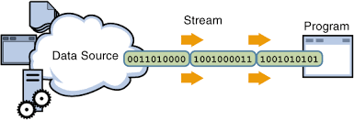
I/O Streams
Program I/O must work together
Input Streams must know how the Output Stream sent data:
What data?
What types?
What format are the types? (not an issue in Java)
What type of stream was used?
In what order?
I/O Streams typically use Sequential Access
for output streams
data appears in the file in the order it is written out
for input streams:
data is read from the file in the order it appears in the file

Slide 12
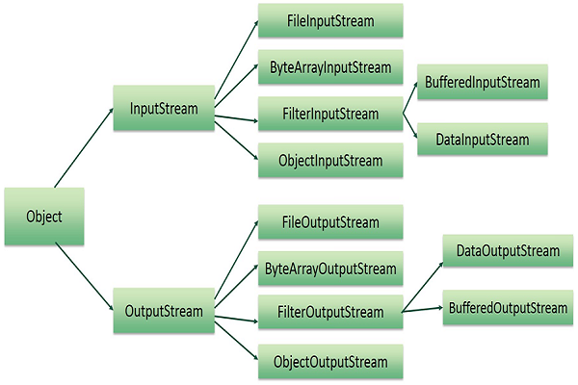
Java I/O
Java has extensive support for I/O of all sorts
java.io.* package
more than 60 different stream types
Lots of features
I/O to programs/files/Internet (files & servers)
encoding
compression
encryption

Slide 13
Some Java Stream Types
Text
BufferedReader/PrintWriter
reads/writes Unicode
Binary
DataInputStream/DataOutputStream
reads/writes bytes
Object files (using Object Serialization)
ObjectInputStream/ObjectOutputStream
reads/writes Java objects

Slide 14
Development vs. Release Formats
During project development:
have program use readable (like text) files
readable
helps with changing parameters
helps with debugging
When product is released
have program use compressed files
less memory
faster
Note that this is an option, not a rule.
XML and JSON are common throughout both stages

Slide 15
Text File Writing Example
try {
File file = new File("Output.txt");
Writer writer = new FileWriter(file);
PrintWriter out = new PrintWriter(writer);
out.println("Janie Jones");
out.println("" + 25);
out.close();
}
catch(IOException ioe) {
System.out.println("File not Found");
}

Slide 16
Text File Reading Example
Person p;
try {
File file = new File("Output.txt");
Reader reader = new FileReader(file);
BufferedReader in = new BufferedReader(reader);
String name = in.readLine();
String ageText = in.readLine();
int age = Integer.parseInt(ageText);
p = new Person(name, age);
System.out.print(p);
}
catch(IOException ioe) {
System.out.println("File not Found");
}
Output?
Janie Jones, 25

Slide 17
How much data does the file have?
Many times we don’t know
A Web browser doesn’t know how much text is in Web page until it reads in the entire thing
read text one line at a time using readLine()
readLine returns null if no more text to read
What happens after reading a text file?
parsing it

Slide 18
Information Management
How an organization:
gathers data
stores and manages data
updates data
distributes data
uses data
synthesizes data into information
Information gleans meaning from data

Slide 19
How is data gathered?
Users enter it
Employees enter it
Generated via algorithms/learning
Acquired from other sources
governments
licensed
partners
etc.

Slide 20
How is data synthesized into information?
Automated mechanisms
machine learning
training models that can be used for prediction
Human analysis

Slide 21
What is a CRUD Web application?
A Web app that:
Creates data
Retrieves data
Updates data
Deletes data
Requires a back-end
Requires high-permanence exchanges

Slide 22
Mechanisms for Web app storage
Client Storage (i.e. browsers)
Cookies
Web/Local Storage
Server Storage
Back-end Databases

Slide 23
Cookies
Small text files stored on a client machine
Data stored in name, value pairs
pairs can be saved/retrieved via document.cookie
Intended to store information about the user
improve session-to-session usage
Standard Browser limits:
Max 4,096 bytes per cookie
Max 50 cookies per site
Max 3,000 cookies in total

Slide 24
Using Cookies in JavaScript
// MAKE A COOKIE
document.cookie = "username=Joe";
…
// READ ALL COOKIES FOR THIS SITE (i.e. all name/value pairs)
let myCookie = document.cookie;
…
// GET THE username COOKIE VALUE
let userNameCookie = myCookie.replace(/(?:(?:^|.*;\s*)username\s*\=\s*([^;]*).*$)|^.*$/, "$1");
…
// DELETE THE COOKIE – SET EXPIRES TO PAST DATE
document.cookie = "expires=Thu, 01 Jan 1970 00:00:00 UTC";

Slide 25
We could store multiple name/value pairs in a Cookie
Separate name=value pairs using ‘;’
Read back cookie
split using ‘;’ as delimiter (to get all values)
OR
filter result to find particular name
if (document.cookie.split(';').filter(function(item) {
return item.indexOf('username=‘) >= 0}).length) {
console.log('A username cookie was found’);
}

Slide 26
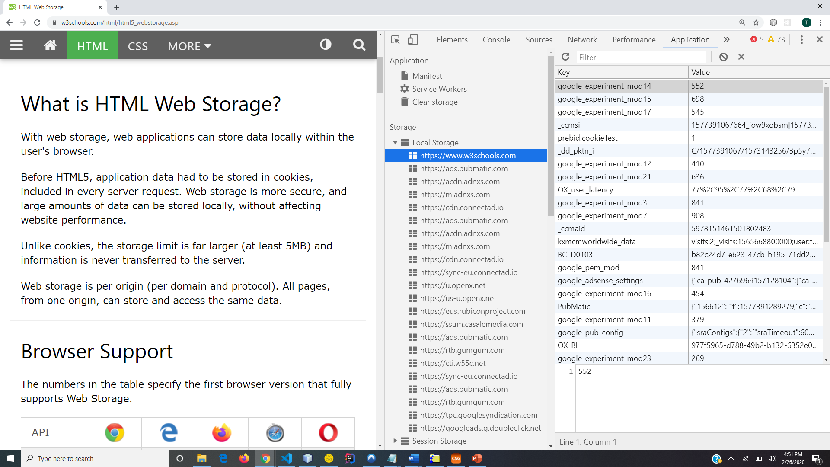
Web Storage?
Also called Local/Session
Much Larger limit than Cookies
recommended limit: 5MB
Per origin storage
per domain & protocol
all pages from one origin can store and access the same data

Slide 27
Two objects for Web Storage
window.localStorage
no expiration date
window.sessionStorage
data for one session only
To check support:
if (typeof(Storage) !== "undefined") {
// Code for localStorage/sessionStorage.
} else {
// Sorry! No Web Storage support..
}

Slide 28
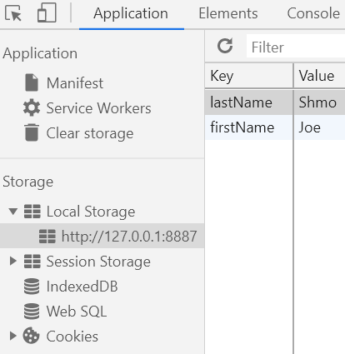
To get and set data in local storage
// Store
localStorage.setItem("lastName", "Shmo");
localStorage.setItem("firstName", "Joe");
// Retrieve
let lastName = localStorage.getItem("lastName");
let firstName = localStorage.getItem("firstName");

Slide 29
What is a DBMS?
Database Management System
Keeps data stored efficiently
Ex: Btrees for an RDBMS
Provides an interface for access
user access
program access

Slide 30


There are different types of DBMSs
RDBMS
Relational Database Management System
typically employ SQL and ORM
JSON Database (NoSQL)
may employ various QLs and ODM
we’ll use GraphQL
Graph, Object, Blob, etc.

Slide 31
RDBMS
Relational Database Management System
Data is stored in tables
Employs Relational Mathematics for combining tables
SQL?
Structured Query Language
SELECT * FROM Users

Slide 32
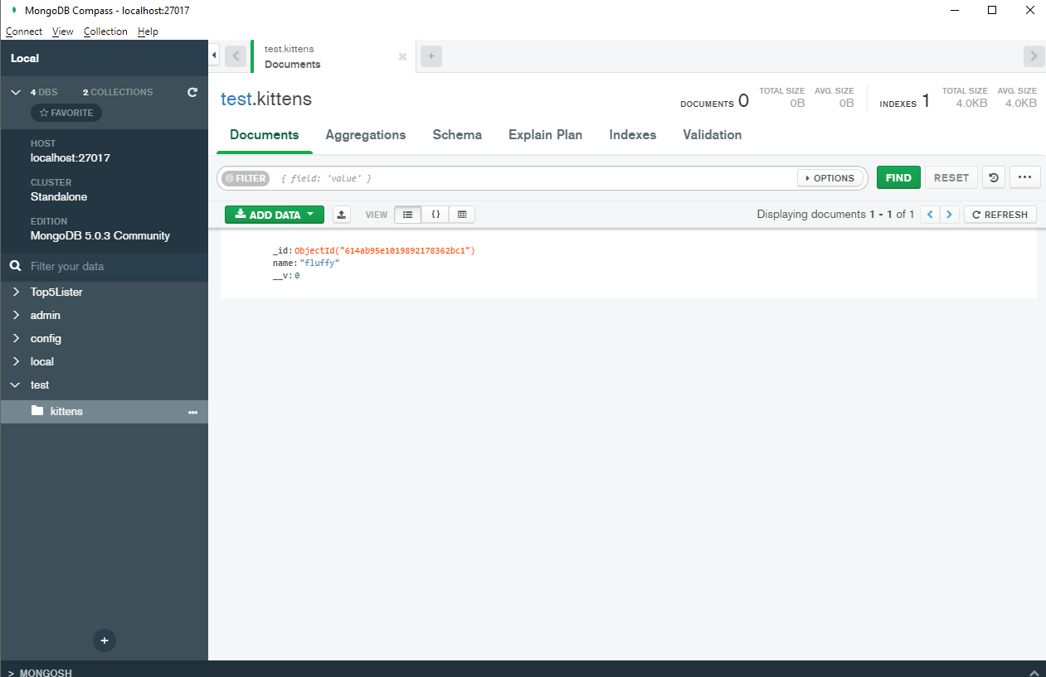
Working with a Database
Set it Up
install proper software
create proper account
Start It
make sure it’s listening
Connect to it
from various applications
Learn its monitoring tools
Ex: MongoDB Compass

Slide 33
What’s Next?
MongoDB
install it
set it up
Collections, Documents, and Fields
CRUD
Making a Back-End API
map JavaScript objects to MongoDB Schemas
add a means to query/mutate our database (GraphQL)
add a back-end server (Express)
connect Front-end code to our back-end API (Apollo)

