Slide 1
CSE 316 Fundamentals of Software Development
Introduction

Slide 2
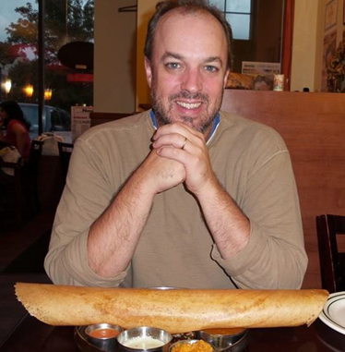
Who am i?
Richard McKenna
richard@cs.stonybrook.edu
New CS 216
Tu 1pm – 3pm
Th 1pm – 3pm
http://www.cs.stonybrook.edu/~richard

Slide 3
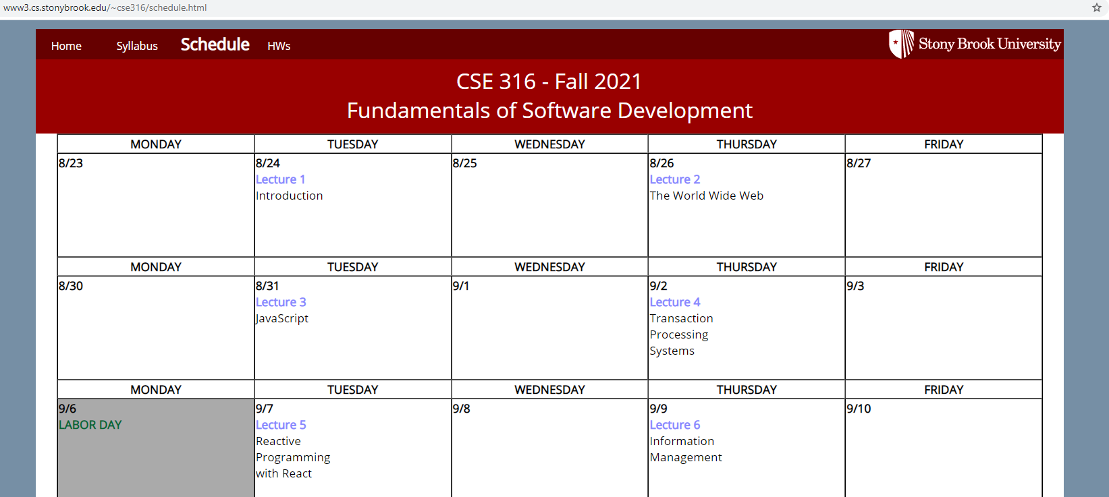
Course homepages
http://www.cs.stonybrook.edu/~cse316
syllabus
schedule (lecture slides, hw, etc …)
etc.
http://blackboard.stonybrook.edu
grades

Slide 4
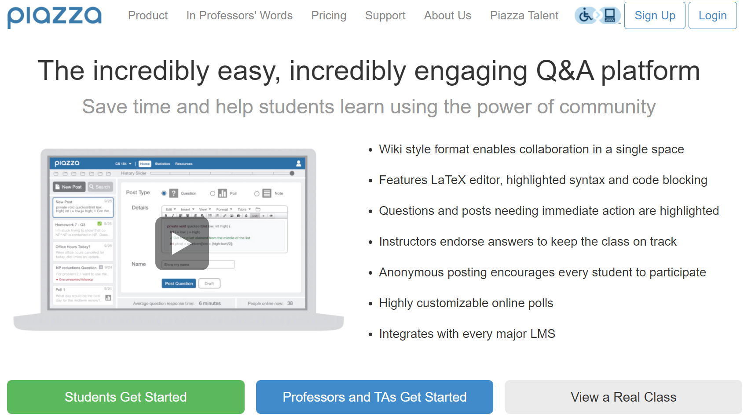
PIazza
Note, this semester I am teaching:
CSE 316 (~160 students)
CSE 381 (30 students, 15 projects)
CSE 416 (~80 students, 20 projects)
… and advising many Research Teams
VIP-BEAR, Vent, Wireframer, Animated Poseur, Wolfie2D, WolfieTools, Algorithms for Games, Audifly, etc.
… and advising 4 Student Organizations
SBCS, SBGD, Student Blood Drive Committee, ColorStack
… and I have lots of other CS Department duties
Undergrad Curriculum Committee, etc.

Slide 5
PIazza
I like to answer HW questions at the start of lecture
Why?
everyone (theoretically) is here
I only have to answer the question once
I am also happy to answer questions in office hours
1pm-3pm, Tu Th
Piazza is primarily for:
Teaching Assistants to answer questions
Students to answer each other’s questions
Do not post your code, of course
Note, you can email me of course, I try my best to keep my email inbox clear, but it can be a challenge
Also note, I cannot be a HW debugger and look through miles of code for all students. See one of our TAs first.

Slide 6

Textbook #1

Slide 7

Textbook #2
Head First Object Oriented Design and Analysis
(on-line version)
by Brett McLaughlin, Gary Pollice, David West
Published by O'Reilly Media, Inc. 2006
Print ISBN-10: 0-596-00867-8
Print ISBN-13: 978-0-596-00867-3

Slide 8

Textbook #3
Head First Design Patterns
(on-line version)
by Eric T Freeman, Elisabeth Robson, Bert Bates, Kathy Sierra
Published by O'Reilly Media, Inc. 2004
Print ISBN-10: 0-596-00712-4
Print ISBN-13: 978-0-596-00712-6

Slide 9
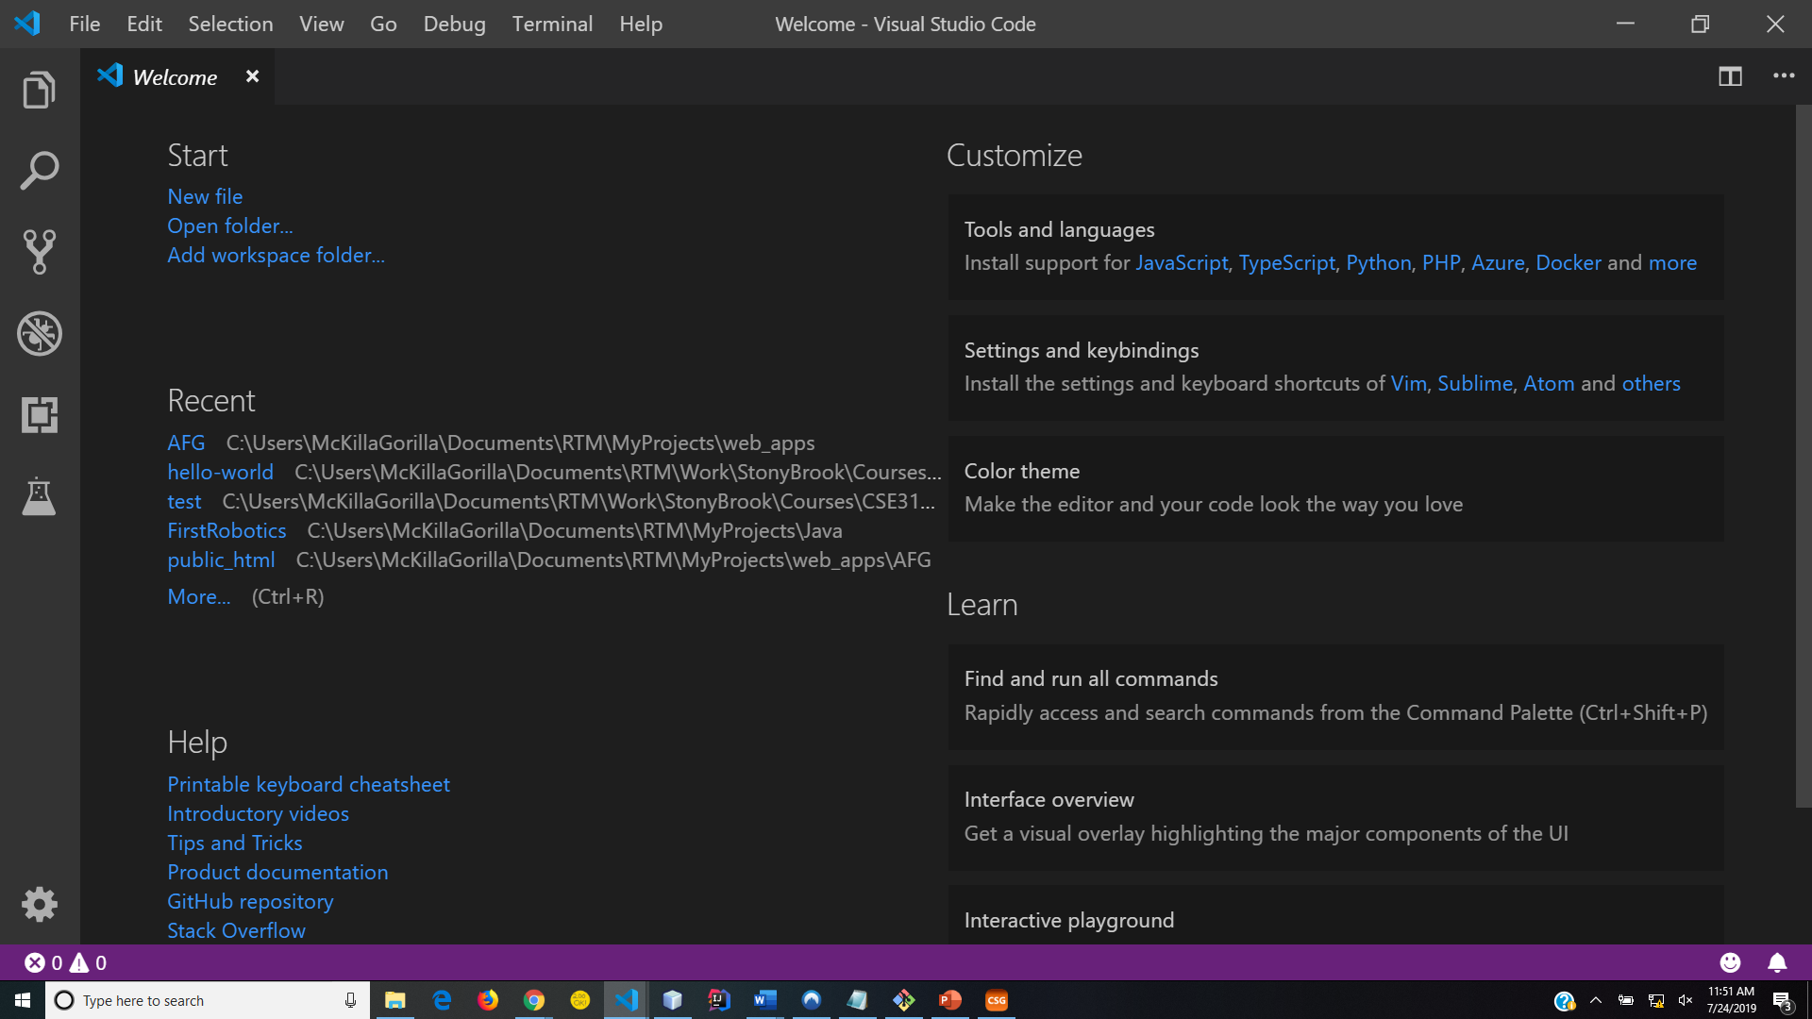
Course IDE: Visual Studio Code
https://code.visualstudio.com/

Slide 10

Course Server: Web server for Chrome

Slide 11

Course Version Control: GitHub

Slide 12

Course language: JavaScript

Slide 13

Course platform: Node

Slide 14
How are grades computed?
3 Homework Assignments 30 %
Final Project (3 stages) 25 %
Midterm 15 %
Final 30%
100 %
Note CEAS Policy: The Pass/No Credit (P/NC) option is not available for this course.

Slide 15
Academic dishonesty
All work you submit for homework, projects, or exams MUST be your own work.
PLEASE UNDERSTAND THESE RULES

Slide 16
Course description
Introduction to systematic design, development and testing of software systems, including event-driven and Web programming, information management, principles and practices for secure computing, software design and development fundamentals, and the application of these skills to the construction of large, robust programs. Students design and implement a secure, full-stack, distributed web application.
NOTE: You must have taken CSE 216 and received a grade of "C" or better in order to take this course. CS Major

Slide 17
Course topics
Event-driven programming, including the use of front-end Web frameworks
Information management, including database CRUD operations and transactions
Software design principles, techniques and patterns
Continuous integration / continuous development
Fundamentals of secure, distributed computing

Slide 18
SO WHAT IS THIS COURSE REALLY ABOUT?
Web Technologies
Professional Development Tools
Plan, then do (design, then code)
Student to Pro
Get you ready for 416 (making a great Web app)
No more toys

Slide 19
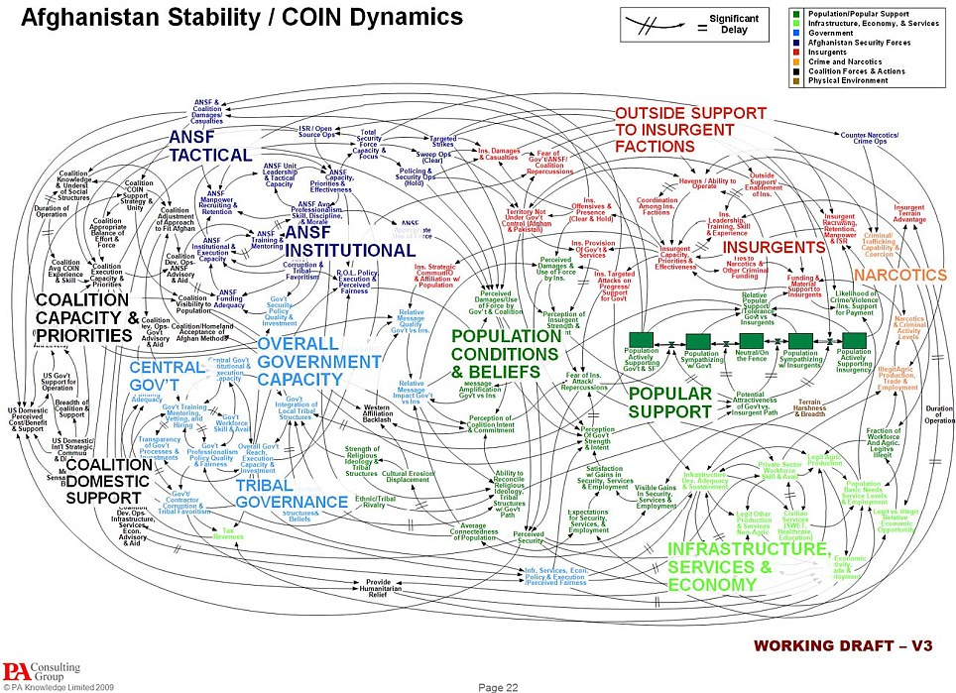
complexity
"When we understand that slide, we'll have won the war."
-General Stanley McChrystal

Slide 20


klocs
As programs get larger, these goals become much more difficult to achieve. Why?
program complexity
team complexity
Notes:
Ref: http://i.dailymail.co.uk/i/pix/2010/04/28/article-0-09562375000005DC-283_964x699.jpg

Slide 21
And what else?
Learn methodologies for building high quality software systems
What properties make a software system high quality?
correctness
efficiency
ease of use
reliability/robustness
maintainability
modifiability
extensibility
scalability

Slide 22
How can these properties be achieved?
By using well proven, established processes preferably while taking advantage of good tools
Requirements Analysis
Design & Document
Evaluate Design
Code
Test
Deploy
Profile
Debug

Slide 23
Other steps to consider
Integration
Maintenance

Slide 24
integration
Done in large projects
Combine developed software into a cohesive unit
A
B
C
D
E
ABCDE

Slide 25

Software maintenance
Follows Deployment
Monitoring and Updating deployed software
Notes:
Ref: http://img.timeinc.net/time/daily/2009/0903/3mile_island_0326.jpg

Slide 26
Software jobs
Not all of you are going to be programmers
but you should know how to design, program, test, debug software
Other types of jobs:
Designer
Tester
Database, Network, Security Administrator
Project Leader
Manager
Founder/CEO
Professor
etc …
NOTE: designers & programmers on a project may not be the same people

Slide 27
Design, then code
In our final project we will design before coding
not easy to do
UML can be used for software design
You cannot design a system unless you really understand the necessary technology
designs cannot be created without a little testing
trying out different small-scale examples (HWs 1, 2, & 3)

Slide 28
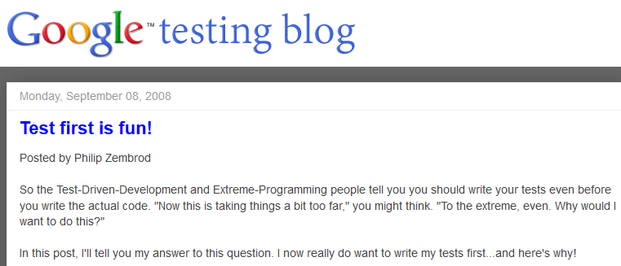


Updated software development lifecycle
Waterfall Model
many variations
Requirements Analysis
Design
Evaluate Design
Code
Test, Debug, & Profile Components
Integrate
Test, Debug, & Profile Whole
Deploy
Maintain

Slide 29
The HW Plan
HW 1 – Vanilla JavaScript and Local Storage
HW 2 – React, AJAX, and a Relational DBMS
HW 3 – MERN
HW 4 – Project Mockups and UML Design
HW 5 – Project Implementation Stage #1
Final Project – Completed Work

Slide 30
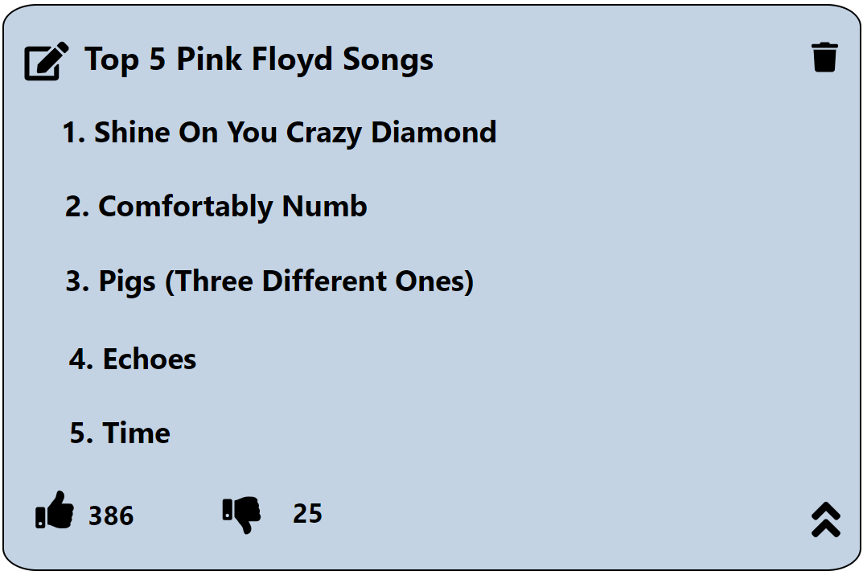
Your project? T5L - The Top 5 Lister!

