Slide 1
Cse 316
JavaScript

Slide 2
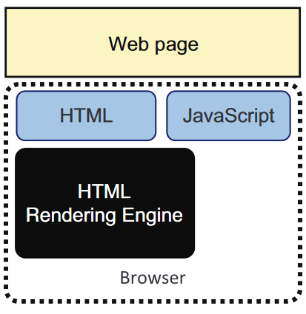
JavaScript is a W3C Standard
Web standard for front-end
A scripting language
  not compiled
  not strongly typed
  stored or generated as plaintext

Slide 3
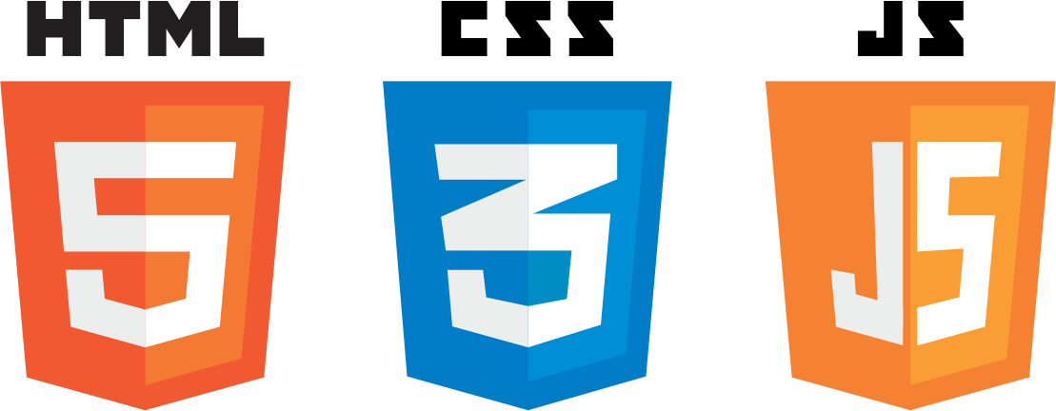
What is JavaScript used for in Web apps?
Multimedia
  rendering to a canvas (2d vs. WebGL)
  playing audio (WebMIDI)
  synthesizing audio (WebAudio)
Responding to user input
Updating the DOM
Loading content
Communicating with servers
  via Web sockets
  via AJAX
  retrieve things from databases
Back End?
  Node.js

Slide 4



THE Scripting Language of the Web
World's most popular programming language?
  Netscape vs. Microsoft
Browser
Web Server
Editor

Slide 5
Web page requests
Browser App
http request
http request
Web Server
Internet
http response
.html
.css
.js
.png
…
http response
.html
.css
.js
.png
…
What does the browser do with the response?

Slide 6
HTML files reference JS
<!DOCTYPE html>
<html>
<head>
<script src="myScript.js"></script>
</head>
<body>
// WE CAN NOW HAVE OUR myScript.js
// CODE BUILD THE CONTENT HERE
</body>
</html>

Slide 7
What if you have many JS files?
Referencing all of them would be awful
Solution? Use modules.
HTML file can reference the entry file, each JS file exports types to make them available in other JS files, then each JS file imports the types they wish to use

Slide 8
HTML file referencing
JS module
<!DOCTYPE html>
<html>
<head>
<script type="module" src="Foo.js"></script>
</head>
<body></body>
</html>

Slide 9
Foo might use other types
import Dummy from "./lib/Dummy.js";
export default class Foo {
constructor() {
this.d = new Dummy();
}
}

Slide 10
Foo might use other types
export default class Dummy {
constructor() {
this.num = 5;
}
}

Slide 11
Functions can be placed in head
(but should be in .js files)
<head>
<script>
function myFunction() {
document.getElementById("demo")
.innerHTML="My First JavaScript Function";
}
</script>
</head>

Slide 12
Web page loading
<script>
document.onload = function() {
buildPage("Home", ".");
}
</script>
Take a look at our homepage, can you figure out the order with which things load?
Browser loads files in order
Top to bottom
External files may load before all html
Global JS code may execute before all html is loaded if you’re not careful
Global variables are added to the window domain
  let myGlobalVariable;
  …
  window.myGlobalVariable = …

Slide 13
Global JavaScript
When a file is referenced, it’s global code is executed
It’s global types are made available. Ex:
class Dummy {
constructor() { this.num = 5; }
}
let d = new Dummy();
Be careful of dependencies!

Slide 14
JavaScript Basics
  statements end with ;
  Is CASE sensitive
  Ignores extra spaces
  \ breaks a string declaration into 2 lines
    "Hello \
    World "
  // Single Line Comments
  /* Multi-Line
  Comments */

Slide 15
JavaScript Variables
You can use var or let, but use let
  let enforces rules regarding scope
let x;
let y = 5;
let pi=3.14;
let person="John Doe";
x = y * 10;
Use determines data type
var x;
var y = 5;
var pi=3.14;
var person="John Doe";
x = y * 10;

Slide 16
Dynamic Data Types
Are all actually objects
String, Number, Boolean, Array, Object, Null, Undefined.
let x; // Now x is undefined
let x = 5; // Now x is a Number
let x = "John"; // Now x is a String

Slide 17
JavaScript Strings
Use single or double quotes:
let carname="Volvo XC60";
let carname='Volvo XC60';
Quotes inside quotes:
let answer="It's alright";
let answer="He is called 'Johnny’”;
let answer='He is called "Johnny"';

Slide 18
Strings have pre-made methods
let text = "Hello";
let len = text.length;
console.log("The text variable has " + len + " characters\n");
let i = text.indexOf("e");
console.log("The letter 'e’ is at index " + i + "\n");

Slide 19
Operators
ARITHMETIC: +, -, *, /, %, ++, --
ASSIGNMENT: =, +=, -=, *=, /=, %=
STRING CONCATENATION: +
COMPARISON: ==, ===, !=, !==, >, <, >=, <=
LOGICAL: &&, ||, !
CONDITIONAL: ?

Slide 20
Conditional Statements
Mostly the same as Java
if ... else if ... else, & switch/case
if (time < 10) {
x="Good morning";
}
else if (time < 20) {
x="Good day";
}
else {
x="Good evening";
}

Slide 21
Iteration
Mostly the same as Java
for, while, do/while
for/in loops through object properties
let x;
let txt="";
let person={fname:"John",lname:"Doe",age:25};
for (x in person) {
txt = txt + person[x];
}

Slide 22
Exception Handling
throw, try, & catch
try {
alert("Welcome guest!");
}
catch(err) {
txt="There was an error on this page.\n\n";
alert(txt);
}

Slide 23
JavaScript Arrays
let cars = [];
cars[100] = "Saab";
cars[1] = "Volvo";
cars[2] = "BMW";
for (let i = 0; i < cars.length; i++) {
console.log(cars[i]);
}

Slide 24
JavaScript Build Arrays with Data
let cars = { "Saab", "Volvo", "BMW"};
for (let i = 0; i < 3; i++){
console.log(cars[i]);
}

Slide 25
JavaScript Arrays can have length
let cars = [];
cars.push("Saab");
cars.push("Volvo");
console.log("There are " + cars.length + " cars");
There are 2 cars

Slide 26
JavaScript’s Associative Arrays do not have length
let CAR_TYPES = {
SEDAN: "SEDAN",
SUV: "SUV"
};
let cars = new Array();
cars[CAR_TYPES.SEDAN] = "Saab";
cars[CAR_TYPES.SUV] = "Volvo";
console.log("There are " + cars.length + " cars");
console.log("The SUV is a " + cars[CAR_TYPES.SUV]);
There are 0 cars
The SUV is a Volvo

Slide 27
Keys and Values
Arrays store data as key,value pairs. Think Hash Tables
let cars = []; // MAKE THE ARRAY
cars['SUV'] = "Subaru";
cars['Sedan'] = "BMW";
// PRINT THE KEYS
let keys = Object.keys(cars);
print("keys: " + keys);
// PRINT THE VALUES
let values = Object.values(cars);
print("values: " + values);
keys: SUV,Sedan
values: Subaru,BMW

Slide 28
This works too
let car = {
"make": "Bugatti",
"model": "Veyron",
"year": 2017
};
let keys = Object.keys(car);
console.log(keys);
let values = Object.values(car);
console.log(values);
keys: make,model,year
values: Butatti,Veyron,2017

Slide 29
Important: JavaScript array manipulation
let arr = ["A", "B", "C", "D"];
In-place array manipulation:
  push/pop arr.push("E"); arr.pop();
  shift/unshift arr.shift(); arr.unshift("A");
  delete delete arr[0];
  splice arr.splice(2, 0, "X", "Y");
  arr(2, 2);
  let arr2 = ["E", "F"];
  New array construction:
  concat let arr3 = arr.concat(arr2);
  slice let arr3 = arr.slice(1);
  empty: arr = [];

Slide 30
The map function
Called on an array
  creates and returns a new array after executing a callback function on each element in the array
    callback returns updated value
  Does not mutate original array
let array = [6, 7, 4, 5];
let array2 = array.map((val)=>{
return val*val;
}) ;

Slide 31
The filter function
Called on an array
  creates and returns a new array only containing the elements that pass the callback test
    callback returns boolean
  Does not mutate original array
let array = [6, 7, 4, 5];
let array2 = array.filter((val)=>{
return ((val%2) == 0);
}) ;

Slide 32
There are many more Array methods
concat, copyWithin, entries, every, fill, filter, find, findIndex, flat, flatMap, forEach, from, get, includes, indexOf, isArray, join, keys, lastIndexOf, map, observe, of, pop, push, reduce, reduceRight, reverse, shift, slice, some, sort, splice, toLocaleString, toSource, toString, unobserve, unshift, values
Note arrays can be sequential or associative
  or just use a JavaScript type Map
let myMap = new Map();
myMap.set("username", "Joe");
let username = myMap.get("username");

Slide 33
1st way to define an object: Anonymous JavaScript Objects
Declaring:
let person = {
first : "John",
last : "Doe",
id : 5566
};
Accessing:
let name = person.last; // OR
let name2 = person["last"];
Assigning:
car.last = "Shmo"; // OR
car["last"] = "Shmo";
What type is the person object variable?

Slide 34
Undefined vs. null
let person;
let car="Volvo";
console.log(person);
console.log(car);
let car=null;
console.log(car);
undefined
Volvo
null

Slide 35
2nd way to define an object, ex: function
function Point( initX, initY ){
this.x = initX;
this.y = initY;
this.update = function(inc) {
this.x += inc;
this.y += inc;
}
}
AND THEN USE:
let p = new Point( 0, 0);
p.update(5);

Slide 36
3rd way:
JavaScript classes
class Point {
constructor( initX, initY ){
this.x = initX;
this.y = initY;
}
update(inc) {
this.x += inc;
this.y += inc;
}
}
AND THEN USE:
let p = new Point( 0, 0);
p.update(5);

Slide 37
Dynamic types
One can add variables and methods to an object
let p = new Point( 1, 2);
p.z = 3;
p.reset = function() {
this.x = 0; this.y = 0; this.z = 0;
}
let methodName = "reset";
p[methodName]();
console.log("z is " + p.z);
z is 0

Slide 38
What is an object’s prototype?
The blueprint from which it was made
All objects have a prototype property
  assigned at creation
The prototype is where the implementation of functions is pulled from

Slide 39
Playing with prototypes
function Point(x, y) {
this.x = x;
this.y = y;
}
let p = new Point(5, 6);
let pProto = Object.getPrototypeOf(p);
pProto.foo = function() {
console.log("y: " + this.y);
}
let q = new Point(7, 8);
q.foo();
p.foo();
y: 8
y: 6

Slide 40
So functions can be added to a type or just one object
function Point(x, y) {
this.x = x;
this.y = y;
}
let p = new Point(5, 6);
let q = new Point(7, 8);
q.foo = function() {
console.log("y: " + this.y);
}
q.foo();
p.foo();
y: 8
js: uncaught JavaScript runtime exception: TypeError: Cannot find function foo in object

Slide 41
DOM Manipulation
Create new nodes (i.e. HTML elements)
Retrieve nodes
Update nodes
Delete nodes
Why?
  dynamically add things to a list, update text, change attributes, remove page elements, change style, etc.

Slide 42
Getting Nodes
document.getElementById(id)
  id is a DOM node
  now we can add child nodes, update it, etc
  what about deleting it? Need the parent node
  note, other methods could get all events of a particular class
<p id="my_paragraph"></p>
…
let myParagraph =
document.getElementById("my_paragraph");
…

Slide 43
Updating the DOM
<p id="my_paragraph"></p>
…
let myParagraph =
document.getElementById("my_paragraph");
myParagraph.innerHTML =
"This will end up as text in the paragraph "
+ "<strong>and</strong> can have "
+ "html embedded inside.";

Slide 44
Make new nodes
<div>Hello, World</div>
<body>
<div id="root"></div>
</body>
let div = document.createElement("div");
div.setAttribute("id", "my-container");
let parent = document.getElementById("root");
parent.appendChild(div);
div.appendChild(document.createTextElement("Hello, World"));

Slide 45
Many DOM manipulation properties and methods
JavaScript HTMLElement type
  https://www.w3schools.com/jsref/dom_obj_all.asp
  https://developer.mozilla.org/en-US/docs/Web/API/HTMLElement
Properties:
  draggable, style, etc.
Methods:
  appendChild, addEventListener, attributes, childNodes, children, classList, parentNode, remove, removeChild, etc.

Slide 46
Callbacks
One can pass a function to a method
let sayHello = function(name){
console.log("Hello " + name);
}
let sayHelloToJoe = function(callback) {
let name = "Joe";
callback(name);
}
sayHelloToJoe(sayHello);

Slide 47
JavaScript event handling
Call functions to respond
Ex: Button click
<body>
<h1>My Web Page</h1>
<p id="demo">A Paragraph</p>
<button type="button" onclick="myFunction">
Submit</button>
</body>

Slide 48
Asynchronous File Loading – Which will print first?
function foo(jsonFilePath) {
$.getJSON(jsonFilePath, function (json) {
let div = document.getElementById("my_div");
let text = json.author + " ("
+ json.version + ")";
console.log(text);
});
console.log("A\n");
}
Who knows?

Slide 49
Asynchronous Image Loading
let myImage = new Image();
myImage.onload = function() {
// NOW WE CAN USE THE IMAGE
console.log("C");
};
console.log("A");
myImage.src = "./images/MyLogo.png";
console.log("B");

Slide 50
JavaScript Event Handling
Define a callback method
Register it with the appropriate control for the appropriate interaction
Note, inside the callback “this” might not be what you think it is

Slide 51
Event Handling Example
Declare control in HTML file:
  <div id="list_heading">@todo</div>
  Define callback in JavaScript:
  class TodoListController {
  …
  processGoHome() {
  window.todo.model.goHome();
}
}
  At startup, after HTML file is loaded, make and register listeners:
  let controller = new TodoListController();
  let control = document.getElementById("list_heading");
  control.addEventListener("click", controller.processGoHome);

Slide 52
What events can we respond to?
onclick
onload
onunload
onchange
onmouseover
onmouseout
onmousedown
onmouseup
etc.

Slide 53
What about events for dynamically built objects?
We have to dynamically add event handlers
let dummyDiv = document.createElement("div");
dummyDiv.innerHTML = "Ok";
dummyDiv.setAttribute("class", "dummy_div");
dummyDiv.setAttribute("onclick", callback); // CALL A callback METHOD
// OR WE COULD USE
dummyDiv.onclick = () => {
// OR THIS WOULD BE THE EVENT HANDLER
}

Slide 54
Lots and lots of other stuff
Asynchronous programming
  Promise
  then
  Await
  Etc.
APIs
  Math, Random, Date, etc.
3rd Party APIs
  jQuery and millions more

Slide 55
Next Up?
Transaction Processing Systems
Reactive Programming
Web App State Management

