Slide 1
Cse 316
Reactive
Programming

Slide 2
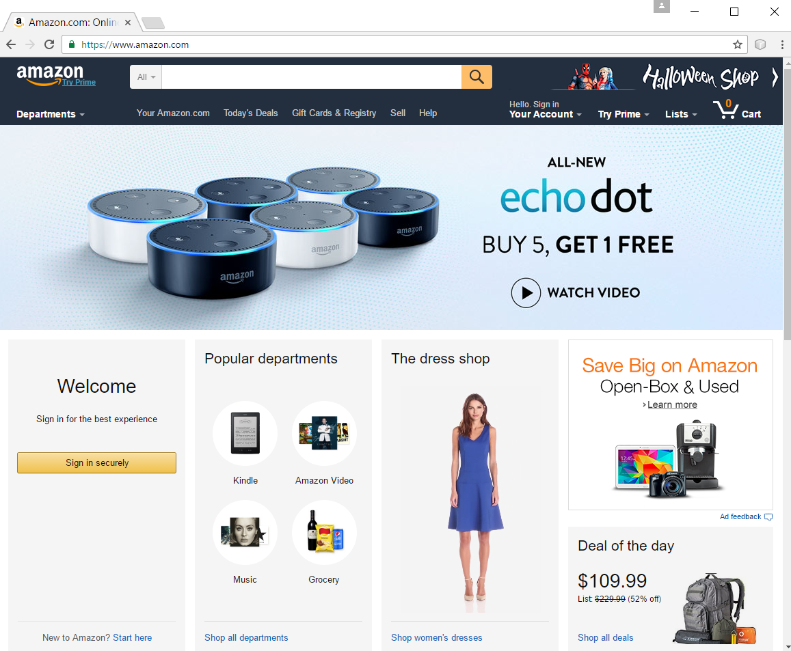
Web Apps Are Complicated
The good: Web standards
URL, HTTP, HTML5, CSS3, JavaScript, JSON, etc.
The bad: complexity
Platforms
Languages
Libraries

Slide 3
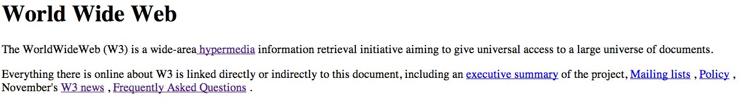
Web Architecture for Flat Files
Client on PC/Mobile using Browser
Requests URL
Host translated to IP by DNS
Browser sends http request to Web Server
Server is Waiting for requests
Server receives request
Server gets requested file and linked files and sends back as response

Slide 4
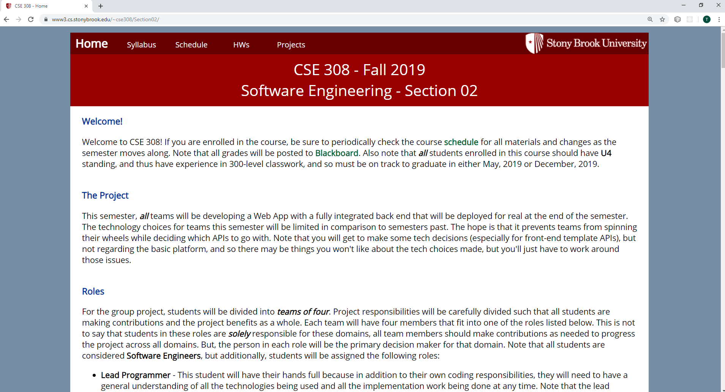
What else only needs a Web Server?
Front-End content
Images
Style sheets
JavaScript
JavaScript libraries

Slide 5
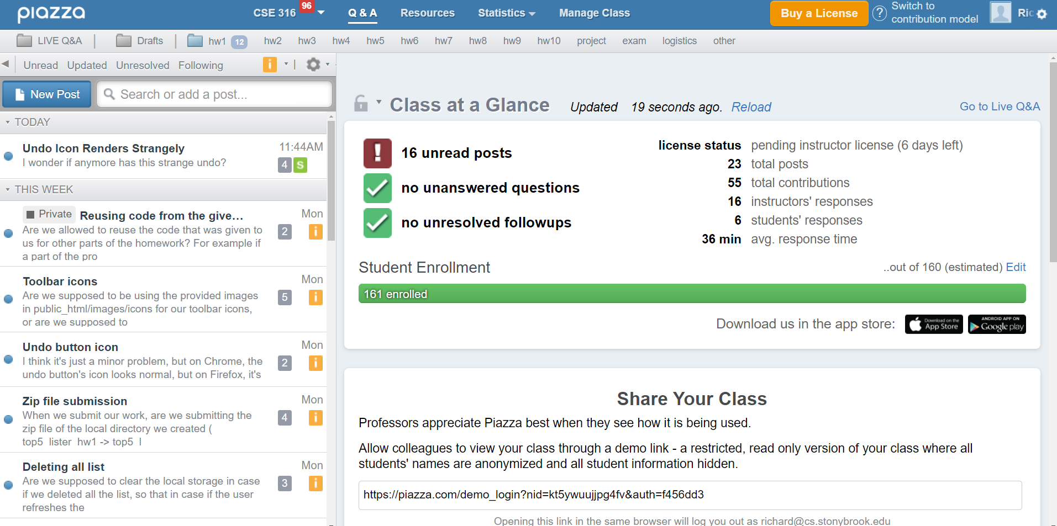
What can’t we do with only a Web Server?
CRUD
Create Data
Retrieve Data
(Created Data)
Update Data
Delete Data
i.e. permanently
(note CRUD operations are not necessarily reactive)

Slide 6
CRUD Needs More
Browser App
http request
http request
Web Server
Internet
http response
.html
.css
.js
.json
.png
…
http response
.html
.css
.js
.json
.png
…
Back-End
Server
What does the browser do with the response?
database

Slide 7



There are many technologies for Back-End Servers
JavaEE Application Servers (Servlets, Java Server Pages, etc.)
Python server using Flask
Node server running ExpressJS

Slide 8



So what’s front-end?
HTML5/CSS3
JavaScript
JavaScript/Node Libraries
React, Angular, Vue, etc.
JavaEE Templating Libraries
JSP
JSF

Slide 9
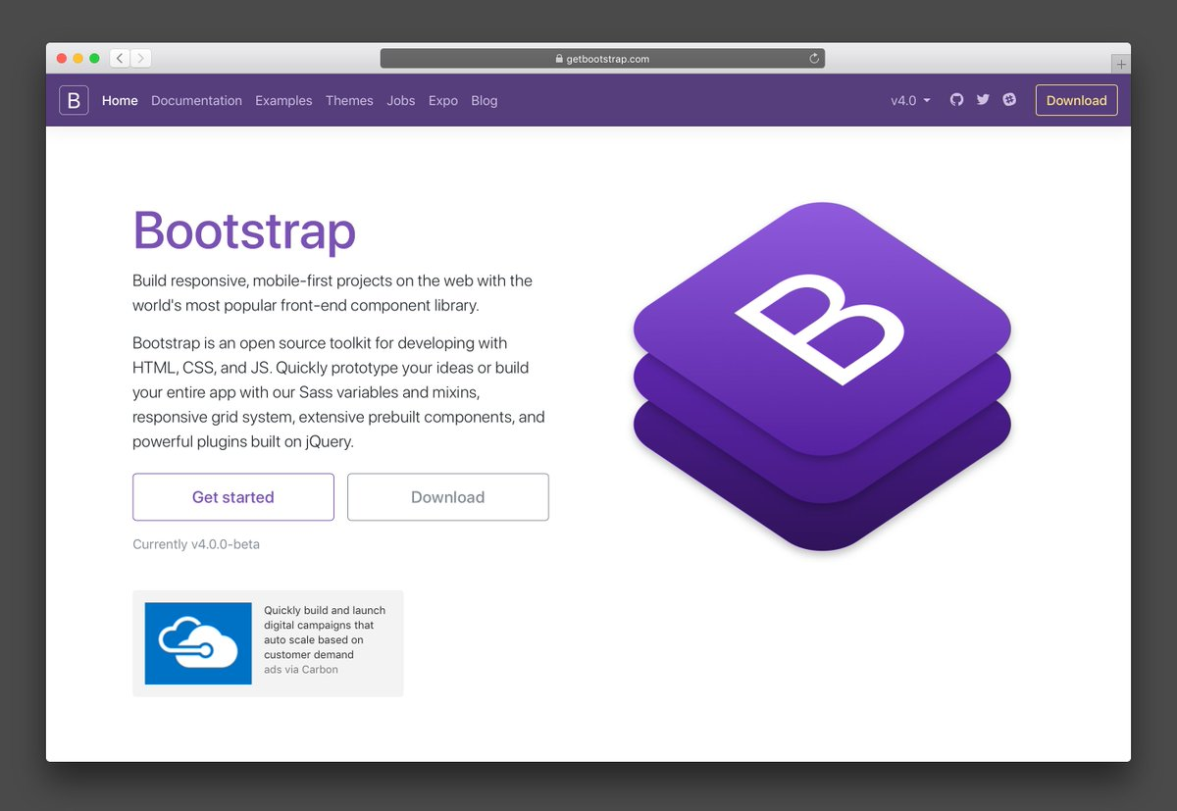
CSS/JS Libraries
Things where the server is not needed
Attach style via pre-made components
Interactivity
card lists
scrolling
Materialize, Bootstrap, etc.

Slide 10

Design Decisions
Logo/Branding
Color Scheme
Layout Scheme
Font Selection
Design Philosophy
A good API can help with all of this

Slide 11

Visually Pleasing Composition
Balance
Symmetry
Regularity
Predictability
Sequentiality
Economy
Unity
Proportion
Simplicity
Groupings

Slide 12

Material Design

Slide 13




Server-Side Templating Libraries
JSP/JSTL
JSF
Angular
React
Vue
Thymeleaf

Slide 14


Why are JSP/JSF/Angular/React front end?
Produce JavaScript
JavaEE Server:
Receives request
Processes JSP/JSF and generates appropriate JavaScript
Why?
browsers have no idea what JSP & JSF are

Slide 15

So what are front-end templating libraries about?
Asynchronous interfacing with back-end code
In response to user interactions
In response to timed events
AJAX vs. Web Sockets
Rendering
Interactivity
Widgits

Slide 16
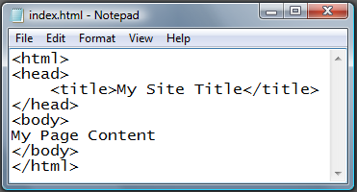
HTML

Slide 17
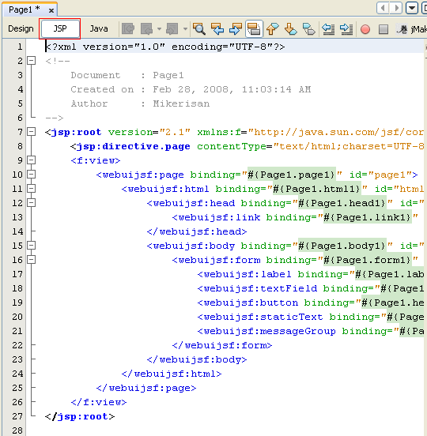
JSP Templating

Slide 18
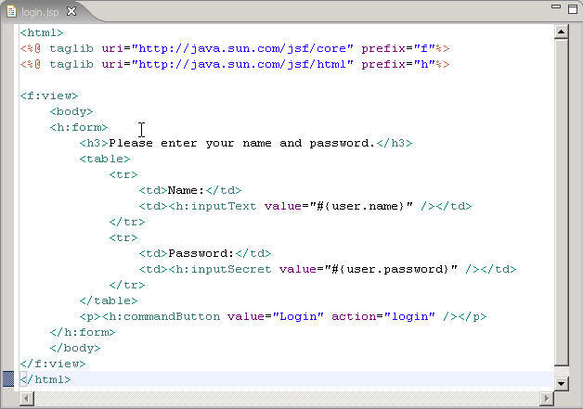
JSF Templating

Slide 19
Angular Templating
<div ng-app="myApp" ng-controller="customersCtrl">
<table>
<tr ng-repeat="x in names">
<td>{{ x.Name }}</td>
<td>{{ x.Country }}</td>
</tr>
</table>
</div>
<script>
var app = angular.module('myApp', []);
app.controller('customersCtrl', function($scope, $http) {
$http.get("http://www.w3schools.com/angular/ex_mysql.php") .then(function (response) {
$scope.names = response.data.records;}); }); </script>

Slide 20
React
Templating library created by Facebook
Runs on Node
Multiple programming styles
Today:
using class-based components (and props)
Next time:
functional components (Hooks)
state management (Context)

Slide 21
React runs on Node
To make it available, start a Node server
From project home directory:
npm start
OR
yarn start
Starts Web server and Node server

Slide 22
React Templating uses JSX
import React from "react";
import PropTypes from "prop-types";
import "./Button.css";
export default class Button extends React.Component {
…
return (
<div className={className.join(" ").trim()}>
<button onClick={this.handleClick}>{this.props.name}</button>
</div>
);
}
}

Slide 23
A few pre-technologies
ECMAScript 2015+ (i.e. ES6+)
Babel
converts ES6 into a backwards compatible version of JavaScript for older browsers
JSX (i.e. JavaScript XML)
JavaScript language extension
Looks like HTML
class App extends React.Component {
render() {
return (
<div>
<p>{}</p>
<p>Content</p>
<p>Footer</p>
</div>
);
}
}

Slide 24
Our Node buildchain
Package manager
For easily installing/updating 3rd party software
yarn or npm
Bundler
bundles code to optimize load time
webpack, Parcel
Compiler/Transpiler
make backwards compatible code
Babel
Note: .gitignore node_modules and don’t submit to blackboard

Slide 25
Why use React?
Because this is some ugliness:
buildRecentWorkLink(workName) {
let newA = document.createElement(AppsterHTML.A);
newA.setAttribute(AppsterHTML.CLASS,
AppGUIClass.HOME_RECENT_WORK_LINK);
newA.setAttribute('href', '#');
newA.innerHTML = workName;
let br = document.createElement(AppsterHTML.BR);
newA.appendChild(br);
let callbackArguments = [recentWorkName];
this.setupCallback(newA, AppsterHTML.ONCLICK,
AppsterCallback.PROCESS_EDIT_WORK, callbackArguments);
return newA;
}

Slide 26
React.Component
You must override render
return JSX element
class MyComponent extends React.Component {
render() {
return <div className="my_header">
Hello, World
</div>
}
}

Slide 27
React Usage
Encourages top-down construction
Each component maintains a state object
Any change should go through setState
setState forces a call to render for that component (and any children)
What do you provide to setState?
an entirely new state object
Ex: to insert one element into a state array, create a whole brand new array

Slide 28
Important: JavaScript array manipulation
let arr = ["A", "B", "C", "D"];
In-place array manipulation:
push/pop arr.push("E"); arr.pop();
shift/unshift arr.shift(); arr.unshift("A");
delete delete arr[0];
splice arr.splice(2, 0, "X", "Y");
arr(2, 2);
let arr2 = ["E", "F"];
New array construction:
concat let arr3 = arr.concat(arr2);
slice let arr3 = arr.slice(1);
empty: arr = [];

Slide 29
The map function
Called on an array
creates and returns a new array after executing a callback function on each element in the array
callback returns updated value
Does not mutate original array
let array = [6, 7, 4, 5];
let array2 = array.map((val)=>{
return val*val;
}) ;

Slide 30
The filter function
Called on an array
creates and returns a new array only containing the elements that pass the callback test
callback returns boolean
Does not mutate original array
let array = [6, 7, 4, 5];
let array2 = array.filter((val)=>{
return ((val%2) == 0);
}) ;

Slide 31
So what is React?
‘A declarative, efficient, and flexible JavaScript library for building user interfaces. It lets you compose complex UIs from small and isolated pieces of code called “components”.’
API:
https://reactjs.org/docs/react-api.html
Made by Facebook

Slide 32
Component Hierarchy
React Components are composed of other Components
i.e. one Component’s render requires another Component
Components may pass things to their child components:
data
callbacks
both done via props

Slide 33
First things first
React apps run on Node.js
application you must install
The Node Package Manager (npm) helps us manage modules
modules? Libraries we’ll use
put in node_modules – never submit this (5 point deduction)
To create a React app, use Create React App (CRA)

Slide 34
Make sure you’re using the proper versions
npm uninstall -g create-react-app
didn't work for me, I still had it installed,
check using:
“where create-react-app” on Windows
“which create-react-app” on Mac
yarn global remove create-react-app
worked for me
To create React app:
npx create-react-app
To start React app:
npm start OR yarn start

Slide 35
index.js
Entry point for our application
imports necessary things like JSON and CSS files
sets up root node (typically App from App.js)
import React from 'react';
import ReactDOM from 'react-dom';
import './css/todo_layout.css';
import './css/todo_style.css';
import App from './App’;
ReactDOM.render(<App />, document.getElementById('root'));

Slide 36
App would be the root React.Component
class App extends React.Component
Define state for App in constructor
should contain all data needed by it and what needs to be passed down to descendent components
Override render method
return JSX elements
pass parameters to lower-order components
gets called when setState is called

Slide 37
Component Example: ShoppingList
class ShoppingList extends React.Component {
render() {
return (
<div className="shopping-list">
<h1>Shopping List for {this.props.name}</h1>
<ul>
<li>Instagram</li>
<li>WhatsApp</li>
<li>Oculus</li>
</ul>
</div>
);
}
}
// Example usage: <ShoppingList name="Mark" />
Equivalent to:
return React.createElement('div', {className: 'shopping-list'},
React.createElement('h1', /* ... h1 children ... */),
React.createElement('ul', /* ... ul children ... */)
);

Slide 38
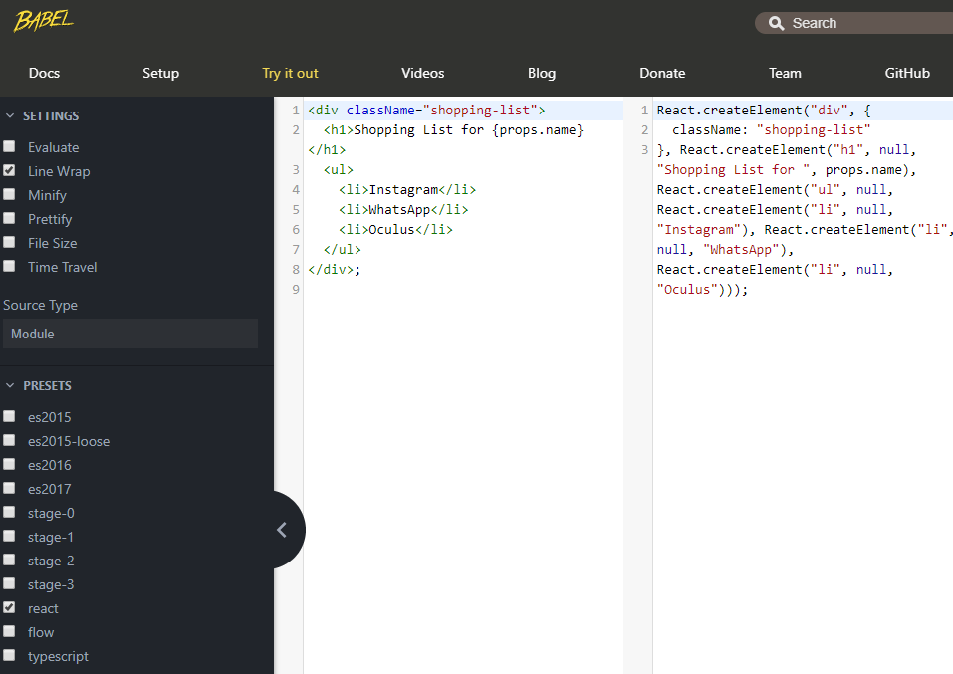

Slide 39
React has its own Virtual DOM
You may not manipulate the DOM directly
React Component are mounted to the virtual DOM
When a component is mounted:
its descendant components are also mounted
they can be rendered repeatedly without remounting
you can be informed of these events via Lifecycle methods

Slide 40
React.Component Lifecycle methods
componentWillMount executed before rendering, on both the server and the client side
componentDidMount executed after the first render only on the client side. This is where AJAX requests and DOM or state updates should occur. This method is also used for integration with other JavaScript frameworks and any functions with delayed execution such as setTimeout or setInterval. We are using it to update the state so we can trigger the other lifecycle methods.
componentWillReceiveProps is invoked as soon as the props are updated before another render is called. We triggered it from setNewNumber when we updated the state.
shouldComponentUpdate should return true or false value. This will determine if the component will be updated or not. This is set to true by default. If you are sure that the component doesn't need to render after state or props are updated, you can return false value.
componentWillUpdate is called just before rendering.
componentDidUpdate is called just after rendering.
componentWillUnmount is called after the component is unmounted from the dom.

Slide 41
export default class Dummy extends React.Component {
componentDidMount() {
console.log('Component WILL MOUNT!')
}
componentDidUnmount() {
console.log('Component WILL UNMOUNT!')
}
render() {
return (
<div><h3>{this.props.myNumber}</h3></div>
);
}
}

Slide 42
React Components
Are sent properties by their parents in parameters
props, i.e. properties
Let’s make an app with a names list:
class App extends React.Component {
constructor() {
this.state = {names: ["Joe", "Jim", "Bob"]};
}
render() {
return <NamesList names='this.state.names' />
}
}

Slide 43
class NamesList extends React.Component {
render() {
return <ul>
{this.props.names.map(function(name, index) {
return <li key={ index }>{name}</li>;
})}
</ul>;
}
}

Slide 44
We can pass callback functions too
Can be done top-down
i.e. parent components to child
Why?
so child components can invoke callbacks that can change app state

Slide 45
class App extends React.Component {
constructor(props) {
super(props);
this.state = { names: ["Joe", "Jim", "Bob"] };
}
addNum = (num) => {
let newNames = this.state.names.map((name) => {
return name + num;
});
this.setState({ names: newNames });
}
render() {
return <NamesList names={this.state.names}
addNumCallback={this.addNum} />
}
}
export default class NamesList extends React.Component {
constructor(props) {
super(props);
this.state = { number: 0 }
}
handleClick = () => {
this.setState({number: this.state.number+1})
this.props.addNumCallback(this.state.number);
}
render() {
return (
<ul>{this.props.names.map((name, index) => {
return <li key={index}
onClick={this.handleClick}>{name}</li>;
})
}
</ul>);
}
}

Slide 46
More things to worry about
State Management
Information Management
Data Flow

