Slide 1
Cse 316
Reactive
State
Management

Slide 2
class App extends React.Component {
constructor(props) {
super(props);
this.state = { names: ["Joe", "Jim", "Bob"] };
}
addNum = (num) => {
let newNames = this.state.names.map((name) => {
return name + num;
});
this.setState({ names: newNames });
}
render() {
return <NamesList names={this.state.names}
addNumCallback={this.addNum} />
}
}
export default class NamesList extends React.Component {
constructor(props) {
super(props);
this.state = { number: 0 }
}
handleClick = () => {
this.setState({number: this.state.number+1})
this.props.addNumCallback(this.state.number);
}
render() {
return (
<ul>{this.props.names.map((name, index) => {
return <li key={index}
onClick={this.handleClick}>{name}</li>;
})
}
</ul>);
}
}

Slide 3
We have seen class-based React components
Some would say the old way of doing things
we’ll do this in HW 2
still valid
What’s wrong with it?
lots of repetitive code (class definitions, passing props, etc)
People want abbreviated code that does powerful things

Slide 4
Stateful apps are tricky
What’s the challenge?
how do all the components deal with the same “state”
Class-based way
store data state in App
pass down to components through props:
state data needed for display
callback functions needed to update state in App
this can get tedious and confusing
What about state for other components?
stores component state that doesn’t affect anything up the food chain

Slide 5
But we want to be smart
We want well-organized code
Mixing presentation and data management isn’t so good
Soon enough we’ll want to integrate:
back-end remote server
back-end database
together, the back-end API
We then have to be very careful managing state

Slide 6
So what’s the plan?
Today learn about:
the React Component lifecycle
functional Components
React Context
React Hooks
Then what?
Databases with MongoDB and Mongoose
Query languages with GraphQL
Back-end APIs with Express, AJAX, and Apollo

Slide 7
The React Component Lifecycle
What’s that?
Helps us understand what happens when and in what order
What’s the Virtual DOM?
React’s DOM
flowed to the real DOM by React
don’t mess with the real DOM in your code
i.e. no document.anything( ever

Slide 8
React.Component
Each component has:
state (do not modify directly, only via setState)
props (never modify at all)
Note that state changes flow to child components via props
props get passed via parent components
<Workspace
currentList={this.state.currentList}
loadListCallback={this.loadList} />

Slide 9
state with class-based components
// SETUP THE INITIAL STATE IN CONSTRUCTOR
this.state = {
myArray : [],
sessionData : {nextKey : 0, counter : 0}
}
…
// LATER, CHANGE STATE TO EFFECT RESULTS IN COMPONENTS
this.setState(prevState => ({
currentList : […prevState.myArray, newItem],
sessionData: { nextKey: prevState.nextKey+1, counter : prevState.counter + 1}
}), () => {
// AFTER EFFECTS WOULD GO HERE
}

Slide 10
setState(newState, callback) and render()
What happens when setState gets called?
note, this function updates the state asynchronously
consecutive setState calls get merged
The state is scheduled for update, but doesn’t happen immediately
Once the state update happens:
render gets called (can use the new state)
setState’s callback function gets called (at some point)
Don’t:
change state from render
have render dependent on a setState callback

Slide 11
render()
What happens inside this function?
Returns a single HTML element
which can have children, grandchildren, etc.
Each subcomponent:
is instantiated
is passed props
gets constructed
gets mounted in the virtual DOM
gets rendered (this propagates a similar cycle for its child components)
Note: components that were in the Virtual DOM but are no longer connected to the latest render cycle get unmounted

Slide 12
React Lifecycle
There might be some things you want to do interleaved between construction, mounting, and rendering of a component
Some like to think of it as:
mounting – birth of your component (via parent render)
update – changing of your component (i.e. setState)
unmounting – death of a component (via not included in parent re-render)
What things might we want to do?
talk to other programs, like a back-end

Slide 13
Lifecycle Mounting Methods
Mounting means putting components into the DOM
React has built-in methods that get called, in this order:
constructor() – again, as the result of a component rendered in a parent
getDerivedStateFromProps – optional, takes state, returns new state
render - required
componentDidMount – optional, for doing work with updated virtual DOM

Slide 14
Lifecycle Updating Methods
A component is updated whenever there is a change in the component’s state or props
React has built-in methods that get called, in this order:
getDerivedStateFromProps – optional
shouldComponentUpdate - optional
render – required
getSnapshotBeforeUpdate - optional
componentDidUpdate – optional

Slide 15
Lifecycle Unmounting Methods
A component is updated whenever there is a change in the component’s state or props
React has one method that get called:
componentWillUnmount – optional
Again, with all of these, you may override them to do work
Note, many of these functions are now not used much because of some new libraries, specifically, Context and Hooks

Slide 16
We have seen class-based components
Again, what’s wrong with them?
lots of repetitive noise:
export class Banner extends React.Component {
constructor(props) {
super(props);
this.state = { …
}
componentDidMount = () => {
…
}
render() {
return (
)
}
}

Slide 17
functional components
Get translated into similar code as class-based component
Look leaner:
function Banner(props) {
return <h1>THIS IS MY BANNER!</h1>;
}
Where’s the render function?
it’s still there

Slide 18
Other components can use functional components
Either class components:
class Workspace extends React.Component {
render() {
return (<div id=“workspace”>
<Banner text={this.props.heading} />
</div>)
}
}
Or functional components:
function Workspace(props) {
return <div id=“workspace”>
<Banner text={this.props.heading} />
</div>
}

Slide 19
functional components can access props
function UserInfo(props) {
return (
<div className="UserInfo">
<Avatar user={props.user} />
<div className="UserInfo-name">
{props.user.name}
</div>
</div> );
}
Note: props are read-only
Rule: all React Components must act like pure functions with respect to their props

Slide 20
Lifting state Up
Many times multiple components require the same data
Have that data managed in their common ancestor
In our Top 5 Lister app
currentList is in App
Why?
many of the components need it
App can flow currentList down through props as needed
App can send down callback functions to update its state
Sending down callbacks through multilple levels is a hassel

Slide 21
How to build a React application
Break the UI Into a Component Hierarchy
elements that get repeated (like list items) should be their own components
makes updating them and handling events easier
Build A Static Version in React
Identify the Minimal (but complete) Representation of UI State
Identify Where Your State Should Live
Add Inverse Data Flow
this is the tricky part
it’s also why there are new ways of doing things

Slide 22

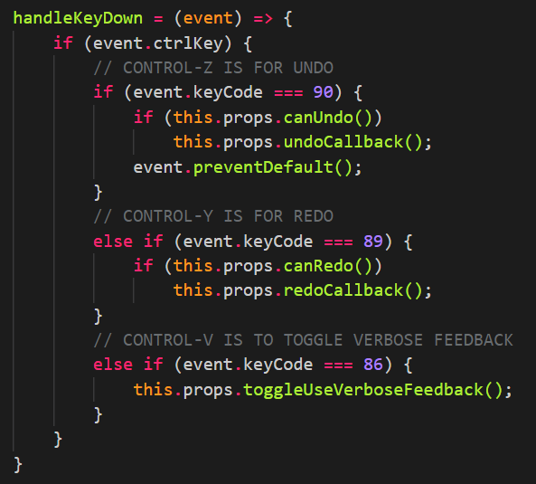
What’s tricky about using React?
Awkward state management
Passing props and callbacks down
Walking up component hierarchies to invoke callbacks
Rebuilding entire state objects for each little change

Slide 23
React Context
Provides a way to pass data through the component tree without having to pass props down manually at every level
Good for when “props” need to be used by multiple components
i.e. props have to be passed down through a chain of components for use
Think “global” sorts of data
Context is primarily used when some data needs to be accessible by many components at different nesting levels. Apply it sparingly because it makes component reuse more difficult.

Slide 24
So how does it work?
Make your own context:
const ThemeContext = React.createContext(‘light’);
This will pass a value down through the entire Workspace:
<ThemeContext.Provider value="dark">
<Workspace />
</ThemeContext.Provider>
This will retrieve it:
static contextType = ThemeContext;
And then we use it:
return <div theme={this.context}>Welcome!</div>

Slide 25
Props Passing Example
function Toolbar(props) {
return (
<div>
<ThemedButton theme={props.theme} />
</div>
);
}
class ThemedButton extends React.Component {
render() {
return <Button theme={this.props.theme} />;
}
}
class App extends React.Component {
render() {
return <Toolbar theme="dark" />;
}
}

Slide 26
Using Context Instead
function Toolbar() {
return (
<div>
<ThemedButton />
</div>
);
}
class ThemedButton extends React.Component {
static contextType = ThemeContext;
render() {
return <Button theme={this.context} />;
}
}
const ThemeContext = React.createContext('light');
class App extends React.Component {
render() {
return (
<ThemeContext.Provider value="dark">
<Toolbar />
</ThemeContext.Provider>
);
}
}

Slide 27
context is made available throughout
class MyClass extends React.Component {
componentDidMount() {
let value = this.context;
/* perform a side-effect at mount using the value of MyContext */
}
componentDidUpdate() {
let value = this.context;
/* ... */
}
componentWillUnmount() {
let value = this.context;
/* ... */
}
render() {
let value = this.context;
/* render something based on the value of MyContext */
}
}
MyClass.contextType = MyContext;

Slide 28
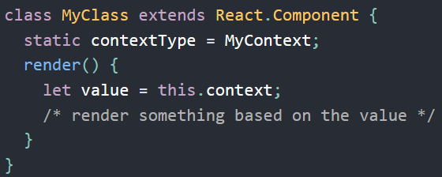
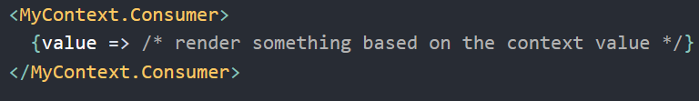
Class vs. Functional Consumers
When the Context value changes, the Provider notifies all Consumers

Slide 29
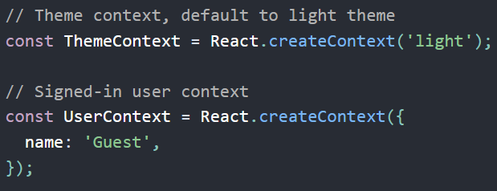
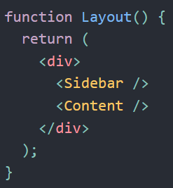
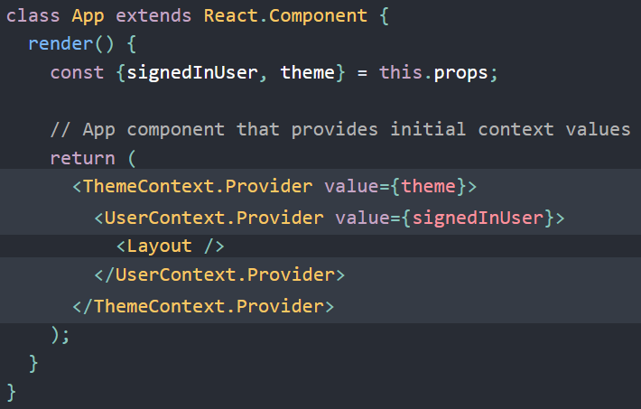
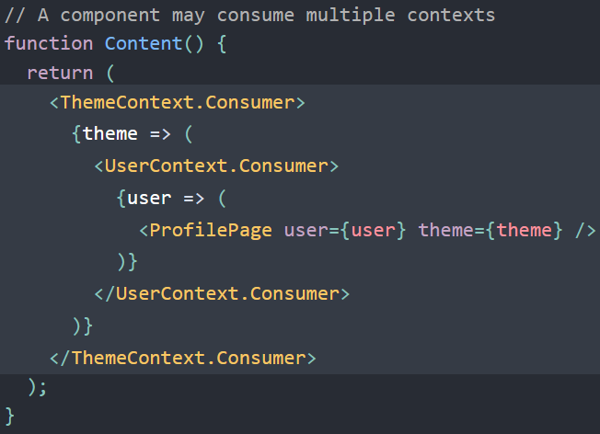
A component can consume multiple contexts

Slide 30
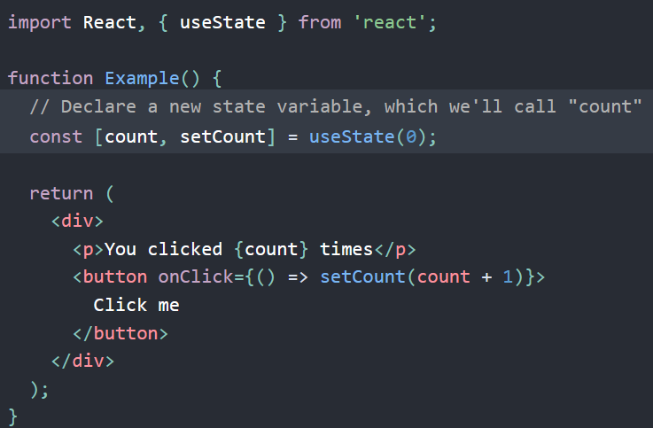
And then there’s Hooks
Use state without writing a class
Again, for functional components

Slide 31
So what is a “hook”?
A function
lets you “hook” into React state and lifecycle features
Things that commonly use hooks:
data fetching
subscriptions
updating the DOM
These are “side effects”, i.e. after an interaction, things get updated

Slide 32
Hooks are functions from the Hooks API
Basic Hook functions:
useState
useEffect
useContext
Additional Hooks:
useReducer
useCallback
useMemo
useRef
useImperativeHandle
useLayoutEffect
useDebugValue
Note: you can also build your own Hooks

Slide 33
useState
returns a pair: the current state value and a function that lets you update it
const [count, setCount] = useState(0);
You can setup multiple state variables at once:
function ExampleWithManyStates() {
// Declare multiple state variables!
const [age, setAge] = useState(42);
const [fruit, setFruit] = useState('banana');
const [top5List, setTop5List] = useState([{name:’Games’,items:[]}]);
// ...
}

Slide 34
React Hooks
Let you use state and other React features without writing a class.
import React, { useState } from 'react';
function Example() {
const [count, setCount] = useState(0);
return (
<div>
<p>You clicked {count} times</p>
<button onClick={() => setCount(count + 1)}>
Click me
</button>
</div>
);
}

Slide 35
More to come
We will make use of hooks in HW 3
Setting up functional components using Flux
state management strategy
pull data from database
subscribe to changes
etc.
In particular, useEffect, useReducer, and more

