Slide 1
CSE 316 Fundamentals of Software Development
The World Wide Web

Slide 2

My advice to you
Be ready to write down terms
What terms?
Terms you are unfamiliar with
Write them down to look up later
Don’t be caught unfamiliar with a term twice

Slide 3

Web users have high expectations
Want apps that are:
fast
elegant
user friendly
dynamic
mobile
secure
social
cross-platform
solve customer pain

Slide 4
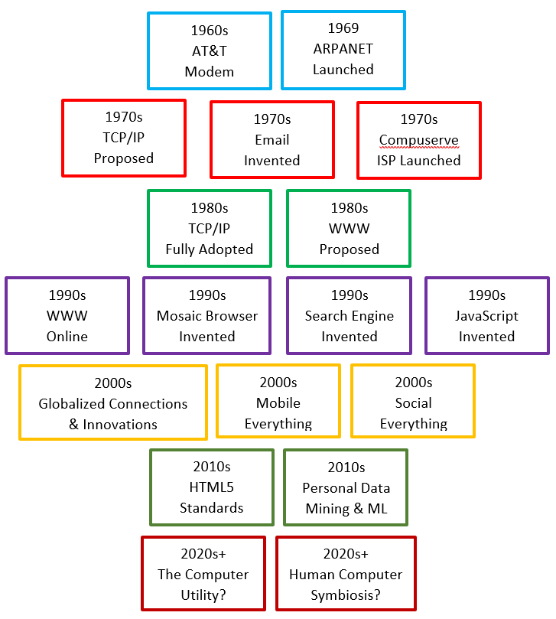
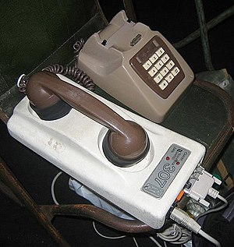
A brief history of the internet

Slide 5


The web from 10,000 feet
An amalgamation of tech
Held together by standards
WWW, URL, URI, HTML, XHTML, XML, HTTP, HTTPS, TCP, IP, UDP, FTP, MIME, IMAP, DNS, JavaScript, CDN, ICANN, IANA, RSA, ICMP, LAN, WAN, POP3, WEP, WPA, LARP, LAIRE

Slide 6
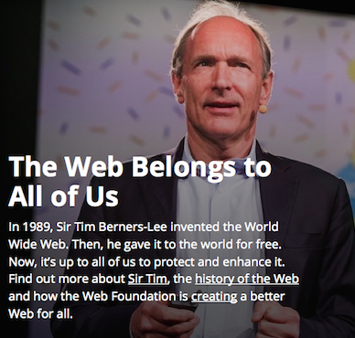
www tech generations
Early 1990s
1St – Flat HTML files, images, etc.
Mid 1990s
2nd – CGI, Perl, etc.
Late 1990s
3rd – Application Servers, Java, C#, etc.
Late 2000s+
4th – The Cloud, CDNs, AWS, Node, etc.

Slide 7
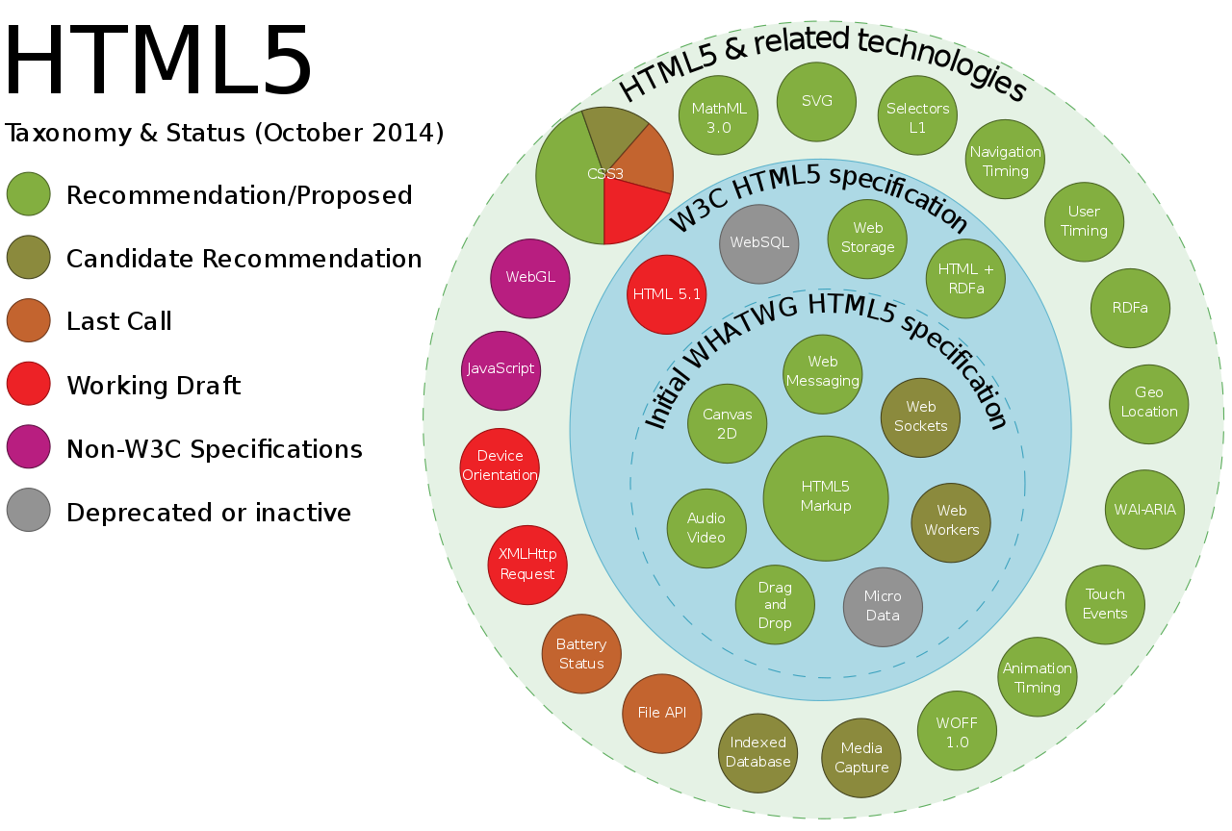

Slide 8
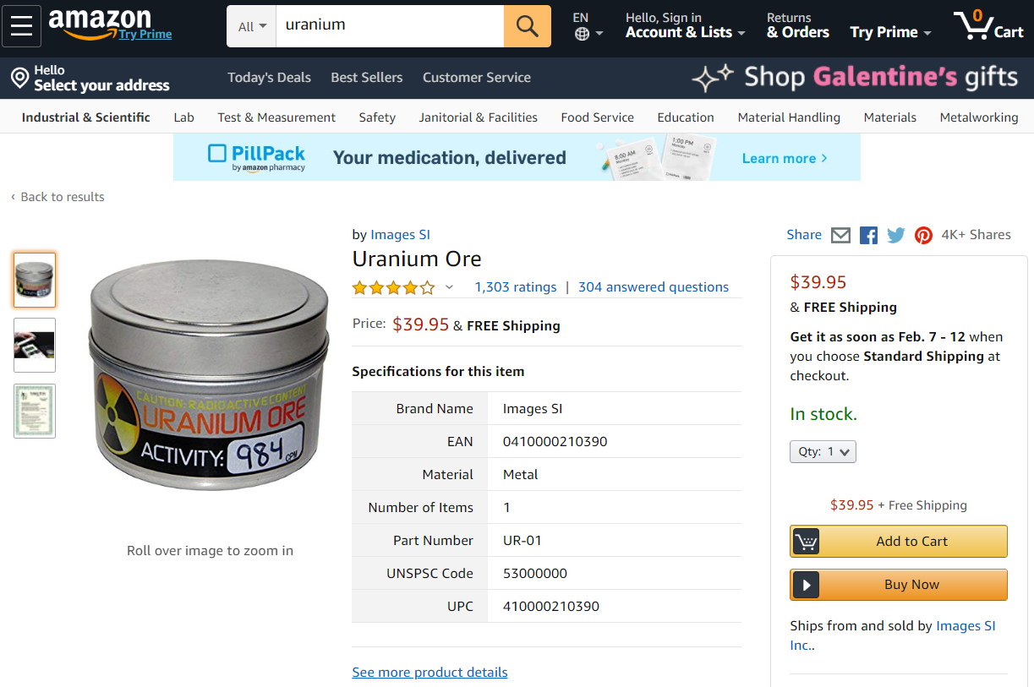
Web apps are complicated
The good: Web standards
URL, HTTP, HTML5
CSS3
JavaScript
JSON
etc.
The bad: complexity
Platforms
Languages
Libraries

Slide 9

Web architecture for flat files
Client on PC/Mobile using Browser
Requests URL
Host translated to IP by DNS
Browser sends http request to Web Server
Server is Waiting for requests
Server receives request
Server gets requested file and linked files and sends back as response

Slide 10
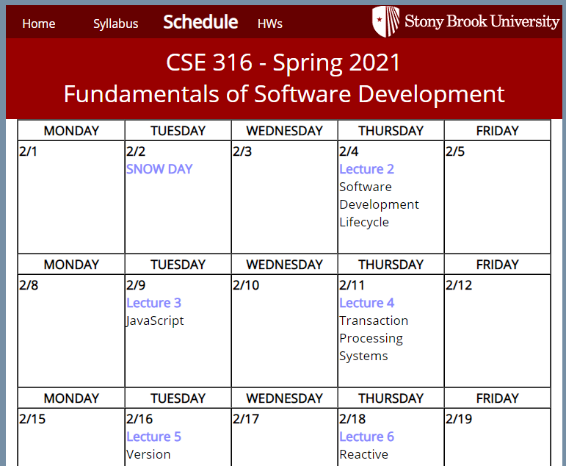
Sometimes all we need is a web server
Front-End content
html (page structure)
css (layout and style)
json (data)
Images & multimedia
JavaScript (executable code)

Slide 11


Web page requests
Browser App
http request
Web Server
http request
Internet
http response
.html
.css
.js
.json
.png
…
http response
.html
.css
.js
.json
.png
…
What does the browser do with the response?

Slide 12
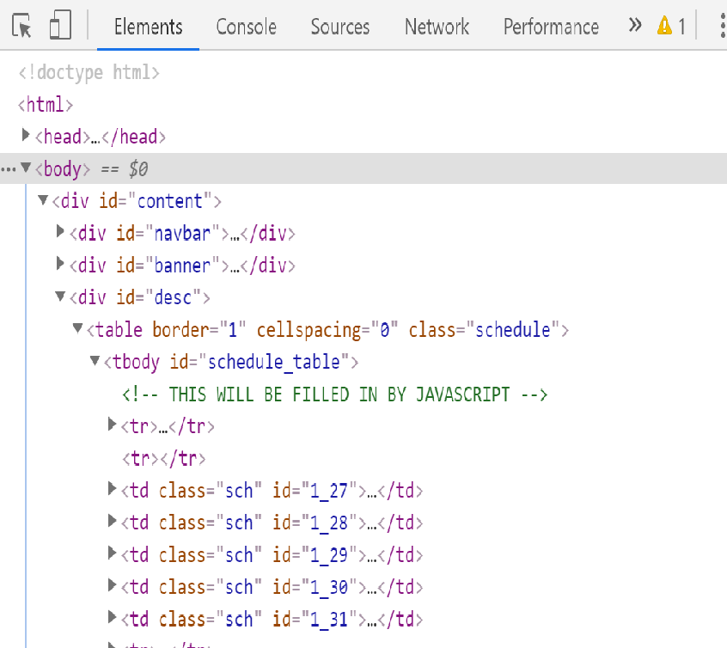
The DOM
Document
Object
Model
Browser data structure
What kind is it?

Slide 13
Crud web applications need more
Create Data
Retrieve/Read Data
Update Data
Delete Data
Requires back-end code (ex: JavaEE, JavaScript/Node.js, PHP, Python, etc.)
This greatly complicates things
Web
Server
Back-End
Server

Slide 14
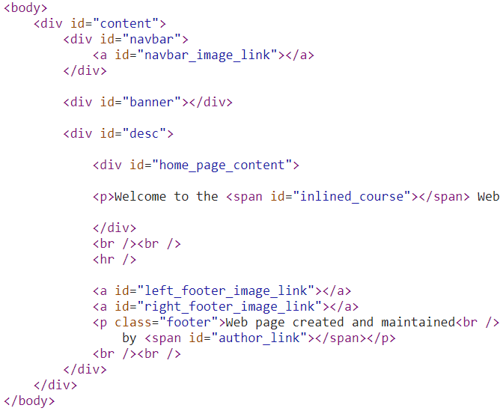
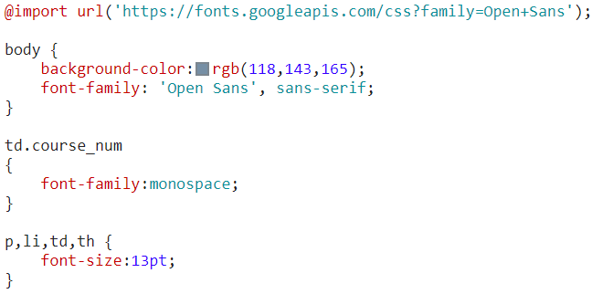
let’s start simple
HTML
provides page structure
references other resources
can directly include page content
CSS
specifies custom page layout
specifies page style
fonts
colors
interactvity

Slide 15
HyperText Markup Language Basic Page Structure
<!doctype html>
<html>
<head>
<title>Window Title Bar Page Title</title>
<!-- META DATA AND FILES TO INCLUDE GO HERE -->
</head>
<body>
<!-- VISIBLE WEB PAGE CONTENT GOES HERE -->
</body>
</html>

Slide 16
Resources we might reference in head
CSS
<link id="layout_css" href="./css/course_homepage_layout.css“
rel="stylesheet" type="text/css">
<link id="style_css" href="./css/sea_wolf.css"
rel="stylesheet" type="text/css">
JavaScript
<script src="./js/jquery.min.js"></script>
<script src="./js/PageBuilder.js"></script>

Slide 17
Html tags for page content
Boxes for organizing sections
<div>
Sections for custom styling inlined content
<span>
Paragraphs <p>, Headers <h>-<h6>, Images <img>, Hyperlinks <a>, Tables <table>, Ordered Lists <ol>, Unordered Lists <ul>, etc.

Slide 18
Elements can have “attributes”
What elements have what attributes?
all have id, class, style and some others
some elements have their own attribute types
<a href="http://www.cs.stonybrook.edu/~richard">Me</a>
<img src="./images/Me.png" />

Slide 19
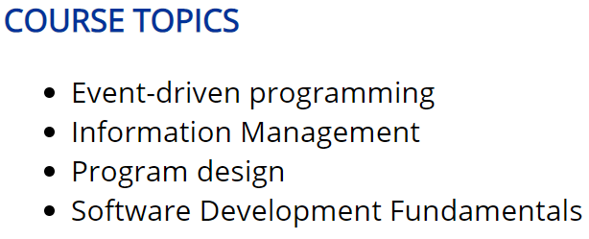
How could we get these results?
<h3>COURSE TOPICS</h3>
<ul>
<li>Event-driven programming</li>
<li>Information Management</li>
<li>Program design</li>
<li>Software Development Fundamentals</li>
</ul>

Slide 20
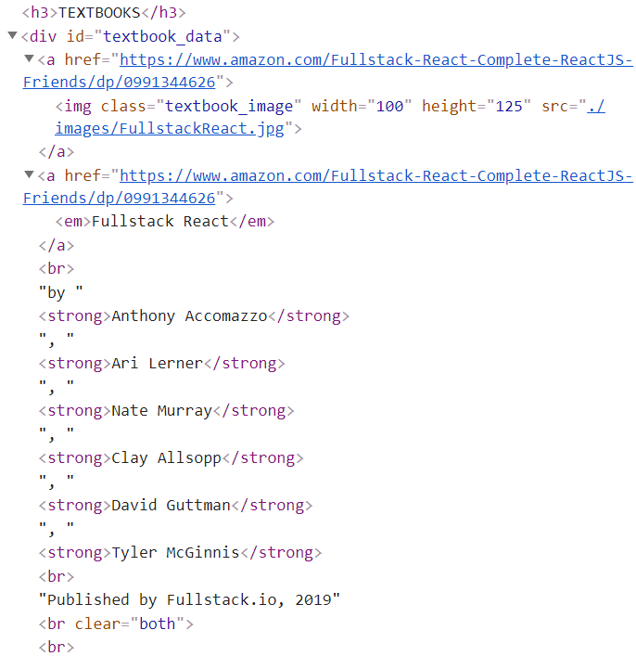

How do we get this?

Slide 21
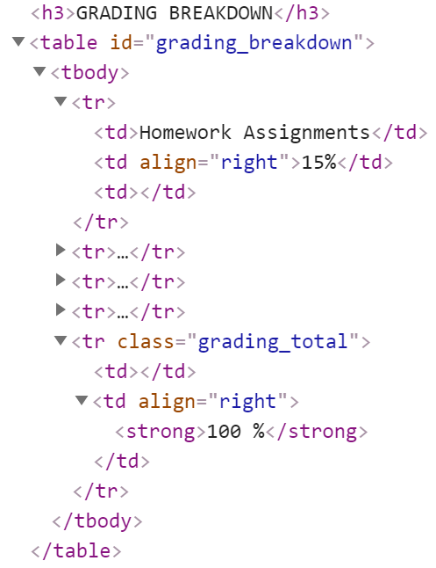
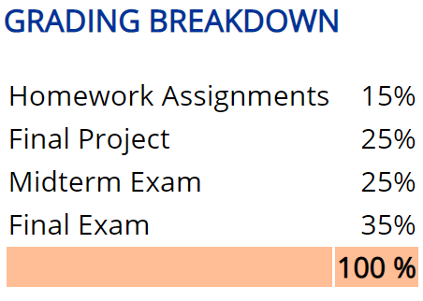
How do we get this?

Slide 22
Why is the bottom row peach colored?
In HTML:
<tr class="grading_total">
<td></td>
<td align="right">
<strong>100 %</strong>
</td>
</tr>
In CSS:
.grading_total {
background-color: rgb(255,190,150);
}

Slide 23
What is css good for?
Positioning HTML elements
Stylizing HTML elements
Note: everything is a box
First Priority: Selecting the necessary HTML Elements

Slide 24
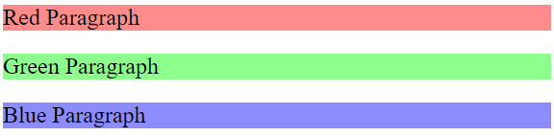
What does selecting mean?
Mapping HTML boxes to CSS style
Map by Element:
HTML: <p>Red Paragraph</p>
CSS: p { background-color: rgb(255,140,140); }
Map by Class:
HTML: <p class="green_paragraph“>Green</p>
CSS: .green_paragraph { background-color: rgb(140, 255, 140); }
Map by Id:
HTML: <p id="blue_paragraph">Blue</p>
CSS: #blue_paragraph { background-color: rgb(140, 140, 255); }

Slide 25
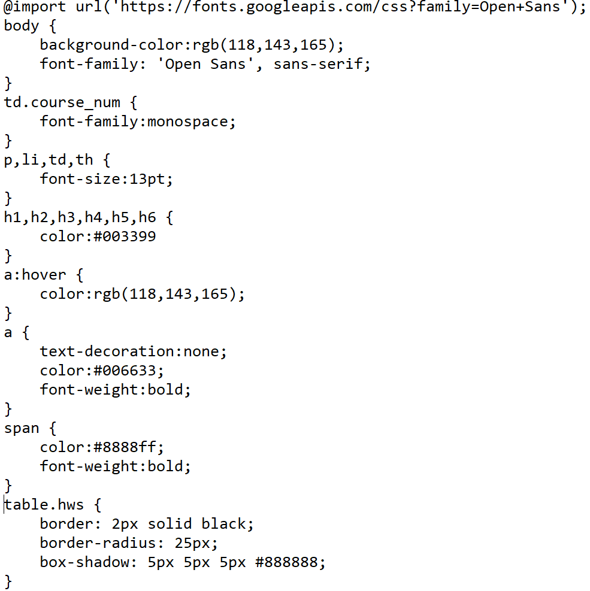
Lots of style
What do these things do?

Slide 26
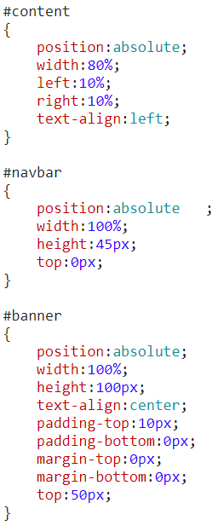
Css positioning is tricky
css position property
static
relative
fixed
absolute
sticky

Slide 27
Let’s take a look at some css layout

Slide 28
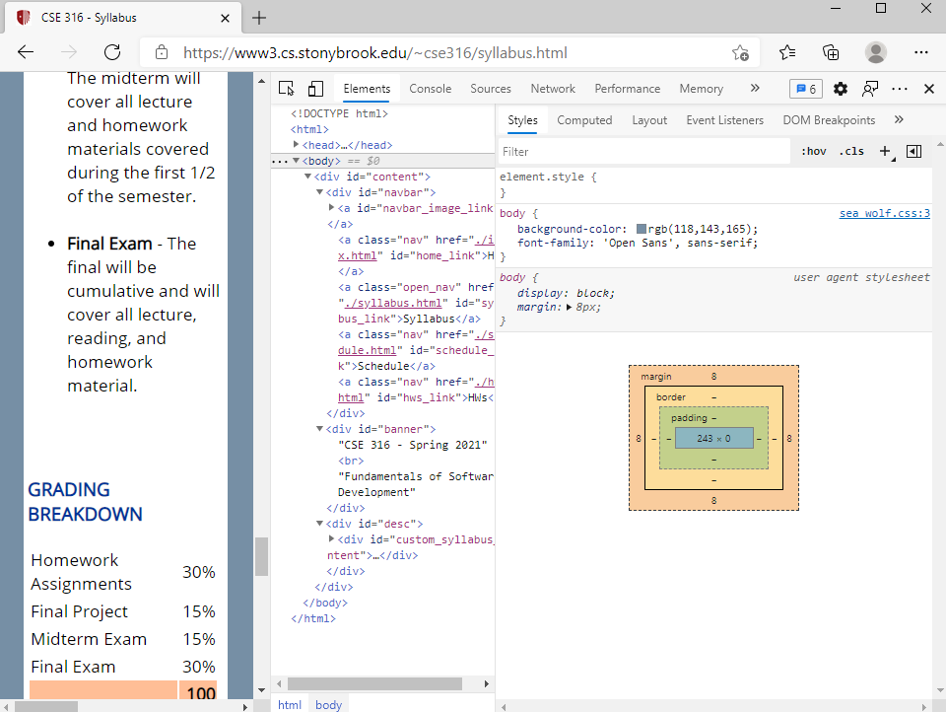
Everything is a box

Slide 29
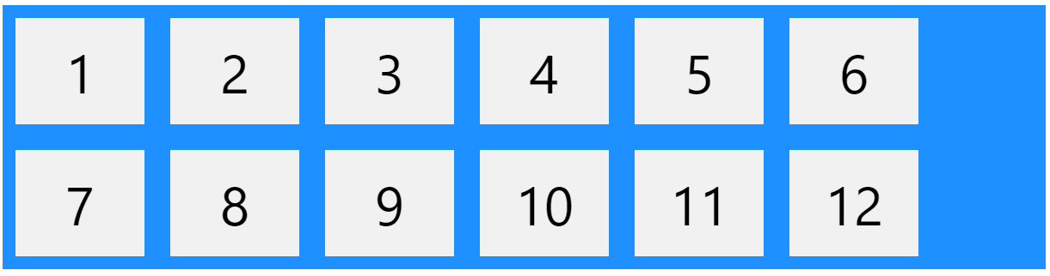
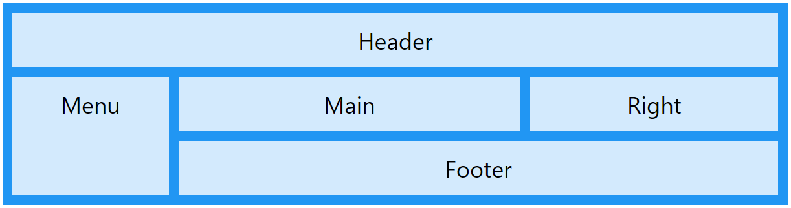
Alternate css3 layout techniques
Flexbox
Grid

