Slide 1
Cse 316
Transaction
Processing
Systems

Slide 2



Examples of transactions
Financial Transactions
Online Game State Change Transactions
Undo/Redo Transactions
Version Control Transactions
…

Slide 3

Transactions must be undoable
Why?
What’s a transaction?
Changes Data
Is atomic
All or nothing

Slide 4

User Interfaces must be forgiving
Users make mistakes
Undo/Redo for life!
Control-Z as a reflex
Every Application Requires it

Slide 5
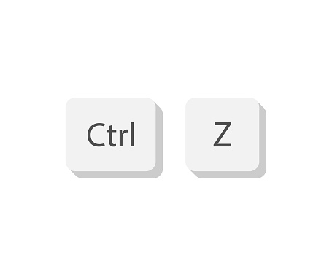
Applications all use Undo/Redo
Sounds like an opportunity for abstraction
Sounds like an opportunity for an API
What do all apps have in common?
undo/redo
transaction stack
What do they have that is different?
the work (i.e. data changes) undo/redo actually does
requires transaction object for each data change

Slide 6
Let’s make a JavaScript API: jsTPS
Java Transaction Processing System
Doesn’t know what the transactions do
Small, multipurpose API
jsTPS is a defined class that manages the transaction stack
jsTPS_Transaction is an undefined class to be overridden

Slide 7
What should the jsTPS class have?
Data
stack of transactions
index of the most recent transaction
flags to let others know when undo/redo are operating
Functionality
add a transaction
do a transaction
peek a transaction (both undo and do)
undo a transaction
clear all transactions

Slide 8
What should the jTPS_Transaction interface have?
Two methods for overriding
one to do a transaction
one to undo a transaction
public interface jTPS_Transaction {
public void doTransaction();
public void undoTransaction();
}

Slide 9
jsTPS_Transaction
class jsTPS_Transaction {
/**
* This method is called by jsTPS when a transaction is executed.
*/
doTransaction();
/**
* This method is called by jsTPS when a transaction is undone.
*/
undoTransaction();
}

Slide 10
jsTPS Data
export class jsTPS {
constructor() {
this.transactions = new Array();
this.numTransactions = 0;
this.mostRecentTransaction = -1;
this.performingDo = false;
this.performingUndo = false;
}

Slide 11
jsTPS – add a transaction
addTransaction(transaction) {
if ((this.mostRecentTransaction < 0)
|| (this.mostRecentTransaction < (this.transactions.length - 1))) {
for (let i = this.transactions.length - 1; i > this.mostRecentTransaction; i--) {
this.transactions.splice(i, 1);
}
this.numTransactions = this.mostRecentTransaction + 2;
}
else {
this.numTransactions++;
}
this.transactions[this.mostRecentTransaction+1] = transaction;
this.doTransaction();
}

Slide 12
jsTPS – do a transaction
doTransaction() {
if (this.hasTransactionToRedo()) {
this.performingDo = true;
let transaction = this.transactions[this.mostRecentTransaction+1];
transaction.doTransaction();
this.mostRecentTransaction++;
this.performingDo = false;
}
}

Slide 13
jsTPS – undo a transaction
undoTransaction() {
if (this.hasTransactionToUndo()) {
this.performingUndo = true;
let transaction = this.transactions[this.mostRecentTransaction];
transaction.undoTransaction();
this.mostRecentTransaction--;
this.performingUndo = false;
}
}

Slide 14
jsTPS – clear all transactions
clearAllTransactions() {
// REMOVE ALL THE TRANSACTIONS
this.transactions = new Array();
// MAKE SURE TO RESET THE LOCATION OF THE
// TOP OF THE TPS STACK TOO
this.mostRecentTransaction = -1;
this.numTransactions = 0;
}

Slide 15
jsTPS – peek to see undoable/redoable transactions
hasTransactionToRedo() {
return this.mostRecentTransaction < (this.transactions.size()-1);
}
hasTransactionsToUndo() {
return this.mostRecentTransaction >= 0;
}

Slide 16
jsTPS example – data to keep track of: Num
export class Num {
constructor() {
this.num = 0;
}
setNum(initNum) {
this.num = initNum;
}
getNum() {
return this.num;
}

Slide 17
jsTPS Example – add transaction
export class AddToNum_Transaction extends jsTPS_Transaction {
constructor(initNum, initAmountToAdd) {
super();
this.num = initNum;
this.amountToAdd = initAmountToAdd;
}
doTransaction() {
let oldNum = this.num.getNum();
let newNum = oldNum + this.amountToAdd;
this.num.setNum(newNum);
}
undoTransaction() {
let oldNum = this.num.getNum();
let newNum = oldNum - this.amountToAdd;
this.num.setNum(newNum);
}
}

Slide 18
jsTPS Example –what happens here?
jTPS tps = new jTPS();
Num num = new Num();
jTPS_Transaction transaction;
transaction = new AddToNum_Transaction(num, 5);
tps.addTransaction(transaction);
transaction = new AddToNum_Transaction(num, 2);
tps.addTransaction(transaction);
transaction = new AddToNum_Transaction(num, 7);
tps.addTransaction(transaction);
transaction = new AddToNum_Transaction(num, 8);
tps.addTransaction(transaction);
transaction = new AddToNum_Transaction(num, 1);
tps.addTransaction(transaction);
tps.undoTransaction();
tps.undoTransaction();
tps.undoTransaction();
tps.redoTransaction();
What’s num after all this?

Slide 19
Never Lose Your Code Again
Have you ever been working on a project and:
your computer died?
you lost your computer?
you made changes to something working and now it’s not working?
you wanted to combine your work with a teammate’s work?
The solution?
Version Control
Version Control manages a Transaction Processing System

Slide 20






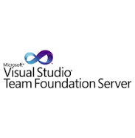
There are many tools out there

Slide 21
We will use Git
Created by Linus Torvalds
also created Linux
Repositories can be managed locally or remotely
Many online providers:
GitHub
BitBucket
GitLab
…

Slide 22

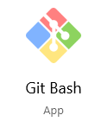
And We’ll use GitHub
Owned by Microsoft
Make an account
Download Git
https://git-scm.com/downloads
We’ll use GitBash

Slide 23
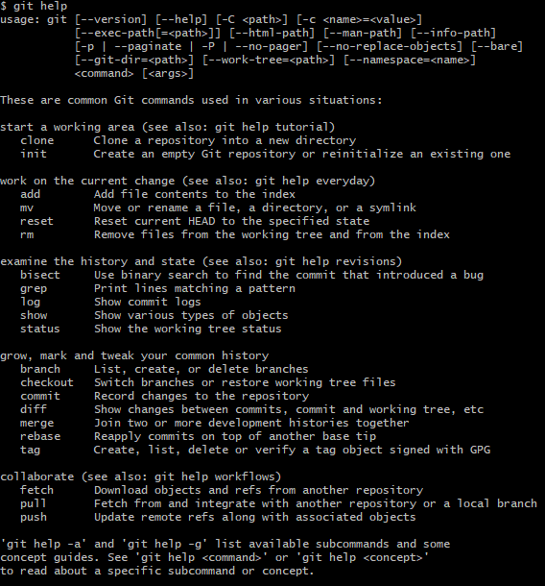
The GitBash Command Line
Try these things:
pwd
ls
ls -l
cd ..
mkdir hw1
cd hw1
Let’s walk through what this does

Slide 24
git init
Creates a local git repository
Puts empty repo in .git
Don’t ever touch anything in .git

Slide 25
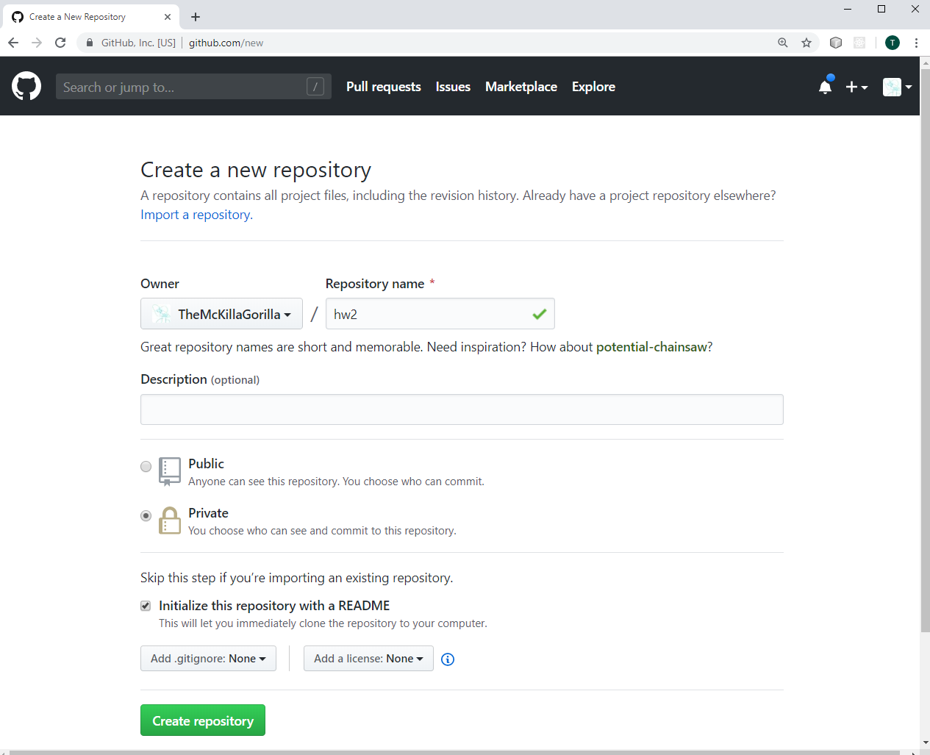

Slide 26
Once your Online Repo is Created
Make sure you are logged into GitHub (like in Chrome)
Connect your local repo to your remote one
git remote add origin https://github.com/TheMcKillaGorilla/hw1
remote add – tells git to specify the remote repository
origin – name you are giving to the remote repository
Now your local repo can push and pull to and from your GitHub repo

Slide 27
First, pull
You will want all the files in the repository
git pull origin master
master? What’s that?
a branch
What’s the branch?
i.e. a version
a repo can have multiple branches

Slide 28
Add any new files
Easiest way, just add everything
git add .
Adds files to the repo
Their changes can now be tracked
Some files you don’t want in your repo
gitignore

Slide 29
Commit Changes
git commit –m "I changed a bunch of important things"
Don’t forget the comments

Slide 30
Push your changes to the remote repo
git push origin master
If you are working alone, no problem
If not, be careful, you may have to pull others’ changes first

Slide 31
Merge & Revert
merge – approve all changes in VSC
revert – to previous version or date

