Slide 1
CS699 Data Mining
Classification of Disability Status
in U.S. Households
Using the 2023 American Housing Survey (AHS) Dataset
Ho Man Cheng & Weitao Peng
Boston University | Metropolitan College
Notes:
Good afternoon, Professor and classmates. I’m Ho Man Cheng, and together with my teammate Weitao Peng, we’re presenting our CS699 Data Mining final project: the Classification of Disability Status in U.S. Households using the 2023 American Housing Survey. Over the next ten minutes we’ll walk you through our data, our pipeline, the thirty-six models we built, and the single configuration that came out on top

Slide 2
Agenda
10-minute presentation | Two presenters
Presenter 1: Ho Man Cheng (~5 min)
Presenter 2: Weitao Peng (~5 min)
1. Problem & Dataset
2. Tools & Algorithms
3. Preprocessing Pipeline
4. Class Imbalance
5. Balancing Methods
6. Evaluation Methodology
7. Results Overview
8. Best Model Identified
9. Key Findings
10. Conclusion & Q&A
Both | Slide 2 / 12
Notes:
Here’s how we’ve split the talk. I’ll cover the problem, the dataset, our tools, the preprocessing pipeline, and the four balancing methods — that’s roughly the first five minutes. Weitao will then take over with the evaluation methodology, the results across all thirty-six models, the best model we identified, the key findings, and our conclusion.

Slide 3
Problem Statement & Dataset
Binary classification on the 2023 American Housing Survey
Objective
Dataset Snapshot
Predict whether a U.S. household contains a member with a disability (Class = Yes / No).
Policy value: targeted resources, accessible housing planning, social services.
Technical goal: compare 36 model configurations to find the strongest classifier.
Source: U.S. Census Bureau AHS 2023
Rows: 12,045 households
Features (after preprocessing): 118
Class distribution: 30.4% Yes / 69.6% No
Train / Test split: 80% / 20% stratified
Ho Man Cheng | Slide 3 / 12
Notes:
Our objective is a binary classification problem: predict whether a U.S. household contains a member with a disability — a Yes/No label. The motivation is practical: these predictions support targeted resource allocation, accessible housing planning, and social-service delivery.
Our dataset comes from the U.S. Census Bureau’s 2023 American Housing Survey. After cleaning we had 12,045 households and 118 features. Importantly, the class distribution is imbalanced — only about 30.4% of households have a disabled member, while 69.6% do not. We used a stratified 80/20 split for training and testing.

Slide 4
Tools & Classification Algorithms
R 4.5.2 | 12 packages | 9 algorithms × 4 balancing = 36 models
Core R Packages
9 Classification Algorithms
caret — unified training / tuning
randomForest, gbm, xgboost
e1071, kernlab — SVM
nnet, naivebayes, rpart
ROSE, smotefamily — balancing
pROC — ROC/AUC analysis
Logistic Regression · Decision Tree
Random Forest · GBM · XGBoost
SVM (Radial) · KNN
Naive Bayes · Neural Network
Linear, tree-based, kernel, and neural families — full comparison across paradigms.
Ho Man Cheng | Slide 4 / 12
Notes:
We built everything in R 4.5.2 using twelve packages. caret gave us a unified training and tuning interface; randomForest, gbm, and xgboost handled the ensembles; e1071 and kernlab provided SVMs; nnet gave us neural networks; ROSE and smotefamily handled resampling; and pROC handled ROC analysis.
We selected nine classification algorithms that span four families — linear, tree-based, kernel, and neural — so the comparison is fair across paradigms. Combined with four balancing methods, that gives us exactly thirty-six model configurations.

Slide 5
Preprocessing Pipeline
From raw AHS CSV → 118 clean, scaled features
1
2
3
4
5
6
7
Remove Class NAs
Drop CONTROL
Numeric Conversion
Median Imputation
Near-Zero Variance
Winsorization
Center & Scale
Drop rows missing the target label
Identifier with zero predictive value
Factor codes → numeric for models
Replace NAs with column median
Lenient filter (freqCut=99/1)
Clip continuous outliers (1%/99%)
Zero mean, unit variance
Result: 9,636 training rows × 118 features → Saved as preprocessed_data.csv, initial_train.csv, initial_test.csv
Ho Man Cheng | Slide 5 / 12
Notes:
Our pipeline has seven stages. First we drop rows missing the class label. Second we drop the CONTROL identifier column, which has no predictive value. Third, we convert factor codes to numeric. Fourth, we impute missing values using the column median. Fifth, a lenient near-zero-variance filter with a 99-to-1 frequency cutoff removes constants while keeping rare binary signals. Sixth, we winsorize continuous features to the 1st and 99th percentiles to tame outliers. Seventh, we center and scale.
The result: 9,636 training rows across 118 features, saved to the three CSVs required by the assignment.

Slide 6
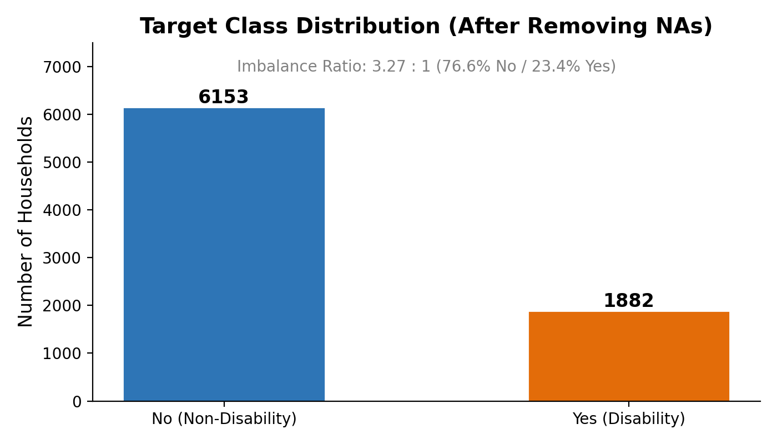
Class Imbalance Problem
Majority class dominates — models bias toward predicting 'No'
Why it matters
~70% No vs ~30% Yes
Accuracy is misleading under imbalance
Minority class (Yes) = the class we most want to detect
Solution: apply balancing before training
Figure 1. Class distribution in the training set
Ho Man Cheng | Slide 6 / 12
Notes:
This chart shows why balancing matters. The majority class — households without a disabled member — makes up roughly seventy percent of the training set. If we naively optimize accuracy, a model can hit 70% just by always predicting No, and still completely miss the minority class we actually care about. In this problem, the Yes class is the policy-relevant one, so recall on that class is what we want to maximize.

Slide 7
Four Balancing Methods
Applied to training set only — test set stays untouched
Random Undersampling
Random Oversampling
Remove majority-class samples to match minority count
Duplicate minority-class samples to match majority count
SMOTE (K=5)
ROSE
Synthesize new minority samples via nearest neighbors
Generate a balanced synthetic sample via smoothed bootstrap
Ho Man Cheng | Slide 7 / 12
Notes:
We applied four balancing strategies — and only to the training set; the test set stays untouched so our evaluation reflects reality.
Random Undersampling removes majority-class rows until both classes match. Random Oversampling duplicates minority rows. SMOTE, with K equal to five, synthesizes new minority samples by interpolating between nearest neighbors. Finally ROSE uses a smoothed bootstrap to generate a fully synthetic balanced sample. Each method rebalances the training data differently — and, as you’ll see, they give very different downstream results. I’ll now hand it over to Weitao to walk through the evaluation.

Slide 8
Evaluation Methodology
Holdout test set | Fixed threshold 0.5 | 5-fold CV for tuning only
How we evaluated 36 models
Metrics Tracked
Hold-out 2,409 rows as unbalanced test set
5-fold cross-validation used only for hyperparameter tuning (never for final scoring)
Predict with fixed decision threshold = 0.5
Report on original imbalanced test → real-world fidelity
TPR (Yes) — recall for the minority class
TPR (No) — recall for the majority class
Precision, F1, AUC, MCC, Kappa
Weighted averages for overall comparison
Extra-credit bar: Yes TPR ≥ 0.77 AND No TPR ≥ 0.73
Weitao Peng | Slide 8 / 12
Notes:
Thank you, Ho Man. Our evaluation protocol is deliberately strict. We held out 2,409 rows as an untouched, unbalanced test set. We used 5-fold cross-validation only for hyperparameter tuning — never for final scoring — and we locked the decision threshold at 0.5 to keep the comparison fair across all thirty-six models.
We report recall on each class separately — Yes TPR and No TPR — along with Precision, F1, AUC, MCC, and Kappa. The extra-credit bar set by the assignment is demanding: Yes TPR must reach 0.77 and No TPR must reach 0.73 simultaneously.

Slide 9
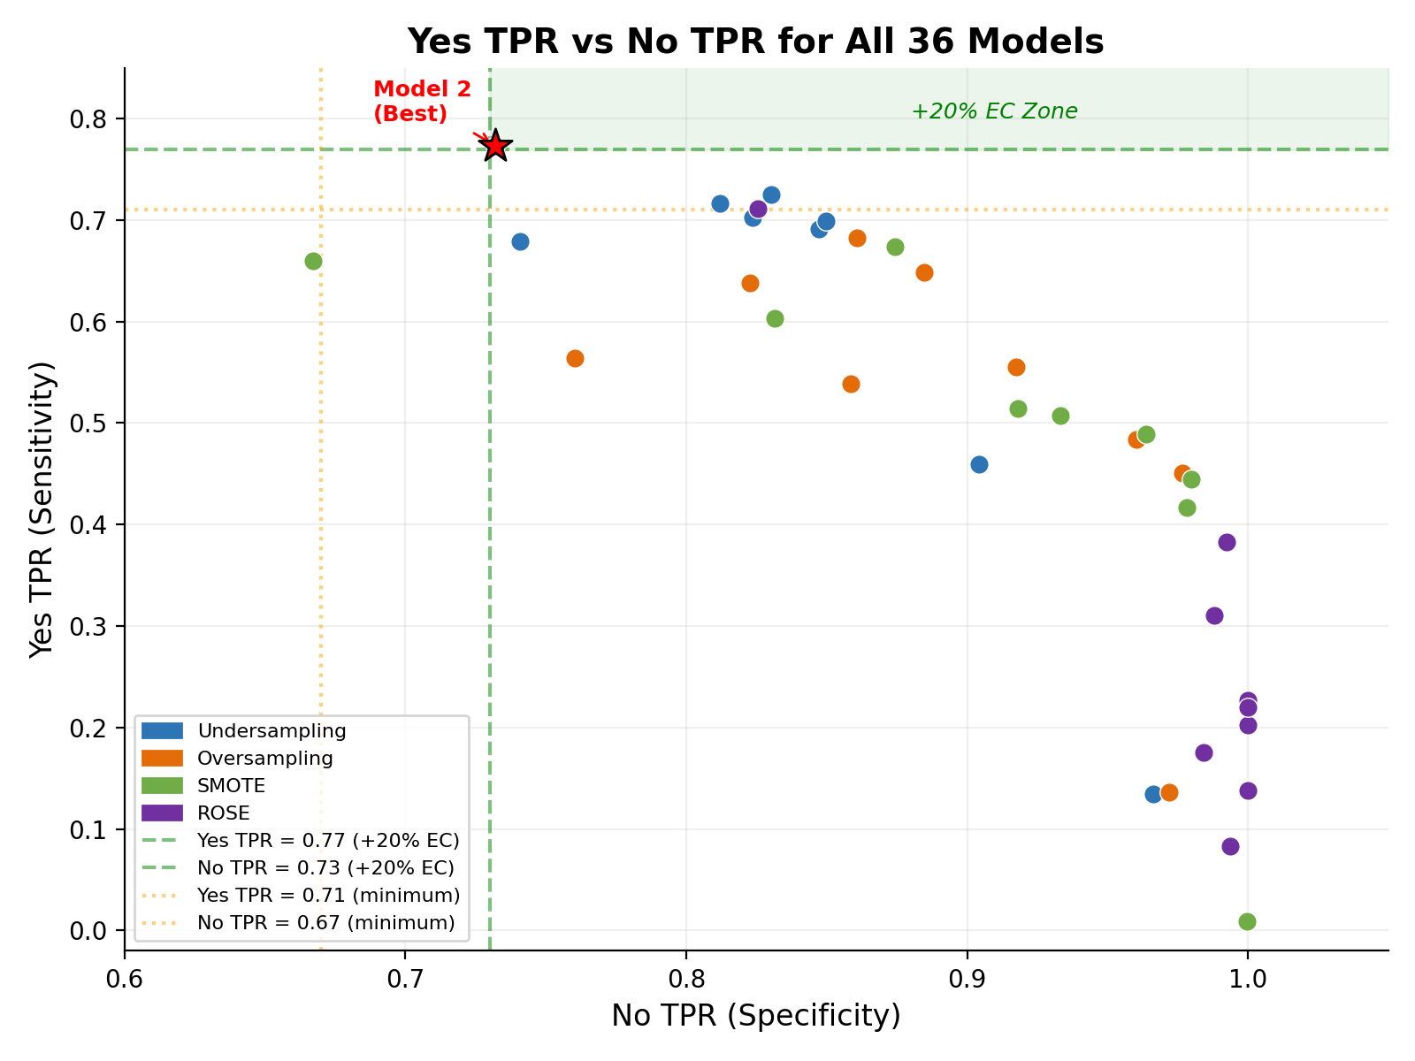
Results Overview — All 36 Models
Yes TPR vs No TPR | upper-right quadrant = strong on both classes
Key Observations
Undersampling pushes Yes-TPR highest
Oversampling / SMOTE favor No-TPR
Tree ensembles cluster in the upper band
ROSE under-performs other balancers
Only a handful cross both thresholds
Figure 2. Per-class recall across 36 configurations
Weitao Peng | Slide 9 / 12
Notes:
This scatter plots Yes TPR on the x-axis against No TPR on the y-axis for every one of the thirty-six models. A few patterns stand out.
Undersampling — the red cluster — pushes Yes-TPR the highest, but at the cost of No-TPR. Oversampling and SMOTE do the opposite: they favor the majority class. Tree ensembles — Random Forest, GBM, XGBoost — cluster in the upper band with strong overall AUC. ROSE consistently underperformed the other three balancers on our data. And critically, only a small handful of points cross both dashed thresholds into the upper-right quadrant that the extra-credit target defines.

Slide 10
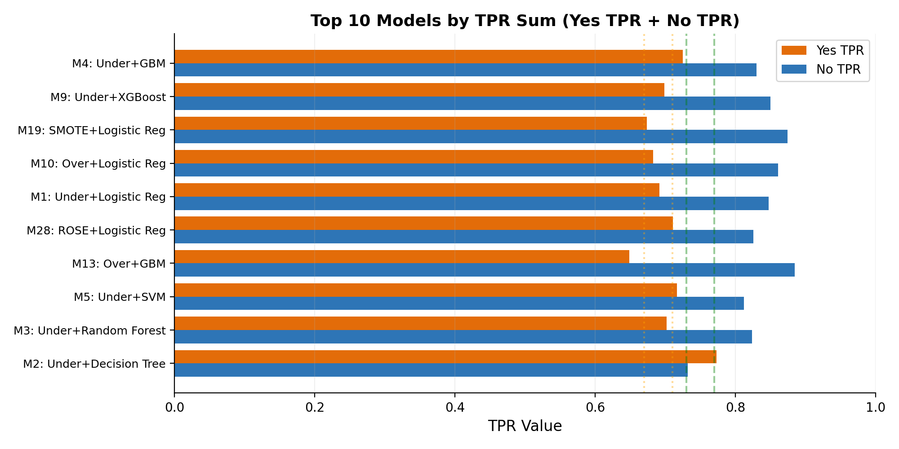
Best Model — Undersampling + Decision Tree
Only configuration that crosses both extra-credit thresholds
Model 2
Under-sampling + Decision Tree
Yes TPR
0.7730
≥ 0.77 required
No TPR
0.7322
≥ 0.73 required
AUC
0.7990
F1 (Yes)
0.6140
Kappa
0.4582
Figure 3. Top 10 models ranked by combined TPR (Yes + No)
Weitao Peng | Slide 10 / 12
Notes:
Our winner is Model 2: Random Undersampling paired with a Decision Tree. It scored Yes TPR of 0.7730, which clears the 0.77 bar, and No TPR of 0.7322, which clears the 0.73 bar — the only configuration to meet both simultaneously. AUC was 0.7990, F1 on the Yes class was 0.6140, and Cohen’s Kappa was 0.4582.
The chart on the right ranks the top ten models by combined TPR. Model 2 sits at the top. This is a reminder that a pruned Decision Tree, given a balanced training distribution, can outperform much heavier ensembles on the metrics that actually matter for this problem.

Slide 11
Key Findings
Lessons from 36 model configurations
Balancing beats accuracy chasing
Simple models can win
Undersampling unlocked the highest Yes-TPR despite shrinking the training set to ~5.8K rows.
A pruned Decision Tree beat ensembles on the minority-class recall target.
Ensembles dominate overall AUC
ROSE offered little lift here
Random Forest and XGBoost top the AUC ranking but underperform Yes-TPR.
Its smoothed-bootstrap samples introduce noise without stabilizing the decision boundary.
Weitao Peng | Slide 11 / 12
Notes:
Four takeaways. First, balancing beats accuracy chasing — undersampling unlocked the highest minority-class recall even though it shrank the training set to roughly 5,800 rows. Second, simple models can win — our pruned Decision Tree beat every ensemble on the dual-recall target. Third, ensembles still dominate overall AUC — Random Forest and XGBoost lead the AUC ranking, but their Yes-TPR lags because the decision threshold of 0.5 is not optimal for their probability distributions. Fourth, ROSE offered little lift on this dataset — its smoothed-bootstrap samples added noise without stabilizing the decision boundary.

Slide 12
Thank You
Questions?
Takeaway: Model 2 (Under + Decision Tree) meets both extra-credit thresholds — Yes TPR 0.7730, No TPR 0.7322.
Ho Man Cheng | Weitao Peng · CS699 Data Mining · Spring 2026
Notes:
To summarize: thirty-six models, nine algorithms, four balancing methods, one strict evaluation protocol — and Model 2, Undersampling plus Decision Tree, is the only one that meets both extra-credit thresholds. Thank you for your time — we’re happy to take any questions.

