Slide 1
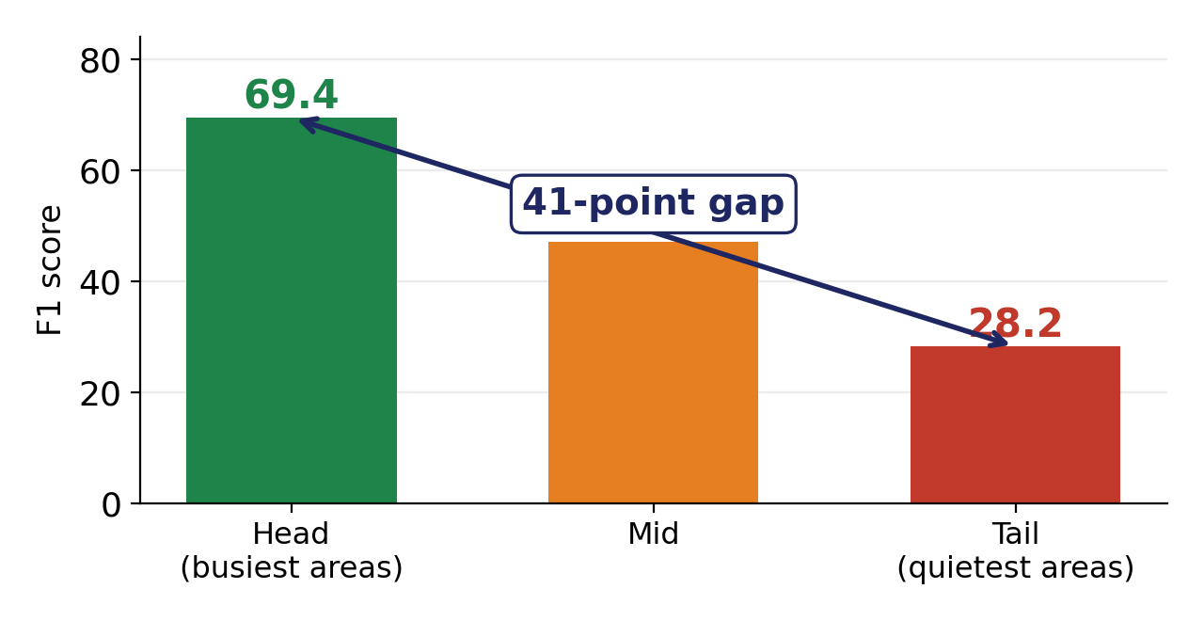
Where we started: the problem
Crime prediction for 6 police stations, trained together without sharing data (federated learning)
THE PROBLEM
The model appeared to serve poor, low-crime neighbourhoods far worse than busy ones — a 41-point gap.
WHY IT MATTERS
These systems decide where police patrol. If the model fails poor areas, real people are affected.
Los Angeles 2018 · 113 neighbourhoods · 8 crime types · 365 days
OUR ORIGINAL GOAL
Close this 41-point gap so the model treats rich and poor areas equally.
Gaurav Jha · Project review
Notes:
We rebuilt the FedCrime paper - crime prediction across six police stations using federated learning, so no station shares its raw data. On real Los Angeles data we reproduced their results. Then we split neighbourhoods into three groups by how much crime they have. Busy areas scored 69, quiet areas 28. A 41-point gap. Our goal was to close it.

Slide 2
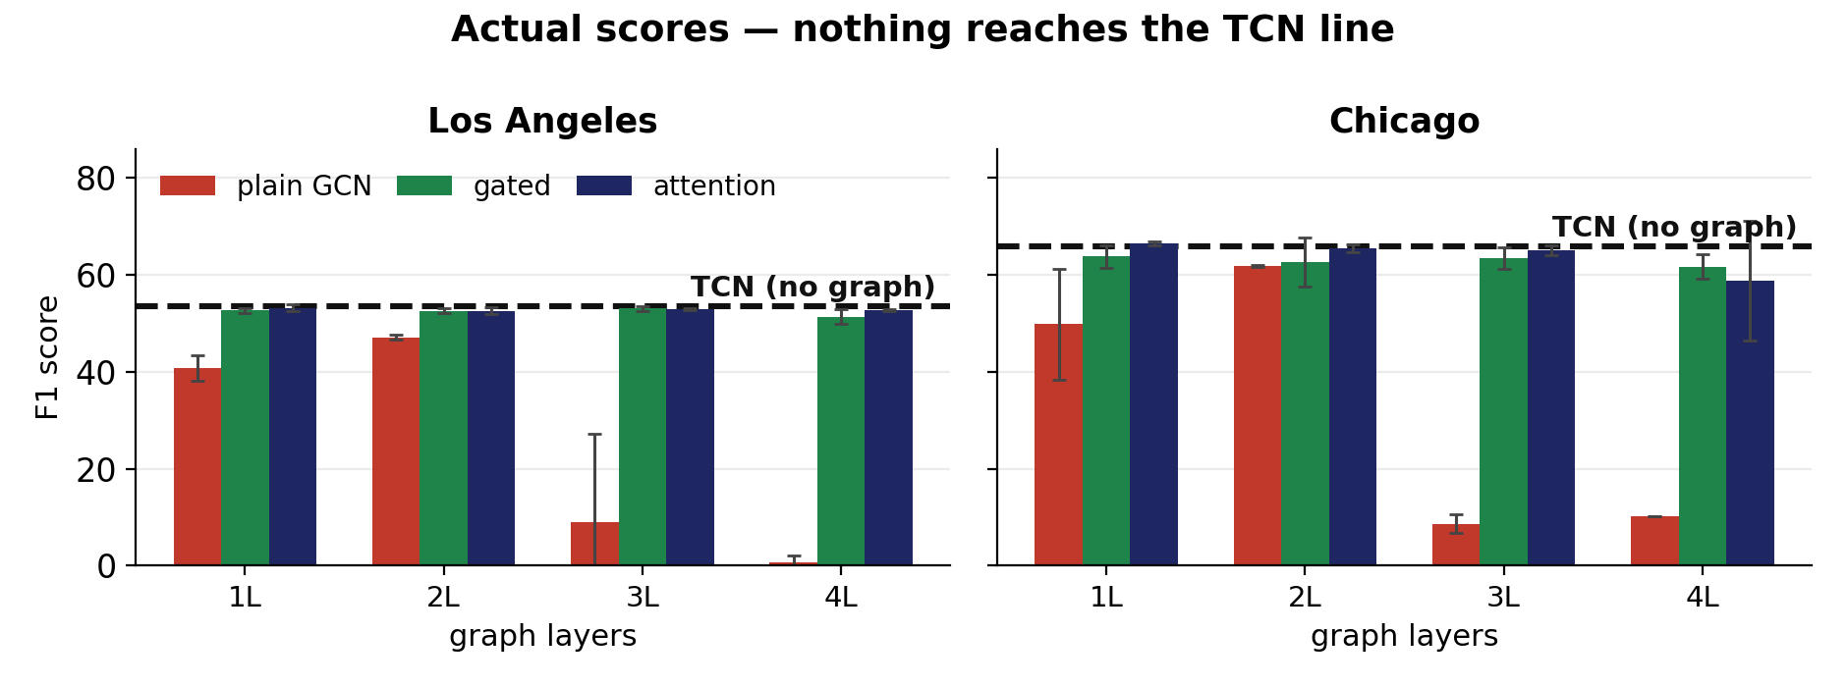
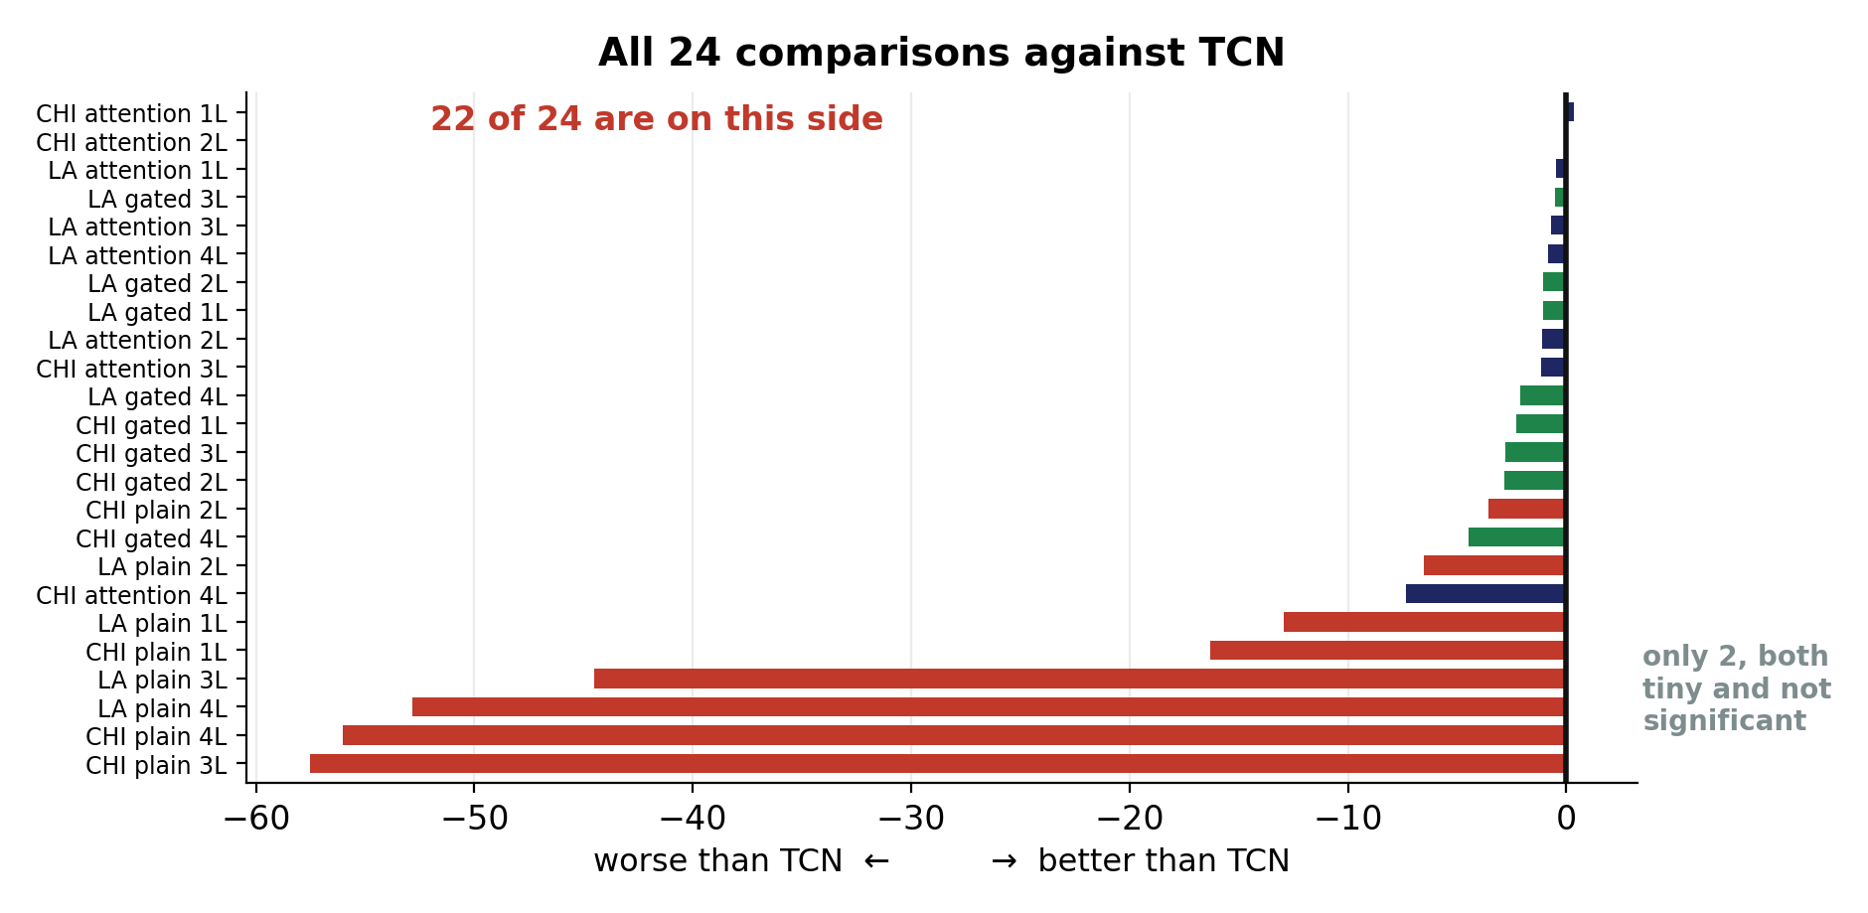
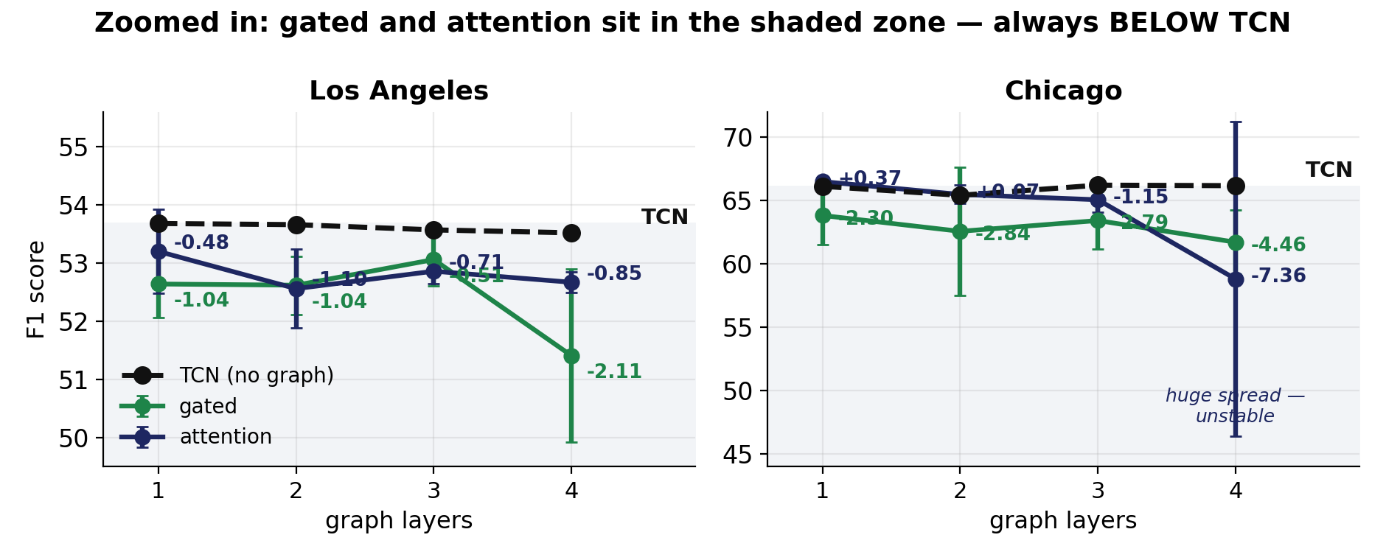
Backup: why gated and attention are behind TCN
Same data, shown three ways. TCN is the dashed black line — nothing gets above it.
WHY PLAIN COLLAPSES
Actual scores, not differences. Plain GCN collapses at 3–4 layers. Gated and attention look close to TCN — but look closer.
It is forced to average with neighbours at every layer and cannot stop. By 3–4 layers all areas look identical, so the model cannot tell them apart.
WHY GATED / ATTENTION ARE FLAT
They have a switch. They learned to turn the graph almost OFF — so they end up doing what TCN already did, minus a small cost.
Not one graph model beat TCN. 22 of 24 worse, 9 significantly.
Notes:
Backup slide for questions about gated and attention. Top left shows actual scores with TCN as the dashed line - plain GCN collapses at 3 and 4 layers. Bottom left is zoomed in so you can see gated and attention are always in the shaded zone, below TCN, by about 1 to 4 points. Right side ranks all 24 comparisons. Plain collapses because it is forced to average with neighbours every layer and cannot stop. Gated and attention have a switch and learned to turn the graph off, so they land where TCN already was.

Slide 3
How we tried to solve it
Five serious attempts. None of them worked.
1
Give poor areas more weight
Standard reweighting: make the model care more about quiet areas. Gap went from 41 to 52 — WORSE.
2
Group-DRO
Optimise for the worst-performing group. Tried three strength settings. Gap stayed at 41.
3
Adaptive thresholds
A different decision cut-off per area and crime type. Improved to 41, then stopped.
Add a graph (GNN)
24 graph comparisons, each against an equal-sized model with no graph. 22 came out negative.
4
Let neighbouring areas share information. 3 types × 4 depths × 2 cities.
24
22
0
5
Gated + attention graphs
tests run
negative
worked
The versions designed to fix over-smoothing. Also negative.
Five reasonable methods all failing was the clue: the problem was not what we assumed it was.
Notes:
We did not give up after one attempt. Five different approaches. Reweighting actually made it worse. Group-DRO and adaptive thresholds did nothing at any setting. Then graphs - twenty-four comparisons across three graph types, four depths and two cities, each against an equal-sized control. Twenty-two negative. Zero worked. When five reasonable methods all fail, that is telling you something.

Slide 4
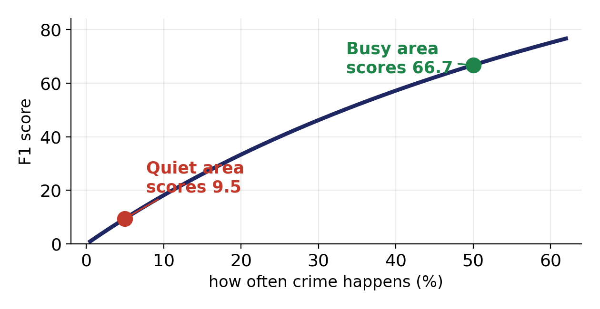
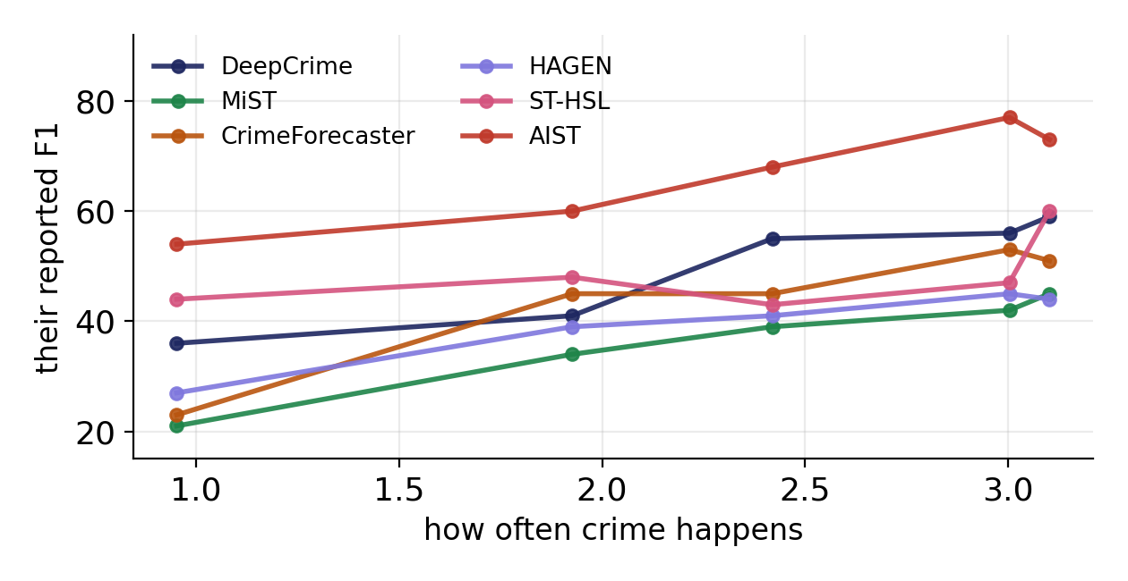
Why nothing worked: the gap is largely not real
The F1 score gives free points where crime is common
6 published papers. Every line slopes upward — their scores track crime volume, not model quality.
A model with ZERO skill — one that just says "crime" every single day — scores 66.7 in a busy area and 9.5 in a quiet one. That is a 57-point "fairness gap" from a model that never looks at the data.
0.87
4 cities
1.3e-5
correlation
same pattern
p-value
This part of the maths is known (Davis 2006, Chouldechova 2017). We cite it — we do not claim it.
Notes:
Here is why every fix failed. The F1 score gives free points where crime is common. A model with no skill at all, that just says crime every day, scores 66.7 in busy areas and 9.5 in quiet ones. So most of our 41-point gap was going to be there no matter how good the model was. We then checked six published papers - every one shows the same upward slope. Their reported scores track crime volume. This basic maths is known and we cite it; what is new is showing it is happening across this whole literature.

Slide 5
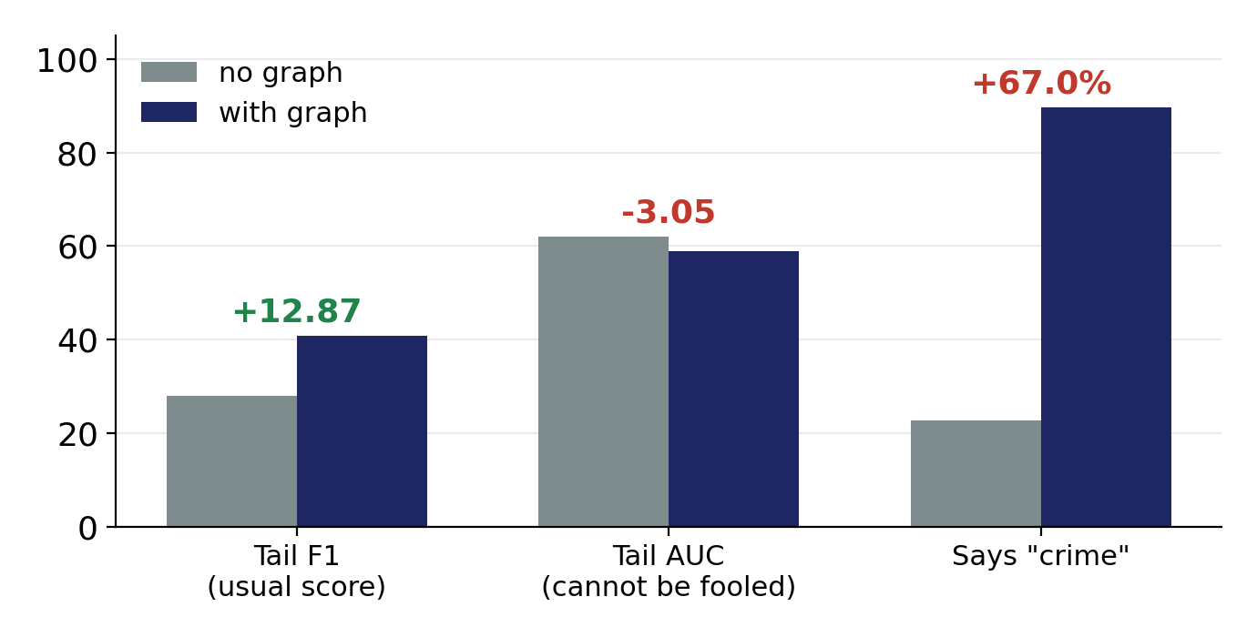
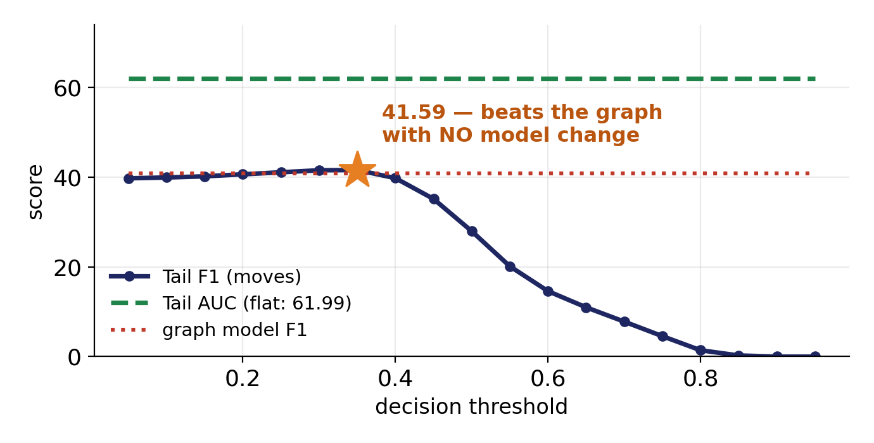
What we found that is new
Correcting for the free points is NOT enough — a model can still fake a fairness win
Chicago. The graph model looks 12.87 better on the usual score — but AUC, which cannot be fooled, is 3.05 WORSE.
Then with NO graph at all — moving one setting — we beat it, with AUC identical at 61.99 on every row.
+12.87
+13.63
61.99
23% → 80%
the graph model gave
ONE setting gave
AUC — identical
how often it cries "crime"
The model did not get better at finding crime. It started labelling 8 out of 10 poor neighbourhoods as high-crime — and the usual fairness score rewarded that.
Notes:
This is the new part. We found a change that raised the fairness score for poor areas by 12.87 points. Our own base-rate correction said the gap had closed completely. But AUC went DOWN by 3.05, and the model went from saying crime 23 percent of the time to 80 percent. Then the decisive test: with no graph at all, just moving the decision threshold, we got a BIGGER improvement of 13.63, while AUC stayed at exactly 61.99 on all nineteen rows. So the fairness improvement was never about the model.

Slide 6
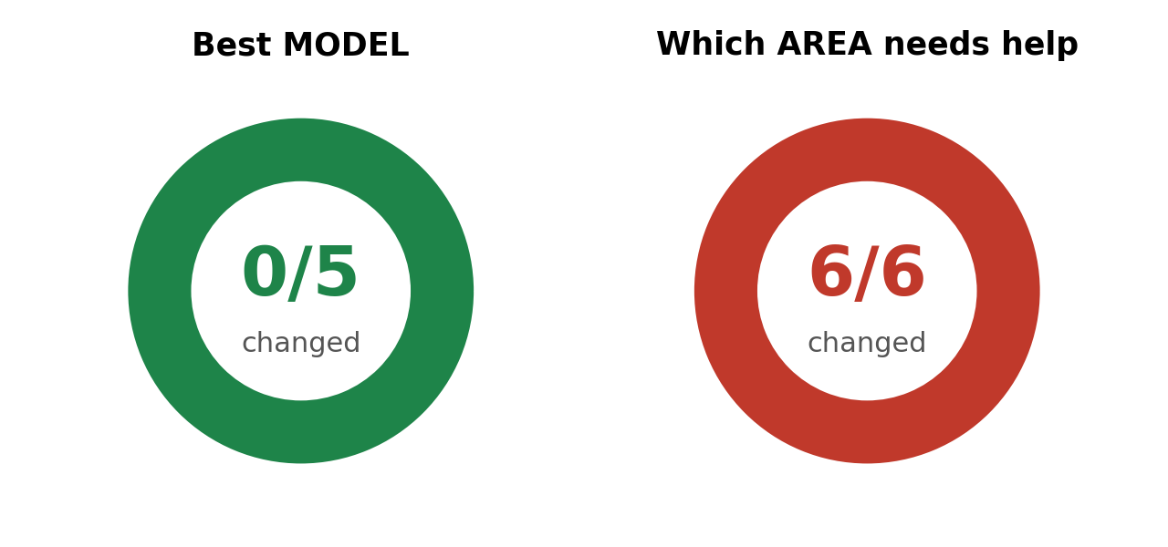
What is new, and where we can publish it
OUR THREE CONTRIBUTIONS
1
Correcting for base rates is NOT enough
TARGET VENUE
A model can fake a fairness win by guessing more often. Our own correction was fooled — only AUC caught it.
ACM FAccT 2027
Conference on Fairness, Accountability and Transparency
2
Published fairness gaps track crime volume
Abstract due 27 October 2026
Paper due 3 November 2026
Acceptance 26.8% — revise round accepts 71%
6 papers, correlation 0.87–0.90, p = 1.3 × 10⁻⁵. Holds with no statistical assumptions at all.
3
It changes who gets help
Picking the best model: unaffected. Picking which area needs help: changed for every single model.
Their call asks specifically for papers that "examine evaluation metrics and measurement practices" — our paper in their own words.
Backup: ACM TIST (journal, no deadline)
DECISION NEEDED: build the paper around this measurement finding, and keep the attack/defence work for a second paper?
Notes:
Three contributions, strongest first. Correcting for base rates is not enough - that is the new claim. Second, published fairness gaps in this field track crime volume. Third, it changes who gets help: model selection is unaffected but remediation targeting flips for every model. Target is ACM FAccT 2027, deadline 3 November, eleven weeks away. Their call for papers asks specifically for work examining evaluation metrics. The decision I need from you is whether to build the paper around this and save the attack-defence work for a second submission.

Slide 7
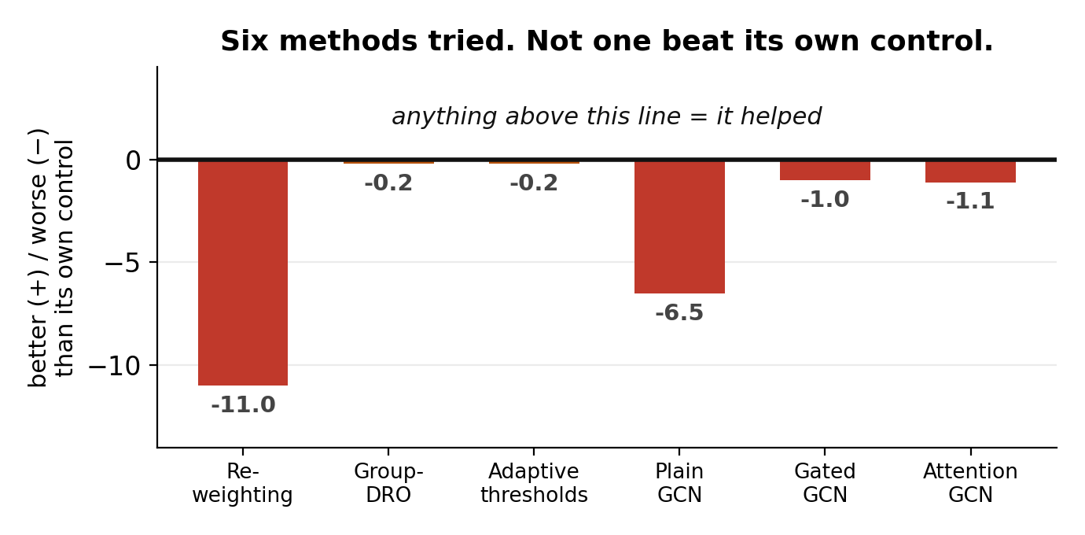
Where we were before physics
Every method was tested against an identical model with the new part switched off
SIX ATTEMPTS, NONE WORKED
Not one added ingredient beat its own matched control. The gated graph even learned to switch itself off.
THE MODEL BARELY BEAT GUESSING
On the burglary data the control scored 53 out of 100 at telling a crime week from a quiet one. 50 is a coin flip.
Reweighting made the gap worse. Group-DRO and adaptive thresholds did nothing.
All three graph types landed below their controls.
WHAT WE CONCLUDED
The limit was in the data, not the architecture. More layers, better graphs and smarter losses all hit the same wall.
6
0
53
methods tried
that worked
score out of 100
This is why the physics result matters: it is the first ingredient in the whole project that earned its place.
Notes:
Before physics, nothing worked. Six methods, each against an identical model with the new part switched off. Reweighting made the gap worse. Group-DRO and adaptive thresholds did nothing. All three graph types came out below their controls. On the burglary data the model scored 53 out of 100 - fifty is a coin flip. We concluded the limit was in the data, not the architecture.

Slide 8
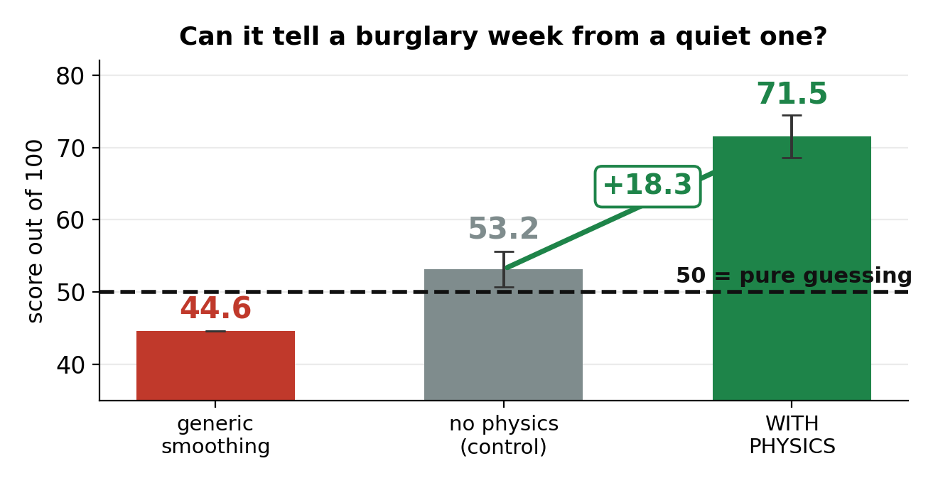
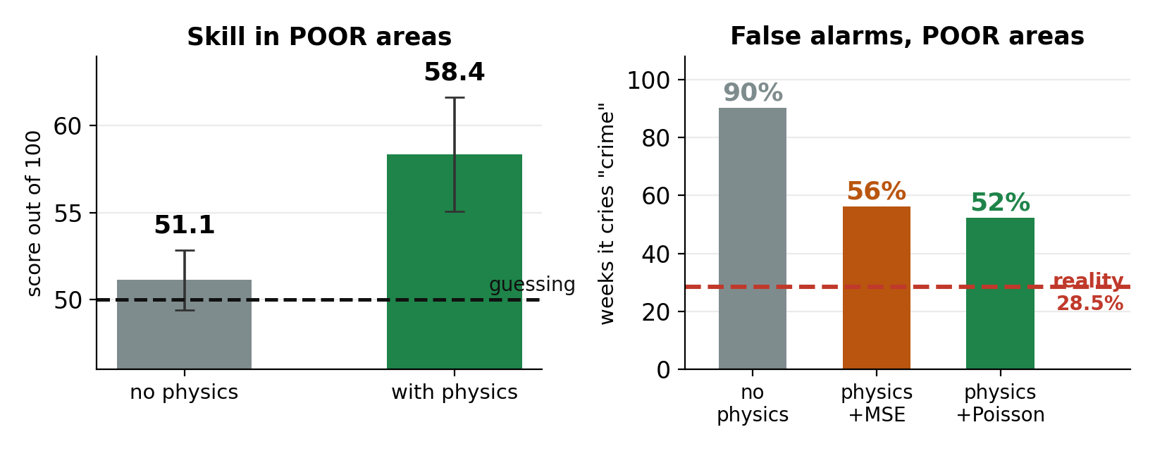
What changed with physics
We wrote a real criminology rule into the model: a burgled street attracts more burglary nearby, and that effect fades over time
It helps most where data is thinnest, and it stops crying wolf:
false alarms in poor areas fall from 3.2x reality to 1.8x.
5 seeds each. t = 9.6, so this is not luck. Generic smoothing scored 44.6 —
WORSE than nothing — so it is the burglary equations doing the work.
53 → 71
51 → 58
3.2x → 1.8x
−23%
overall skill
skill in poor areas
false alarms there
size of errors
Honest limit: it learned WHERE burglary happens, not WHEN — like knowing it rains a lot in London without knowing about next Tuesday.
Notes:
Then we wrote a real criminology rule into the model. The score went from 53 to 71 out of 100. Five seeds, t equals 9.6, so this is not luck. Generic smoothing scored 44.6 - worse than nothing - which proves it is the burglary equations doing the work, not just smoothing. It helped poor neighbourhoods most, 51 to 58, and cut false alarms there from 3.2 times reality to 1.8 times. Honest limit: it learned where, not when.

Slide 9
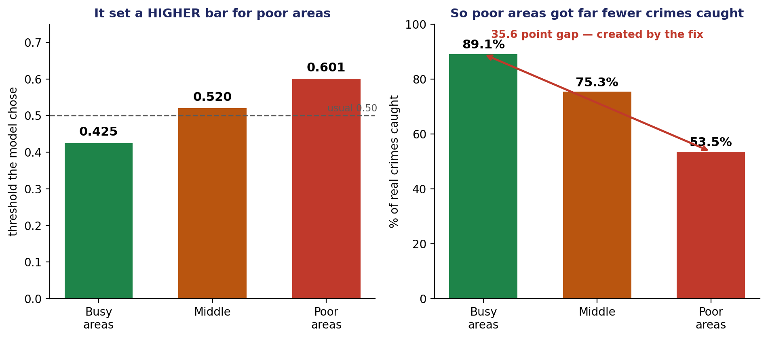
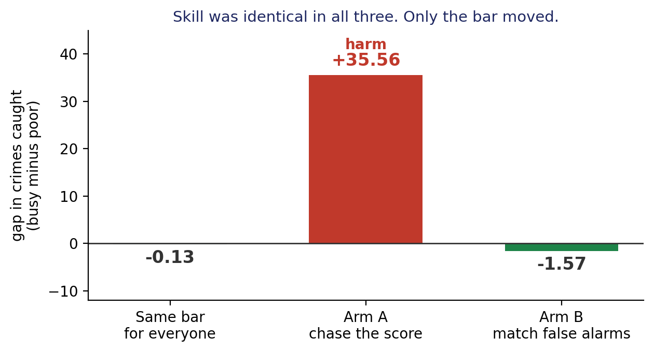
We let the model choose the bar itself
The professor suggested adaptive thresholds — not a fixed rule, but a bar the model decides from the data
ARM A — ACTIVELY HARMFUL
Chasing the score opened a 35.6 point gap in crimes caught — on data where every group was equally easy to predict. The fix caused the harm.
ARM B — HONEST, BUT NOT A FIX
Matching false alarms instead kept the gap at −1.57. Correct — but it adds no skill. It only stops us fooling ourselves.
Arm A: we told it "get the best score you can in every group." It chose a HIGHER bar for poor areas, so far fewer real crimes there were caught.
THE GIVEAWAY
AUC moved by 0.07 in all three — essentially nothing. The model never changed. Only the bar moved, and the score followed.
Notes:
The professor suggested adaptive thresholds - let the model decide the bar from the data instead of using a fixed rule. We tried two versions. Arm A said: get the best score you can in each group. It chose a higher bar for poor areas - 0.601 versus 0.425 for busy ones - so only 53 percent of real crimes in poor areas were caught, against 89 percent in busy ones. A 35.6 point gap, on data where every group was equally easy to predict. The fix caused the harm. Arm B matched false alarm rates instead and behaved correctly, but it adds no skill - it only stops us fooling ourselves. The giveaway is AUC: it moved 0.07 in all three. The model never changed. So adaptive thresholds are not a fix. They are a measuring tool.

Slide 10
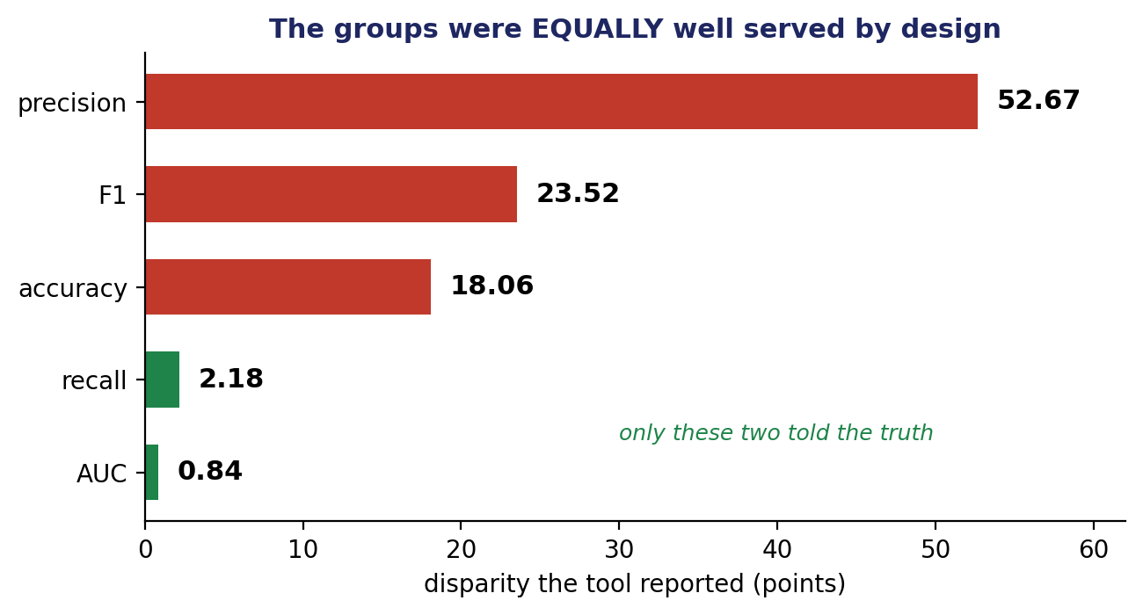
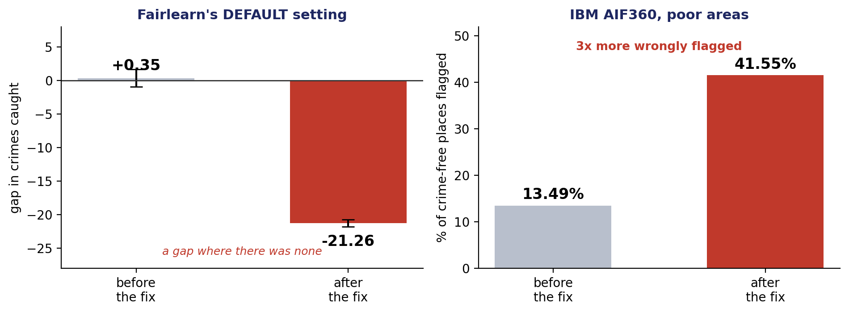
We tested the fairness tools everyone uses
Fairlearn (Microsoft) and AIF360 (IBM). We gave them data where all groups were equally well served, and watched what they did.
THE DEFAULT SETTING IS THE BAD ONE
Fairlearn’s default opened a 21 point gap in crimes caught where there was none. A user who changes nothing gets this.
IBM’S TOOL FLAGGED 3x MORE
AIF360 took wrongly-flagged crime-free places in poor areas from 13.5% to 41.6% — to close a gap that was never real.
We built the data so every group had exactly the same skill. Only the amount of crime differed.
The honest answer is "nothing to fix." Precision reported a 52.67 point problem.
Verified: same numbers on Kaggle and locally, 5 seeds.
Notes:
Then we tested the two fairness libraries that thousands of people actually use - Fairlearn from Microsoft and AIF360 from IBM. We gave them data where we had built every group to have exactly the same skill. Only the amount of crime differed. The honest answer is: there is nothing to fix. Fairlearn reported a 52.67 point precision problem and a 23.52 point F1 problem. AUC reported 0.84 - the truth. Worse, Fairlearn’s default repair setting opened a 21 point gap in crimes caught where none existed. And IBM’s tool took wrongly flagged crime-free places in poor areas from 13.5 percent to 41.6 percent - three times more - to close a gap that was never real. We ran this five times and got the same answer on Kaggle and locally.

Slide 11
Where this leaves us
One finding, shown four separate ways
Graph models
+16.95 score, but skill went DOWN 4 points
Threshold sweep
moving one number beat the whole architecture
Adaptive thresholds
chasing the score opened a 35.6 point gap
Fairlearn / AIF360
the default setting does the same thing
The score everyone reports moves a long way without the model getting any better.
Physics was the one ingredient that raised real skill — +18.32 AUC — which no threshold can do.
Next: extend from 2 cities to 8, then write the paper.
Notes:
To close: this is one finding shown four separate ways. Graph models gained 17 points of score while actual skill went down 4. Moving a single threshold beat the entire architecture. Letting the model pick thresholds opened a 35.6 point gap. And the two libraries everyone uses do the same thing on their default settings. The score the field reports moves a long way without the model getting any better. Physics was the one ingredient in this whole project that raised real skill - plus 18.32 - which no threshold can fake. Next step is extending from two cities to eight, then writing the paper.

