Slide 1

Arab Open University — Faculty of Computer Studies
AOU
Logo
Information Technology and Computing
DEEPFAKE IMAGE DETECTION SYSTEM
A Forensic System for Detecting Synthetic Facial Images
Student Name: Ziad Mohamed Ahmed Mohamed
Course: TM471B — Final Year Project
Student ID: 22510251
Date: May 2026
Supervisor: Dr. Amira Abdelfattah
1
Notes:
Welcome everyone. My name is Ziad Mohamed Ahmed, student ID 22510251, presenting my final year project: the Deepfake Image Detection System, developed under the supervision of Dr. Amira Abdelfattah. This system uses VGG16 transfer learning, MTCNN face detection, and Grad-CAM explainability to classify facial images as real or fake with 96.27% accuracy.

Slide 2
Deepfake Image Detection System | TM471B — May 2026
AOU
Agenda
1
Introduction
7
Implementation
2
Problem Statement
8
System Interfaces
3
Objectives
9
Results
4
Technologies Used
10
System Architecture
5
Comparison with Existing Tools
11
Future Work
6
System Design
12
Conclusion
2
Notes:
This presentation follows ten sections. I will cover the background and problem, our objectives, the proposed AI solution and how it compares to existing tools, the system design and implementation details, results, future work, and a conclusion. Total presentation time: 5 minutes.

Slide 3
Deepfake Image Detection System | TM471B — May 2026
AOU
Introduction
What are Deepfakes?
AI-generated synthetic media — images and videos — created using deep learning models such as GANs, capable of producing highly realistic fake human faces indistinguishable from genuine photographs.
Why Automated Detection?
Traditional forensics tools (metadata analysis, human inspection) are no longer effective against modern GAN-generated fakes. Deep learning-based automated detection is essential at scale.
3
Notes:
Deepfakes are AI-generated fake images and videos made with Generative Adversarial Networks. They are used for fraud, impersonation, and spreading misinformation. As generative models like StyleGAN and Stable Diffusion become more accessible, human inspection alone is no longer sufficient. Automated, explainable detection systems are urgently needed.

Slide 4
Deepfake Image Detection System | TM471B — May 2026
AOU
Problem Statement
The Threat
Real-World Threats
The Gap — Why This Project
■ GANs produce hyper-realistic faces Which is undetectable by human eye
▶ No accessible, browser-based deepfake detector for still images
👤
Identity Fraud
■ Traditional tools (metadata, human inspection) fail against modern deepfakes
▶ Existing tools require subscriptions, installation, or technical expertise
📰
Disinformation
■ Most commercial tools are closed-source, video-only, or lack explainability
⚖
Evidence Manipulation
▶ No open-source solution with Grad-CAM explainability and zero data storage
🔐
Social Engineering
▶ Non-technical users (journalists, forensic analysts) are underserved
4
Notes:
The core problem has two dimensions. On one hand, deepfake technology has advanced to the point where GANs like StyleGAN2 produce faces indistinguishable from real ones — exposing critical weaknesses in traditional forensics. On the other hand, no accessible, explainable, and privacy-preserving detection tool exists for still images that non-technical users can actually use.

Slide 5
Deepfake Image Detection System | TM471B — May 2026
AOU
Objectives
FR1
Gather and preprocess a diverse dataset of real and AI-generated facial images from credible open-source repositories.
FR2
Develop and train a CNN model (VGG16 transfer learning) capable of differentiating between original and synthetic facial photographs.
FR3
Evaluate model performance across standard metrics: accuracy, precision, recall, and F1-score Which targeting ≥90% accuracy.
FR4
Build an interactive, browser-based web interface allowing users to upload images and receive real-time authenticity classifications.
NFR
Integrate interpretability features, Grad-CAM heatmaps and confidence scores for forensic and media verification practitioners.
5
Notes:
The project has five objectives aligned with the four functional requirements and one non-functional requirement. FR1 covers data collection; FR2 covers model training; FR3 covers performance evaluation; FR4 covers the web interface; and the NFR covers explainability through Grad-CAM heatmaps. Achieving ≥90% accuracy was a hard constraint.

Slide 6
Deepfake Image Detection System | TM471B — May 2026
AOU
Technologies Used
Language:
Python 3.10
DL Framework:
PyTorch + TorchVision
Web Framework:
Flask
Face Detection:
facenet-pytorch (MTCNN)
CNN Model:
VGG16 (ImageNet weights)
Explainability:
Grad-CAM
Frontend:
HTML5 · CSS3 · JS
Dataset:
RealVsFake_81k (Kaggle)
Stack validated on NVIDIA GPU (CUDA) • Python 3.10+ • PyTorch 2.x • All libraries open-source
6

Slide 7
Deepfake Image Detection System | TM471B — May 2026
AOU
Comparison with Existing Tools
Feature | This System (DeepScan) | Sensity AI | Deepware Scanner | MS Video Authenticator
Visual Explainability (Grad-CAM) | ✓ Yes | ✗ No | ✗ No | ✗ No
Downloadable PDF Report | ✓ Auto-Generated | Paid Tier Only | ✗ No | ✗ No
No Account / Sign-up | ✓ Anonymous | ✗ Required | ✗ Required | API Key Needed
Data Storage | ✓ In-Memory Only | ✗ Cloud | ✗ Cloud | ✗ Cloud
Open Source | ✓ Fully Documented | ✗ Proprietary | ✗ No | Partial
Face Detection | ✓ MTCNN | Unspecified | Unspecified | Unspecified
Confidence Score | ✓ % + Probability Bar | Partial | ✓ Yes | ✓ Yes
Input Type | Still Image (JPG/PNG) | Image & Video | Video Only | Image & Video
7
Notes:
Comparing our system against three leading commercial tools. Our system uniquely offers Grad-CAM visual explainability, automatic PDF report generation, anonymous use with no account needed, in-memory privacy-first processing, and full open-source availability. No competitor offers all of these features together, particularly the combination of explainability and zero data storage.

Slide 8
Deepfake Image Detection System | TM471B — May 2026
AOU
System Design
VGG16 Architecture
Dataset & Training Setup
Model: VGG16 — 16 layers, ~138M parameters
Dataset: RealVsFake_81k_by_Wish (Kaggle)
Pre-trained: ImageNet weights (transfer learning)
Total: 120,000 images (60K Real + 60K Fake)
Frozen: Convolutional Blocks 1–4
Real Sources: FFHQ [70K] + CelebA [11K]
Trained: Block 5 + Custom classifier head
Fake Sources: StyleGAN · Stable Diffusion · AiGenImage
Custom Head: Linear(25,088→4,096) → ReLU → Dropout(0.5) → Linear(4,096→2)
Split: 70% Train / 15% Val / 15% Test
Optimizer: Adam lr=1×10⁻⁴, wd=1×10⁻⁵
Preprocessing: MTCNN crop → 224×224 → ImageNet norm
Loss: Cross-entropy + Label Smoothing ε=0.1
Epochs: 10 · Batch 64 · GPU accelerated
8
Notes:
The model design uses VGG16 with transfer learning. We freeze the first four convolutional blocks which already capture generic visual features from ImageNet, and fine-tune Block 5 plus a custom binary classifier head. The dataset contains 120,000 balanced images from multiple real and fake sources, split 70-15-15 for training, validation, and testing.

Slide 9
Deepfake Image Detection System | TM471B — May 2026
AOU
Implementation — System Pipeline & Key Features
1. Upload
2. Face Detect
3. Inference
4. Grad-CAM
5. Result
6. PDF Report
User drags image (JPG/PNG/WEBP); in-RAM only
MTCNN crops face; fallback to full image
VGG16 classifies; SoftMax confidence score
Heatmap over Block 5 highlights artifacts
Label + confidence bar + overlay toggle
Auto-generated forensic PDF download
Explainable
Privacy-First Design
Forensic PDF Report
Grad-CAM heatmaps show which facial regions drove the prediction, meeting FR4 and building analyst trust.
Images in-memory only; never written to disk; auto-deleted post-response. Zero storage — fully GDPR compliant.
Downloadable report: verdict, confidence score, Grad-CAM overlay and scan timestamp, ready for evidence filing.
Implementation Challenges & Mitigations
Dataset Bias
Balanced 60K/60K subset across multiple generative models (GAN + Diffusion)
GPU Constraints
Batch=64, gradient clipping, StepLR scheduler for stable training
No Face Detected
Fallback: full-image inference with a visible user warning
Borderline Confidence
Raw % displayed so analysts can judge ambiguous ~50% predictions
17

Slide 10
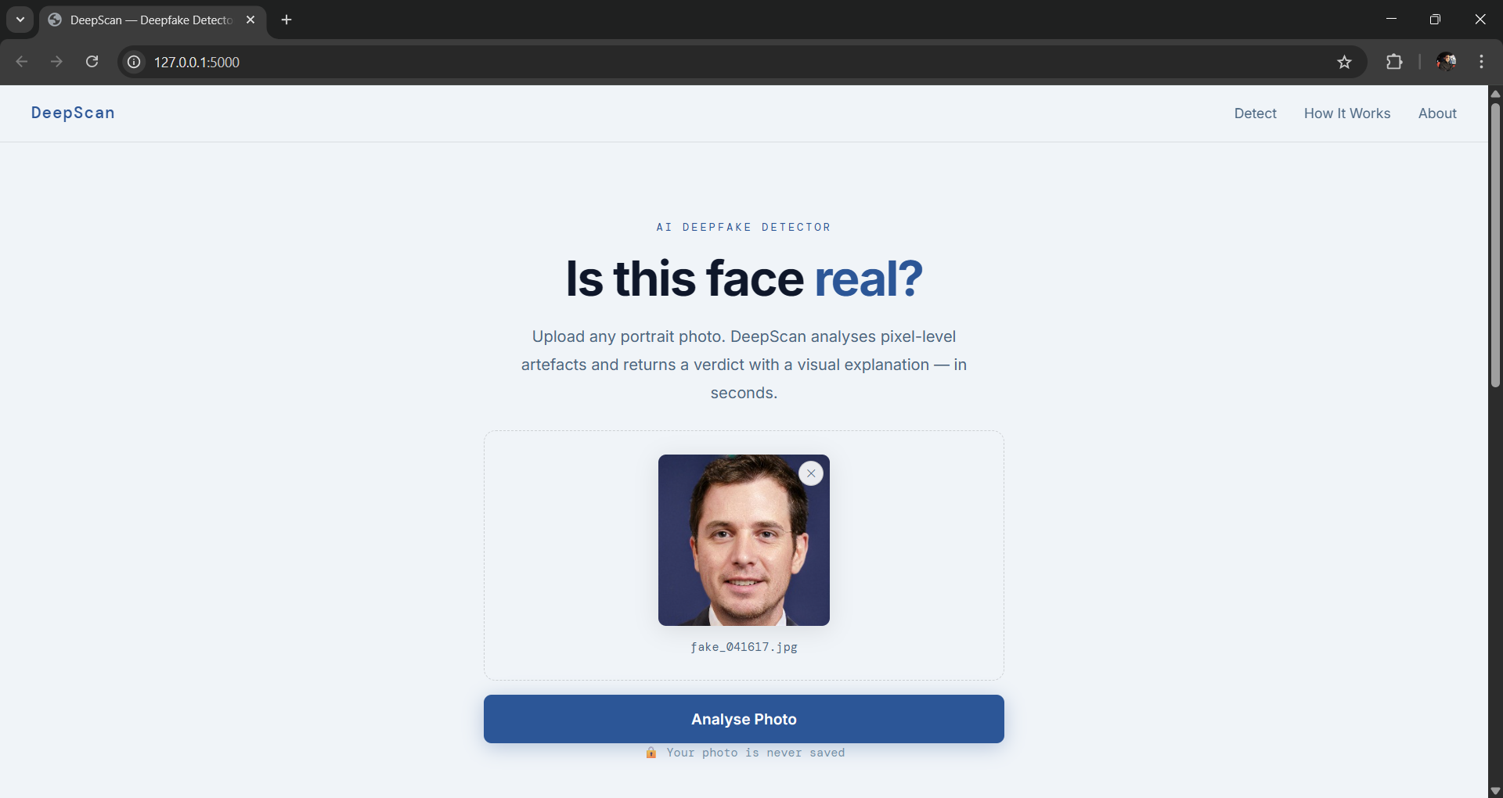
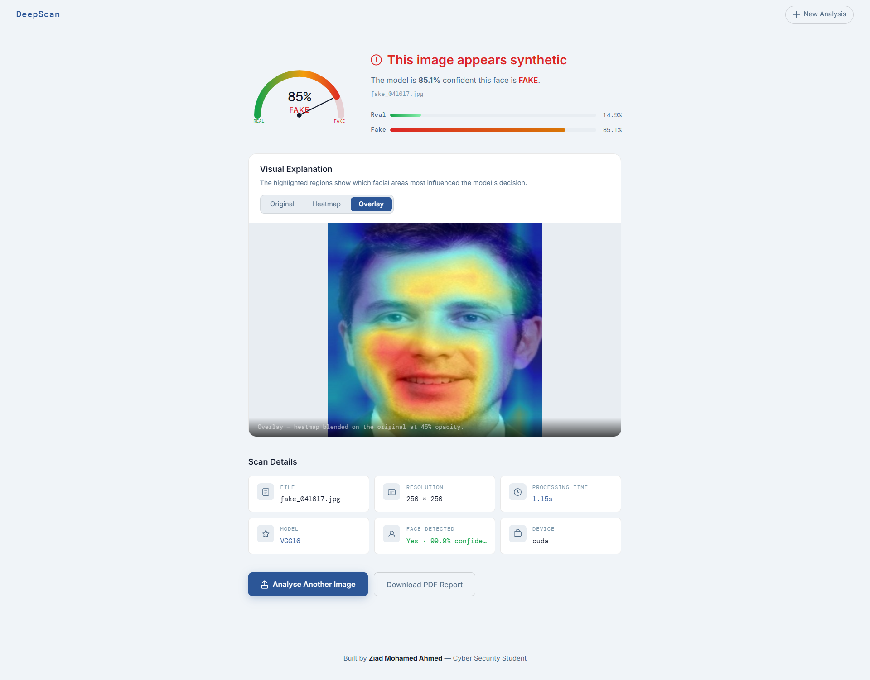
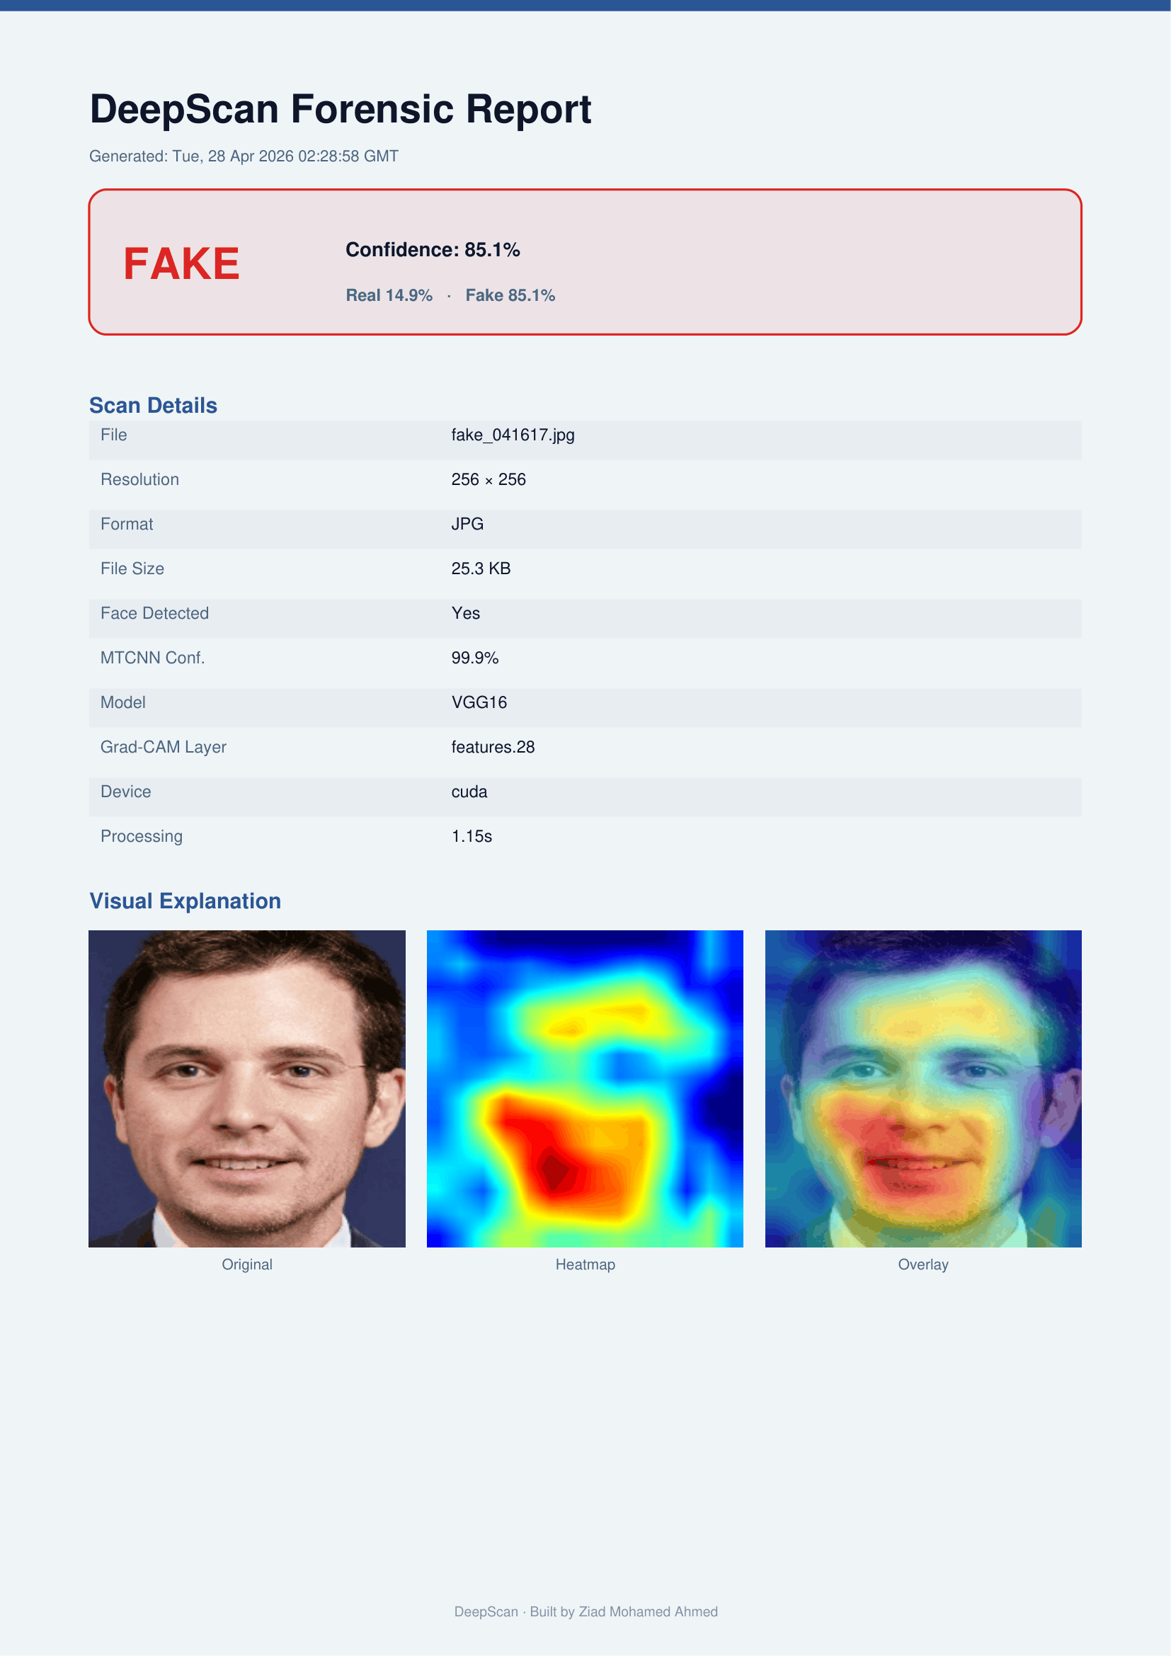
Deepfake Image Detection System | TM471B — May 2026
AOU
System Interfaces
Upload Interface
Result Interface
Forensic Report
18

Slide 11
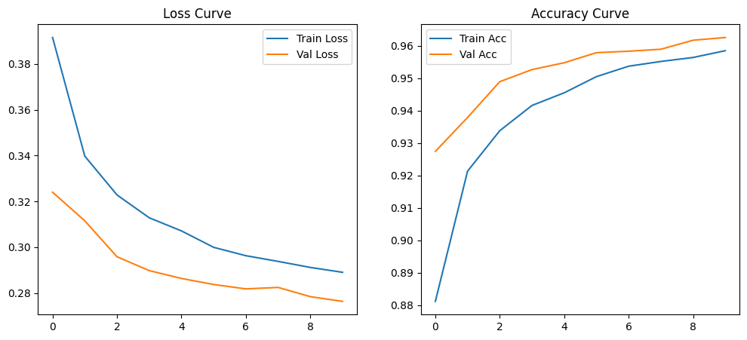
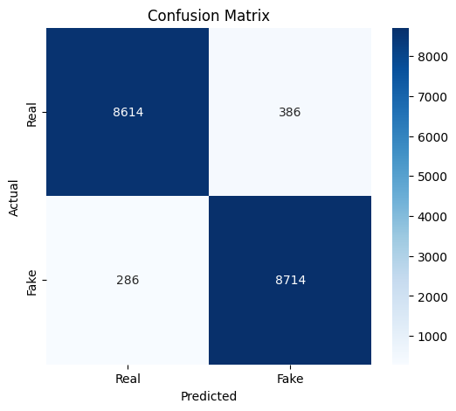
Deepfake Image Detection System | TM471B — May 2026
AOU
Results
Model | Accuracy | Prec.(Real) | Rec.(Real) | Prec.(Fake) | Rec.(Fake) | Macro F1
VGG16 ★ | 96.27% | 0.97 | 0.96 | 0.96 | 0.97 | 0.96
EfficientNet-B3 | 92.71% | 0.95 | 0.90 | 0.91 | 0.95 | 0.93
ResNet18 | 90.49% | 0.92 | 0.89 | 0.89 | 0.92 | 0.90
100%
10
Notes:
VGG16 achieved 96.27% test accuracy — significantly above our 90% target. The confusion matrix shows 8,714 true positives and 8,614 true negatives. With only 286 false negatives, the model is more sensitive to detecting fakes than mislabelling real images — which is the safer error for a forensic tool. EfficientNet-B3 and ResNet18 both met the 90% threshold but were outperformed by VGG16.

Slide 12
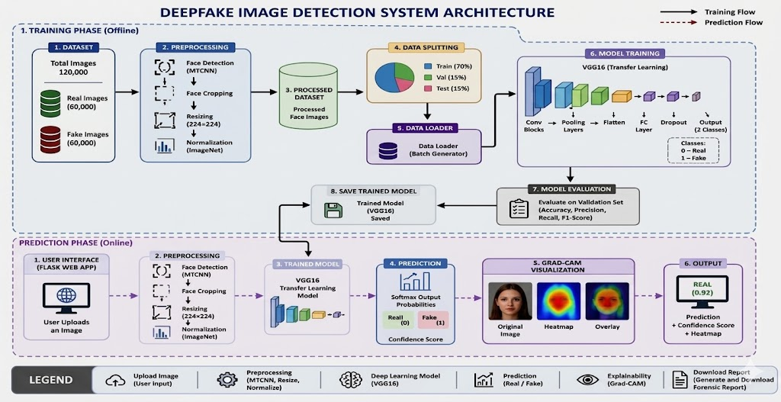
Deepfake Image Detection System | TM471B — May 2026
AOU
System Architecture

Slide 13




Deepfake Image Detection System | TM471B — May 2026
Future Work
AOU
Future Work
Video Analysis
Audio Detection
Optical flow + frame-consistency checks for AI-manipulated video sequences
Spectrogram classifiers (RawNet2, Wav2Vec) to identify AI-generated speech & voice cloning
ID Document Verify
Model Expansion
OCR consistency checks and MRZ validation for passports and national ID cards
Retrain on Stable Diffusion / DALL·E; explore Vision Transformers (ViT) for cross-dataset robustness
Notes:
Four future directions. The roadmap bar shows a natural sequence from video → audio → ID documents → ViT retraining. The modular Flask architecture makes these extensions straightforward. ~20 sec.

Slide 14
Deepfake Image Detection System | TM471B — May 2026
AOU
Conclusion
VGG16 achieved 96.27% test accuracy with a balanced Macro F1-score of 0.96, satisfying all functional requirements and the ≥90% accuracy threshold while delivering real-time inference within ≤5 seconds.
Three Contributions to AI-Assisted Digital Forensics
1
Rigorous empirical comparison of VGG16, EfficientNet-B3, and ResNet18 under identical, reproducible conditions — providing a reference benchmark on RealVsFake_81k.
2
Practical integration of MTCNN + VGG16 + Grad-CAM into a deployable, browser-based forensic tool accessible without installation or account registration.
3
Concrete roadmap for future development: video analysis, audio verification, identity document inspection, Vision Transformers, and active learning.
"Deepfake technology is advancing faster than the forensic frameworksdi designed to contain it. This project demonstrates that accurate, explainable, and privacy-preserving detection is achievable today using open-source architectures."
12
Notes:
To conclude: VGG16 achieved 96.27% accuracy, all requirements were met, and the system is deployable today without any proprietary infrastructure. The project makes three contributions: a reproducible benchmark comparison, a practical deployable forensic tool, and a clear roadmap for future work. Deepfakes are advancing rapidly — this project demonstrates that accessible, explainable detection tools can be built with open-source resources. Thank you.

