Slide 1

Analysis of Fatal Police Shooting
by Volodymyr Shereperov

Slide 2
Introduction
The main purpose of the analysis is to determine the categories of people shot by US police. I want to know whether such resistance on the part of the police was necessary. And also learn the trends in the behavior of offender.

Slide 3
Dataset
The dataset that I have chosen contains information about the offenders as well as data on the incident. From it I took data on age, gender, weapons, date of crime, as well as the total number of incidents.

Slide 4
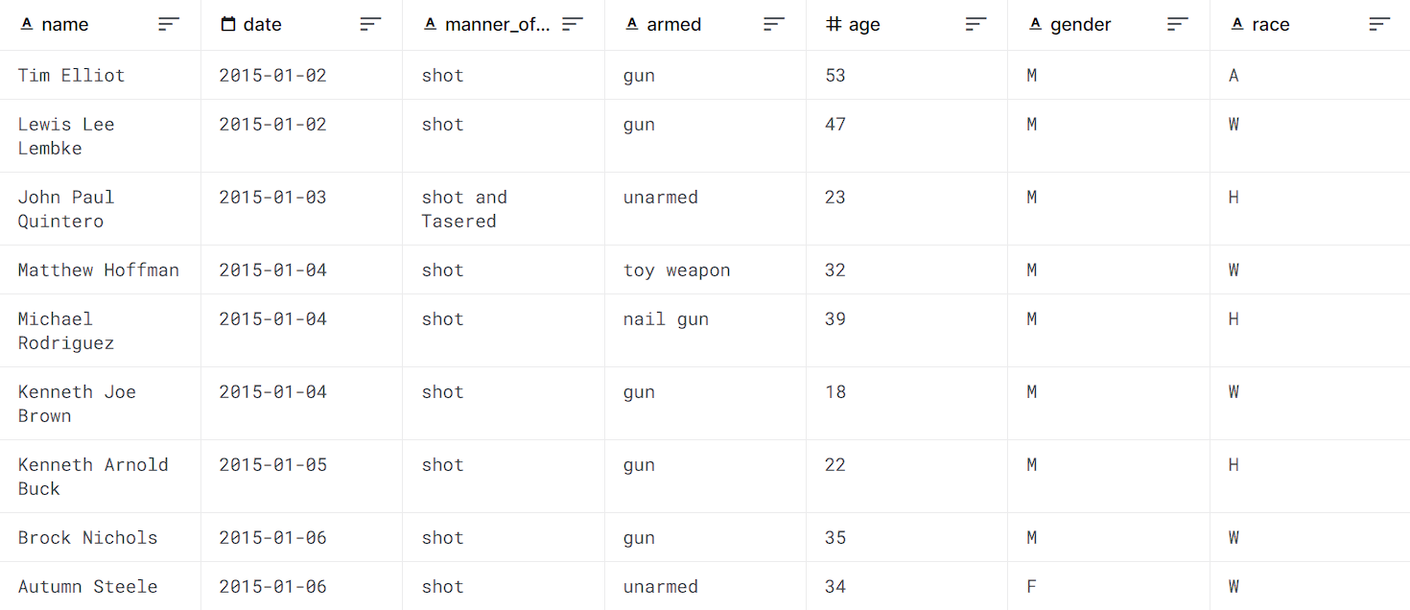

Slide 5
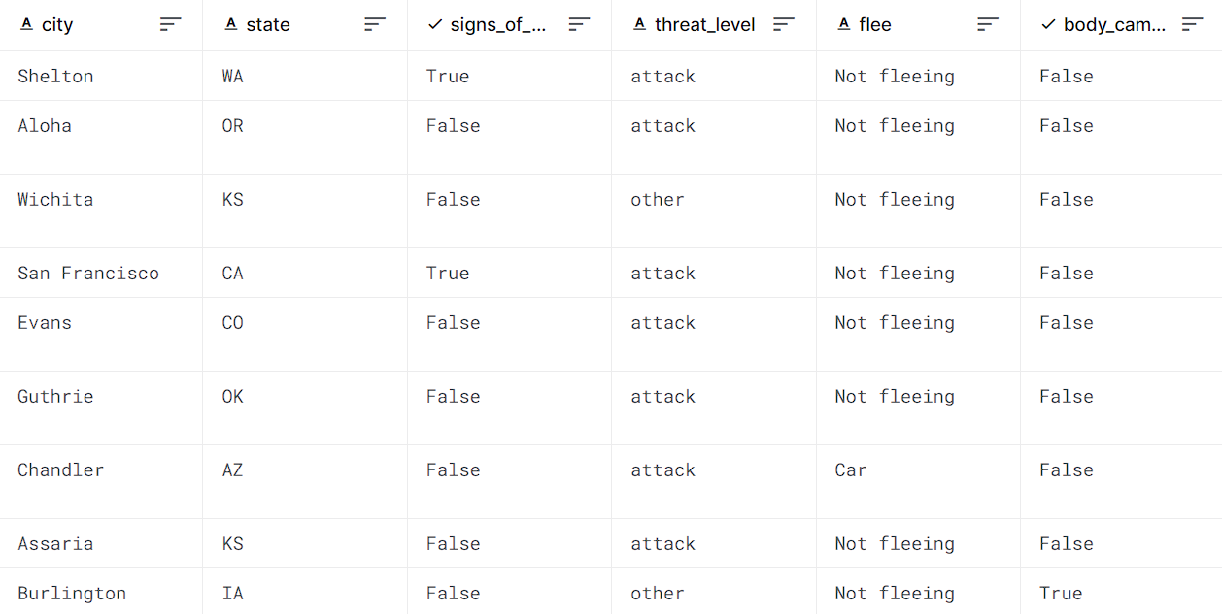

Slide 6
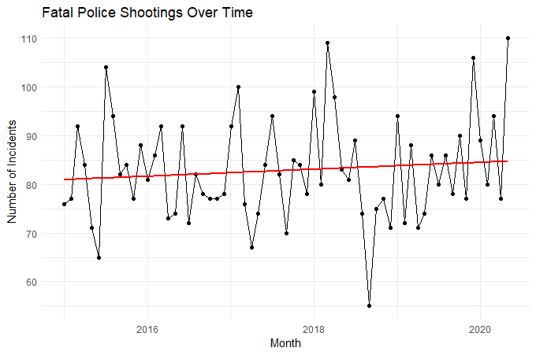

Slide 7
The graph shows a too sharp change in the number of incidents. Such data come out due to too small a data sample (5 years). However, according to the trend line, the number of incidents is increasing every year. This makes the issue relevant.

Slide 8
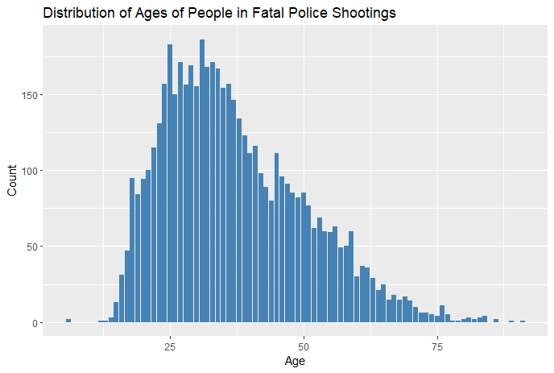

Slide 9
The main age category of offenders: 23-35 years old. We can also see a slight increase in numbers starting at age 44.

Slide 10
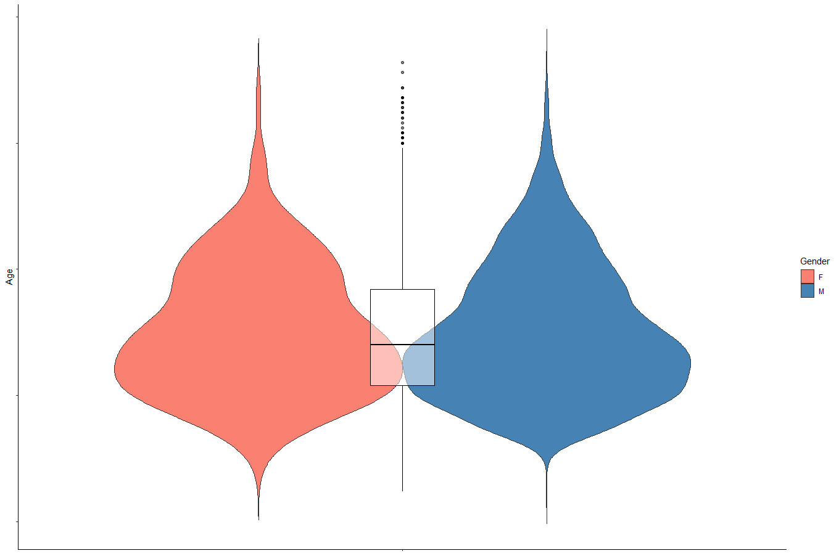
The violin plot also shows an almost complete identity between age and gender. However, it was interesting to notice some small differences.

Slide 11
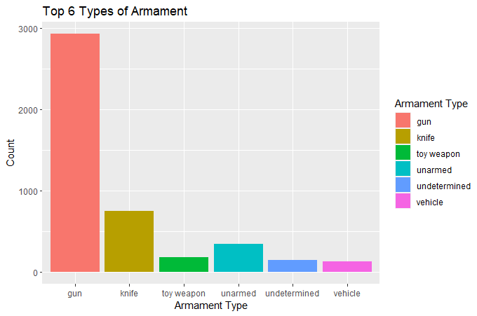

Slide 12
The most common weapons are the gun (with a large predominance) and the knife. It can be concluded that the vast majority posed a threat to the police.

Slide 13
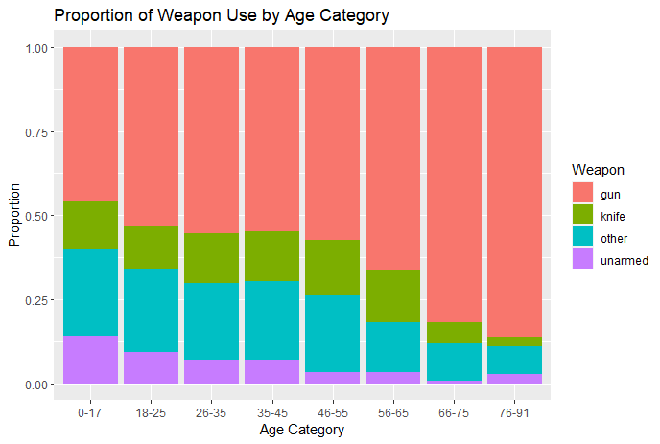

Slide 14
This chart indicates a trend that the older the offender, the more often he prefers a gun.

Slide 15
Conclusions
It was determined that the trend of committing police shootings is slightly increasing. The criminals were more often young and middle-aged men who had dangerous weapons with them. The most used was the gun, with the use increasing with the age of the offender.

