Slide 1
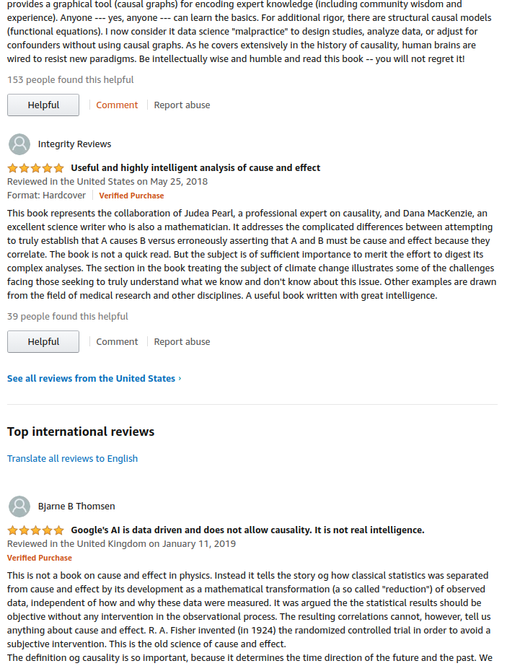
Amazon reviews
Zdenek Vesely
Notes:
Welcome

Slide 2
Disclaimers and assumptions
An interview assessment, not a real pitch
Any action suggested here is probably already implemented, outdone or rejected
Assuming an advance A/B testing framework
Notes:
Has anybody been working for Amazon?
I haven’t seen the gears in Amazon, neither studied carefully the current features.
I’m not naive.
A and B are correlated or depended.
A is higher, B is higher
Causality: push A higher, will B follow?

Slide 3
Correlation vs causation
Observational data → “correlations”
  Detecting existence of patterns
  Dependence (statistical terminology)
A/B testing → causation
  Measuring cause – effect
  Dependence (common language)
Woman
product
Woman review
?
Woman v2b rate
Notes:
Can gender of reviewer have an effect on buyer?
Observation – products with top 5 reviews mostly from women → higher “view-to-buy rate” for women customer
From observational data we can only detect “correlation” (or other relations).
Dependency – doesn’t know the direction.
WR → WB 2x chances
Action: make women see women reviews - wrong

Slide 4
Data
Product categories analyzed:
  Clothing, Shoes and Jewelry
  Movies and TV
  Electronics
  Books
Set of products and reviews
Not full set of the Amazon products
Separate HTML report for each category

Slide 5
Data - features
stars - the review rating (1 - 5)
helpful_positive_1 - 0/1 - the review is helpful positive if it has at least 3 up-votes and there is at least 80% positive votes (1), 0 otherwise
helpful_negative_1 - 0/1 - the review is "helpful" negative (spam) if it has at least 3 down-votes and there is at least 80% negative votes (1), 0 otherwise
tokens - a vector of unique base words excluding stop words
n_words - number of words in the review
relative_review_time - number [0,1]
price - product price (illustrative)
also_bought - products that are often in the same basket
Notes:
What is the relation between the reviews and the helpfulness?
What is the review behavior among different categories?
Is there a relationship between price and reviews?
Which group of reviewers is more valuable to the business?
Is there a relation between reviews from products which are bought together?
Optional - Any other hypothesis you think is interesting, as long it would have business value for Amazon

Slide 6
Tasks
What is the relation between the reviews and the helpfulness?
What is the review behavior among different categories?
Is there a relationship between price and reviews?
Which group of reviewers is more valuable to the business?
Is there a relation between reviews from products which are bought together?
Optional - Any other hypothesis you think is interesting, as long it would have business value for Amazon

Slide 7
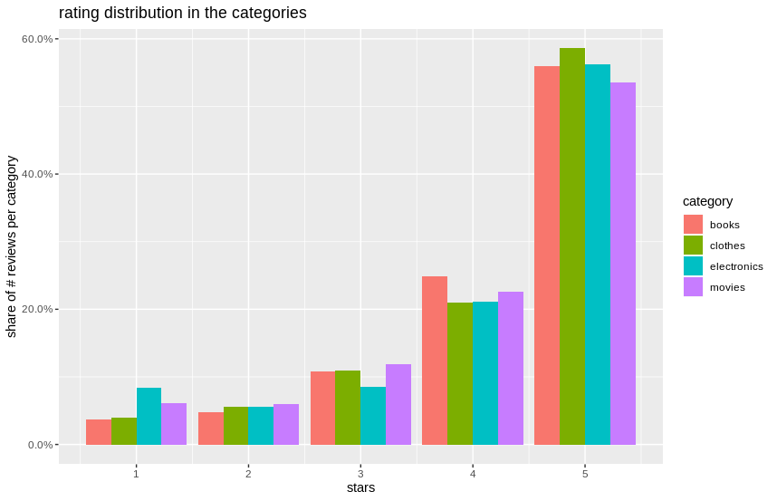
Reviews – helpfulness relationship
The stars

Slide 8
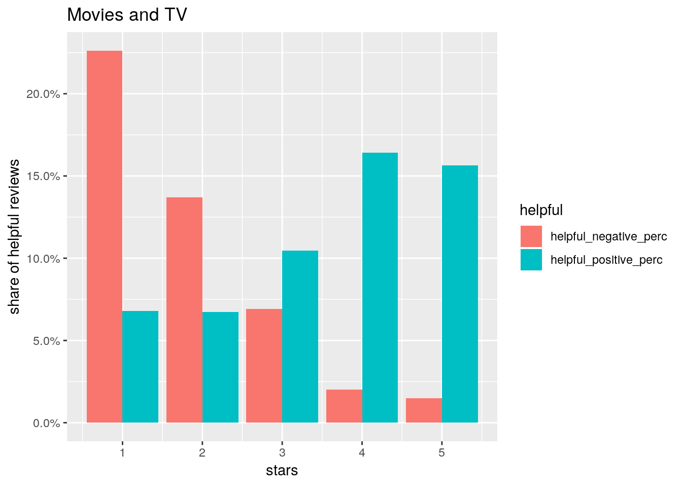
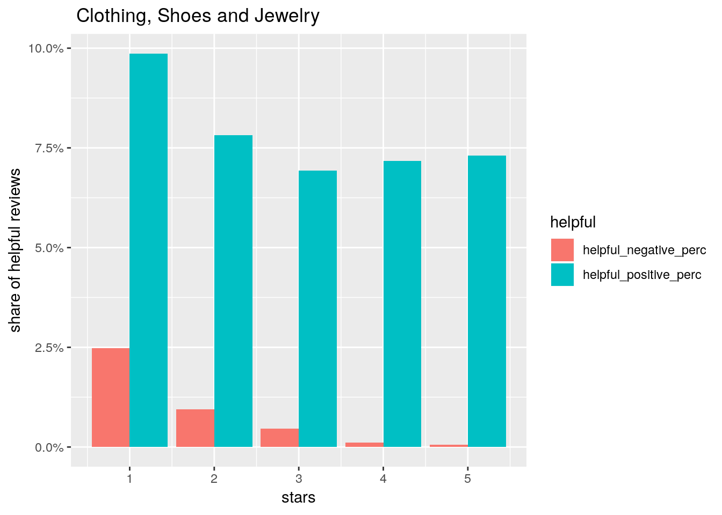
Reviews – helpfulness relationship
The stars
Notes:
Clothes – negative review as warning – low quality
Movies – positive review – agreeing with the view
Disclaimer – much more 5* reviews, low percentage is expected
Action item idea – find similar product with similar 5* review
Instead of being discourage from buying the product – offer better alternative
(I don’t like the material - 2* – scarf)

Slide 9
Reviews – helpfulness relationship
The review text - words
Identifying words linked to high rating or helpful reviews
Example of helpful words
  Movies: booklet, beginn, orchestra, yoga, archiv, cardio, stereo…
  Electronic: digit, mode, display, note, record, sourc, mention, manual, program
Notes:
NLP: Sentiment analyses
e.g. Christmas – both positive and least helpful (top 15)
Also not helpful – relative (grandfather, sister etc.)
Already in place – identifying key words and showing them by the product

Slide 10
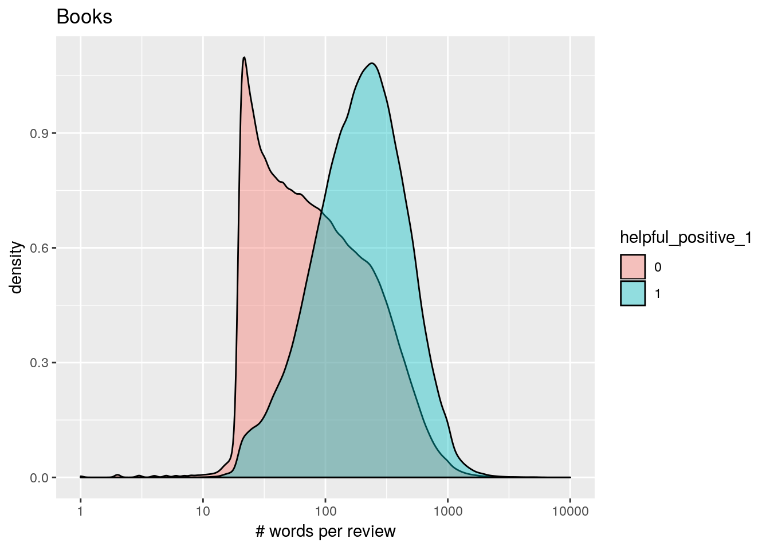
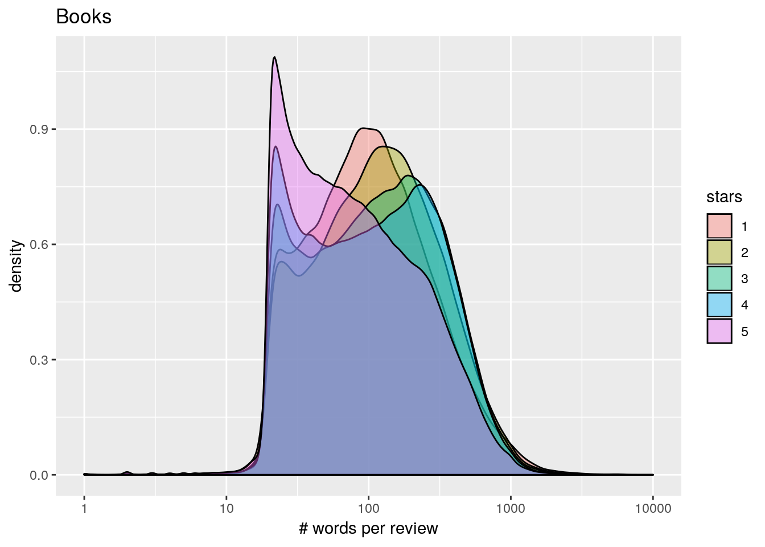
Reviews – helpfulness relationship
The review text - length
Notes:
Similar for all 4 categories
The longer the more helpful
Big spike in not helpful short reviews – these are usually 5* reviews

Slide 11
Reviews – helpfulness relationship
The review text – action item
Predict review text helpfulness based on:
  Words
  Length
  Rating
Show helpful reviews on top for new products
Helpful 5* review can sell the product (A/B test)
Helpful 1* review?
Notes:
I haven’t check helpful 5* words vs helpful 1* words
The clothes category – lots of products with low review count per product
Implementation + A/B test needed to estimate the value
Helpful 5* review is good product advertisement
helpful 1* review can discourage from buying it.
Company values – customer first or sales first?
Sales are not always the best metric for customer satisfaction.
Better metric – holistic - follow also the return ratio (maybe the customer buys better product and will not return it)
Or – as mentioned before – suggest similar product with similar but high rate review

Slide 12
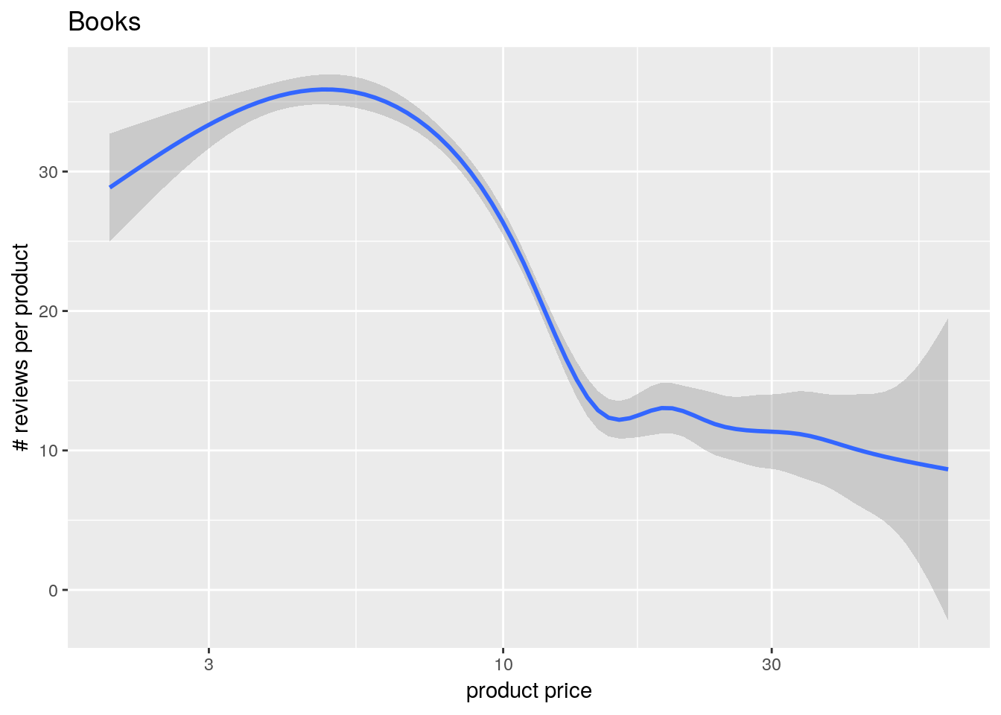
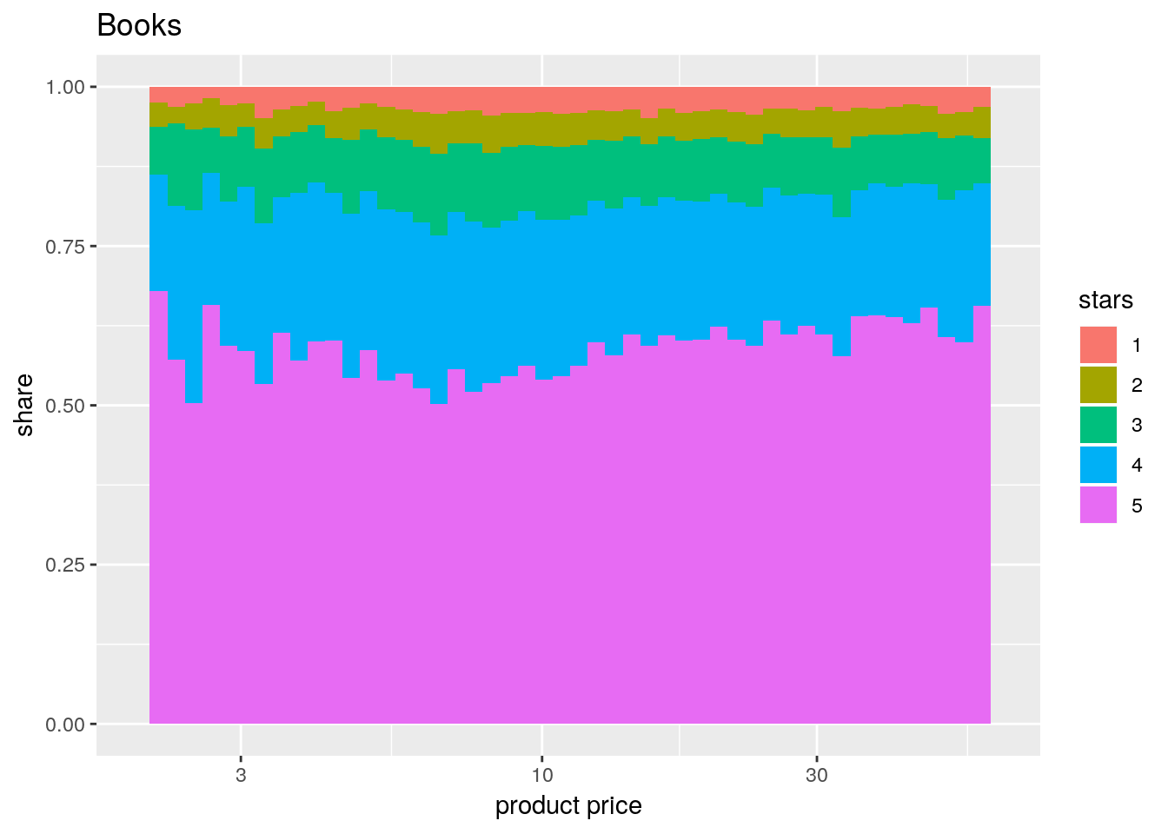
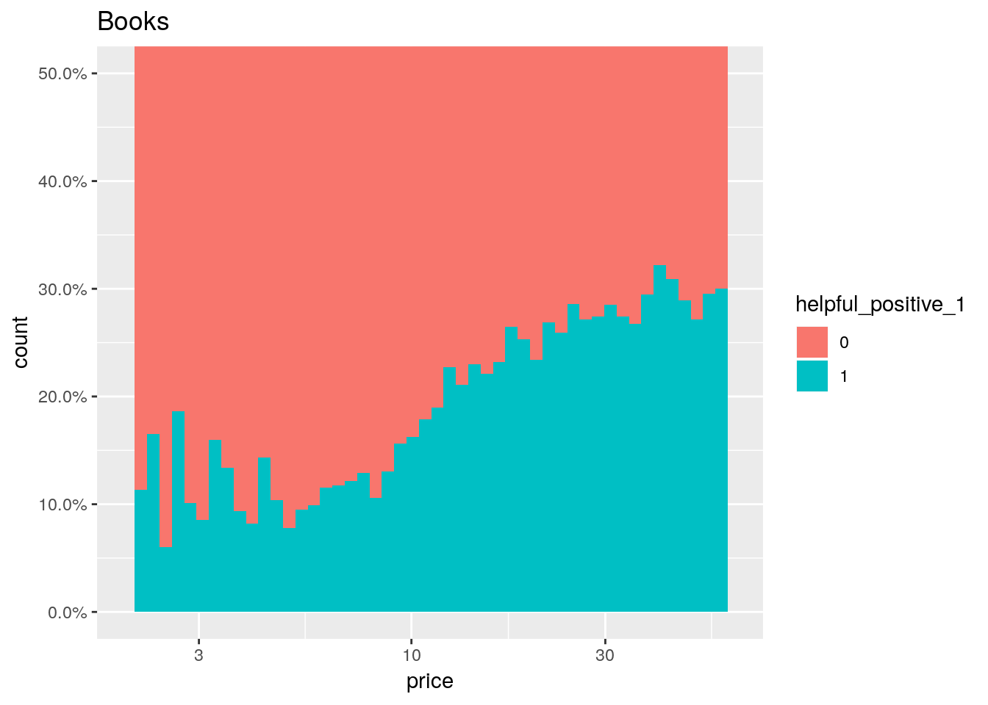
Price and reviews
Price is only illustrational
# reviews per product declining with price
Ratings not to overly sensitive to the price
Incentives for reviews (high price, low # reviews)
Notes:
Price is only illustrative (changes with time)
Higher price → lower sales → lower reviews counts
But – this pattern in Books and Electronics
Not in Clothes or Movies
Idea – create incentives for reviews of expensive products without many reviews
eg. voucher, discharge…
Especially for established reviewers (high rating? - collaborative filtering)
Again – A/B test that
geom_smooth – loess (Local Polynomial Regression Fitting) – 95% confidence interval

Slide 13
Review behavior among different categories
The customer demographics and behavior differs in clothes store, bookstore etc.
Differences in:
  Helpful words
  Helpfulness & spam rate
  # reviews per product
  ...
Notes:
Clothes – bargain hunters
Books, movies – opposite, less price sensitive (movies from torrent)
Electronics – mainstream
In most of attributes are differences. But there are also similarities (distribution of stars.)

Slide 14
Which group of reviewers is more valuable to the business?
This is question on causality
  Only speculations (hypothesis)
Positive:
  Helpful high rating = advertisement
  Helpful low rating → less returns?
  Higher price + low # reviews → value
  Taboo products?
Notes:
Taboo product – high sales potential, low # reviews
I do not have sales data, but find product with low reviews/sold products ratio

Slide 15
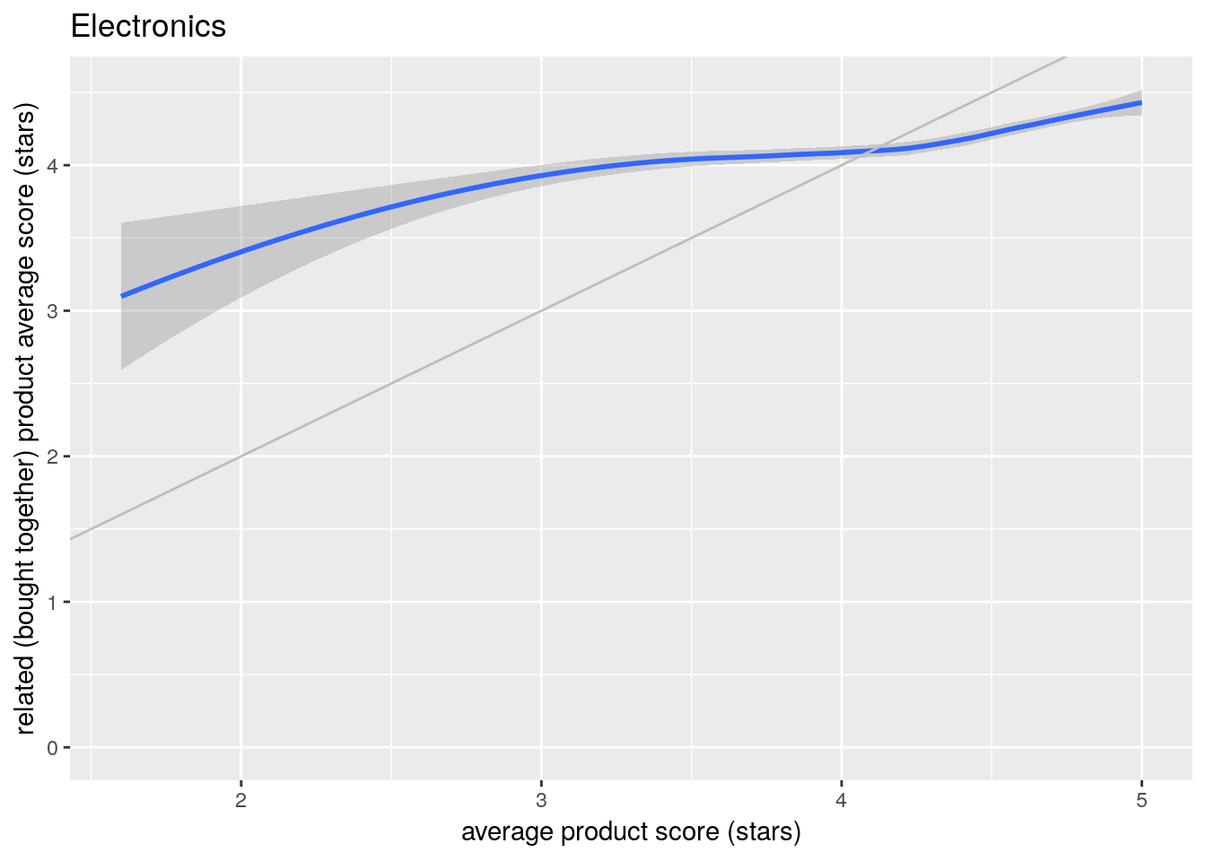
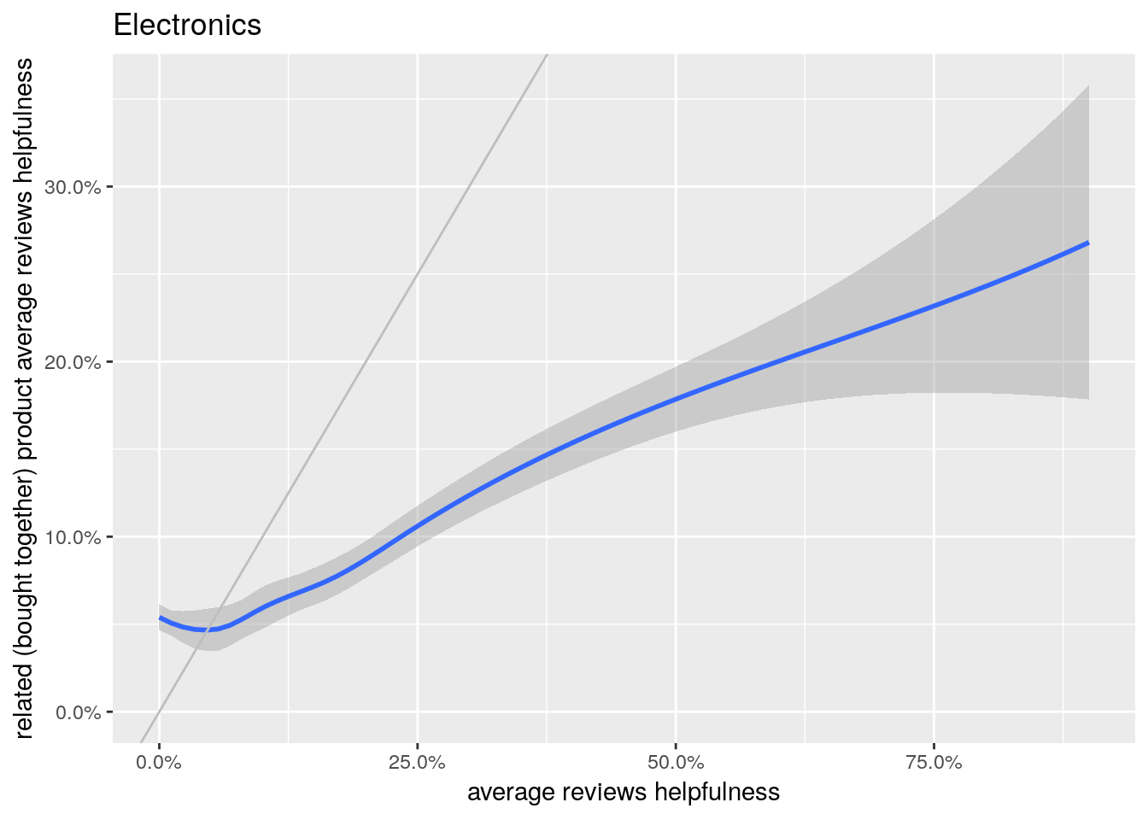
Reviews of products bought together
Both rating and helpfulness correlated
  For all 4 categories
Notes:
Another possible analyses
- same reviewer takes
- same time reviews
- words similarities
geom_smooth – loess (Local Polynomial Regression Fitting) – 95% confidence interval

Slide 16
Thank you
Questions?
More on:
  github.com/zdenekvesely/takeaway_interview
Reports:
  Books report
  Movies and TV report
  Electronics report
  Clothing, Shoes and Jewelry report

