Slide 1
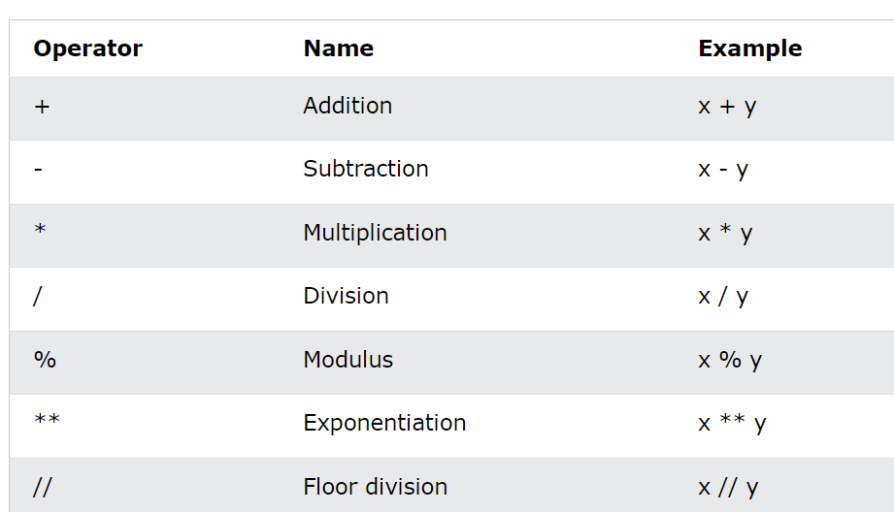
Python Arithmetic Operators

Slide 2
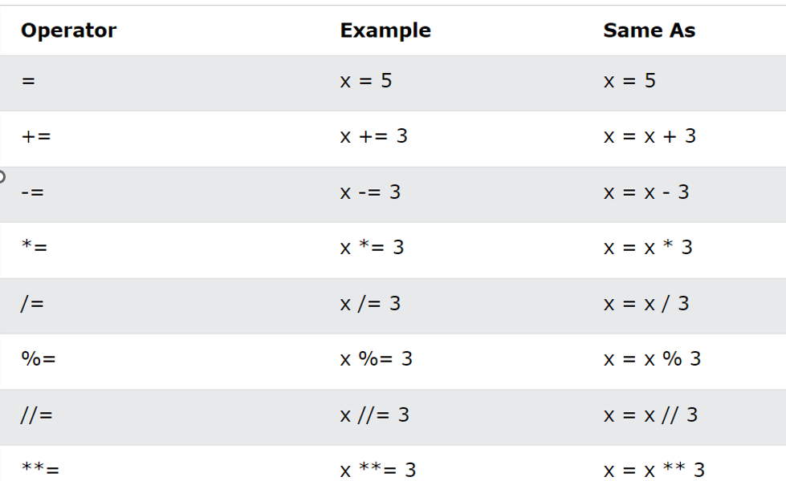
Python Assignment Operators

Slide 3
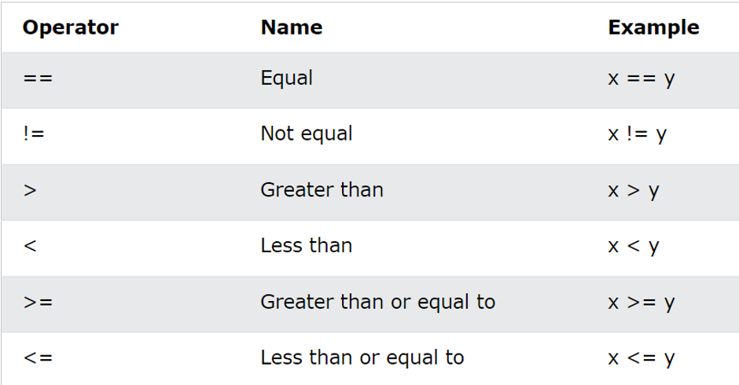
Python Comparison Operators

Slide 4
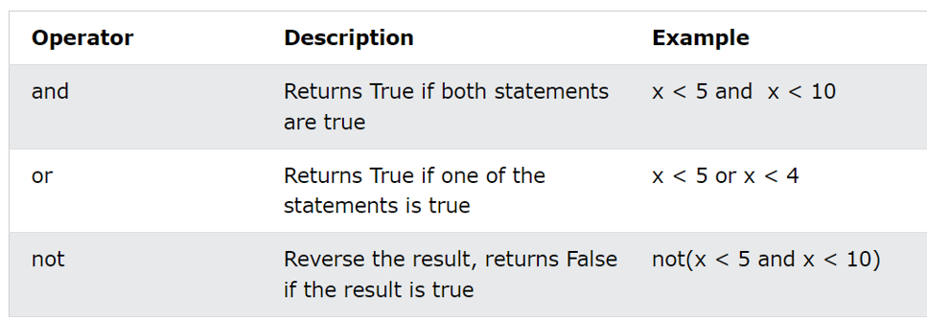
Python Logical Operators

Slide 5

Python Identity Operators

Slide 6
