Slide 1
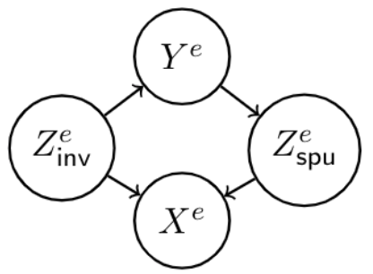
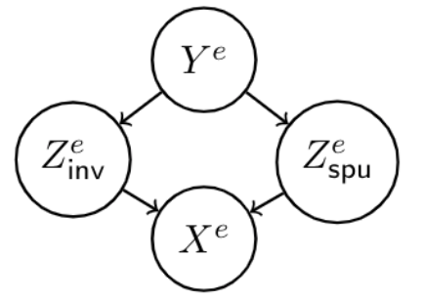
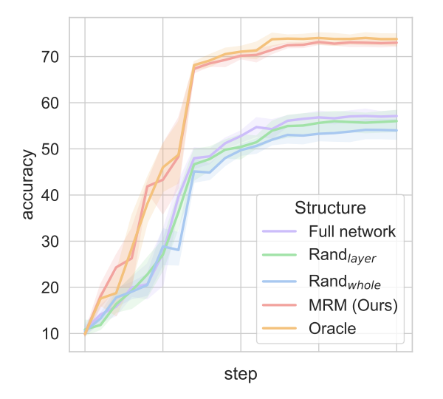







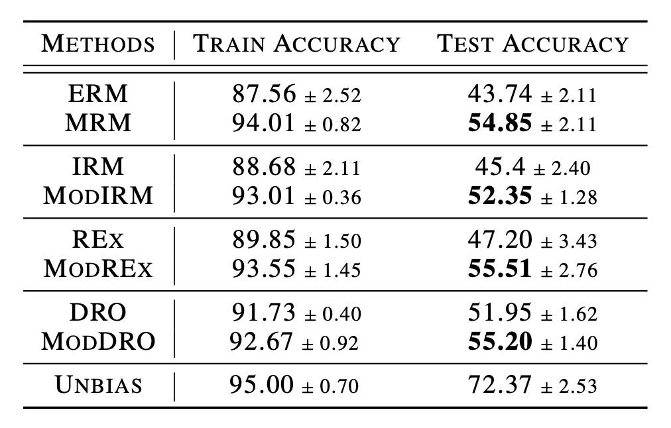
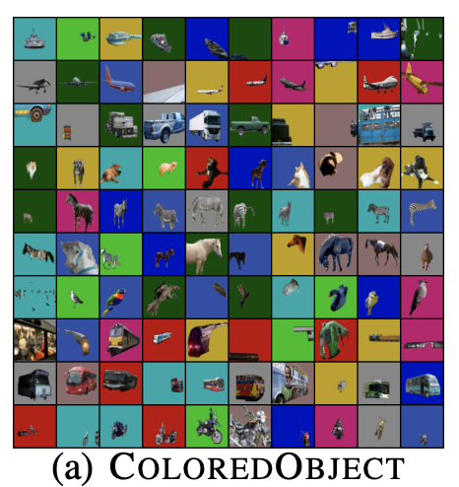






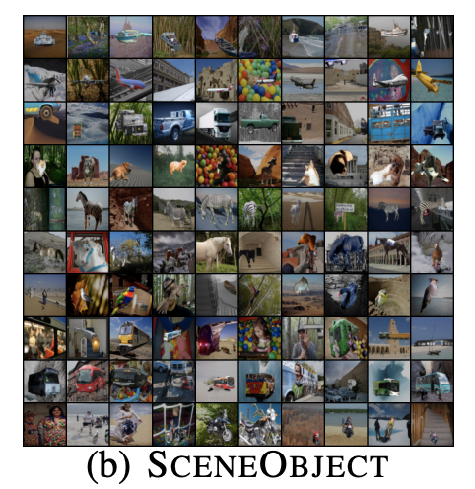
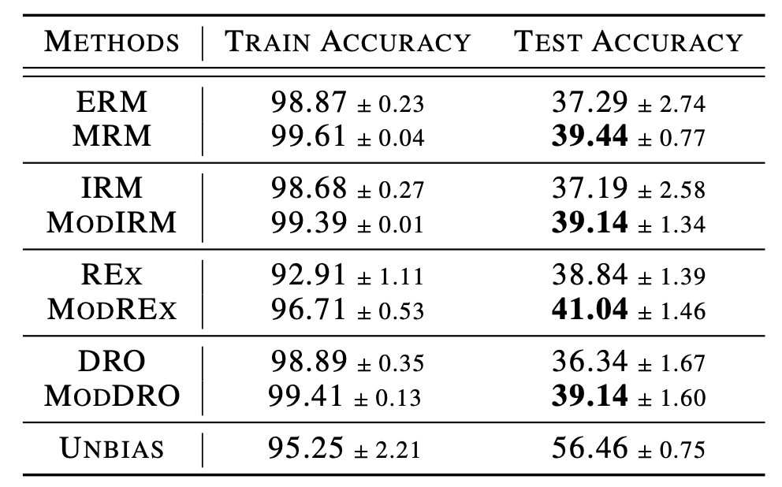




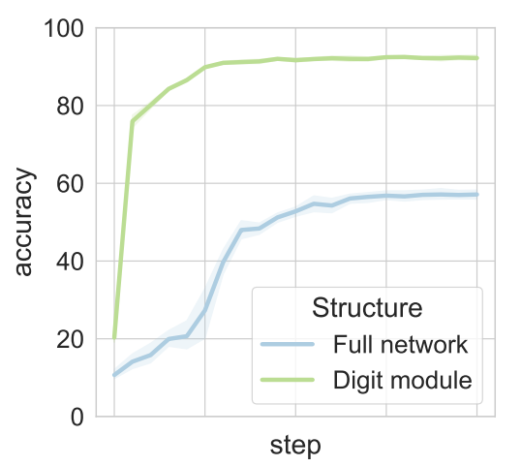
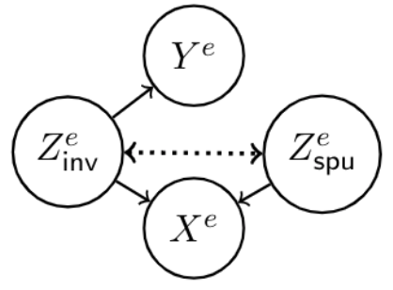
Can Subnetwork Structure be the Key to Out-of-Distribution Generalization?
Dinghuai Zhang¹ , Kartik Ahuja¹, Yilun Xu², Yisen Wang³, Aaron Courville¹
¹MILA, ²MIT, ³Peking University
Distribution shift problems
But “non realizable” cases are also possible:
Functional “lottery ticket”
Generalization is one of the core problems in machine learning
Deep learning has addressed IID generalization to a large extent
But out-of-distribution (OOD) generalization problem is still far from cooked
[4] proposes that there exists subnetwork good for IID generalization. We show that a functional variant of it exists for OOD settings
Invariant Risk
Minimization,
arxiv 2019
Risks of
Invariant Risk Minimization,
ICLR2021
We propose Modular Risk Minimization (MRM), a straight forward yet effective method to find a good OOD module:
Spurious correlation
A (linear) motivating example
A spurious relationship or spurious correlation is a mathematical relationship in which two or more events or variables are associated but not causally related, due to either coincidence or the presence of a certain third, unseen factor.
Suppose all labels and latent features are binary
train the full model
searching module with some desired OOD & sparsity properties
retrain the module with same initialization
Bias in data: let and have a correlation
Out-of-distribution generalization problem
Side note: When is high dimensional, the model tends to rely on it
MRM is designed to be easy to combine with other invariant methods like IRM, REx, … and becomes ModIRM, ModREx, … See the full paper for more details
Consider a supervised learning setting where data follows
Proposition (informal): for a sparse classifier and regular classifier on dataset with such bias, when the dimensionality of spurious feature is large enough:
and have similar in-distribution performance
has better margin and out-of-distribution performance
(Oracle means searching module with extra information about test domain in step 2)
Multiple environments assumption: each environment
We only have a subset of environments in training time
More experiments
The goal of OOD generalization problem is defined as
Insights
Data structure
Sparsity on proper places has good inductive bias for OOD generalization
In [6], this is also the case where the proposed algorithm only use subset of linear features, corresponding to sparsity in parameters
How should we push this insight into deep neural networks?
We assume input data
is generated from and
We follow the “realizable” assumption [5], where
Functional Modularity Analysis
We also assume there exists inverse maps
A neural network is parametrized by
We search for a module / subnetwork
with module mask
The goal is then to learn
The subnetwork structure is learned end-to-end with Gumbel-sigmoid trick
Four algorithms are studied: ERM, IRM, REx, GroupDRO
Related works
Modular subnetwork introspection
“Realizability” means invariant features contain all information about label
Does a good subnetwork for OOD exist within a spuriously biased large network?
References
In this work we consider “realizable” case:
We construct a 10-class “FullColoredMNIST”
with previous stated bias for modularity probing,
where digit is invariant feature
[1] Invariant Risk Minimization, arxiv 2019
[2] Out-of-Distribution Generalization via Risk Extrapolation, ICML2021
[3] Distributionally Robust Neural Networks for Group Shifts: On the Importance of Regularization for Worst-Case Generalization, ICLR2020
[4] The lottery ticket hypothesis: Finding sparse, trainable neural networks. ICLR2019
[5] Out of Distribution Generalization in Machine Learning, arxiv2020
[6] Causal inference using invariant prediction: identification and confidence intervals. Jonas Peters et al. JRSSB
We use data which has the same distribution with out-domain to search for a digit module which is good for OOD
We take ERM as an example here:

