Slide 1
Can Subnetwork Structure be the Key to Out-of-Distribution Generalization?
Dinghuai Zhang, Kartik Ahuja, Yilun Xu, Yisen Wang, Aaron Courville
Mila, MIT, Peking University

Slide 2
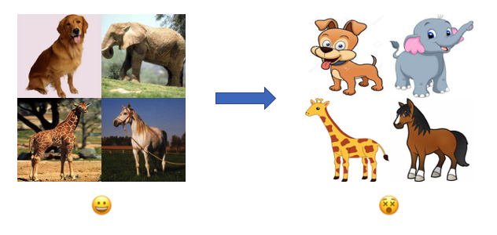
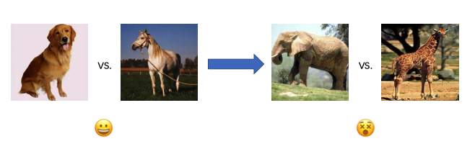
Distribution shift problems
Generalization is one of the core problems in machine learning
Deep learning has addressed IID generalization to a large extent
But out-of-distribution (OOD) generalization problem is still far from cooked

Slide 3
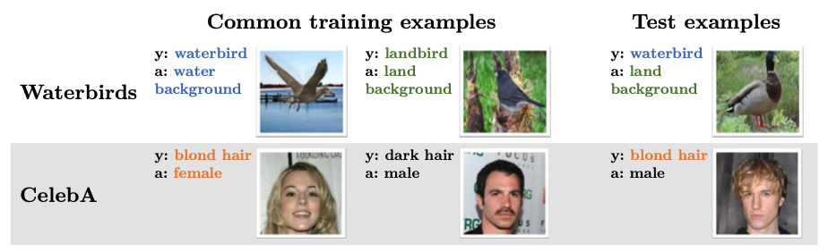
Spurious correlation
“True label” may be spuriously correlated with some spurious properties
DISTRIBUTIONALLY ROBUST NEURAL NETWORKS FOR GROUP SHIFTS, ICLR2020

Slide 4
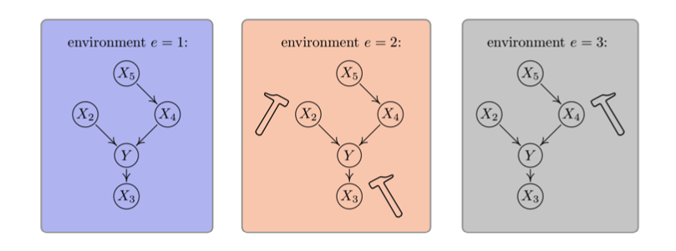
Multiple environments
“Data is collected in different settings and then shuffled to serve as ‘IID’ ones.” “Shuffling data is a loss of information.” --- Leon Bottou
Data collected from different environments follow different distributions
Causal inference using invariant prediction: identification and confidence intervals. Jonas Peters et al. JRSSB

Slide 5


Out-of-distribution generalization problem
Consider a supervised learning setting where data follows
Multiple environments assumption: each environment
We only have a subset of environments in training time
The goal of OOD generalization problem is defined as

Slide 6
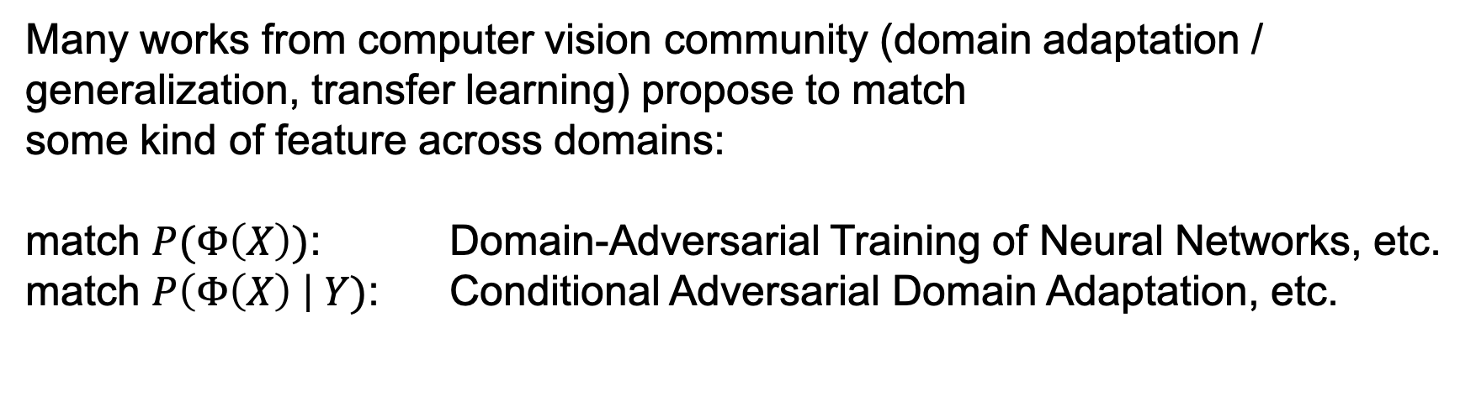
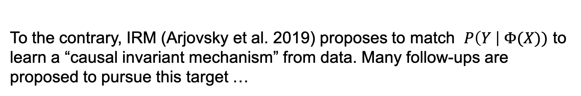
Related works
Many works from computer vision community (domain adaptation / generalization, transfer learning) propose to match
some kind of feature across domains:
match $P(Φ\left(X\right))$: Domain-Adversarial Training of Neural Networks, etc.
match $P\left(Φ\left(X\right) \right| Y)$: Conditional Adversarial Domain Adaptation, etc.
To the contrary, IRM (Arjovsky et al. 2019) proposes to match $P\left(Y \right| Φ(X))$ to learn a “causal invariant mechanism” from data. Many follow-ups are proposed to pursue this target …
Invariant Risk Minimization, arxiv 2019

Slide 7







Data structure
We assume input data
is generated from
We follow the “realizable” assumption¹, where
We also assume there exists inverse maps
The goal is then to learn
1. Out of Distribution Generalization in Machine Learning, arxiv2020

Slide 8
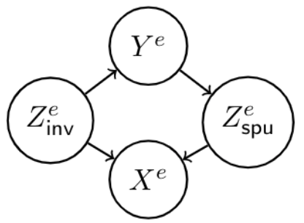
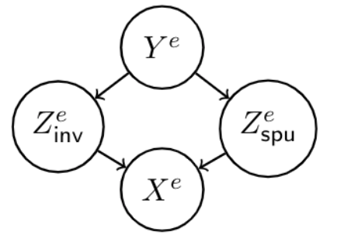
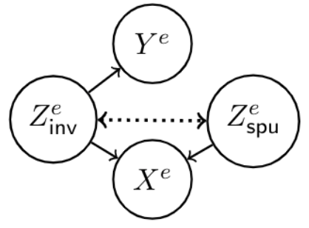
Other settings
“Realizability” means invariant features contain all information about label
In this work we consider “realizable” case
But “non realizable” cases are also possible:
Invariant Risk Minimization, arxiv 2019
Risks of Invariant Risk Minimization, ICLR2021

Slide 9





A (linear) motivating example
Suppose all labels and latent features are binary
Bias in data: let and have a correlation
When is high dimensional, the model tends to rely on it¹
Proposition (informal): for a sparse classifier and regular classifier on dataset with
such bias, when the dimensionality of spurious feature is large enough:
and have similar in-distribution performance
has better margin and out-of-distribution performance
1. Understanding the failure modes of out-of-distribution generalization, ICLR2021

Slide 10
Insights
Sparsity on proper places has good inductive bias for OOD generalization
In Peters et al (2015), this is also the case where the proposed algorithm only use subset of linear features, corresponding to sparsity in parameters
How should we push this insight into deep neural networks?
Causal inference using invariant prediction: identification and confidence intervals. Jonas Peters et al. JRSSB

Slide 11



Functional Modularity Analysis
A neural network is parametrized by
We search for a module / subnetwork
with module mask
The subnetwork structure is learned end-to-end with Gumbel-sigmoid trick
Four algorithms are studied: ERM, IRM, REx, GroupDRO
Invariant Risk Minimization, arxiv 2019
Out-of-Distribution Generalization via Risk Extrapolation, ICML2021
Distributionally Robust Neural Networks for Group Shifts: On the Importance
of Regularization for Worst-Case Generalization, ICLR2020

Slide 12
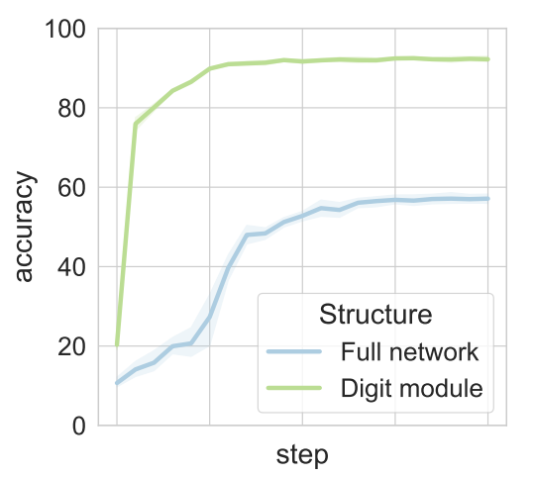
Modular subnetwork introspection
Does a good subnetwork for OOD exist within a spuriously biased large network?
We construct a 10-class “FullColoredMNIST”
with previous stated bias for modularity probing,
where digit is invariant feature
We use data which has the same distribution with out-domain to search for a digit module which is good for OOD
We take ERM as an example here:

Slide 13
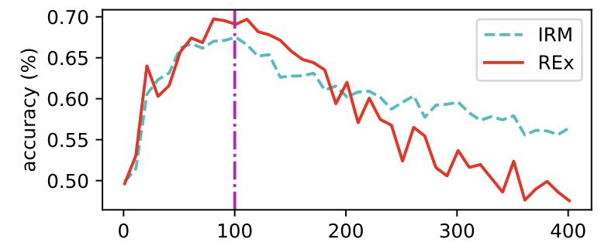
Feature selection viewpoint
A subnetwork with good inductive bias exists within a large network!
This partially reflect that invariant feature could be extracted effectively
with proper structure.
In fact, people have claimed the OOD algorithms are doing feature selection:
(OOD penalty terms can only works well when they’re involved at 100 steps)
Out-of-Distribution Generalization via Risk Extrapolation, ICML2021

Slide 14
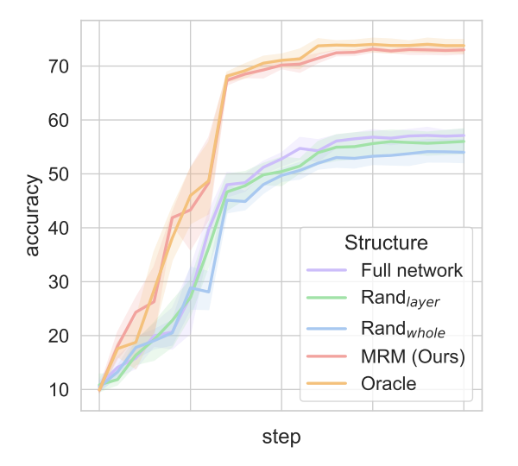
Functional “lottery ticket”
Frankle et al. proposes that there exists subnetwork good for IID generalization
We show that a functional variant of it exists for OOD settings
We propose Modular Risk Minimization (MRM), a straight forward yet effective method to find a good OOD module:
train the full model
searching module with some desired OOD & sparsity properties
retrain the module with same initialization
MRM is designed to be easy to combine with other invariant methods like IRM, REx, … and becomes ModIRM, ModREx, … See the full paper for more details
(Oracle means searching module with extra information about test domain in step 2)
The lottery ticket hypothesis: Finding sparse, trainable neural networks. ICLR2019

Slide 15
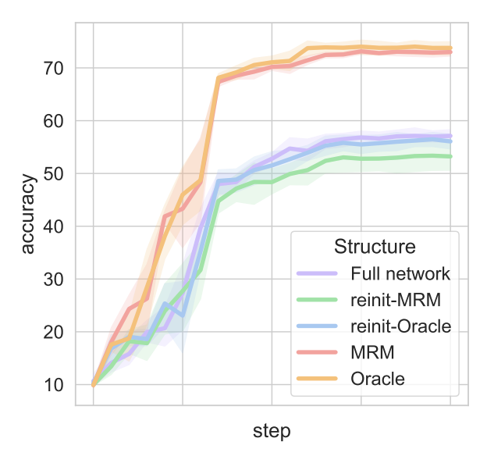
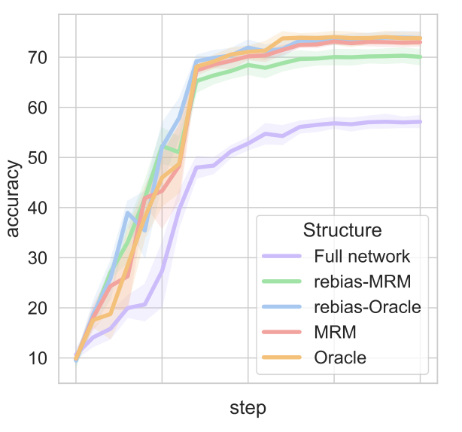
Ablation study
1. Importance of initialization
2. Effects of bias relationship
The learned structure is invariant to any kinds of spurious color relationship!

Slide 16
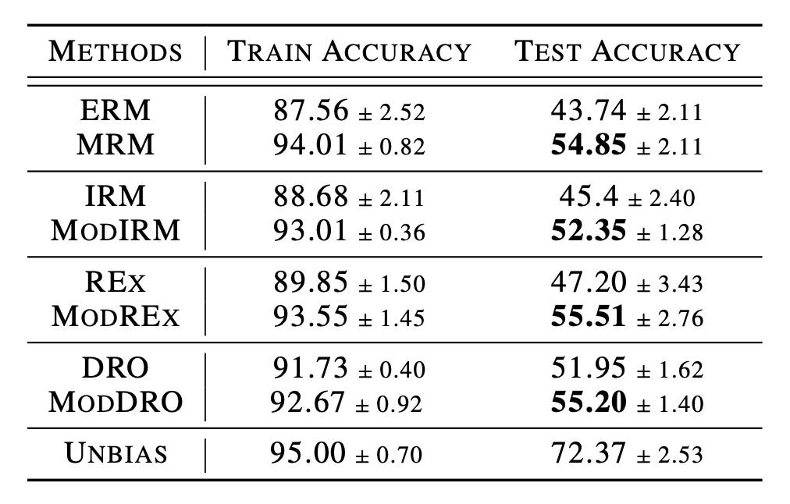
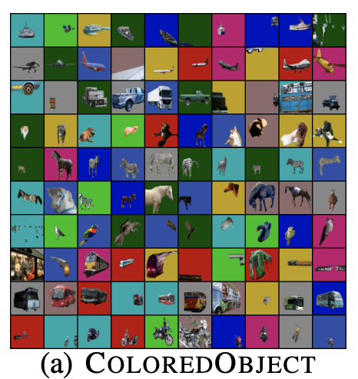
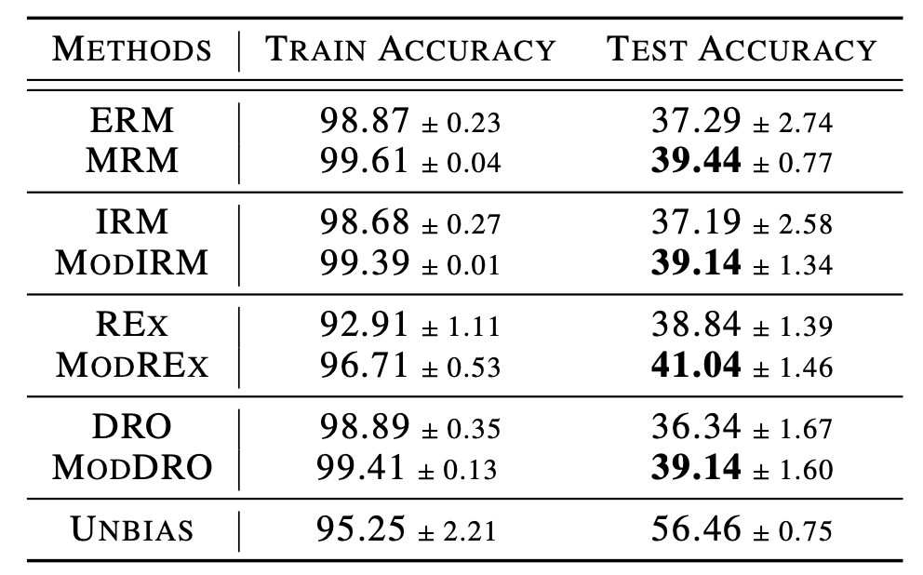
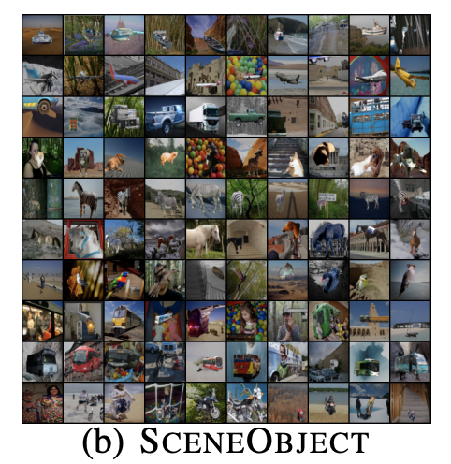
More experiments

Slide 17
Thank you for listening!
Notes:
In Slide Show mode, select the arrows to visit links.

