Slide 1
Intro of Out-of-distribution Generalization
Dinghuai Zhang 2020.12

Slide 2
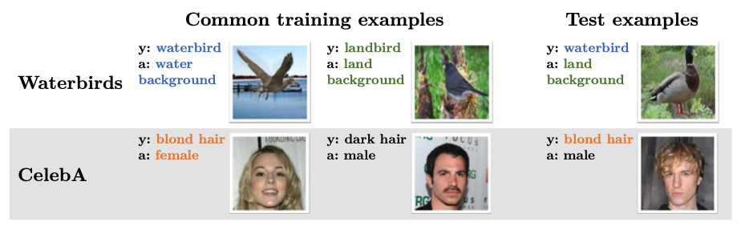
What’s “spurious” correlation?
“true label” and “spurious label”

Slide 3
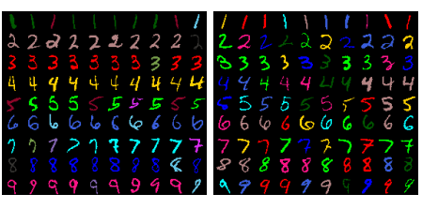
What’s “spurious” correlation?
“true label” and “spurious label”

Slide 4

GroupDRO
DISTRIBUTIONALLY ROBUST NEURAL NETWORKS FOR GROUP SHIFTS:
ON THE IMPORTANCE OF REGULARIZATION FOR WORST-CASE GENERALIZATION, Shiori Sagawa et al.

Slide 5
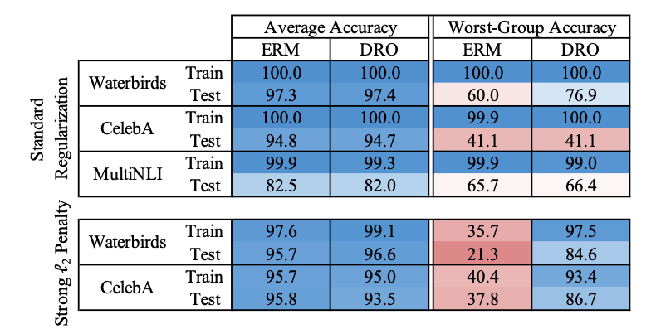

Slide 6
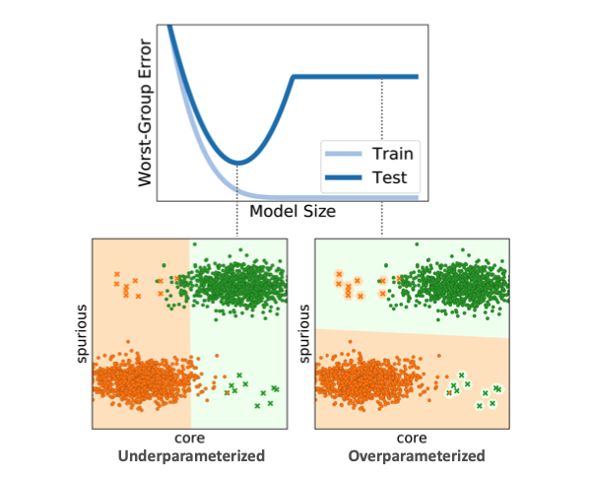
Overparameterization exacerbates spurious correlations
As model size grows, avg errors decrease,
but worst group error increases
Reason: overparametrized models use
spurious feature to classify
An investigation of why overparameterization exacerbates spurious correlations, Shiori Sagawa et al.

Slide 7
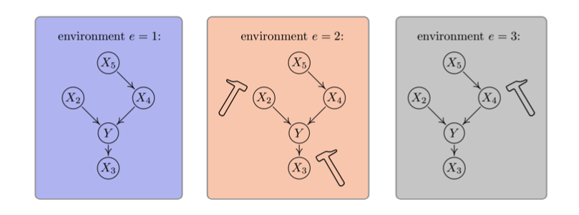
How to get rid of “spurious” feature? Or, how to do invariant learning
Causal inference using invariant prediction: identification and confidence intervals. Jonas Peters et al

Slide 8
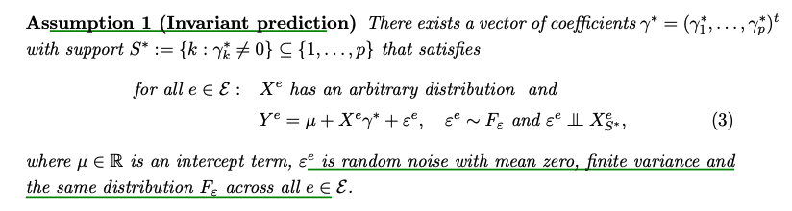
Invariant Causal Predictoin (ICP)
We will interchangeably use “domain” and “environment”.

Slide 9
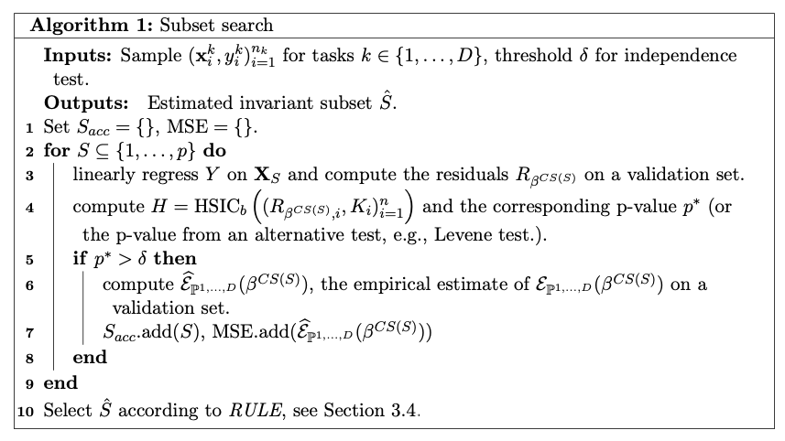
Causal Transfer Learning
Invariant Models for Causal Transfer Learning Mateo Rojas-Carulla et al

Slide 10
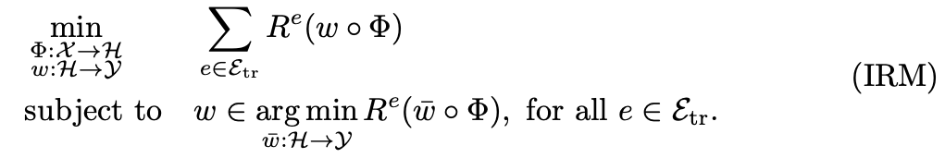
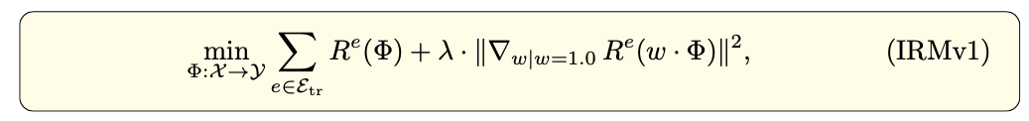
Invariant Risk Minimization

Slide 11
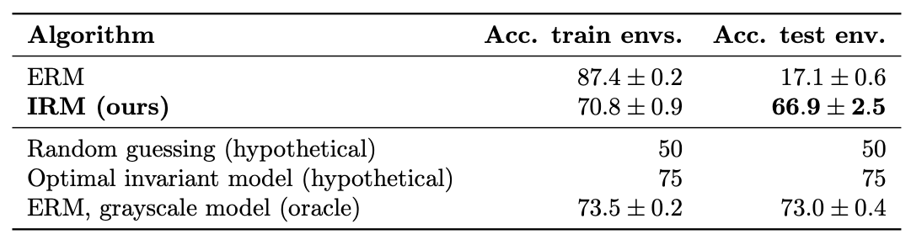
ColoredMNIST
Binary classification: 0~4 as positive class, 5~9 as negative class
Each image is either red or green
Domain1 (train): In all positive images, 70% are red; in all negative images, 30% are red.
Domain2 (train): In all positive images, 80% are red; in all negative images, 20% are red.
Domain3 (test): In all positive images, 10% are red; in all negative images, 90% are red.
Correlation between shape & label is 75% (because 25% label noise)

Slide 12

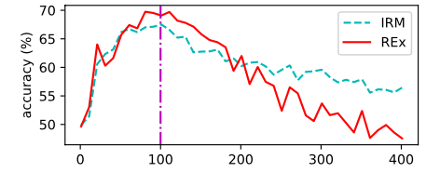
REx
Out-of-Distribution Generalization via Risk Extrapolation (REx), David Krueger et al.

Slide 13
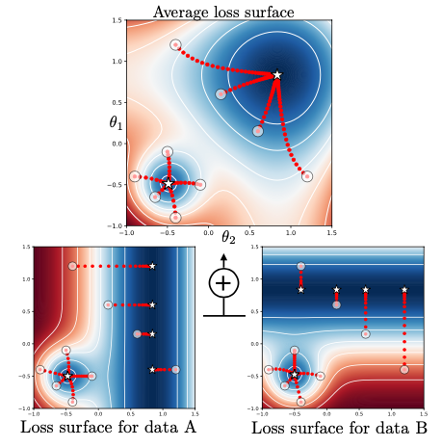

Learning explanations that are hard to vary
Learning explanations that are hard to vary Giambattista Parascandolo et al.

Slide 14


“and mask”
Learning explanations that are hard to vary Giambattista Parascandolo et al.

Slide 15
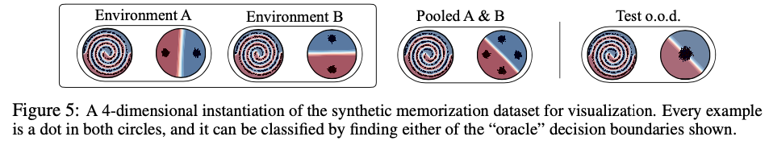
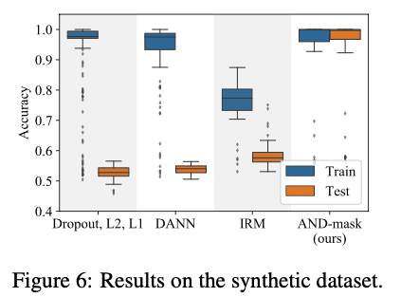

Slide 16
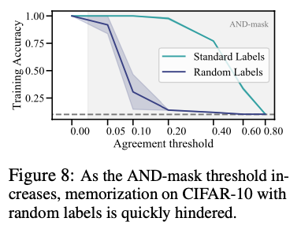
CIFAR10 random label
Learning explanations that are hard to vary Giambattista Parascandolo et al.

Slide 17
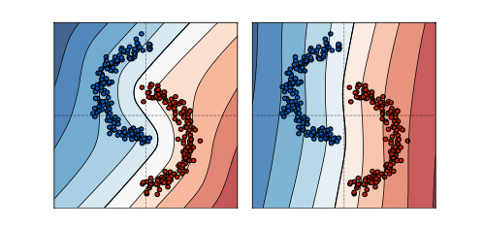
Gradient Starvation
“overfitting” property of ERM
Gradient Starvation: A Learning Proclivity in Neural Networks Mohammad Pezeshki et al.

Slide 18
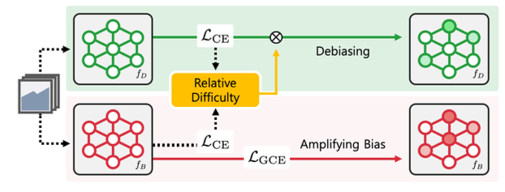
Learning from Failure
Setting: eg. No multiple domains
99% data: label & color has 1 to 1 corresponding
1% data: label & color has no corresponding
Learning from Failure: Training Debiased Classifier from Biased Classifier Junhyun Nam et al.

Slide 19
More papers at https://sites.google.com/site/irinarish/ood_generalization
Thank you very much!

