Slide 1

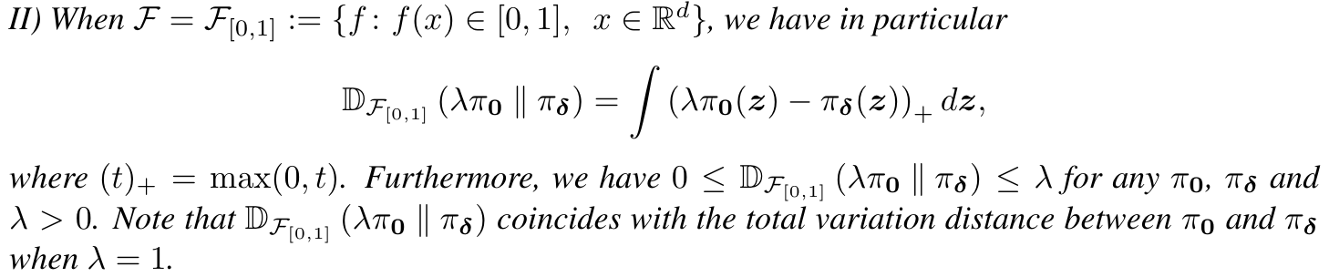


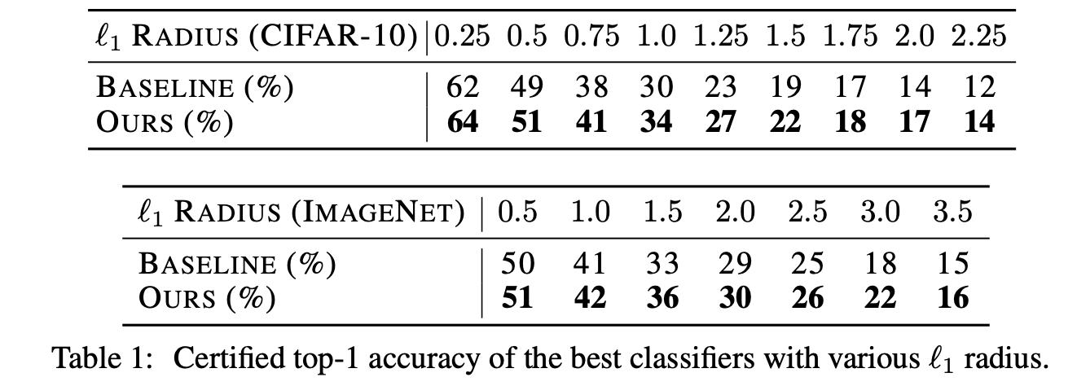
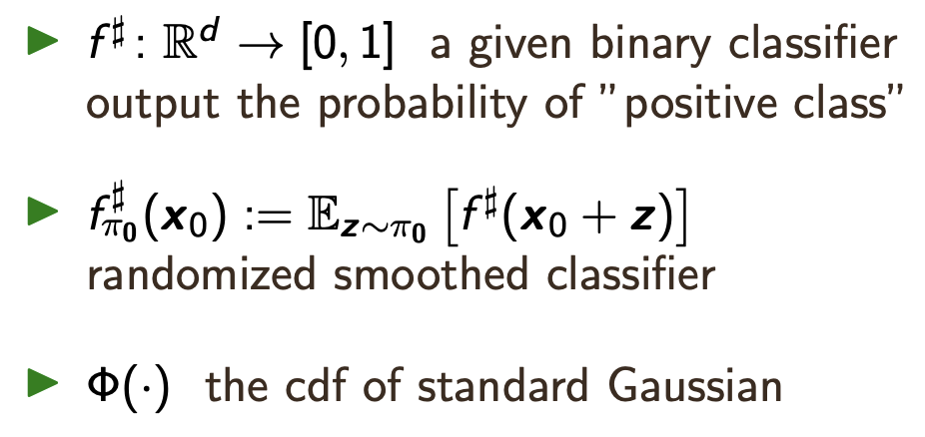
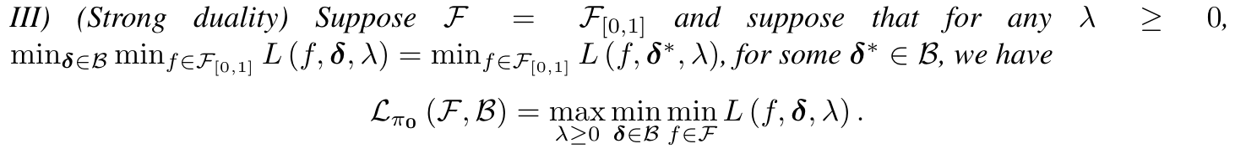
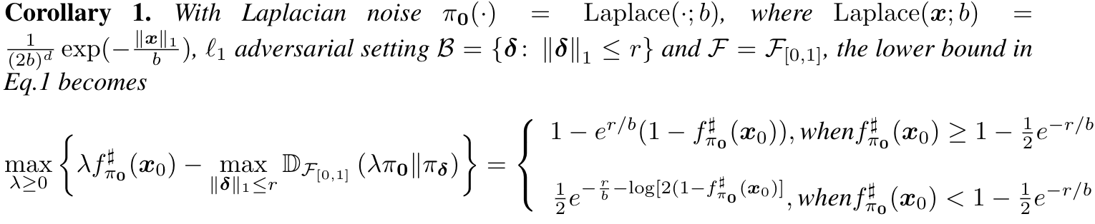
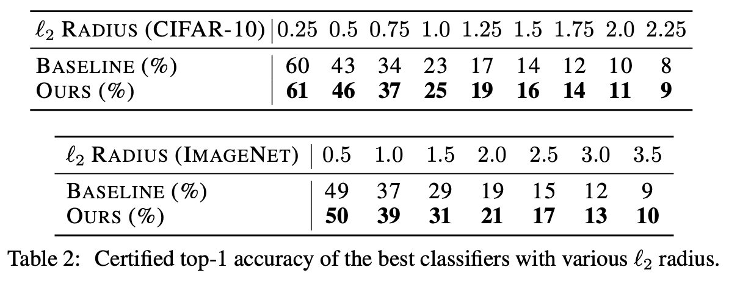




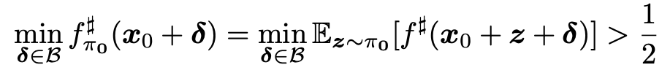
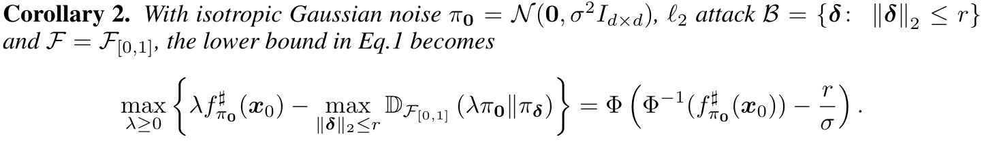

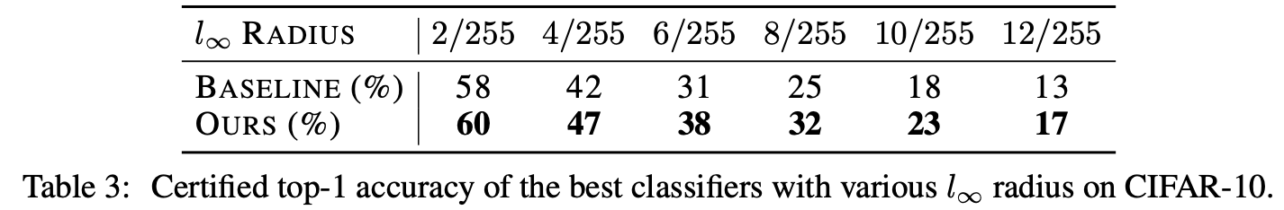
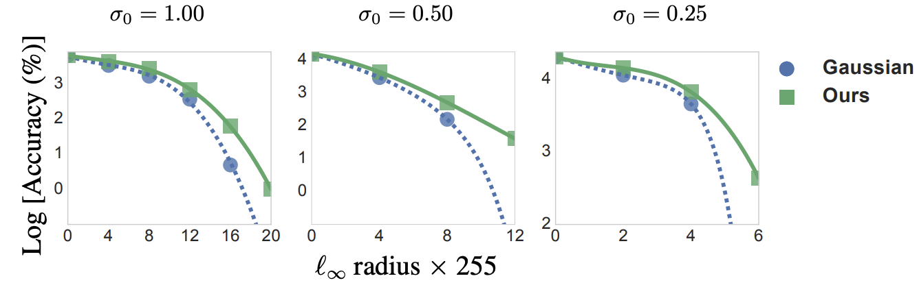
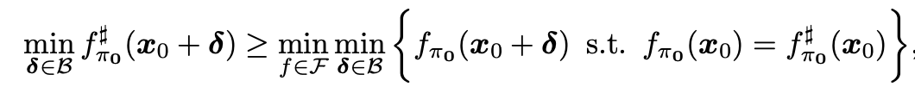
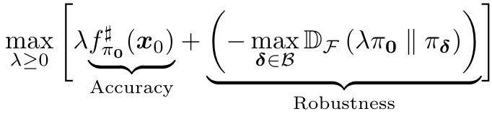
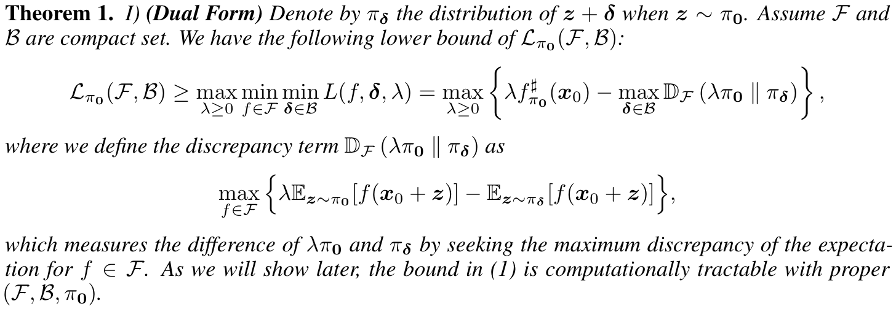
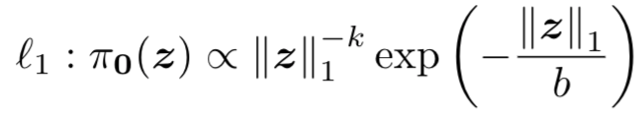
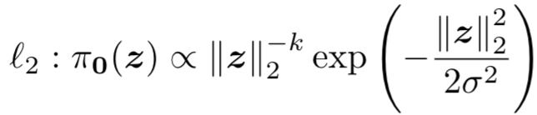
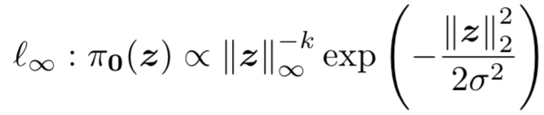
Black-Box Certification with Randomized Smoothing:
A Functional Optimization Based Framework
Dinghuai Zhang*, Mao Ye*, Chengyue Gong*,
Zhanxing Zhu, Qiang Liu
Peking University & University of Texas at Austin
Background on Randomized Smoothing
Experimental Results
Certification means a guarantee that a classifier won’t change its prediction when perturbing input under some condition. For simplicity, we consider a binary classification setting. Below are three important notions we study:
Results for and certification
Our theorem is applicable and flexible. When specified in and settings, we can exactly recover the bound derived by [4] and [1], different from their original Neyman-Pearson lemma approaches:
For any testing data point and the classifier predicts positively, i.e., , we then want to verify whether still holds for any . The mathematical formulation of certification in binary setting results in:
Compared to previous non-randomized certified defenses approaches including exact [2] or relaxed version [3] of certification, the randomized variants could significantly scale to larger settings [1]. We also discuss the pros and cons of our work compared to [6] in paper.
Results for certification
Improving Certification Bounds
Constrained Adversarial Certification
We further demonstrate the effectiveness of our results by investigating more proper smoothing distribution for certification through its guide. An intuitive trade-off can be achieved from the confidence lower bound we obtained in Theorem 1:
We reformulate the original randomized smoothing certification problem as a functional optimization one.
The Lagrangian function of this constrained optimization states
In our paper, we analyze this insightful decomposition and diagnosing what properties a good certification distribution should possess. We find that the smoothing distribution should avoid so-called “then shell” phenomenon [5] and hence more concentrated. Henceforth, we propose new distribution family to achieve the goal for :
Results of l_inf verification on CIFAR-10, on models trained with Gaussian noise data augmentation with different variances σ0. Our method obtains consistently better results
Then we can obtain our main theoretical argument:
References
[1] Jeremy M Cohen, et al. Certified adversarial robustness via randomized smoothing. arXiv preprint arXiv:1902.02918, 2019.
[2] Chih-Hong Cheng, et al. Maximum resilience of artificial neural networks. In Automated Technology for Verification and Analysis 2017.
[3] Eric Wong and J Zico Kolter. Provable defenses against adversarial examples via the convex outer adversarial polytope. arXiv preprint arXiv:1711.00851, 2017.
[4] Jiaye Teng, et al. $\ell_1$ adversarial robustness certificates: a randomized smoothing approach, 2020.
[5] Roman Vershynin. High-dimensional probability: An introduction with applications in data science, volume 47. Cambridge University Press, 2018
[6] Greg Yang et al. Randomized smoothing of all shapes and sizes. arXiv preprint arXiv:2002.08118, 2020.

