Slide 1
Neural Approximate Sufficient Statistics for Implicit Models
Yanzhi Chen*¹, Dinghuai Zhang*², Michael Gutmann¹, Aaron Courville², Zhanxing Zhu³
¹The University of Edinburgh, ²MILA, ³Beijing Institute of Big Data Research

Slide 2
Overview
Background
Method
Related works
Results

Slide 3

Background
Implicit statistical models
defined by the data generating process rather than the likelihood function^{[1]}
Examples
SIR model (epidemiology), Ricker's model (ecology), g-and-k model (finance)

Slide 4
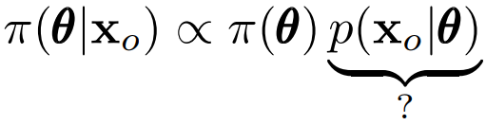
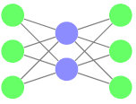


Background
Likelihood-free inference
posterior
prior
likelihood
1.sample
2.learn
on D with e.g. ABC^{[2]}, NDE^{[3,4]}
problem: high-dimensional density estimation is difficult

Slide 5







Method
Overview
1) first find a low-dim, near-sufficient statistics s(·)
2) infer the posterior with s
learning s(·) may not require the estimation of density or density ratio

Slide 6




Method
Main idea
learning sufficient statistics <====> infomax representation learning
other MI estimators
we can maximize any non-KL proxy^{[5,6,7]} of MI that has better properties

Slide 7
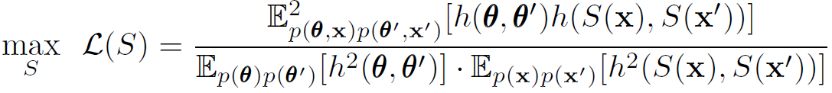
Method
Distance correlation (DC)^{[5]} proxy:
S
h is some 'centered' distance function
Jenson-Shannon divergence (JSD)^{[6]} proxy:
S
sp = softplus function
T

Slide 8
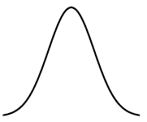



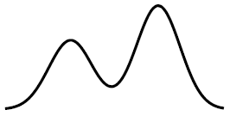


Method
Dynamic sufficient statistics learning
learn the statistics and posterior iteratively
accelerate
update
statistic network
posterior solver
improve
*posterior solver can be any sequential LFI algorithms e.g. SMC-ABC^{[2]}, SNL^{[4]}

Slide 9

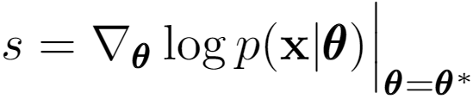

Related works
Related works
parameter-prediction-as-statistics^{[8]}
we prove it is (generally) not sufficient
score-as-satistics^{[9]}
only locally sufficient around

Slide 10
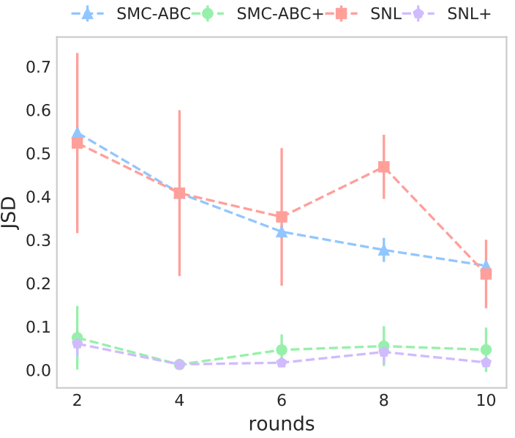
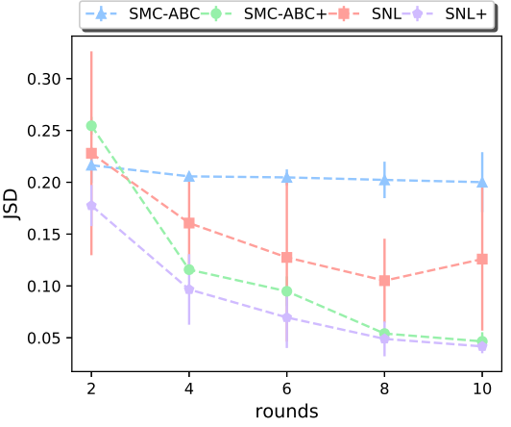
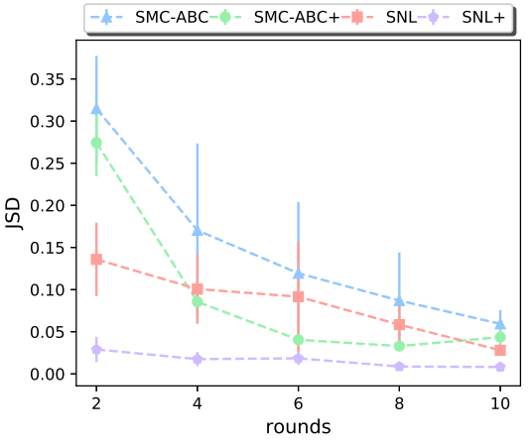
Results
applying to existing LFI algorithms: SMC-ABC^{[2]} ,SNL^{[4]}
direct inference
with s.s
Ising model
Gaussian copula
OU Process
x-axis: learning rounds y-axis: JSD(true P, learned P)

Slide 11
Contribution
For likelihood-free inference
new method for learning sufficient statistics based on infomax principle
For representation learning
establish a link between representation learning and Bayesian inference

Slide 12
Reference
[1]. Monte Carlo methods of inference for implicit statistical models, JRSS B 1984
[2]. Adaptive Approximate Bayesian Computation, Biometrika 09
[3]. Fast epsilon-free Inference of Simulation Models with Bayesian Conditional Density Estimation, Neurips 16
[4]. Sequential Neural Likelihood, AISTATS 19
[5]. Partial distance correlation with methods for dissimilarities, Annals of Statistics 14
[6]. Learning deep representations by mutual information estimation and maximization, ICLR 19
[7]. Wasserstein dependency measure for representation learning, Neurips 19
[8]. Constructing summary statistics for ABC, JRSS B 09
[9]. Mining gold from implicit models to improve likelihood-free inference, PNAS 20

