Slide 1
Measuring Treatment Effect with Neural Networks
Dinghuai Zhang, April 2021

Slide 2
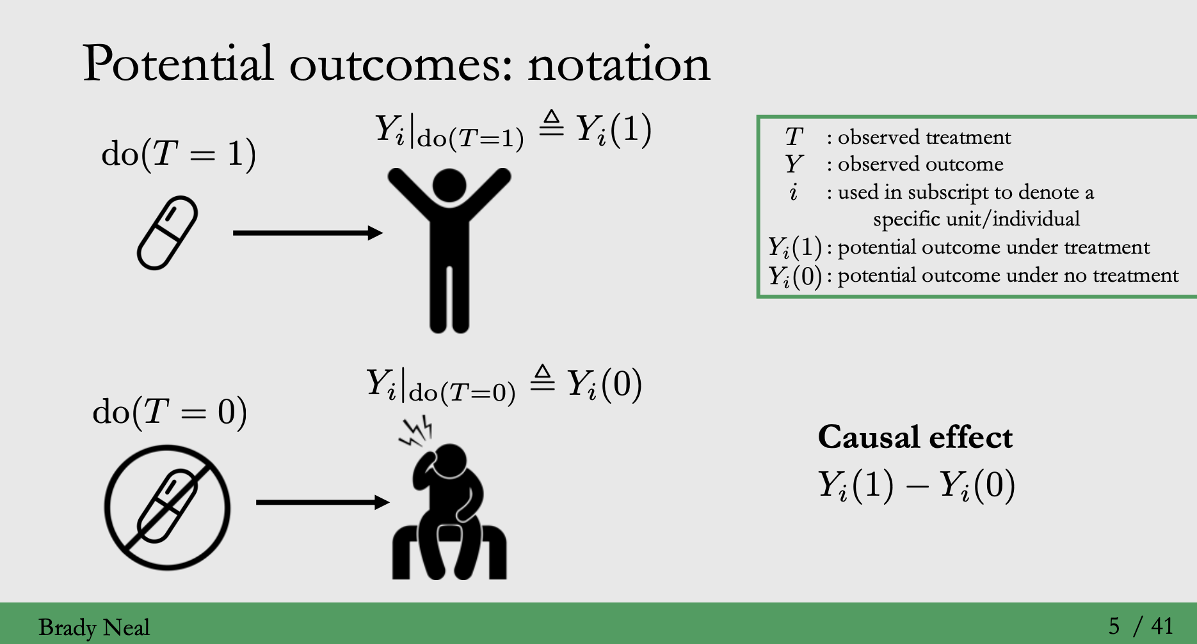
Setting
Data: {(x, y, t)}
t is treatment, can discrete or continuous value; there could be even multiple treatments
Regress y on x
Want to measure the causal effect / treatment effect

Slide 3
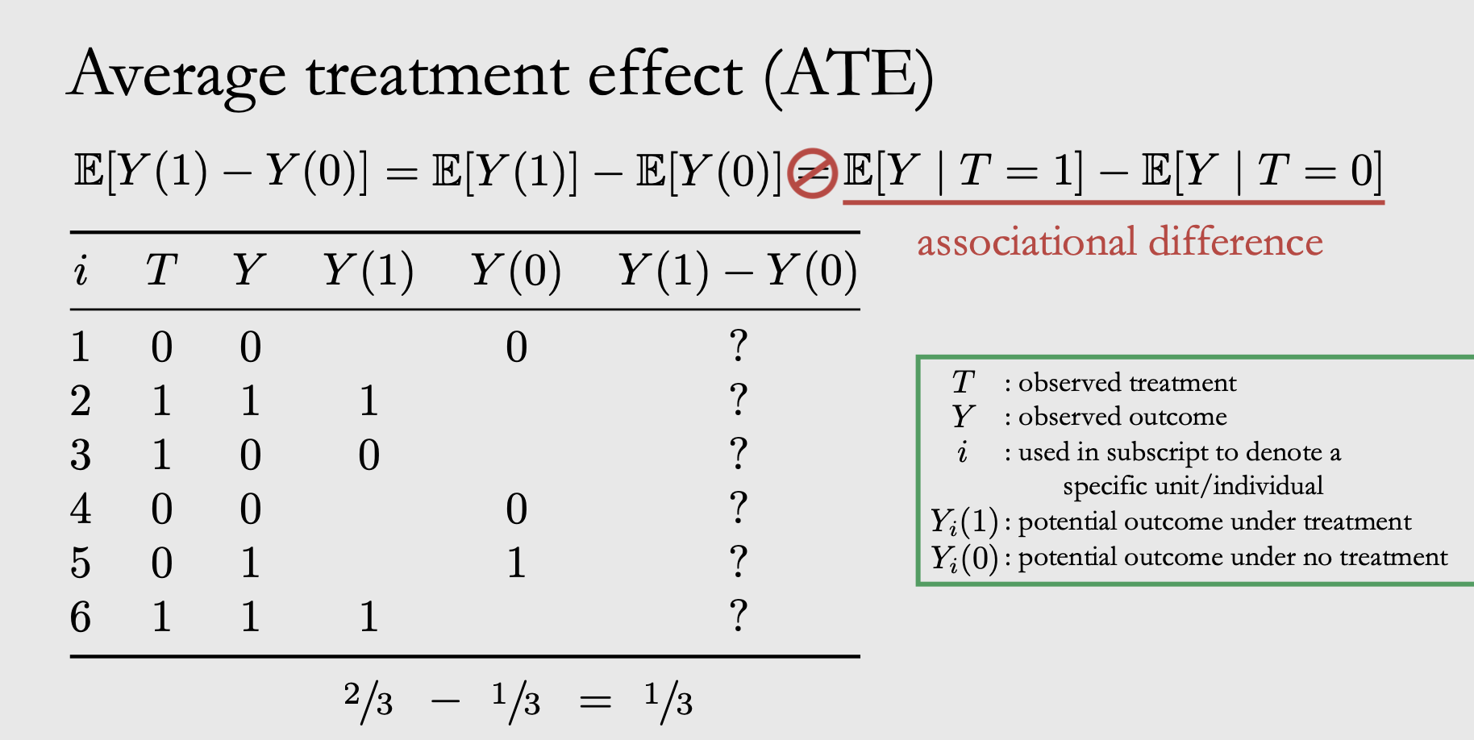
Problem of Causal INference

Slide 4
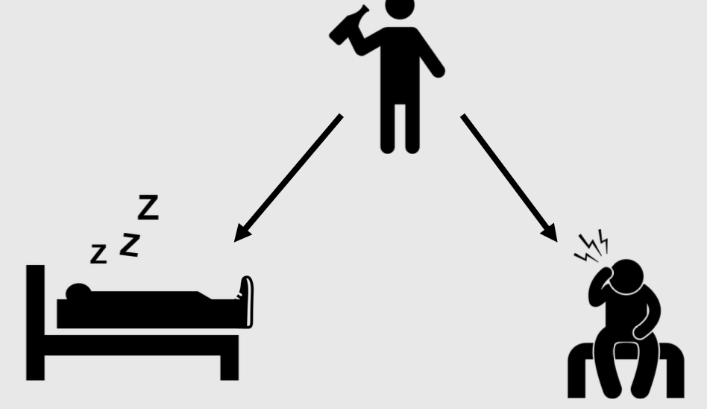
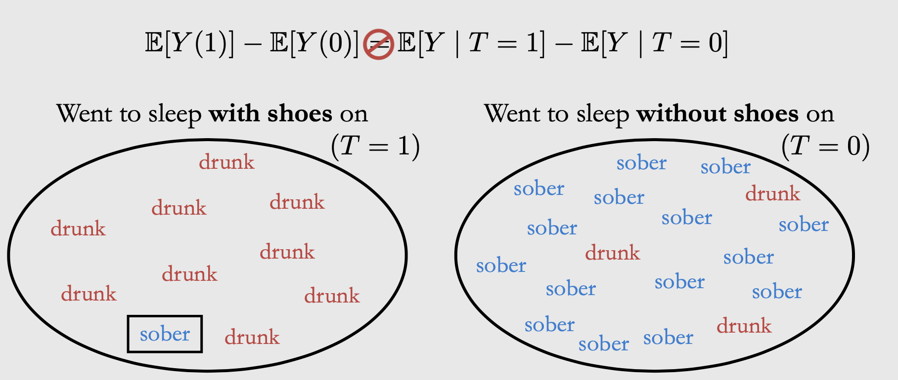
X
Y(1) and T=0 or 1 is not independent!
T
Y

Slide 5
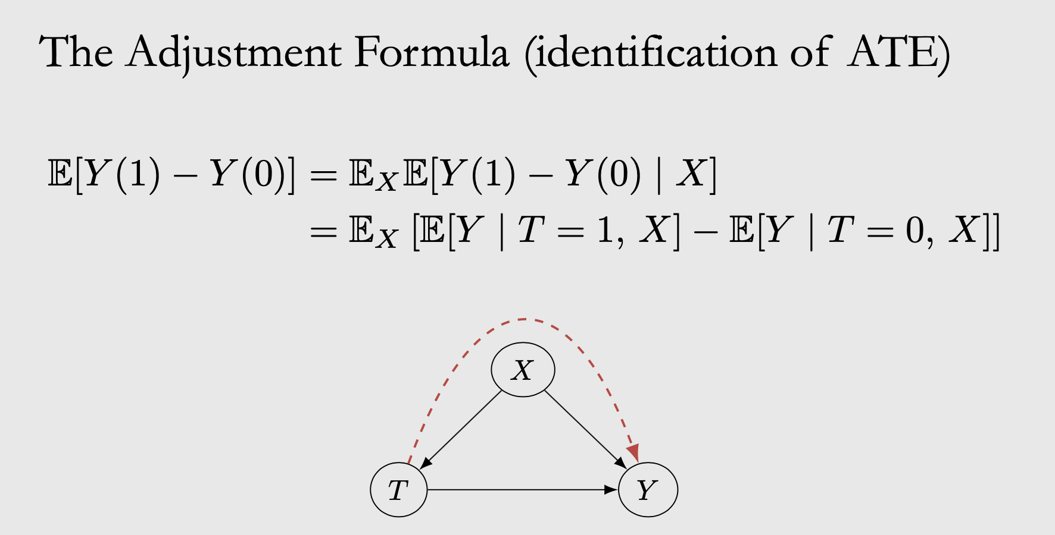
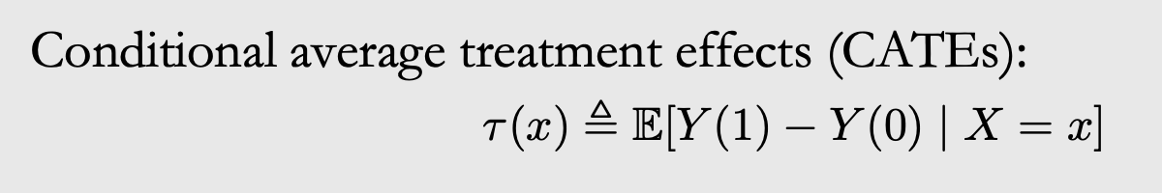
With some assumptions…

Slide 6
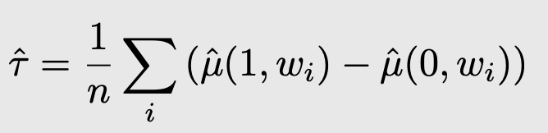
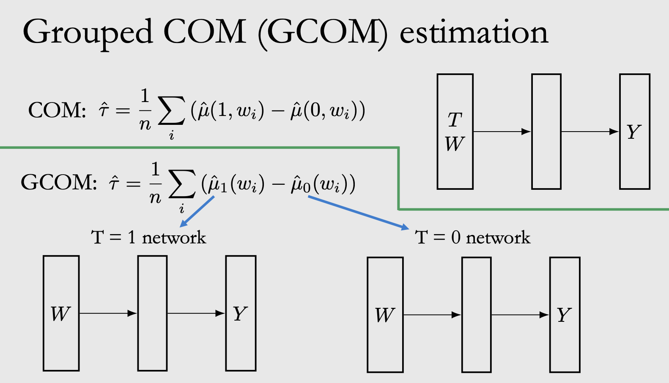
Estimate the treatment effects
The feature is high dimensional, while T is scalar!

Slide 7
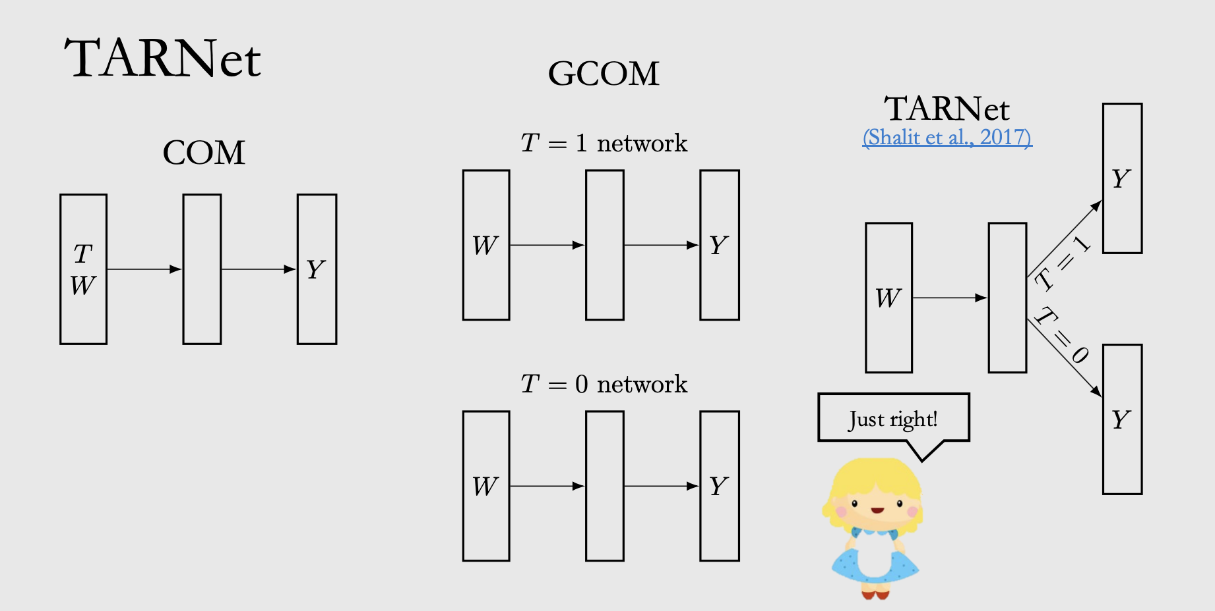
TARNet
Estimating individual treatment effect: generalization bounds and algorithms

Slide 8
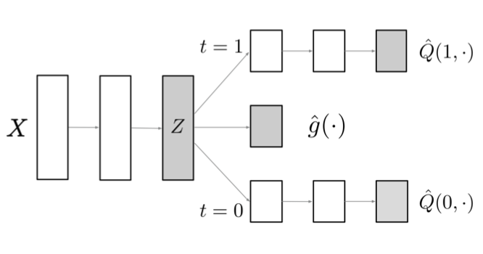
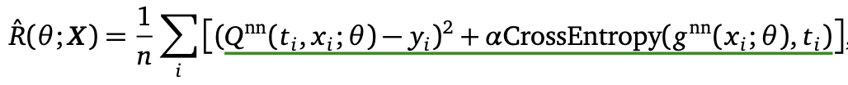
Dragonnet
This middle branch is to estimate propensity score P(t=1|x)
Adapting Neural Networks for the Estimation of Treatment Effects

Slide 9
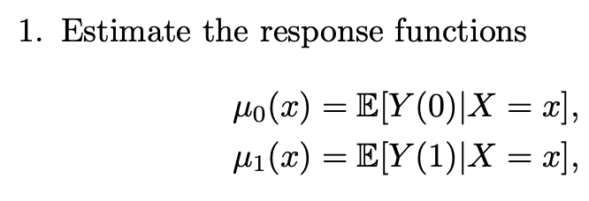
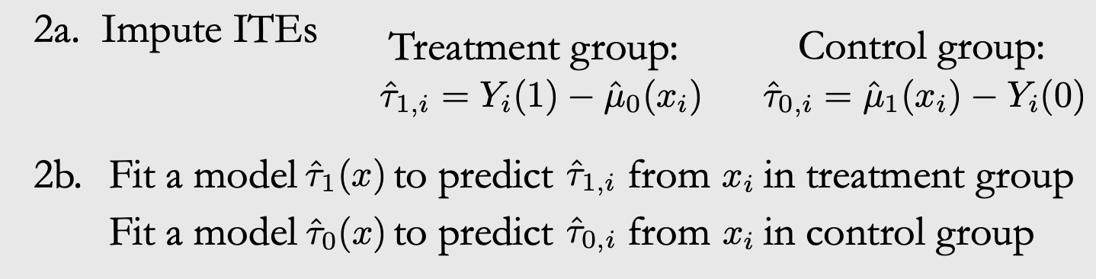
X-Learner
Meta-learners for Estimating Heterogeneous Treatment Effects using Machine Learning

Slide 10
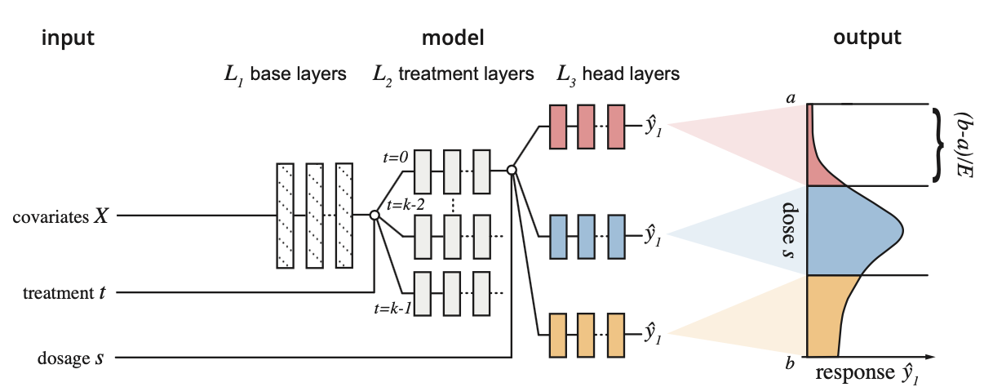
DRNEt
Multiple treatment
continuous value of dose
Learning Counterfactual Representations for Estimating Individual Dose-Response Curves

Slide 11
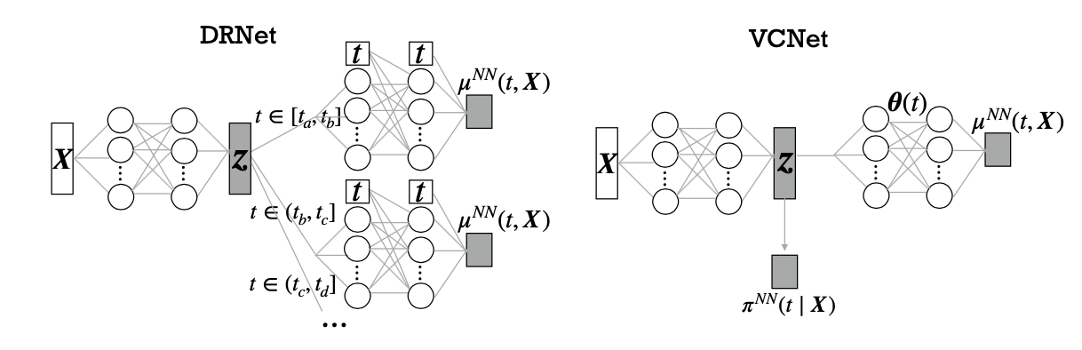
VCNet
(single treatment)
VCNET AND FUNCTIONAL TARGETED REGULARIZATION FOR LEARNING CAUSAL EFFECTS OF CONTINUOUS TREATMENTS

Slide 12
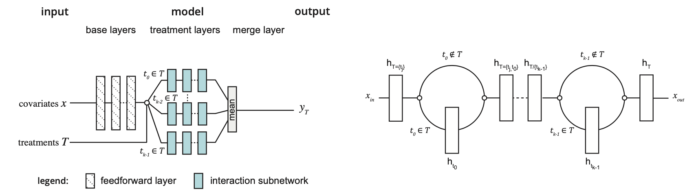
Ncore
Neural Counterfactual Representation Learning for Combinations of Treatments

Slide 13
Thank you for listening!

