Slide 1

Advanced Systems Lab System Architecture
Dina Zverinski

Slide 2
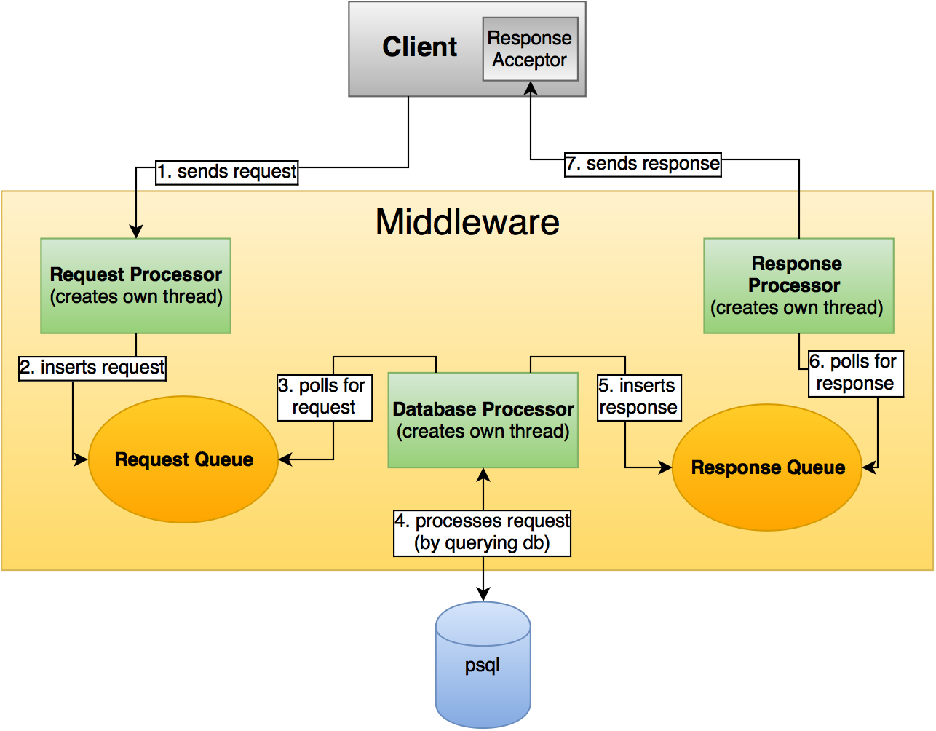

Slide 3
Remarks
Client has an own thread with a ServerSocket to be able to accept responses anytime
Client disconnects from Middleware as soon as a request is sent
Client only sends next request after receiving a response (callback), Middleware always has to respond
Client has to register first, in order to get an ID (but will be assigned the same ID if he reregisters)
Middleware is consists of 3 main threads (processors), that are hold an own thread pool of “workers”

Slide 4
Database
Client: ID, IP Address, Port
Queue: ID
Message: ID, sender ID, receiver ID, queue ID, content, timestamp
IDs are foreign keys (to make sure a valid ID is inserted)
IP & Port needed to allow Client to reregister
Connection pool at Database Processor

Slide 5
Communication
Strings
Start with “Codes” (for any kind of request/response/error)
Comma separated
Parsed accordingly by Client and Middleware

Slide 6

Thank you for your attention.

