Slide 1
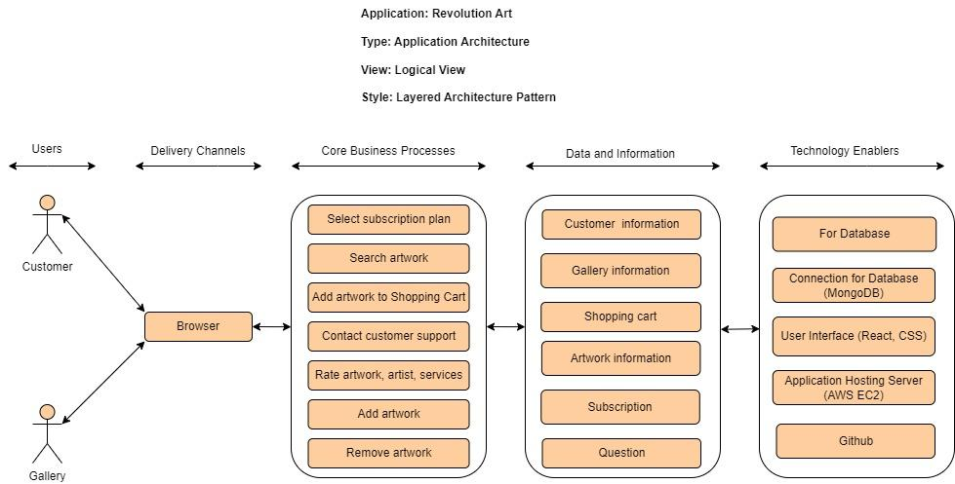

Slide 2



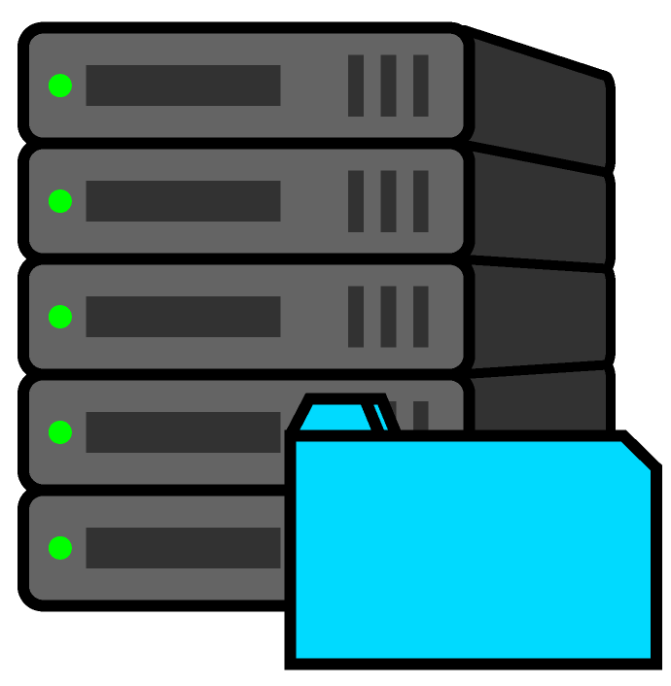
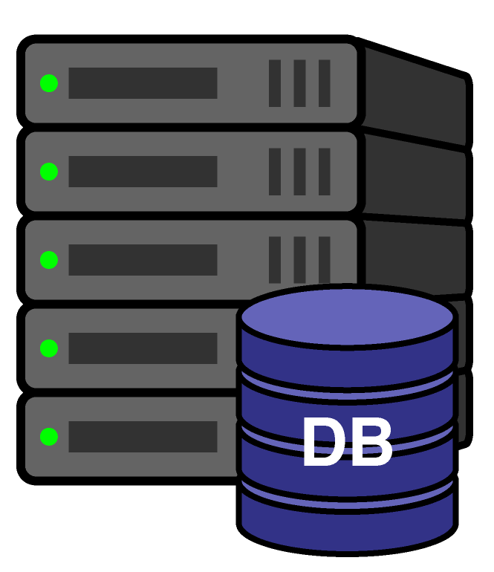


Application: Revolution Art
Type: Application Architecture
View: Process View
Style: Client-Server Architecture Pattern
Firewall
Firewall
Super Users / Admins
Firewall
Packet Filtering Firewalls
Packet Filtering Firewalls
Packet Filtering Firewalls
Authenticating Users
User
Browser
Web Server
Application Server
Database Server
Type: AWS EC2
Type: AWS EC2
Type: AWS RDS
Protecting Sensitive Data
Auditing and logging activity and transactions
Validating Input
Authorizing Users
Handling Exceptions
Encrypting Sensitive Data

Slide 3
