Slide 1
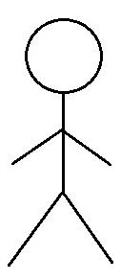
Use Case Diagram
Revolution Art Web Application Use Case Diagram
Module: 01. Buyer's Account
01.01 Create an Account
01.02 Sign Into Account
Daily Need Manager
01.03 Delete an Account
01.04 Modify General User's Information
Subscribed Galleries
01.05 Review and Choose Subscription plan
01.06 Update Password
Account Manager
01.07 Select Recurring Payment
Subscribed Clients
01.08 Cancel Subscription Plan
01.09 Agree to Privacy Conditions
Advertisement Sales Representative
01.10 Customer Support
01.11 See History of Purchase
Accountant
01.12 Rate Artwork, Artist, Services

