Slide 1

Revolution Art
GIT REPOSITORY
TEAM 1

Slide 2
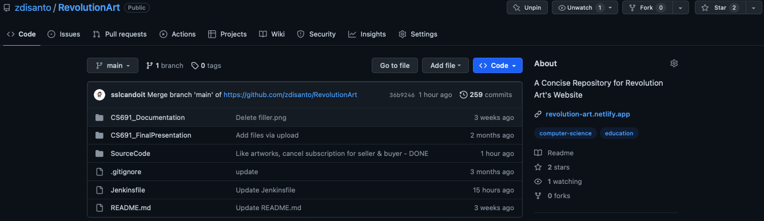
https://github.com/zdisanto/RevolutionArt

Slide 3
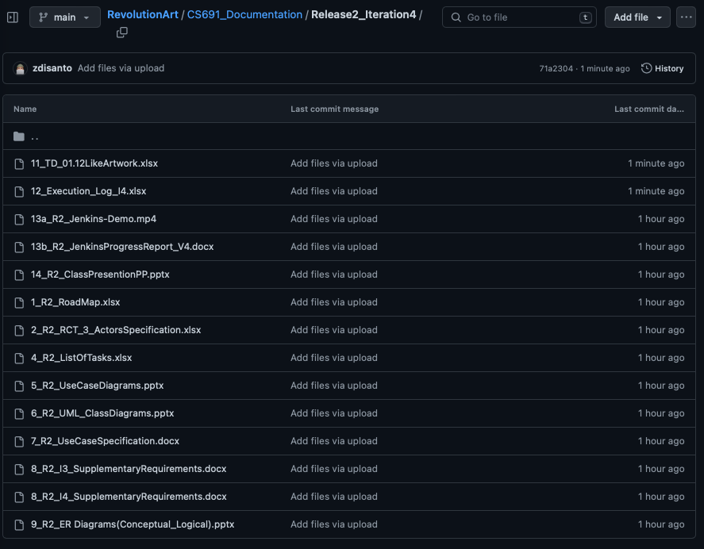
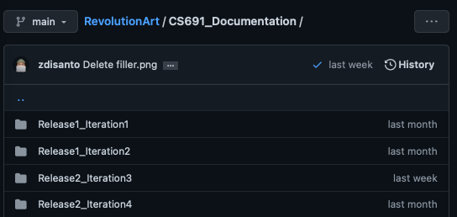
R2 Archive Documentation

Slide 4
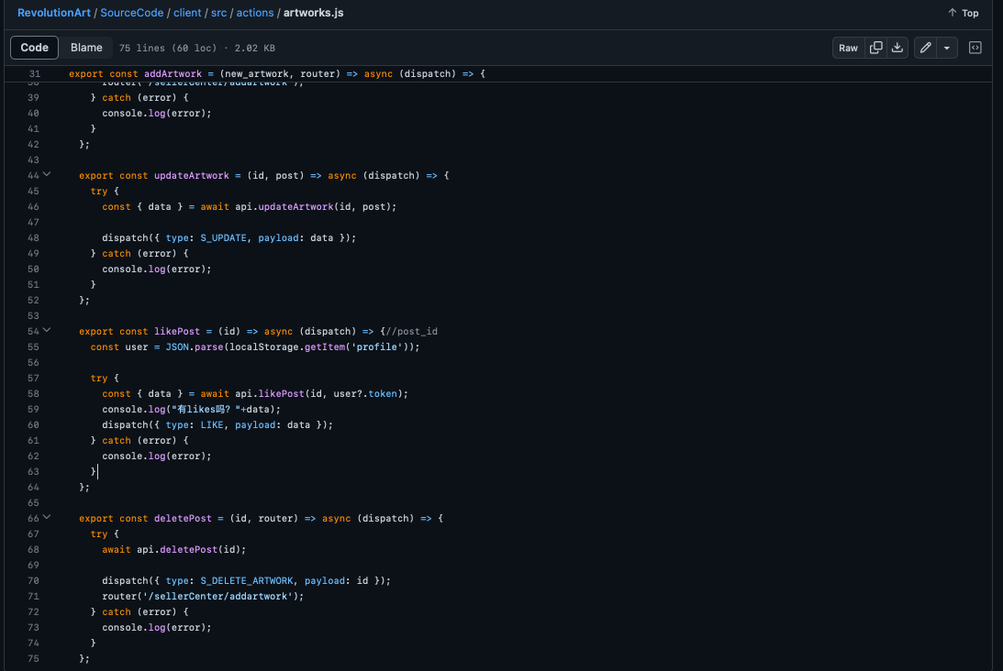
Sample Source Code
[01.12 - Like Artwork]

Slide 5
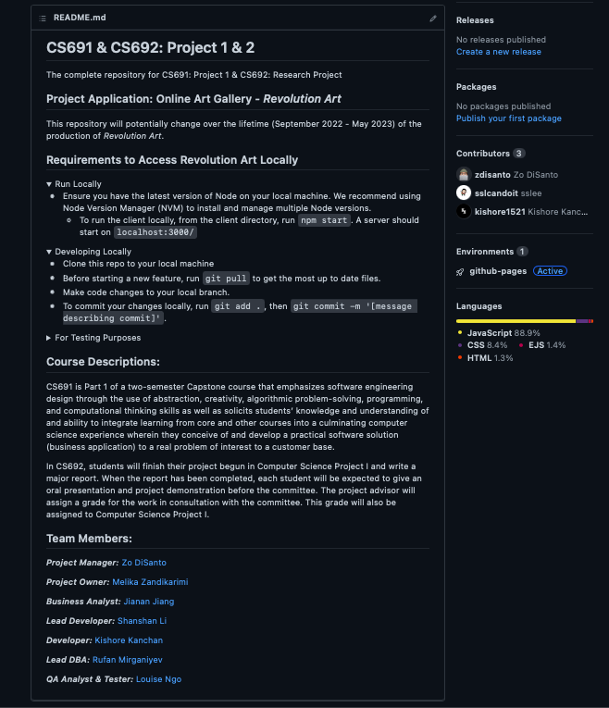
Build & Deployment Procedure

Slide 6
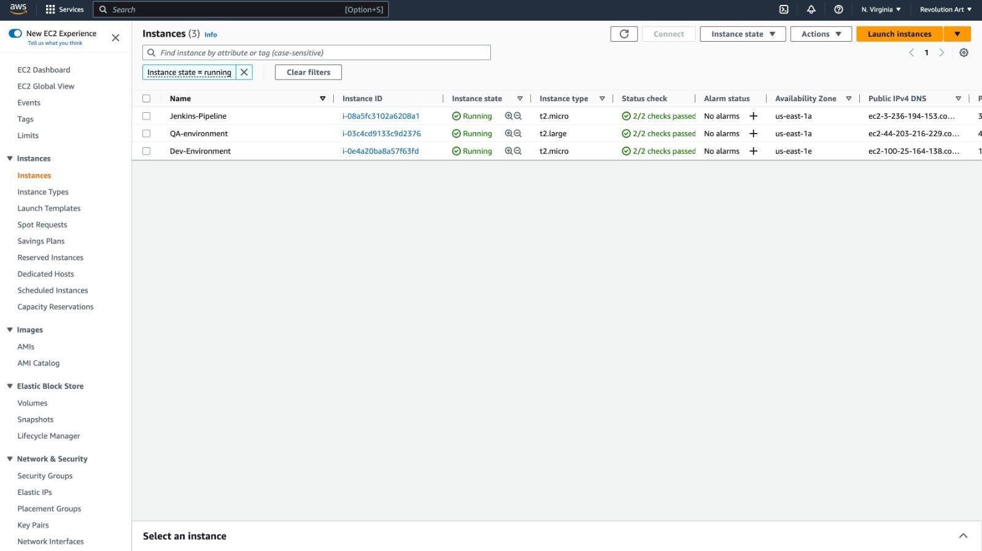
AWS EC2 Nodes (DEV/QA)

