Slide 1
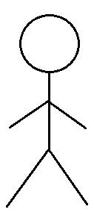
R2 I3: Use Case Diagrams
I1
02.01 Create an Account
I2
I3
I4
02.02 Sign Into Account
02.11 Review & Choose Subscription Plan
Account Manager
Subscribed Galleries
02.05 Add Artworks
02.06 Remove Artworks
02.07 Modify Artwork Information

Slide 2
R2 I4: Use Case Diagrams
I1
I2
I3
I4
01.08 Cancel Subscription Plan
01.12 Like Artwork
Subscribed Clients
Account Manager
02.12 Cancel Subscription
Subscribed Galleries

