Slide 1
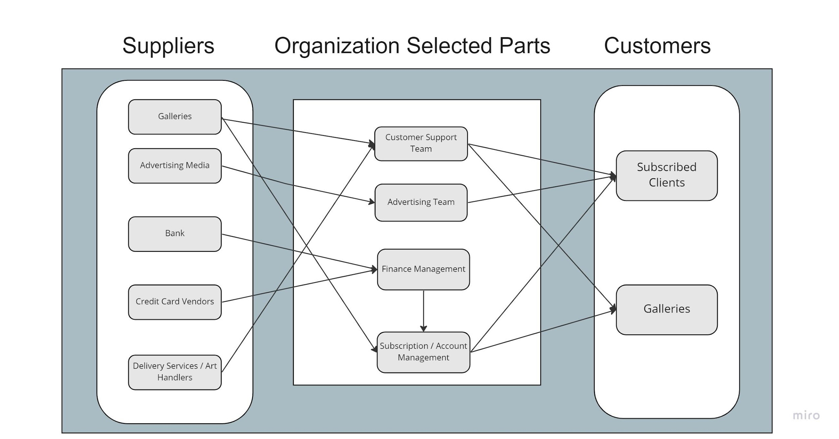
Revolution Art - Business Relationship Map

Slide 2
User Roles by Business Group
External Users (Customers)
Subscribed Clients (Louise Ngo)
Subscribed Galleries (Melika Zandikarimi)
Business Group | User Role | Team Member Name
Finance Management | Accountant | Jianan Jiang
Advertising Team | Advertisement Sales Representative / Art Market Analysist | Melika Zandikarimi
Subscription / Account Management | Account Manager | Jianan Jiang
Customer Support Team | Coordination with Art Handlers / Daily Need Manager / Solving technical issues | Kishore Kanchan

