Slide 1
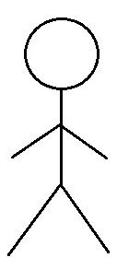
R2-Iteration 3-Use Case Diagrams
I1
02.01 Create an Account
I2
I3
I4
<<extend>>
02.02 Sign Into Account
<<extend>>
02.11 Review & Choose Subscription Plan
Account Manager
Subscribed Galleries
<<extend>>
02.05 Add Artworks
<<extend>>
<<extend>>
02.06 Remove Artworks
02.07 Modify Artwork Information

